Slide 1
Predict Student Performance from Game Play
Team members:
Harinee Kannan
Karthick Subramanian
Praveen Paidi
Sriram Chandrasekaran
Team : Sun Devils

Slide 2
Introduction
The goal of this project is to predict student performance during game-based learning in real-time.
Data being collected while student answering questions in online game.
Each session has 18 questions to answer.
There are 22 levels of questions and three level_segments(0-4, 5-12, and 13-22) where user can access previous answered questions.
Data is provided for all 22 level of questions in each session with different activities being noted down.

Slide 3
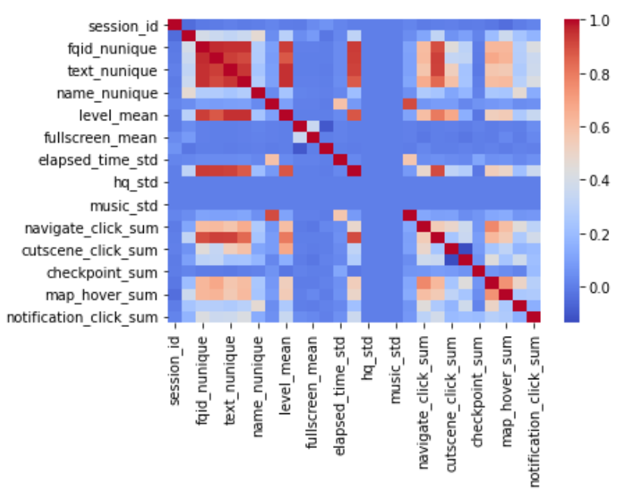
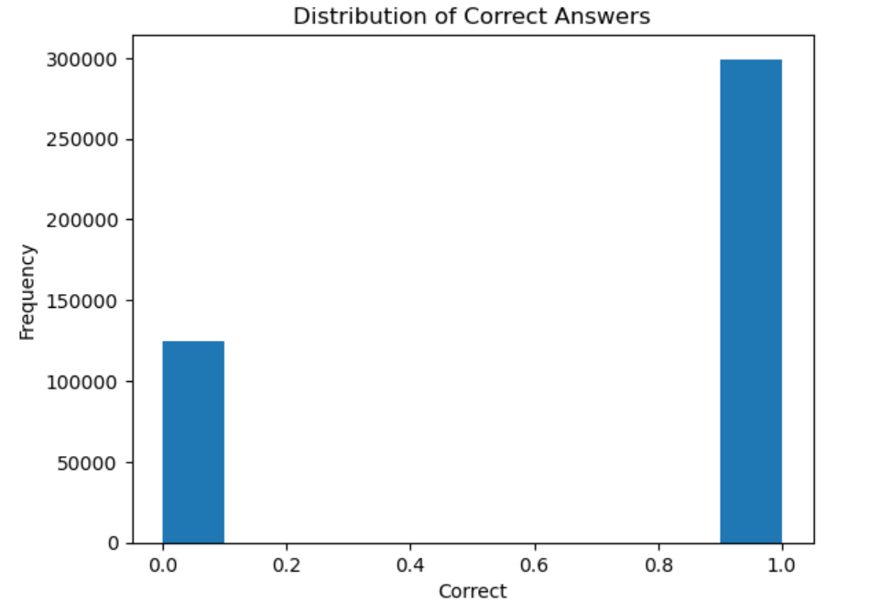
Dataset Analysis
Correlation Matrix
Imbalance Data
Number of correct answers: 295752
Number of incorrect answers: 128364
Data is bit imbalanced with correct answers being more than 2.5 times than incorrect answers.
Sparse data:
Hover time : limited data in data columns and 0.2 % of instances
Page: The page number of the event and 0.1% of the instance

Slide 4
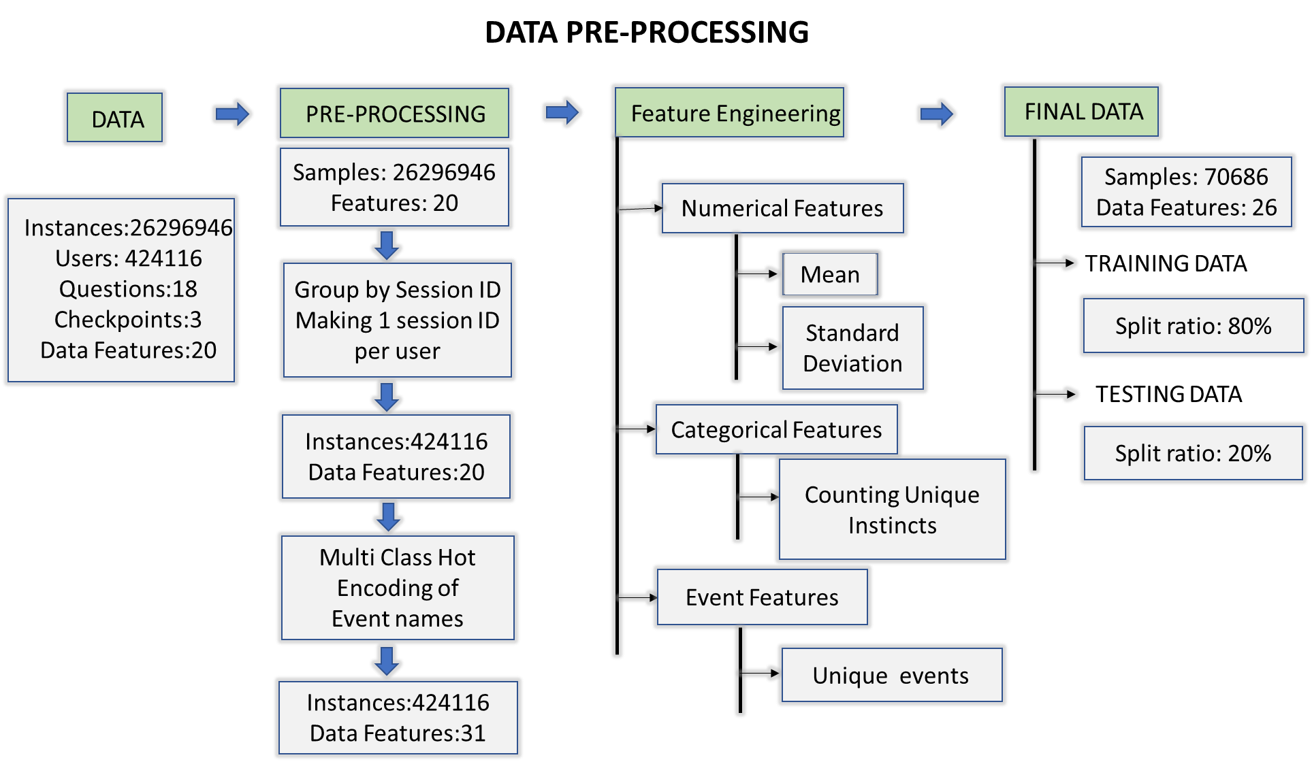
Data Pre-Processing
Notes:
Thanks, Harinee. Hello everyone. I will briefly talk about the feature engineering we have implemented before training the machine learning model. I’d like to introduce 3 data types we have used. The first, Categorical features - they contain a limited, and usually fixed, number of possible values. Numerical Features have numerical values. And the event variables - This refers to the recorded events such as clicking on an object in the scene, clicking on a cutscene, clicking on the character’s notebook, and so on. As Harinee explained, the game works based on clicks given by the user. These clicks are recorded and are accessed as event variables. In total, we are using 5 categorical features, 5 numerical features and 10 event variables.
Talking about preprocessing, we first group the data based on session ID and make only one session ID per user. Then we convert the event_name, which is a categorical feature into a numerical feature by one hot encoding. This significantly increases the number of features in our data. Now, we needed to get a better overview of the data so we created simple aggregate features. For numerical features, we found the mean and standard deviation. For Categorical features, we counted the unique values. And for Event features, we summed up the one hot encoding of unique events. All of this is done by grouping the data based on session ID and level group. Upon doing this we obtain 26 features and and over 70k samples. This is the data that we finally work with and we do a 80-20 split for training and testing respectively. Now over to Sriram for an overview on the different algorithms used.

Slide 5
Algorithm Selection
CONSTRUCTION OF CLASSIFICATION MODEL
PERFORMANCE EVALUATION
LOGISTIC REGRESSION
NEURAL NETWORK
OPTIMUM THRESHOLD
TRAINING F1 SCORE
XG BOOST
TESTING ACCURACY
RANDOM FOREST
Model | Factors Considered
LOGISTIC REGRESSION | Data is imbalanced Performs well on Low and Medium Imbalanced data
RANDOM FOREST | Multiple Decision trees using ensemble learning. Handles large data well.
XG BOOST | Boosting technique provides weightage to features, combines weak learners Fast and more accurate
NEURAL NETWORK | Handles High Dimensional data well. Nonlinear relationship between features Transfer Learning

Slide 6
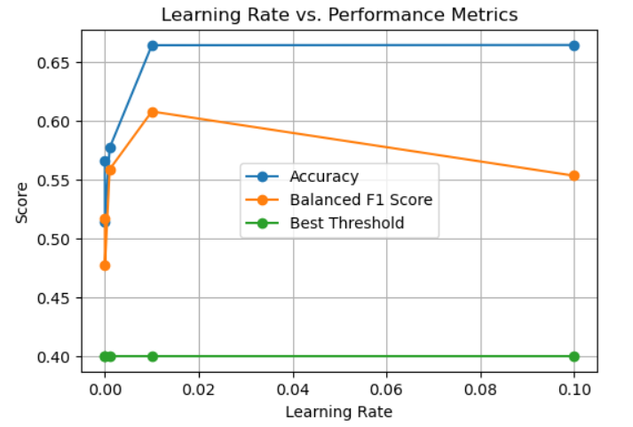
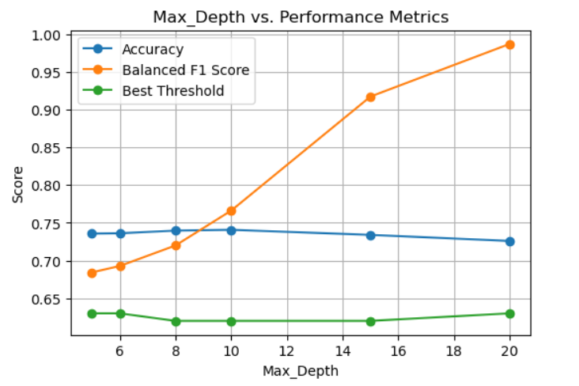
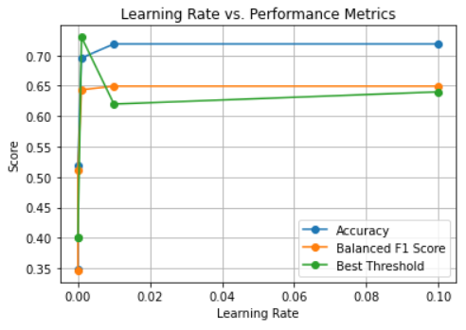
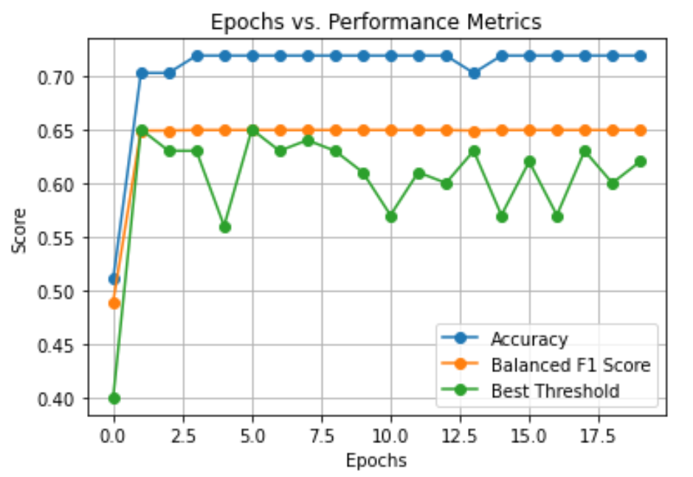
Logistic Regression
Random Forest
Neural Network
Best Learning rate: 0.01
Best Max_depth: 10
Best no. Epochs: 10
Best Learning rate: 0.01

Slide 7
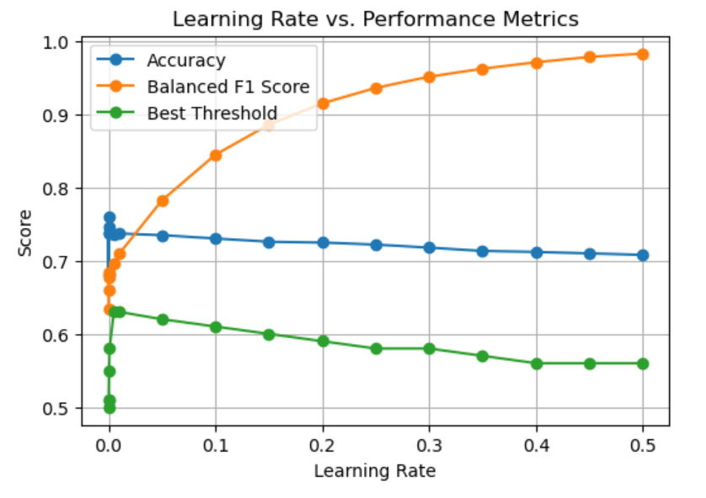
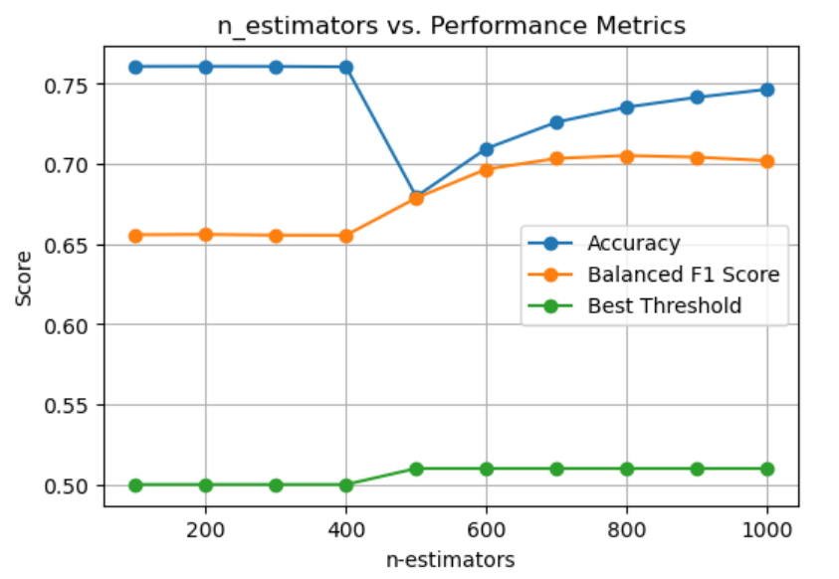
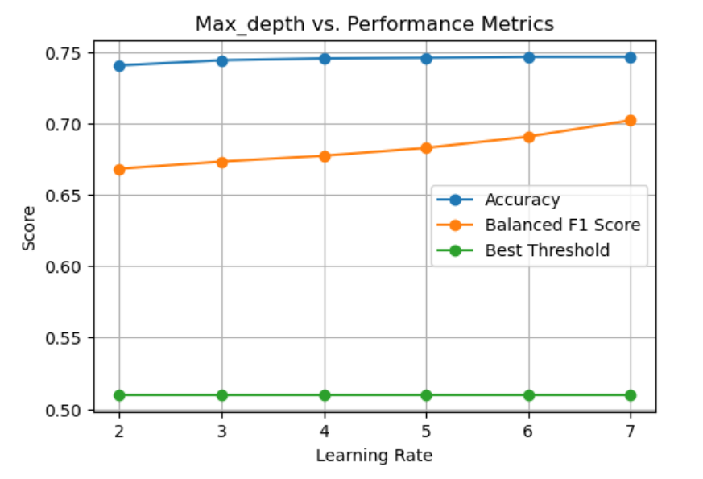
XG Boost
Best Learning rate: 0.0001
Best n-estimator: 400
Best Max-Depth: 7

Slide 8
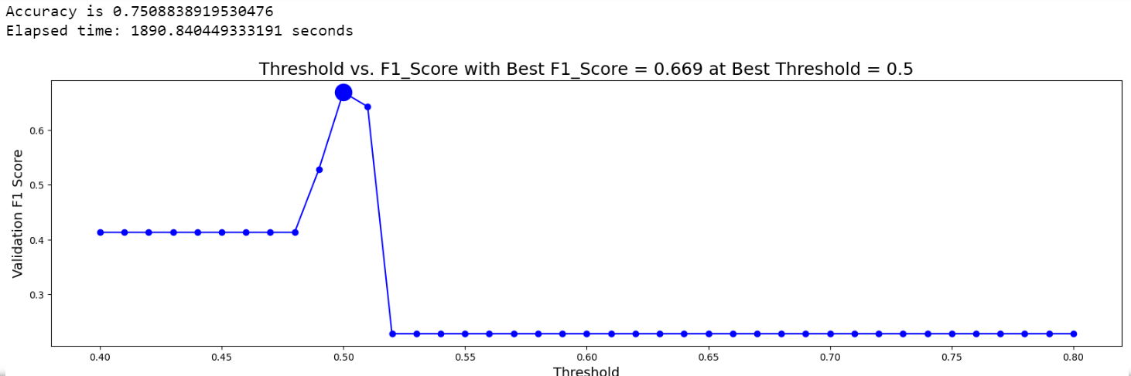
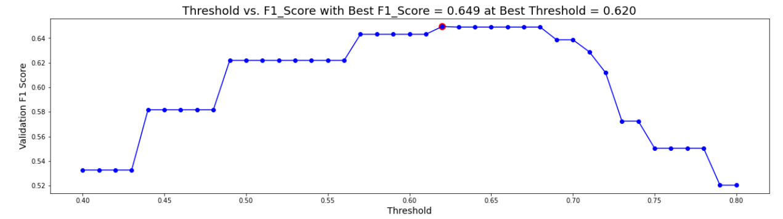

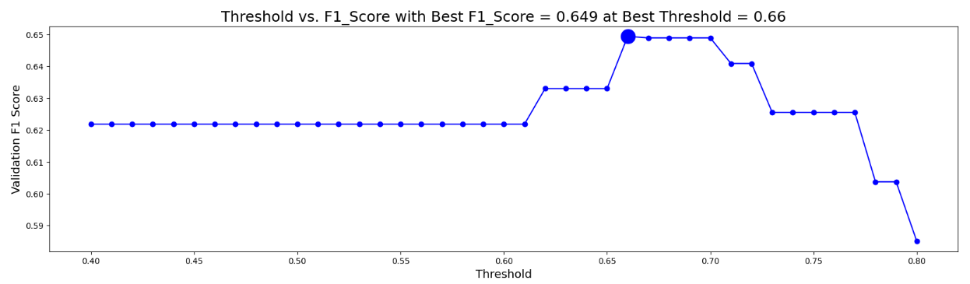
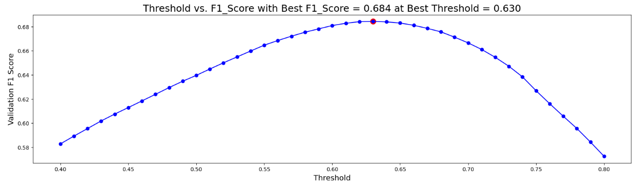


K FOLD for best hyper parameters
XG BOOST
NEURAL NETWORK
LOGISTIC REGRESSION
RANDOM FOREST

Slide 9
Training time
S.No | Algorithm | Activity | Time Taken
1. | Logistic Regression | Hyper Parameter Tuning | 927 sec
 |  | K Fold | 563 sec
2. | Random Forest | Hyper Parameter Tuning | 974 sec
 |  | K Fold | 413 sec
3. | Neural network | Hyper Parameter Tuning | 3291 sec
 |  | K Fold | 1860 sec
4. | XG Boost | Hyper Parameter Tuning | 3817 sec
 |  | K Fold | 1890 sec
Inference
Accuracy achieved with XG boost model is the highest followed by the Random forest model.
Feature Engineering is the major part of the project and effective pre-processing is a mandatory requirement for the model to work efficiently.
Quantizing threshold estimation play an important role while using a imbalance data.

Slide 10
Future Scope of the project
The Project will become a major part of the interactive online learning ecosystem.
The project will be highly used for intelligent tutoring practices.
The team will be attempting to improve the accuracy to attempt the Kaggle competition. Currently the best F1 score is 0.753 in the Kaggle competition and we currently stand at 0.687 F1 score.

Slide 11
Thank You! :)
Any questions?

