Slide 1

QUALITY PREDICTION IN A MINING PROCESS
By
P.Praveen 17481A05D8
N.Chandrika 17481A05C1
P.Vignesh 17481A05C9
M.Srikanth 18485A0522
Under the guidance of
Mr. M. N. Satish Kumar, M. Tech,(Ph. D)
Assistant Professor

Slide 2
ABSTRACT
The % of Silica is measured in a lab experiment it takes at least one hour for the process engineers to have this value.
As this impurity is measured every hour and it takes a lot of time for a day and causes delay in the process.
Our proposed system is quality prediction in a mining process and it can able to predict the silica(impurity) % in the ore concentrate in a less time.
we are building a predictive analytics system in that we are applying Machine Learning algorithm like Multiple Linear Regression which is integrate with flask web application. And further we used Random Forest, Decision Tree, LSTM to find the best accurate model and it helps the engineers for early prediction and reduce the impurities.

Slide 3
OBJECTIVES :
To evaluate the feasibility of using Machine Learning Algorithm like Multiple Linear Regression and Deep Learning Algorithm like LSTM to predict in real-time the percentage of silica concentrate of froth flotation processing plant.
Predict silica percentage in an ore concentrate and report the results immediately without wasting the time in froth flotation processing plant.
To develop a web application which is built by using flask framework and it is integrated with trained ML model and it help the engineers, giving them early information to take actions (empowering!).

Slide 4
RELATED WORK :
Here we used a datasets for predicting silica impurity in flotation process.
Dataset is collected from the below link
https://www.kaggle.com/edumagalhaes/quality-prediction-in-a-mining-process

Slide 5
METHODOLOGY:
In this project we used Multiple Linear Regression algorithms to predict silica impurity in a mining process for Model Building with Web Application. Also further implemented and Evaluated with Random Forest, Decision Tree, Long Short Term Memory.
Multiple Linear Regression:
Multiple linear regression, also known simply as multiple regression, is a statistical technique that uses several explanatory variables to predict the outcome of a response variable. The goal of multiple linear regression is to model the linear relationship between the independent variables and dependent variable.
Multi linear regression model would take the form:
yi​=β0​+β1​xi1​+β2​xi2​+...+βp​xip​+ϵ
where, for i=n observations:
yi​=dependent variable
xi​=explanatory variables
β0​=y-intercept (constant term)
βp​=slope coefficients for each explanatory variable
ϵ=the model’s error term (also known as the residuals)
x1, x2, …, xk are the predictors in the multiple regression model.

Slide 6
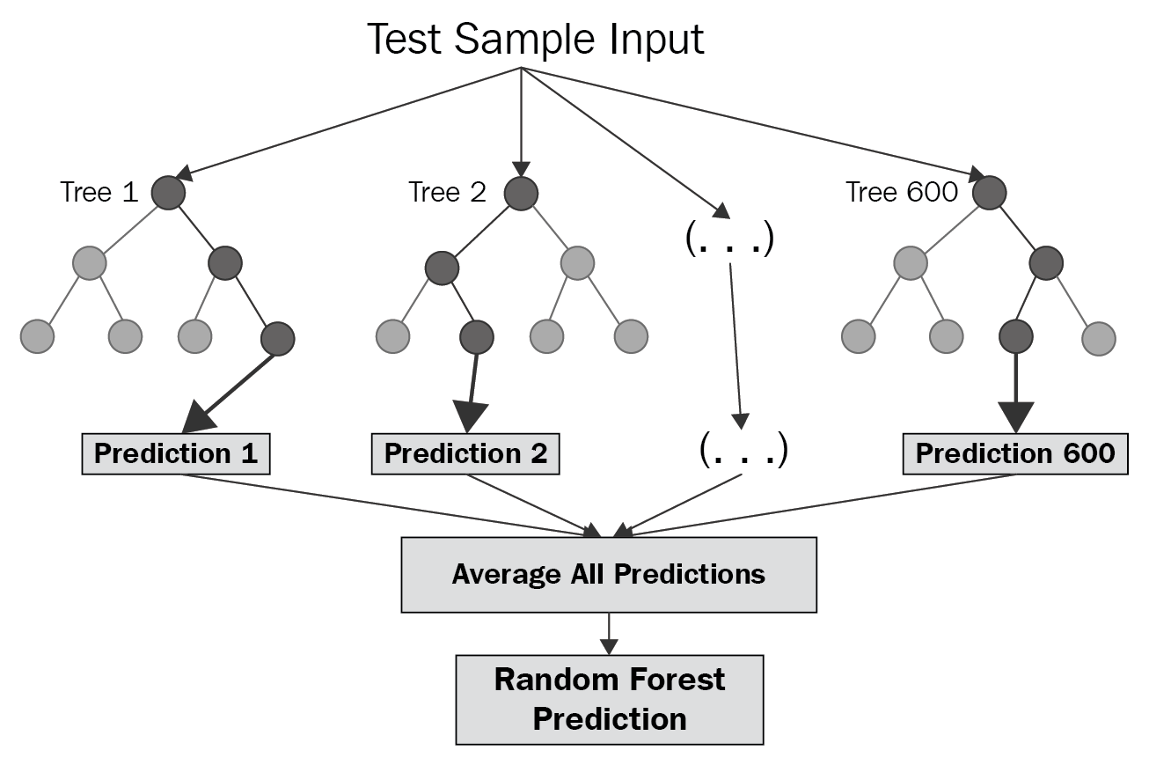
Random Forest:
Random forest is a Supervised Learning algorithm which uses ensemble learning method for classification and regression. Random forest is a bagging technique and not a boosting technique. The trees in random forests are run in parallel. There is no interaction between these trees while building the trees. It operates by constructing a multitude of decision trees at training time and outputting the class that is the mode of the classes (classification) or mean prediction (regression) of the individual trees.

Slide 7
Decision Tree:
Decision tree builds regression or classification models in the form of a tree structure.
It breaks down a dataset into smaller and smaller subsets while at the same time an associated decision tree is incrementally developed.
The final result is a tree with decision nodes and leaf nodes. A decision node has two or more branches, each representing values for the attribute tested. Leaf node represents a decision on the numerical target.
The topmost decision node in a tree which corresponds to the best predictor called root node.

Slide 8
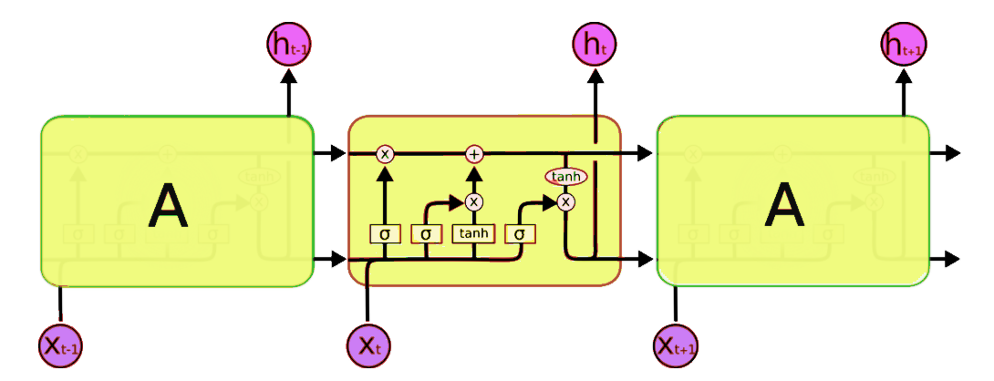
Long Short Term Memory:
LSTM is a recurrent neural network (RNN) architecture that REMEMBERS values over arbitrary intervals. LSTM is well-suited to classify, process and predict time series given time lags of unknown duration.
RNN and HMM rely on the hidden state before emission / sequence. If we want to predict the sequence after 1,000 intervals instead of 10, the model forgot the starting point by then. LSTM REMEMBERS.

Slide 9
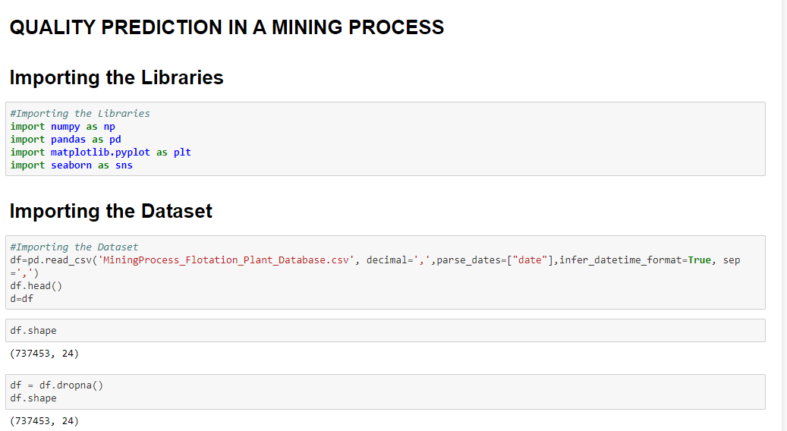
IMPLEMENTATION OF PROJECT:

Slide 10
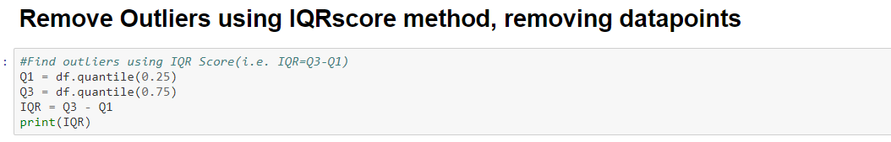
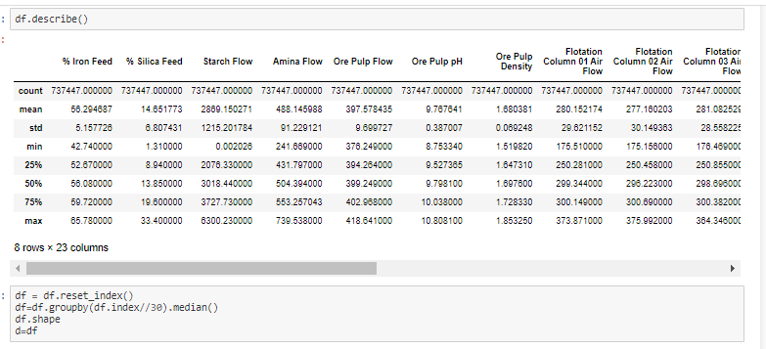

Slide 11
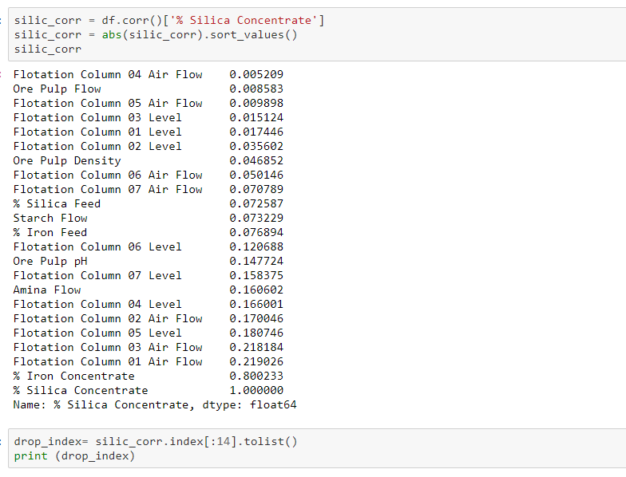

Slide 12
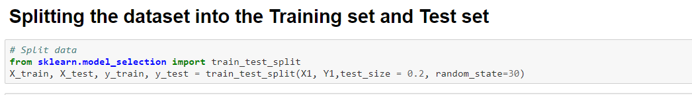
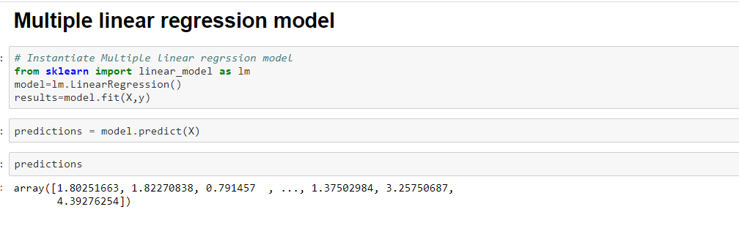
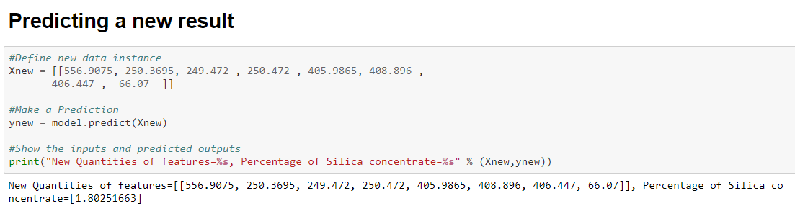

Slide 13
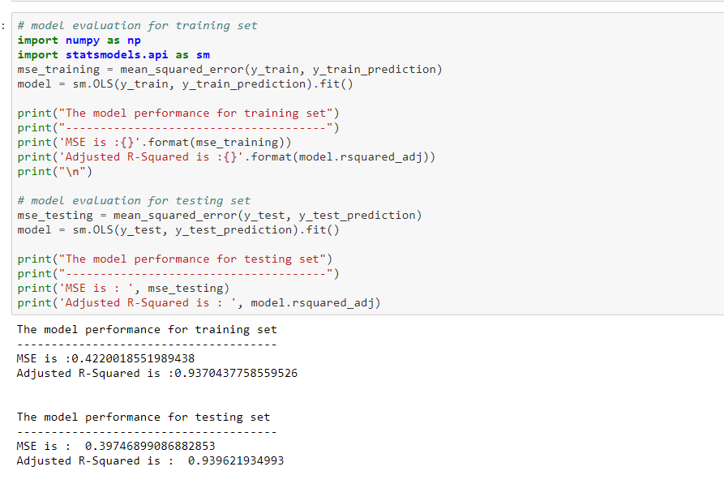

Slide 14
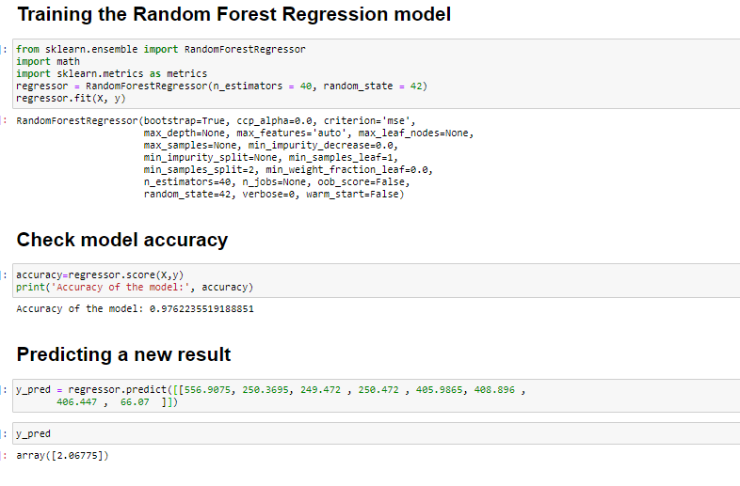

Slide 15
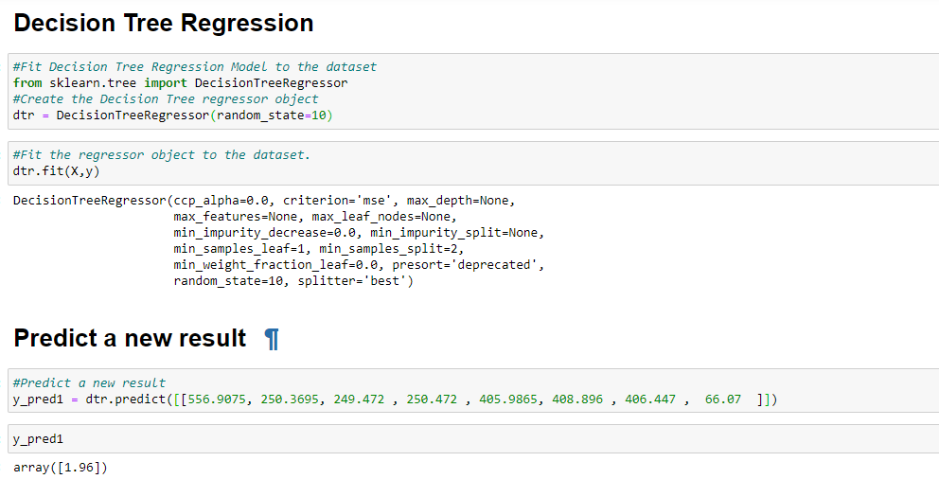

Slide 16
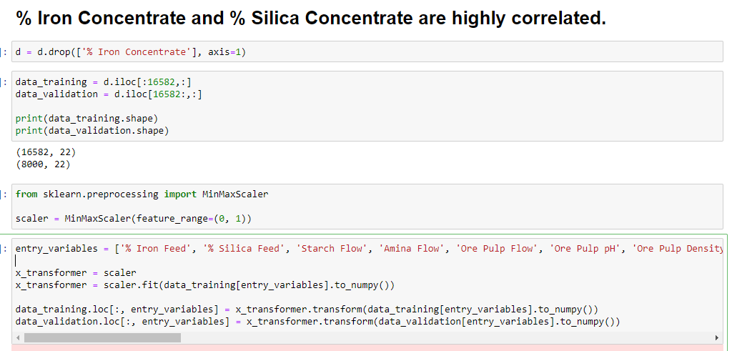
LSTM:

Slide 17
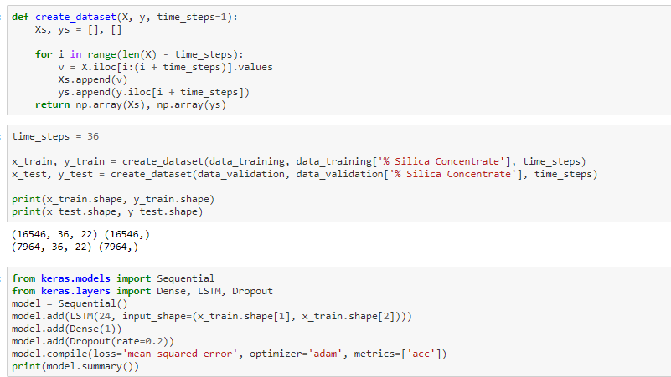

Slide 18
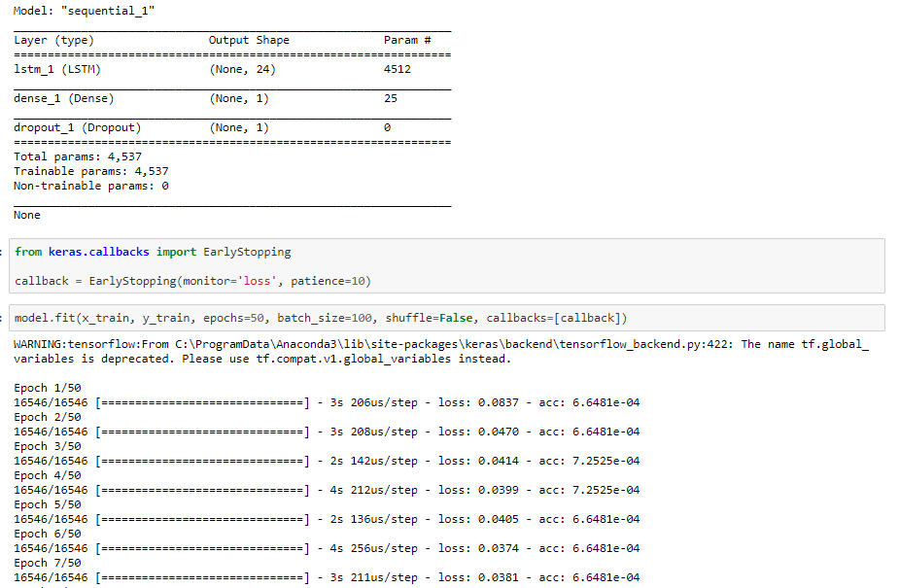

Slide 19
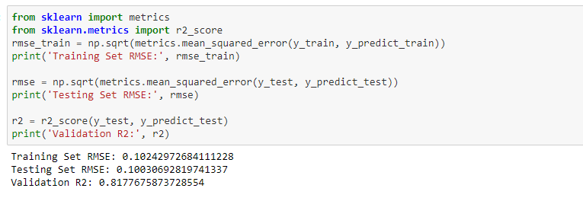
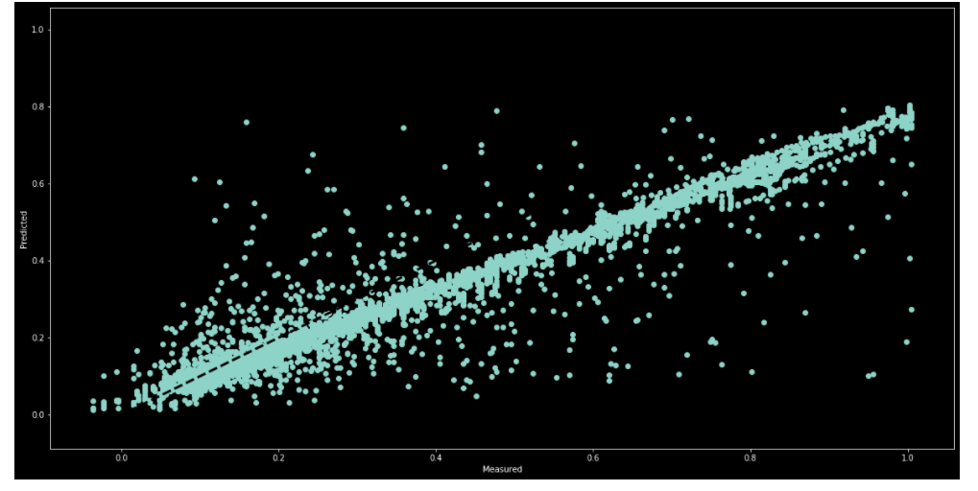

Slide 20
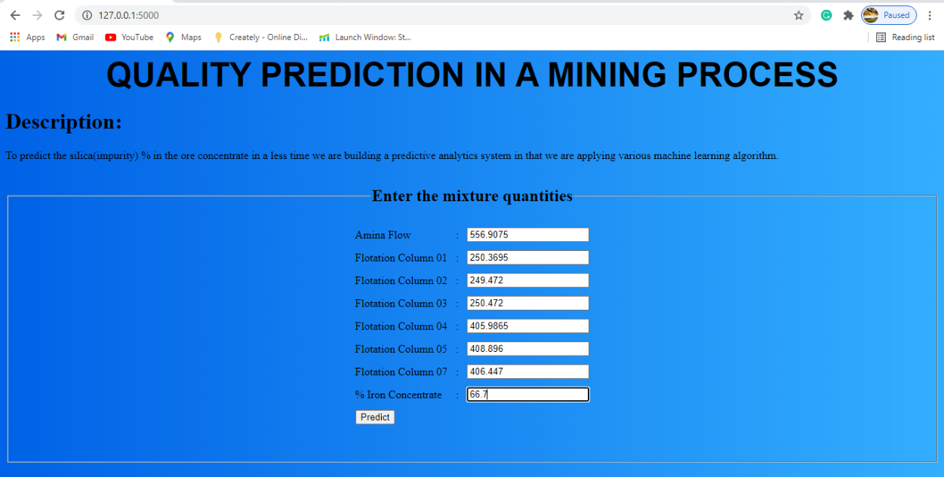
Predicted Output:

Slide 21
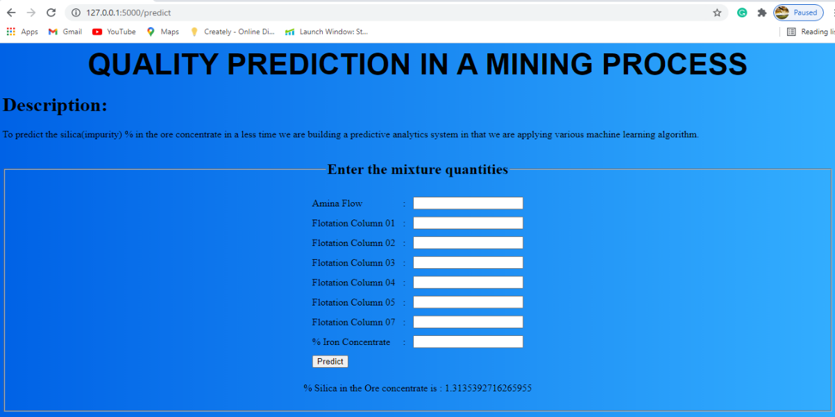
Predicted Output:

Slide 22
Any questions?

Slide 23
ThanK YoU

