Slide 1

Word Count and Page Rank using Map Reduce
CS512 Final Project
Project_Group 12
Gunjan Singh (gs896)
Meghana Tumkur Narendra(mt1080)
Praveen Pinjala (pp813)
Shikha Vyaghra (sv629)

Slide 2
Word Count
Command to create a jar file
mvn clean install
To run Wordcount for small data
cd WordCount
hadoop jar target/WC-Final-0.jar com.example.Wordcount input/smallInput.txt smalldataOutput
To run Wordcount for large data
cd WordCount
hadoop jar target/WC-Final-0.jar com.example.Wordcount input/smallInput.txt largeDataOutput

Slide 3
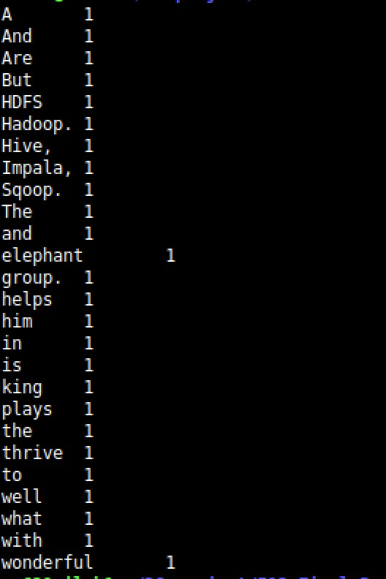
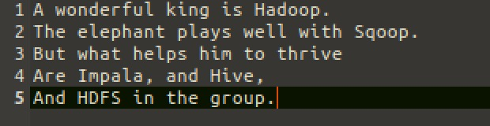
Word Count : Results
Input with small text
Output with the words and its count

Slide 4
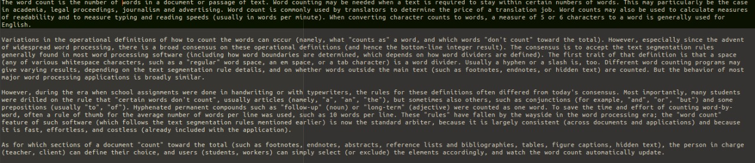
Word Count : Results
Input with large text

Slide 5
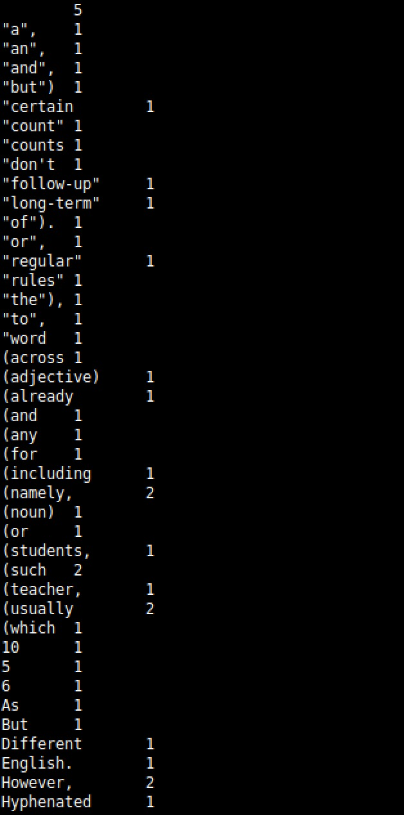
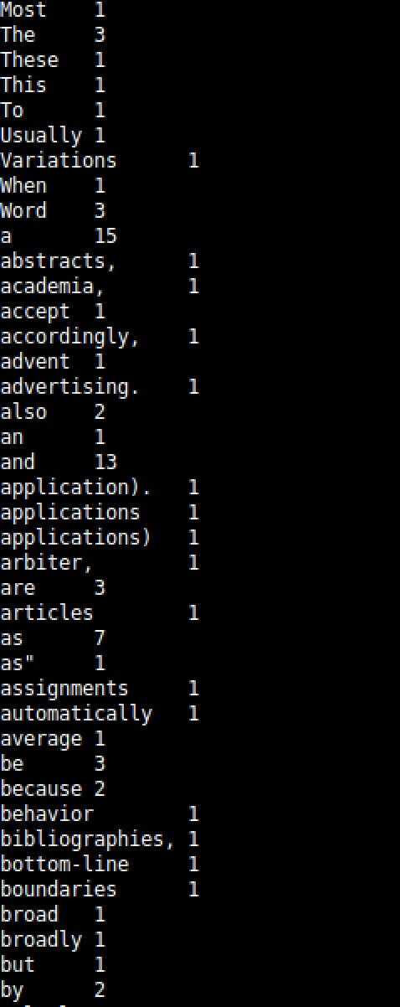
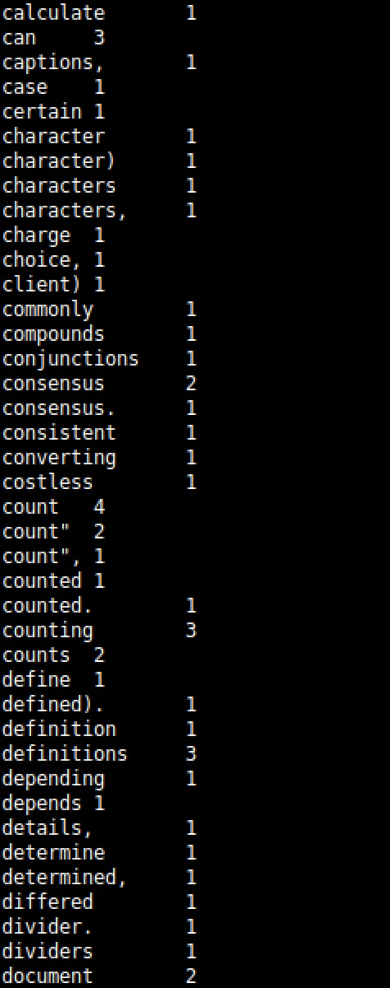
Output with the words and its count

Slide 6
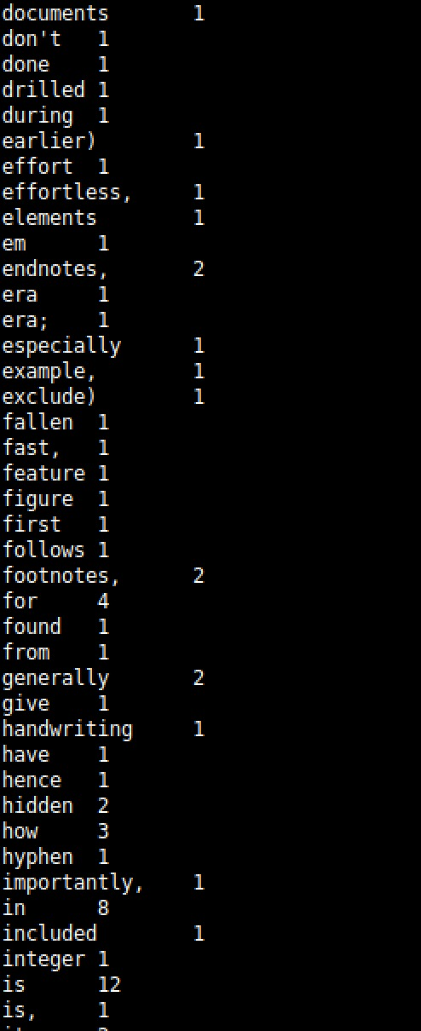
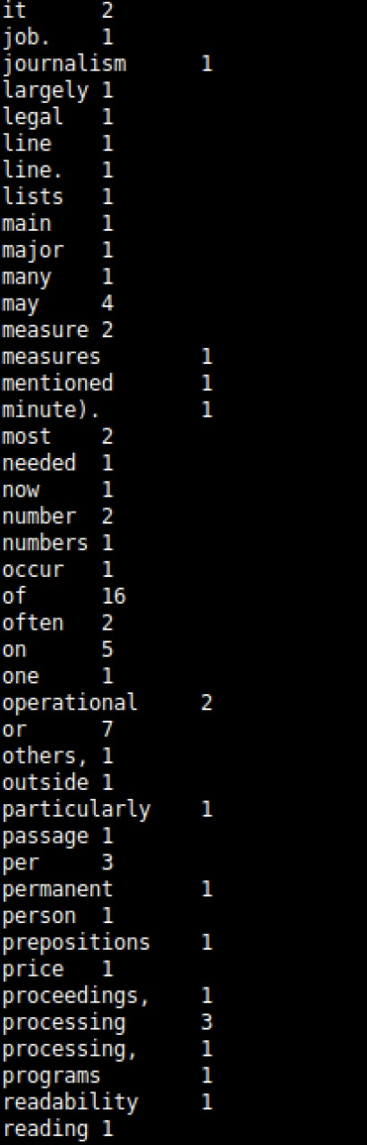
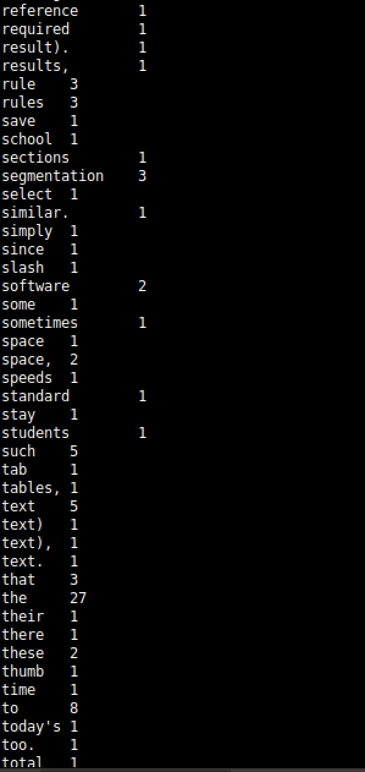
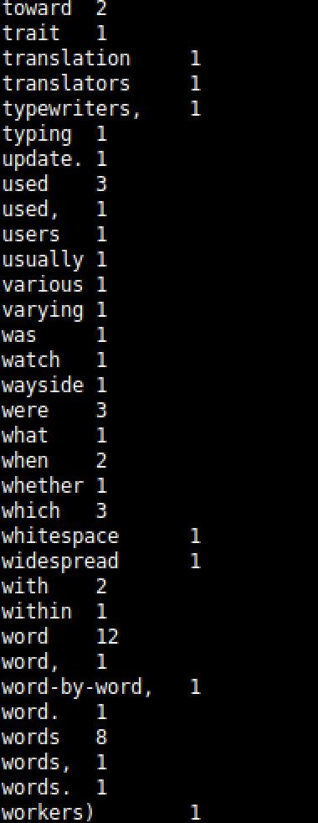
Output with the words and its count, cont’d..

Slide 7
Page Rank
The testable input file should be placed in the Input folder initially before running the code.
To run Page rank
cd PageRank
hadoop jar target/PageRank-0.jar com.example.PageRank input/input_file.txt output_folder_name/ 0.85 5 0.01 true true
Hadoop fd –ls
hadoop fs -cat out2/pag....
The above last two commands are used to see the output on the console window.
Also, output can be directly seen in the txt format in the Output file created after running the Hadoop command.

Slide 8
Cont’d..
Arguments example for Page rank
args example = ["/input/test.txt", "/output“, "0.85", "5", "0.01", "true", "true"]
/input/test1.txt: The input folder
/output: The output folder
0.85: The damping factor.
5: The maximum number of iterations.
0.01: The criterion to break from the iterations (minimum difference).
true: Delete the output folder before starting (if found).
true: Show the results at the end.

Slide 9
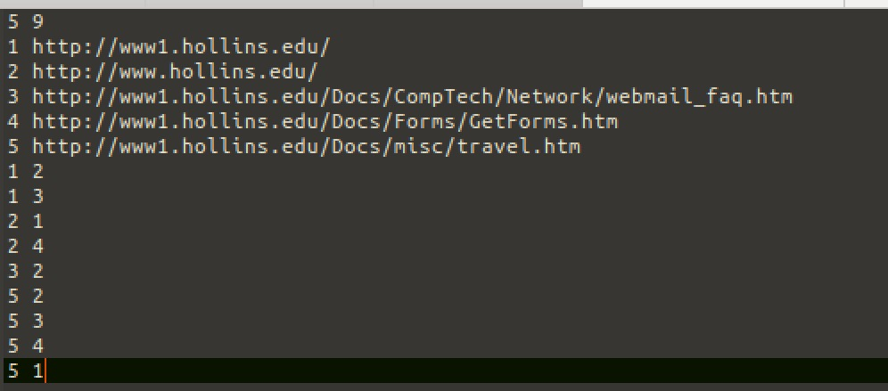
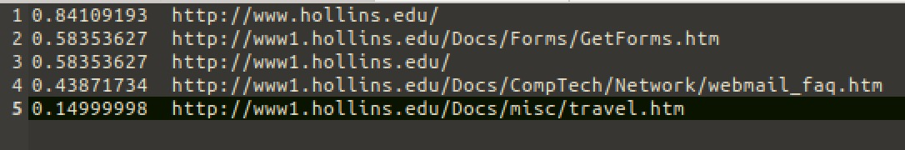
Page Rank: Results
Input
Output with the rankings

Slide 10
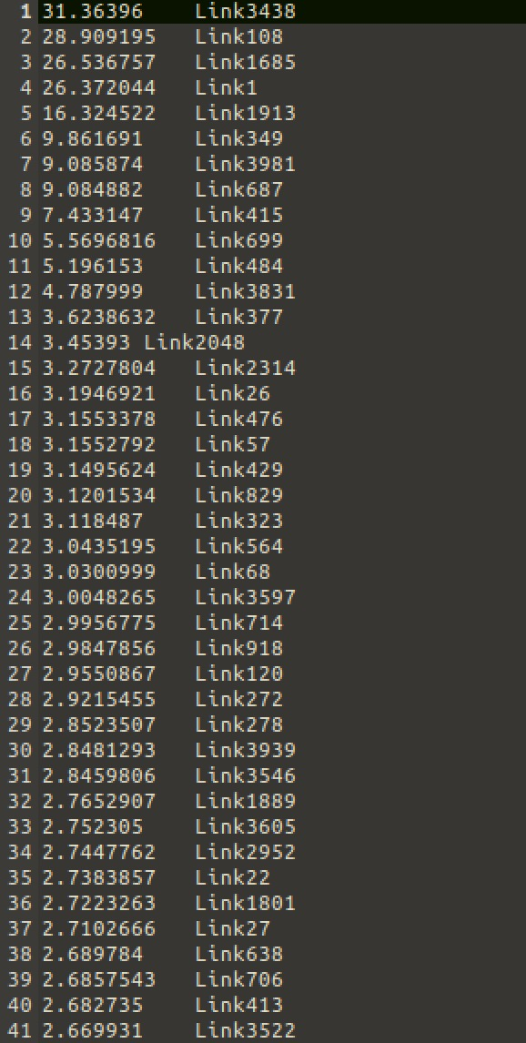
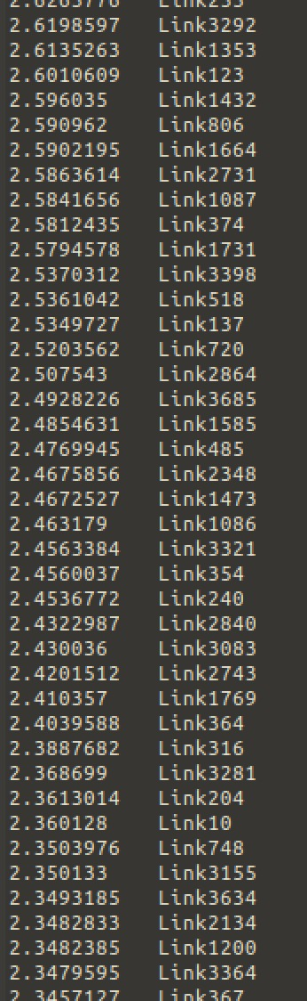
Page Rank: Results
We have also tested the PageRank for the big set of input.
The input file for the large dataset set can be seen in the folder PageRank/input/test2.txt and the output can be seen in PageRank/output/pagerank_output_test2.txt
Sample output is shown below.

Slide 11
Thank you!!

