Slide 1

APPLE STOCK PRICE PREDICTION FOR NEXT 30 DAYS
PRESENTED BY
POLURI PRAVEEN

Slide 2
PROJECT OVERVIEW
Objective : Predict Apple’s stock closing price for the next 30 days using historical data (2012–2019).
Motivation : Stock prices are volatile and influenced by trends and external events, requiring reliable short-term forecasting.
Problem statement : Stock price movements are difficult to predict using one method. Therefore, multiple models are tested to identify which gives the most accurate 30-day forecast.

Slide 3
DATASET DESCRIPTION
Data: The dataset P625 DATASET.csv contains 2011 entries.
Time Period: 2011-2019
Features: Date, Open, High, Low, Close, Adj Close, Volume.
Shape: 2011 rows × 7 columns
Target: Next 30-Day Closing Price.
Data Quality: Dataset contains no null or missing values.

Slide 4
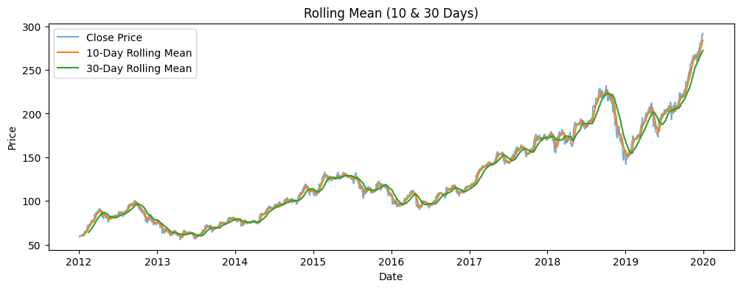
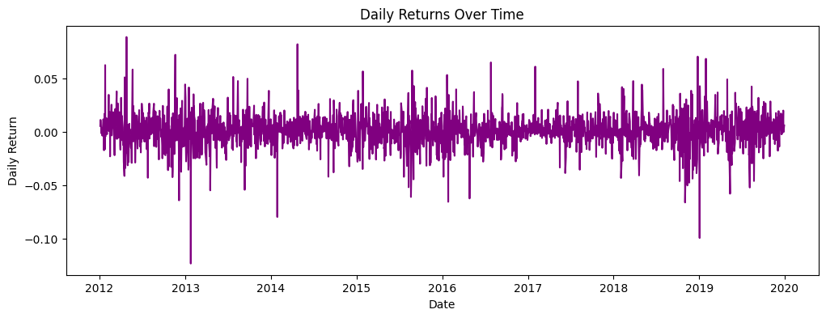
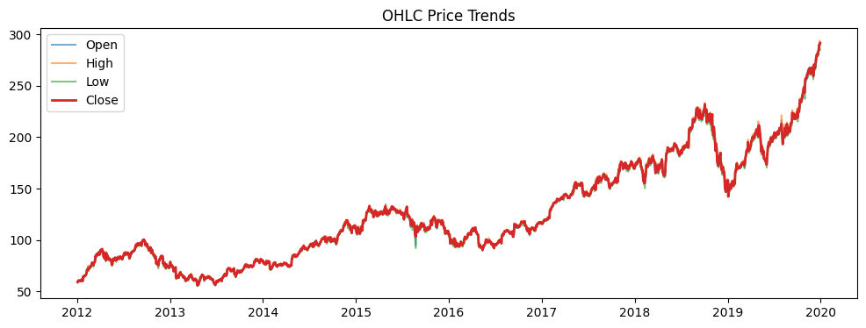
EDA
Rolling Mean Analysis:
Rolling mean is used to smooth short-term price fluctuations.
It highlights the overall trend and shows that the stock is trending upward over time.
Daily Returns: Daily percentage changes fluctuate around zero, with large spikes showing high volatility.
OHLC Price Trends (Open, High, Low, Close):
Stock prices fluctuate on each trading day.
Overall upward movement indicates long-term growth.
Sudden drops reflect market reactions and external events.

Slide 5
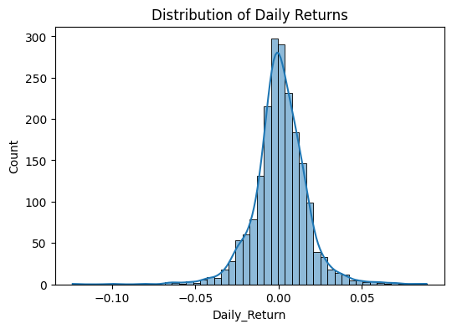
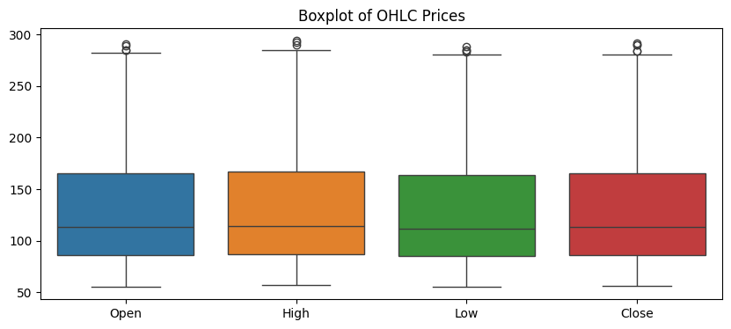
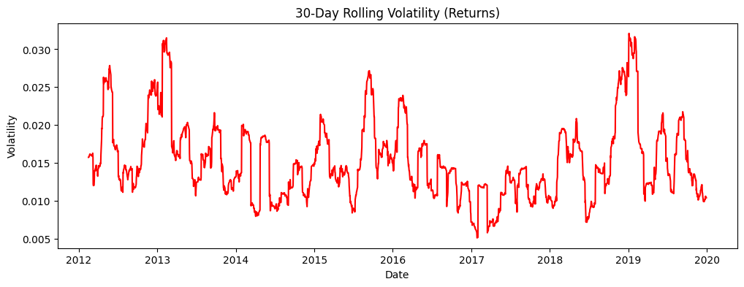
EDA
We analyzed key metrics using visual tools to understand price behavior.
Histogram: Shows the frequency of prices within specific ranges.
Boxplot: Highlights outliers and price variability.
Volatility: Measures price fluctuations, indicating market uncertainty.

Slide 6
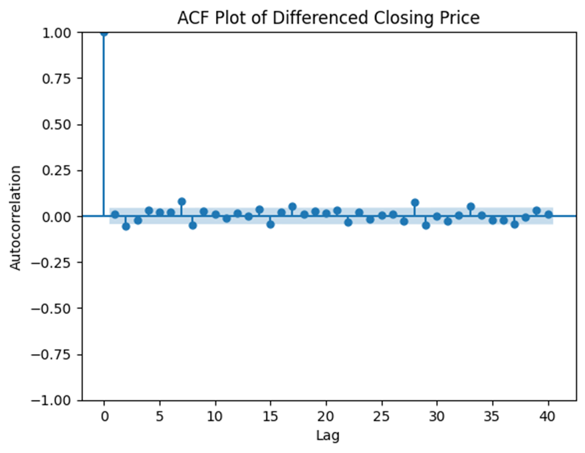
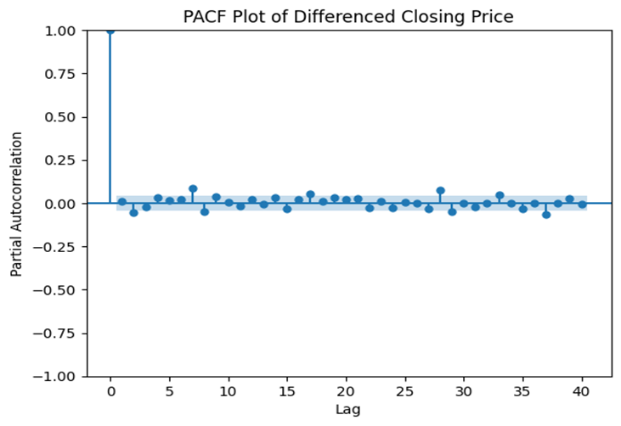
ACF AND PCEF CLOSING PRICE
Applied ACF and PACF on closing prices to study time dependency.
The middle straight line in ACF/PACF represents the confidence limit.
Bars crossing the limit indicate significant correlation with past prices.

Slide 7
FEATURE ENGINEERING
Outliers handled using the IQR method.
Created MA-10 and MA-30 to capture price trends.
Calculated 30-day volatility to measure market risk.
Added lag features and removed missing values.

Slide 8
MODEL BUILDING
Performed train–test splitting to evaluate model performance.
Built statistical time-series models:
  ARIMA for trend-based forecasting
  SARIMA for seasonal patterns
Built machine learning models:
  Random Forest
  XG Boost
Models were trained on historical stock data and compared.

Slide 9
MODEL EVALUTION
Models evaluated using MAE and RMSE
Lower values indicate better performance
Model | MAE | RMSE
ARIMA | 8.08 | 10.90
SARIMA | 7.20 | 9.48
Random Forest | 11.86 | 15.21
XG Boost | 22.18 | 25.28

Slide 10
FINAL MODEL SELECTION
Models were evaluated using MAE and RMSE.
SARIMA performed best with the lowest error values.
ARIMA showed moderate accuracy.
Random Forest and XG Boost performed weaker.
SARIMA was selected for 30-day stock price prediction.

Slide 11
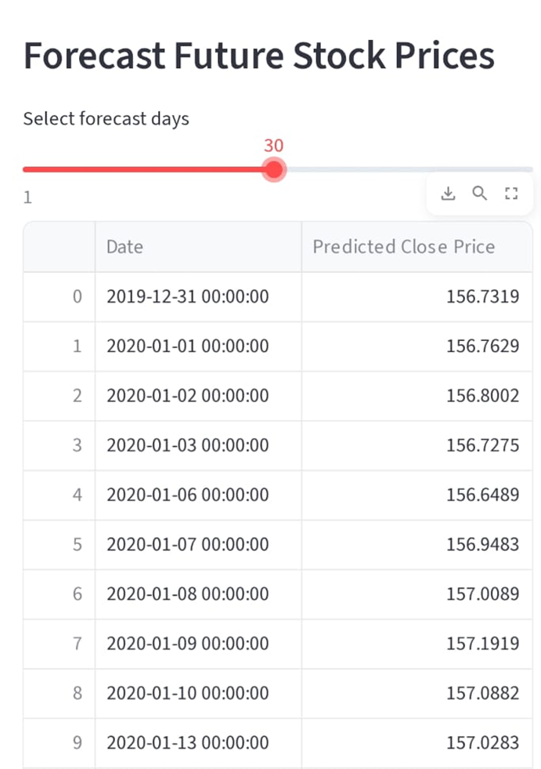
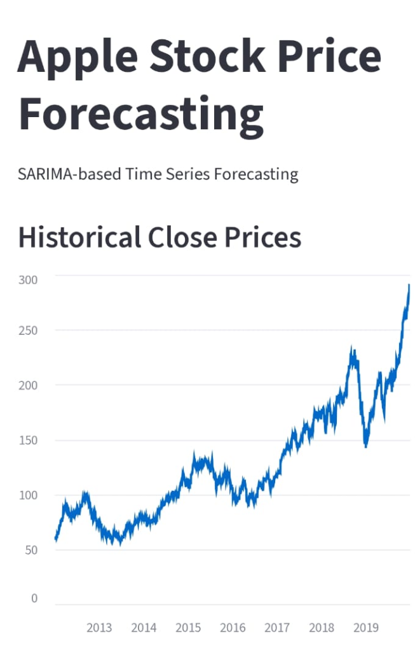
DEPLOYMENT
Developed an interactive Streamlit web application.
Users can select a date range for prediction.
The app displays 30-day stock price forecasts.
Visualizes historical prices and predicted trends.
Enables easy and real-time analysis for users.

Slide 12
THANK YOU….

