Slide 1

GetYourDoctor- Doctor Appointment System
Praveen Rao V P

Slide 2
Introduction
GetYourDoctor – A Doctor Appointment System is a free, appointment booking system for making the process of booking an appointment in a clinic easier and simpler. With Spring Boot and utilization of REST API in the backend and React in the Frontend, the application is fully functional and ready for deployment.
This application enables a user to register, login, search and book appointments, as well as cancel appointments before a specific date if the timing is inconvenient for the patient. Hence, this application is purely a patient-centric application.

Slide 3
Special Features
Using OpenAI API, I have implemented a ChatBot called Dr. ChatBot, where you can enter your ailments and Dr ChatBot will display what possible diseases or condition you might have and suggest clinics near you!
(Under Development) I am also planning to have an API which collects latest news about advancements in Healthcare, and Government Schemes for medical industry and display it in the home pages.

Slide 4
Components Interaction.
Client
Patient
Backend
Admin
SUPERADMIN
DOCTOR
ADMIN

Slide 5
Entity Relationships
Doctor
Doctor
Doctor
Slot
Slot
Doctor
Doctor
Slot
ClinicArea
Slot
ClinicArea
Slot
ClinicArea
Slot
Appointment
Appointment
Appointment
Patient

Slide 6
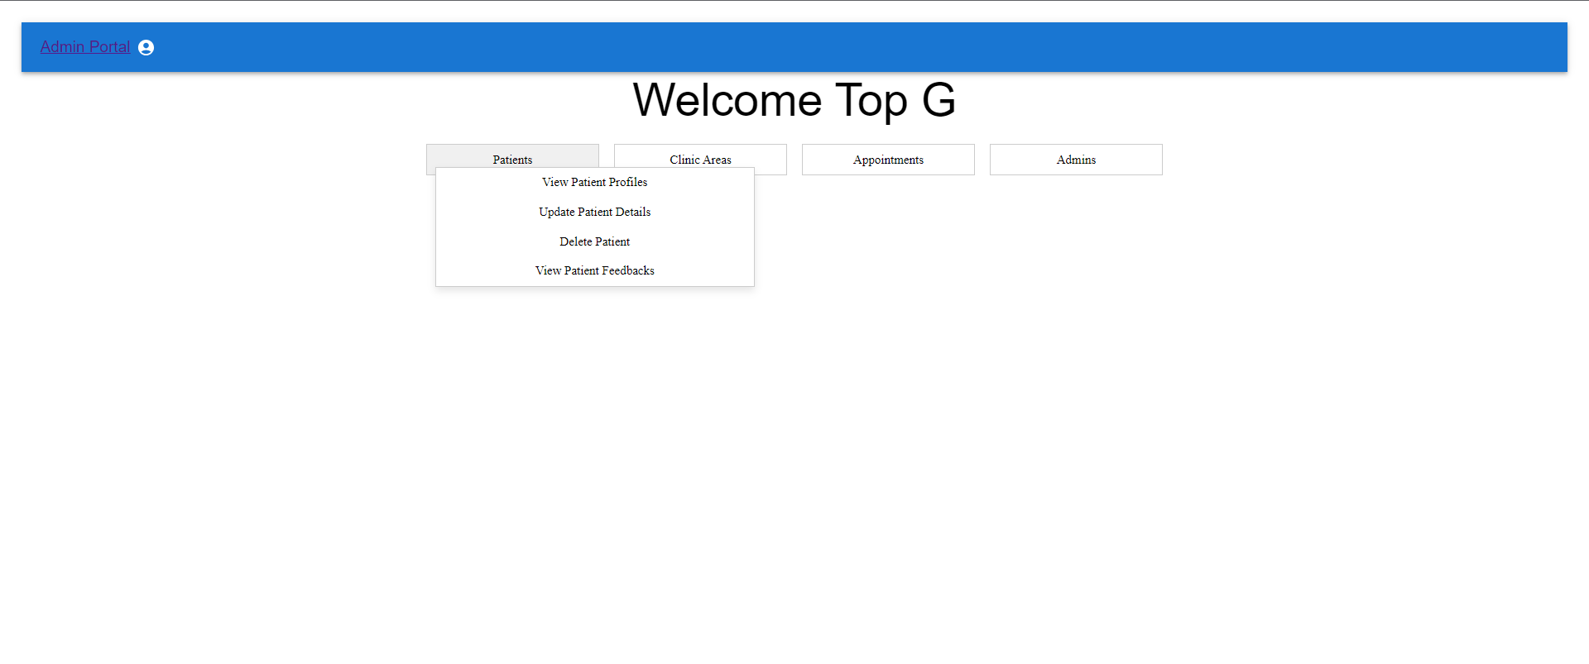
Screenshots

Slide 7
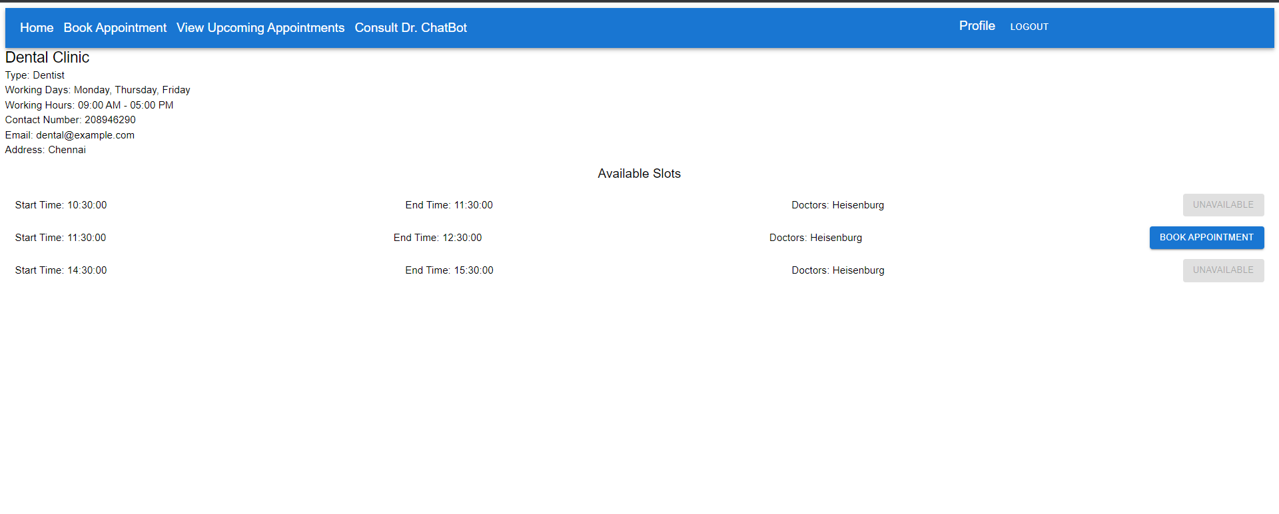
Screenshots

Slide 8
Conclusion
GetYourDoctor is a new prototype on an implementation of Doctor Appointment System, which I believe will help the general populace and the clinics both in an organized and efficient way of treatment of common diseases through a streamlined and organized way of setting up appointments.

Slide 9
THANK YOU

