Slide 1

Organ Donation and Transplantation using Blockchain
by
S. Laikha Firdos
Roll No. 204G1A3221
P. Sujitha
Roll No. 204G1A3253
Y. Praveen Reddy
Roll No. 214G5A3203
Under the guidance of
Mr. K. Venkatesh, _{M.Tech., (Ph.D)}
Assistant Professor
GitHub Link: https://github.com/k-venky/CSD_2020-24_A-2
Department of Computer Science and Engineering (Data Science)
Srinivasa Ramanujan Institute of Technology
(Affiliated to JNTUA & Approved by AICTE) (Accredited by NAAC with ‘A’ Grade & Accredited by NBA (EEE, ECE & CSE)
Rotarypuram Village, B K Samudram Mandal, Ananthapuramu – 515701.
2023 - 2024

Slide 2
Abstract
Organ transplantation plays a vital role in saving many lives. The success of transplantation greatly depends on the timely and matching of donors with compatible recipients. However, the shortage of available organs for transplantation remains a major challenge.
The core idea of this project is to establish a blockchain based platform and that provides the low cost and enhances security, and facilitates matching of the organs. We will generate a unique hash value for each user. The main aim is to address the critical issues surrounding organ shortages and streamline the organ allocation process, ultimately saving more lives.

Slide 3

Contents
Introduction
Literature Survey
Existing System
Proposed System
Objectives
Requirements
System Architecture
Data Flow Diagram / UML / ER
Implementation
Results (Screenshots)
Conclusion
References
Paper submission proof

Slide 4
Introduction
Organ matching and transplantation can be a life-threatening and life-saving process in modern medicine that addresses the acute shortage of viable organs for patients suffering from terminal or severe chronic illnesses.
This complex process involves identifying and pairing organ donors with recipients in a manner that increases the chances of transplant success and patient survival. There are other ways that blockchain technology can be applied to healthcare like organ matching and organ transplantation.

Slide 5
Literature Survey
The paper "Indriya: Building a Secure and Transparent Organ Donation System with Hyperledger Fabric" presents a novel approach to managing organs information and it is donation systems using efficient technology called blockchain by using Hyperledger Fabric.
The main drawback of the system is the lack of detailed discussion on potential challenges and limitations faced and also the huge amount for gas amount.
The paper on “Organ Bank Based on Blockchain” presents a promising solution to enhance transparency and security in organ donation and transplant systems. However, like any research work, there may be some drawbacks and challenges that need to be considered. Here are some potential drawbacks of the paper and techniques used in it, along with suggestions on how to overcome them.
The drawback is Scalability Concerns. The paper proposes using blockchain technology for organ bank management, which can face scalability issues as the system grows.

Slide 6
EXSISTING SYSTEM
The existing system relies on traditional methods to store and manage healthcare data. Most of the databases are centralized.
As some of the systems have low scalability as they have not used enhanced technologies.
Few of the systems does not discuss the specific challenges faced during the implementation and deployment of the Hyperledger Fabric-based organ donation system.

Slide 7
Proposed System
The proposed system focuses on blockchain technology to create a Decentralized Application for organ donation and transplant system.
The system is mainly implemented on Ethereum Blockchain.
In the proposed system we overcame all the drawbacks of the existing system by providing security, cost-effective and user friendly application.

Slide 8
Objectives
First objective is to create a unique id for both the patients and the donor using IPFS Technology.
To send an alert message to both Patient and Donor upon successful matching.

Slide 9
Modules
Hospital Module:
This module is responsible for managing hospital-related activities within the system. It includes functionalities such as registering donors and patients, managing organ transplantation processes, viewing transplantation statuses, and securely logging out after completing tasks.
Donor Module:
The donor module facilitates interactions and activities related to organ donation. Donors will login credentials which they got through SMS from the hospital,

Slide 10
Modules Cont..
hospital, the donor will utilize this information to access the system, view their donation statuses, and securely log out after completing their tasks.
Patient Module:
The patient module focuses on managing healthcare-related activities for patients. Patients will login credentials which they got through SMS from the hospital, request organ transplantation, view the status of their organ requests, and securely log out after completing their tasks.

Slide 11
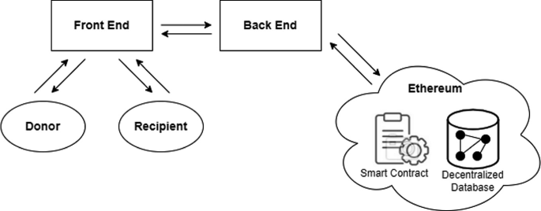
System Architecture
Figure No. 1 Architecture of the project

Slide 12
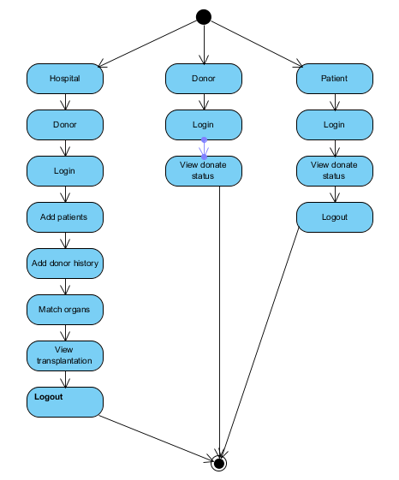
Activity Diagram
Activity diagrams are graphical representations of workflows of stepwise activities and actions with support for choice, iteration and concurrency. In the Unified Modelling Language, activity diagrams can be used to describe the business and operational step-by-step workflows of components in a system. An activity diagram shows the overall flow of control.
Figure No: 2 Activity Diagram

Slide 13
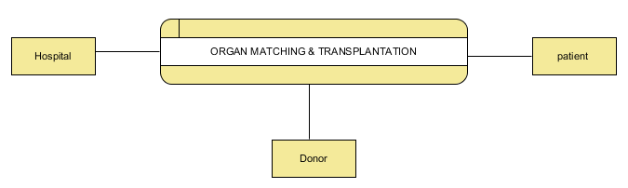
Data Flow Diagram
A Data Flow Diagram (DFD) is a traditional way to visualize the information flows within a system. It shows how information enters and leaves the system.
Figure No. 3 Data Flow Diagram

Slide 14
Implementations
Implementation can be explained in three ways like the hospital, donor and patient side.
The hospital will register themselves by giving the necessary details and then login with the credentials.
Hospital can add both the patient and donor details and will then match the organs based on the availability and can also be able to view the transplant details.
The patient and the donor will register into the system by providing the required details .
They will receive the alert messages when an organ is successfully matched.

Slide 15
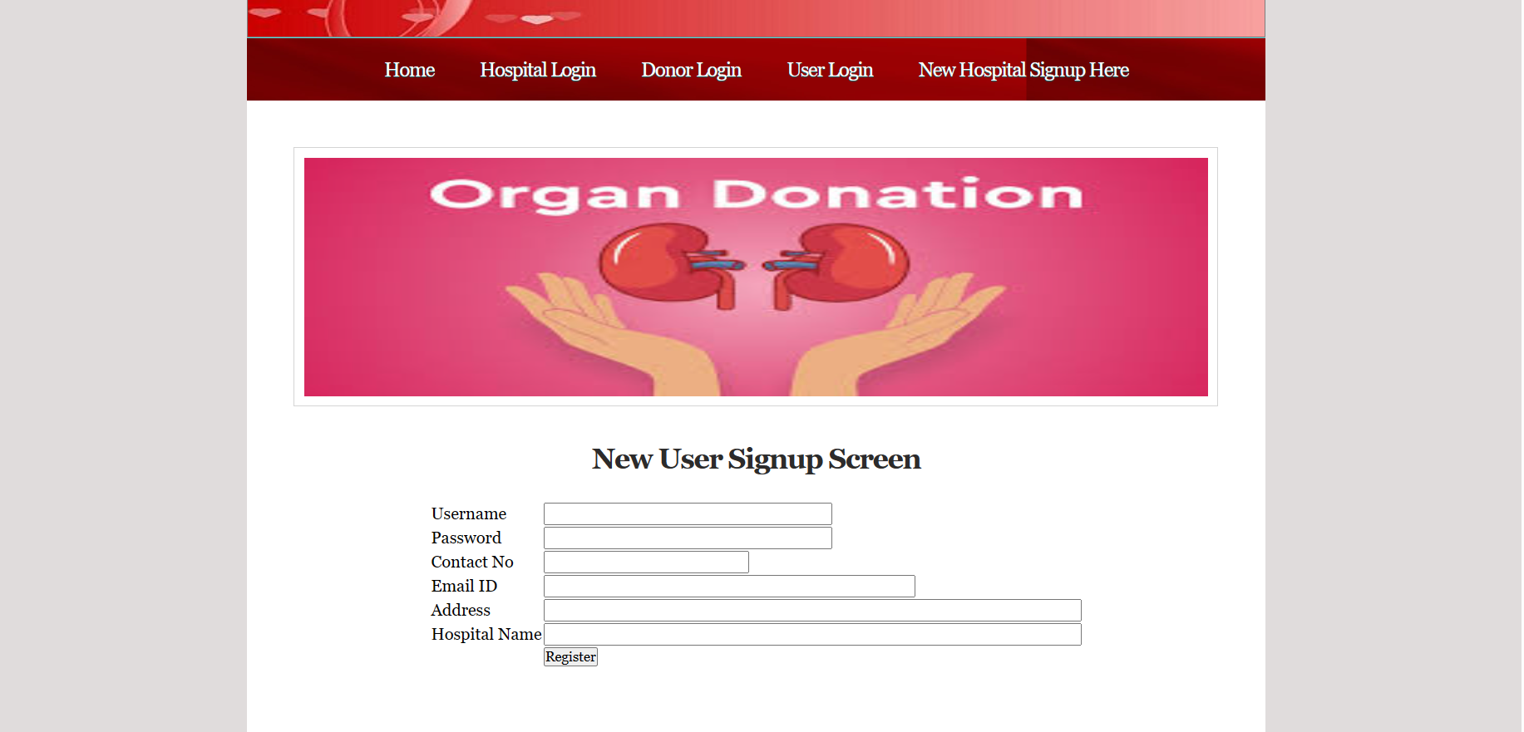
Results
Figure No: 4 Activity Diagram

Slide 16
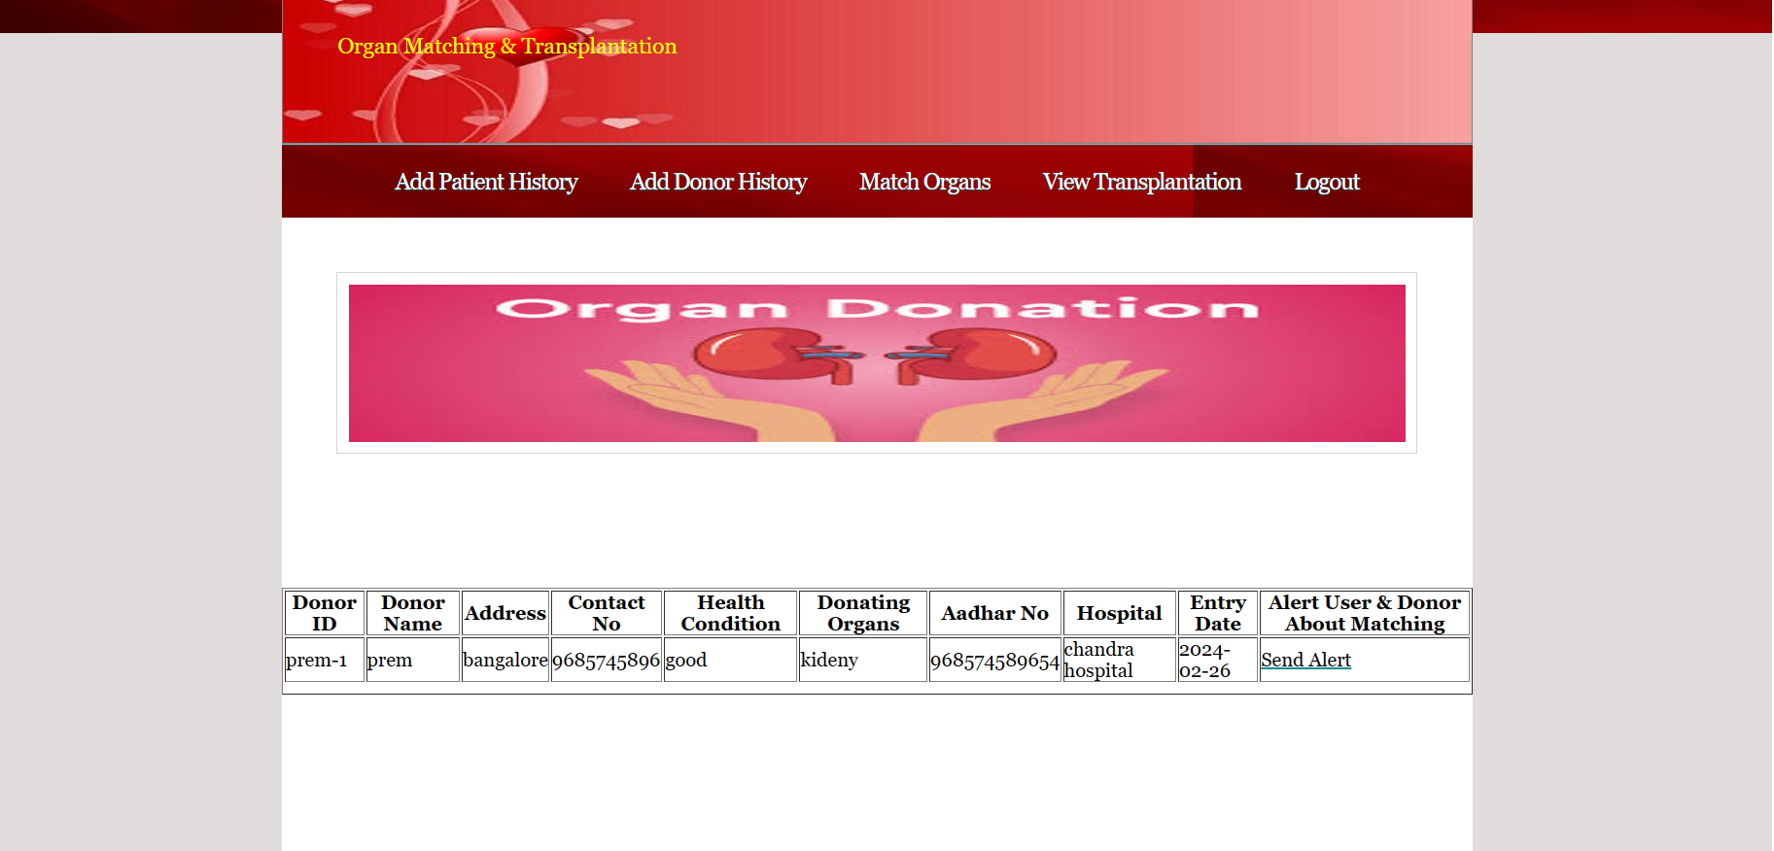
Results
Figure No: 5 Sending alert

Slide 17
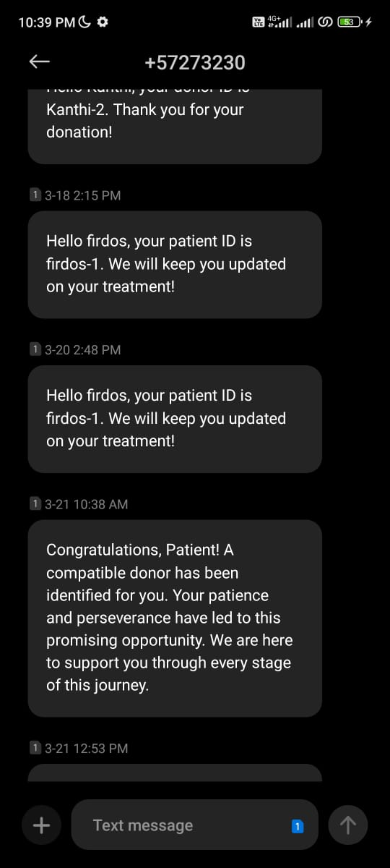
Results
Figure No: 6 Alert Message is sent

Slide 18
Conclusion
In the proposed system we have mainly focused on the importance of the blockchain technology in the organ matching and transplant by ensuring all the aspects like transparency, security where an id is provided to each user, and efficient way for finding the organ. The proposed system also overcomes the challenges which are faced in the existing systems like lack of proper communication between the users and also it reduces the gas amount. The IPFS technology is used to generate a unique ID which can be immutable thereby enhancing the security of the information

Slide 19
Reference
[1]. Navjeevan Chaudhary, SunilKumar S. Manvi, Nimrita Koul, “Organ bank Based on Blockchain”, IEEE International Conference on Electronics, Computing and Communication Technologies.
[2]. Satyajit Ghosha, Mousumi Duttaa “Indriya: Building a Secure and Transparent Organ Donation System with Hyperledger Fabric”
[3]. G. Shobana, Dr. M. Suguna, “Blockchain Technology towards Identity Management in Health Care Application”, International Conference on I-SMAC.
[4]. P. Ranjan, S. Singh, S. Agrawal and V. K. Singh, "Decentralized and distributed system for organ/tissue donation and transplantation", 2019 IEEE Conference on Inform

Slide 20
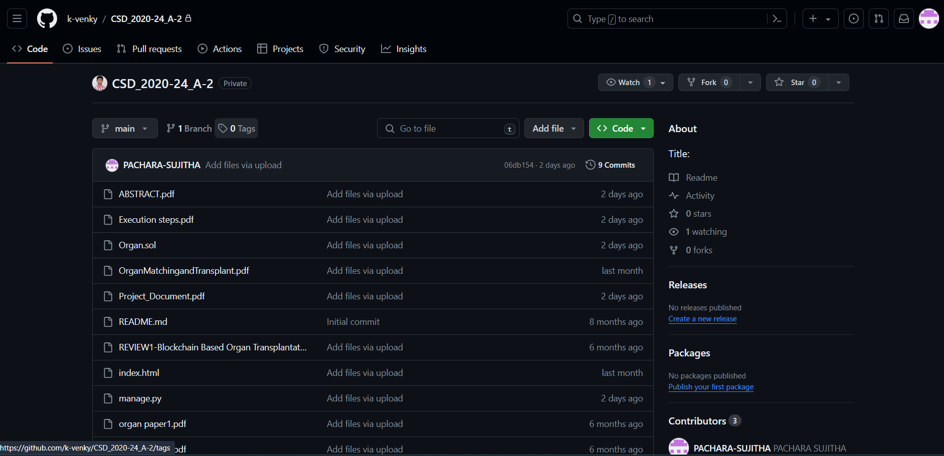
GitHub Dashboard
Figure No: 7 GitHub Dashboard

Slide 21
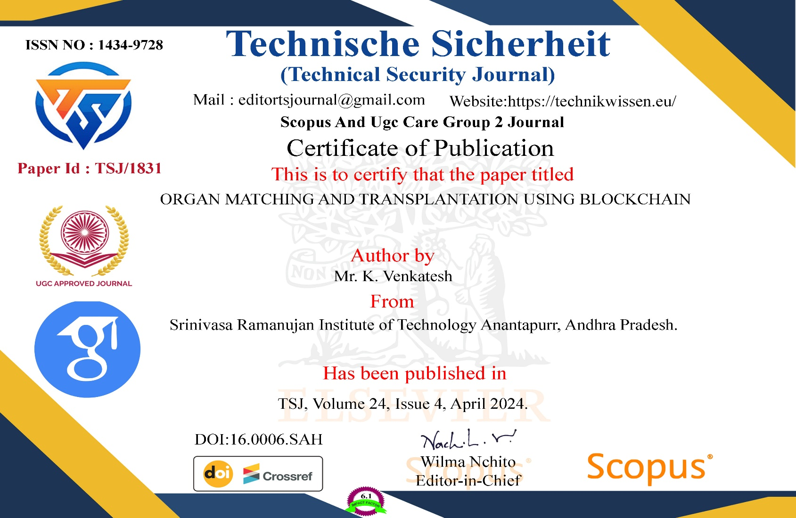
Paper Publication
Figure No: 8 Certificate for Paper Publishing

Slide 22
Thank You!!!

