Slide 1




System Integrations

Slide 2


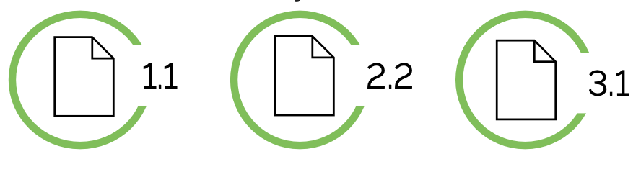



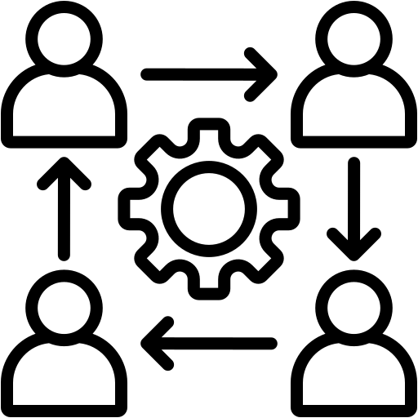
Document Management in GPLM
Content
Version Controlled.
Metadata
Document
Traceable
Lifecycle Managed
Change Managed

Slide 3
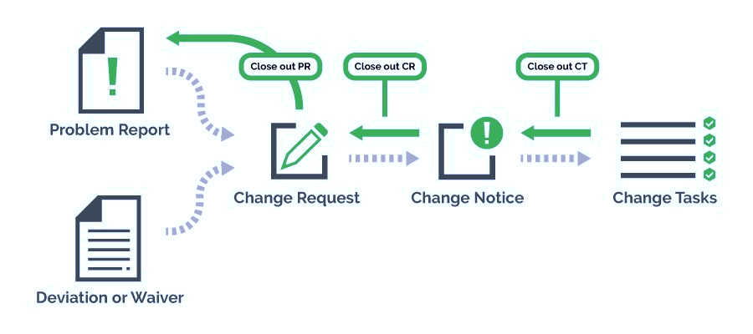
Closed Loop Change Management Overview

Slide 4

Partner PLM Integration
Partner PLM
DMZ
Windchill PLM
File
REST
WRS
PDM
Custom Program

Slide 5
Windchill – SAP Interface
SAP
PTC
Windchill
Change
Middleware
Part
Part
XML
Files
BOM
BOM
ESI
ERP Connector
DIR
Status message
Enterprise
Services
BAPIs
ABAP Proxy
XREF Tables
Change Notice, Part, MBOM, Document Links are sent to ERP system
Success/Failure messages sent back to Windchill
XMLs are completely customizable according to client requirements.
Windchill ERP Connector – MiddleWare – SAP R3 ERP.

Slide 6
THANK YOU

