Slide 1
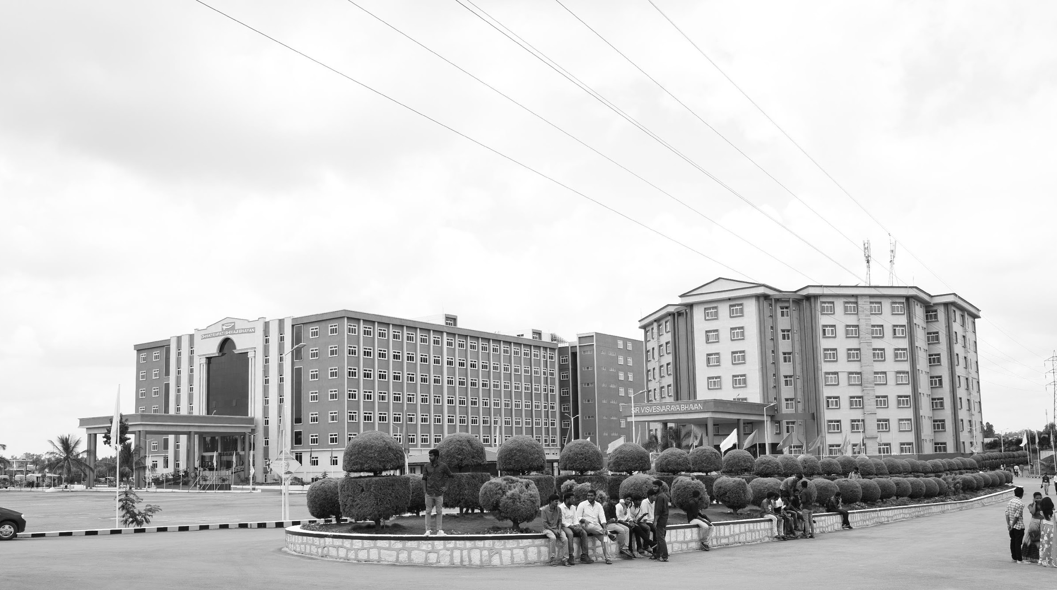

Smart Bridge using IOT
Review 3
Major Project
Project ID: Alpha 22
AY 2021-25
GITAM (Deemed-to-be) University
Project Team:
J Yugandhar Reddy - BU21EECE0100418
T Praveen - BU21EECE0100451
K Balaji - BU21EECE0100453
Department of Electrical Electronics and Communication Engineering
Project Mentor:
Dr. Ajith Kumar
Project In-charge:
Dr. Ambar Bajpai
www.gitam.edu

Slide 2
Objective and Goals
Objective
Monitor water levels in real-time using a water level sensor and an ultrasonic sensor to detect rising water during floods.
Use servo motors to lift the bridge automatically when the water level exceeds a safe threshold, preventing vehicle movement.
Transmit water level data to the Blynk app for real-time monitoring and remote alerts.
Notify users via Blynk notifications when water levels become critical, ensuring timely action.
Goals
Develop an automated smart bridge system that detects rising water levels and controls bridge movement using IoT and servo motors.
Ensure real-time monitoring and alerts through the Blynk app, providing users with timely notifications for flood situations.

Slide 3
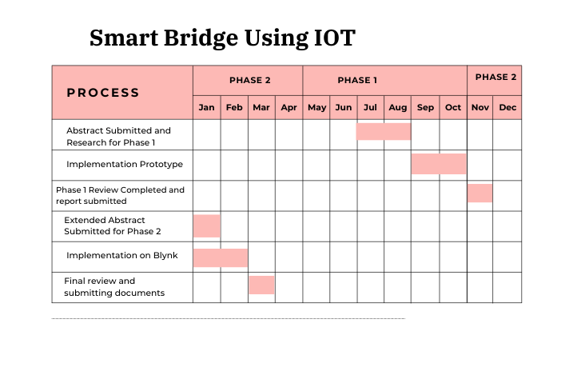
Project Plan
Gant Chart - Milestones and Activities

Slide 4
Literature Survey (Improved post minor project)
Key Publications
The 7th International Conference on Computational Intelligence and Digital Technology (ICCIDT-2K25) to be held during 16th and 17th May 2025.
The 11th IEEE CONECCT, a premier international conference on Electronics, Computing, and Communication Technologies, will be held from July 10-13, 2025, at Sterlings Mac Hotel, Bangalore, India.
Key Resources – Literature Survey
Title | Author and Date | Methodology
Development of an IoT-based Bridge Safety Monitoring System | Jin-Lian Lee , Yaw-Yauan Tyan , Ming-Hui Wen1 , Yun-Wu Wu- 17 May 2017 | The system consists of monitoring devices installed on the bridge, which collect data on water levels, pressure, pipeline conditions, and gas levels. This data is transmitted to a cloud-based server through wireless communication for real-time analysis. The system is powered by photovoltaic units with a sun-tracking mechanism, providing supplementary energy.
IoT Based Bridge Automation with Hybrid Power Supply | Suchismita Dutta, Kingsuk Majumdar, Dola Sinha - 12 November 2022 | The bridge uses solar PV arrays and a MAGLEV windmill as a hybrid power supply, ensuring energy efficiency and automation. The control system is managed via an Android app, with an Arduino UNO, relay module, and Bluetooth, enabling wireless operation. LEDs provide smart illumination controlled by daylight intensity, and the bridge's movements are monitored in real-time using sensors.

Slide 5
Components Used
NodeMCU ESP8266 – Microcontroller for IoT connectivity
Water Level Sensor – Detects rising water levels
Ultrasonic Sensor – Measures water height for precise monitoring
Two Servo Motors – Lifts the bridge when water reaches a critical level
Arduino Board – Controls sensor data processing and motor movement
Jumper Wires – For circuit connections
Power Supply – 5V DC source

Slide 6
Working Principle
The NodeMCU ESP8266 acts as the central microcontroller, connecting to Wi-Fi and controlling the entire system.
A water level sensor is connected to the A0 analog input of the NodeMCU to detect rising water levels.
An ultrasonic sensor (HC-SR04) is connected to D2 (Trig) and D3 (Echo) to measure the exact distance between the bridge and the water surface.
Two servo motors are connected to D5 and D6, allowing the bridge to lift automatically when the water level exceeds a predefined threshold.
The power supply provides 5V to the NodeMCU, with sensors and servos connected to the appropriate voltage levels.
The Blynk app is used for real-time monitoring, displaying water level readings and sending alerts when the water level becomes critical.
When the water level sensor detects an increase, the NodeMCU processes the data and checks if the threshold is exceeded.
If the threshold is crossed, the NodeMCU sends signals to the servo motors, lifting the bridge to prevent vehicles from crossing.
Once the water recedes below the threshold, the bridge automatically lowers, restoring normal traffic movement.
The Blynk app updates in real time, displaying water level changes and sending notifications to alert users about potential flooding conditions.

Slide 7
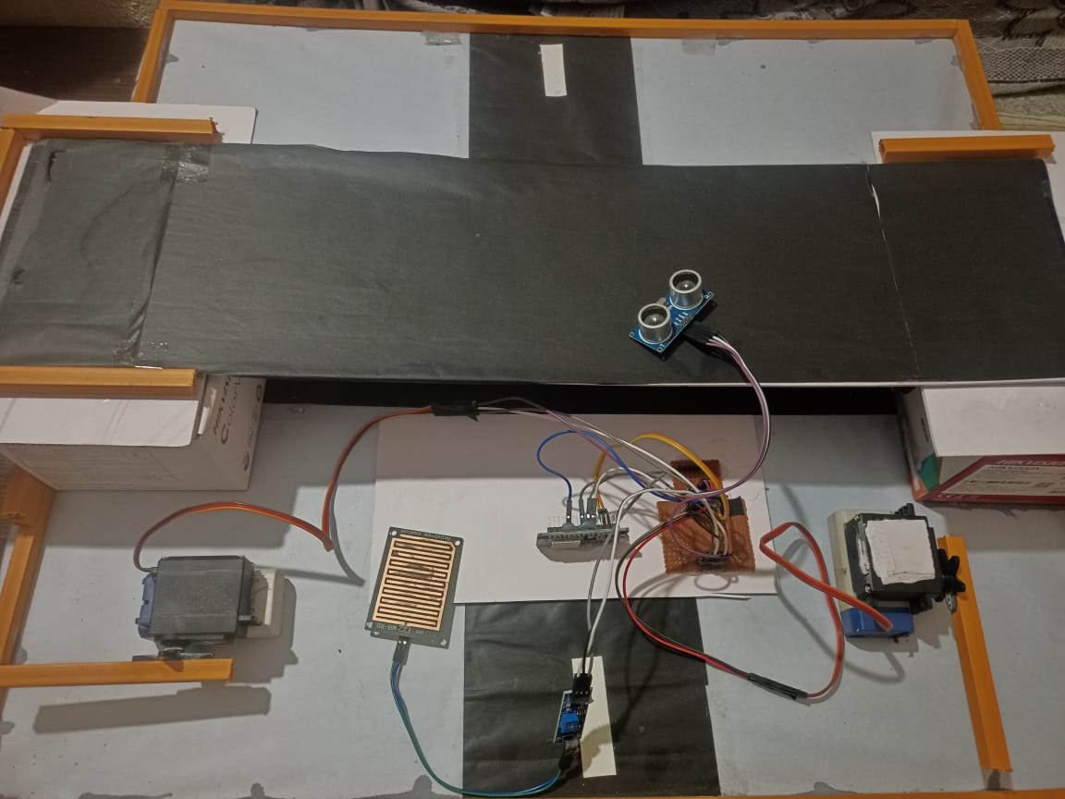
Hardware Architecture

Slide 8
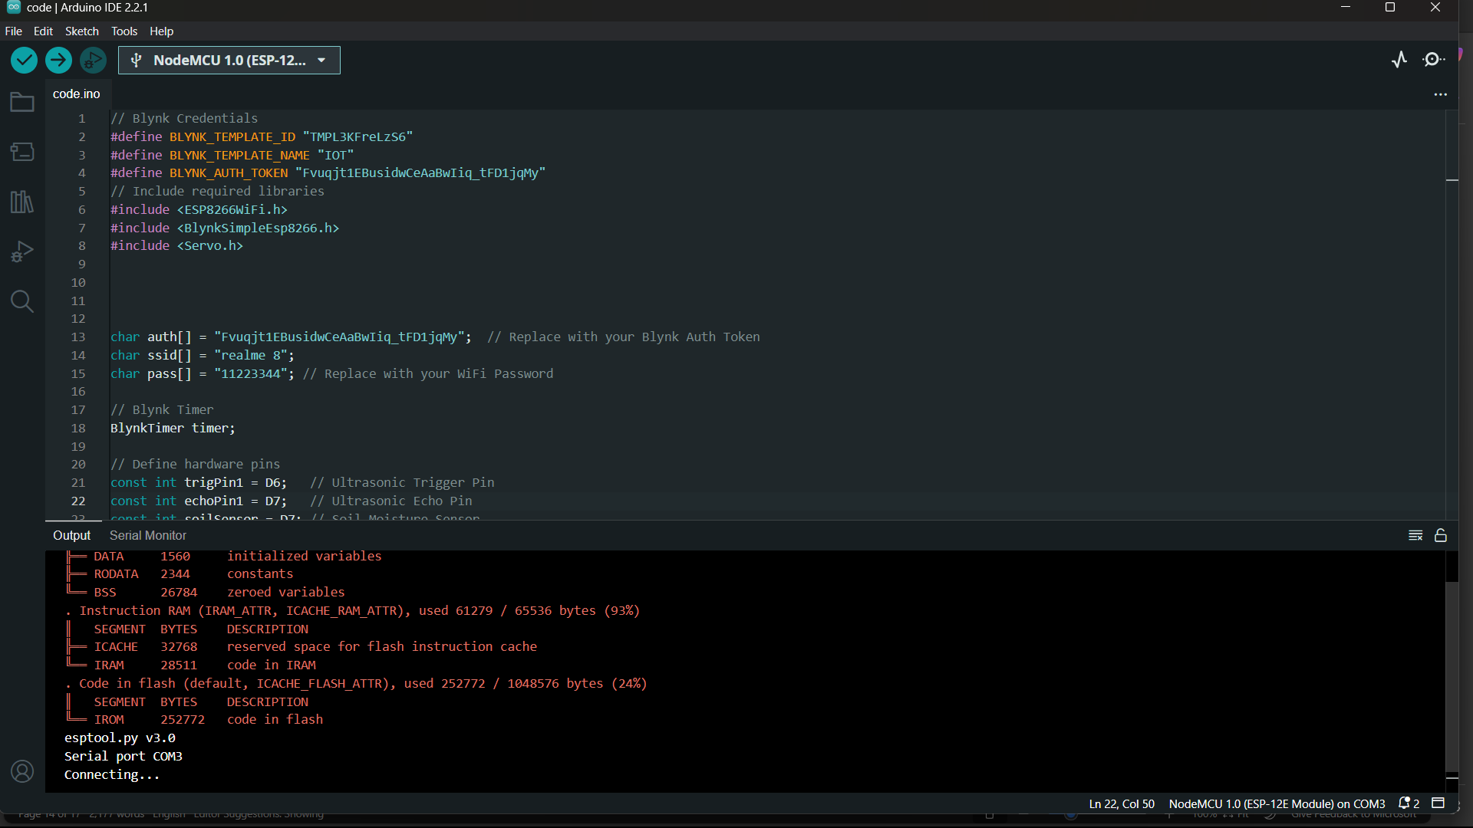
Implementation on Blynk

Slide 9
Implementation on Blynk App
The Blynk app is used to monitor water levels in real-time and control the smart bridge remotely.
A new project is created in the Blynk app, and the authentication token is generated, which is later added to the NodeMCU code.
The NodeMCU ESP8266 connects to Wi-Fi and sends water level data from the water level sensor and ultrasonic sensor to the Blynk cloud server.
Virtual pins (V1, V2, etc.) are used to send sensor values to the Blynk dashboard, where widgets display the readings.
A gauge widget is added to display the real-time water level data received from the water level sensor on virtual pin V1.
A value display widget is used to show the ultrasonic sensor readings on V2, which provides additional accuracy in flood detection.
Once the water level returns to normal, the bridge is automatically lowered, and the Blynk app updates the readings accordingly.

Slide 10
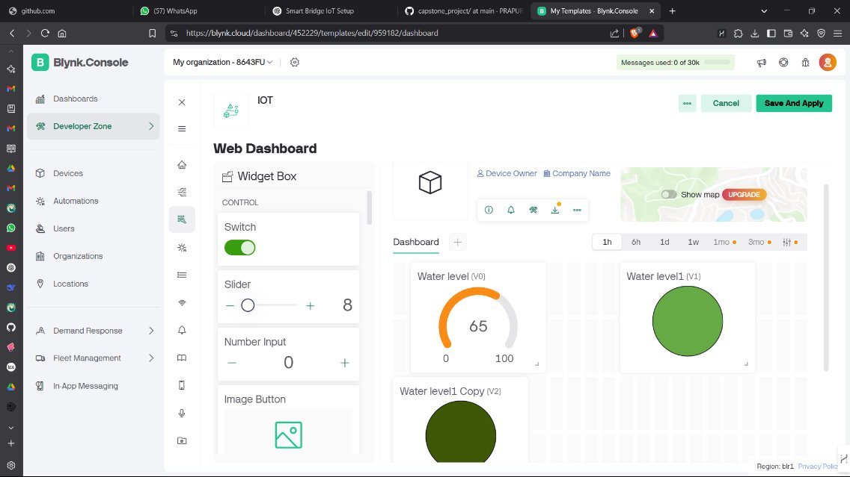
Implementation on Blynk

Slide 11
Conclusion & Future Work
Summary and Conclusion
The smart bridge system successfully detects rising water levels using a water level sensor and ultrasonic sensor, ensuring timely action during flood conditions.
The NodeMCU ESP8266 processes sensor data and efficiently controls servo motors, allowing the bridge to lift automatically when water levels exceed a predefined threshold.
The integration of the Blynk app provides real-time monitoring and remote alerts, ensuring users stay informed about potential flooding risks.
The automated bridge mechanism enhances safety by preventing vehicle movement in hazardous conditions and restoring normal traffic flow once the water recedes.
This project demonstrates the effectiveness of IoT-based automation in real-world applications, offering a cost-effective and reliable solution for flood-prone areas.
Future Work
The next step for this project is to write a conference paper that documents the design, implementation, and performance analysis of the smart bridge system.
The paper will follow the IEEE conference format, including sections such as Abstract, Introduction, Methodology, Experimental Results, Conclusion, and References to ensure clarity and proper structuring.

Slide 12
Contribution
Team Progress and Movement
Initial Progress: Researched existing flood monitoring systems and identified key components required for the IoT-based smart bridge implementation. Designed the system architecture, finalized hardware selection, and developed the initial circuit connections and block diagram.
Mid-Progress: Integrated NodeMCU ESP8266, water level sensor, ultrasonic sensor, and servo motors, and tested their functionality. Developed and debugged the Arduino code, ensuring smooth sensor data processing, decision-making, and bridge automation.
Final Progress: Optimized the system’s performance, validated results through real-world simulations, and refined the response time. Prepared documentation for the conference paper, highlighting implementation details, experimental results, and future enhancements.
Individual Contribution:
K Balaji:
Worked on the hardware integration, ensuring proper connections between NodeMCU, sensors, and servo motors for smooth operation.
Assisted in troubleshooting power management issues, optimizing voltage regulation, and stabilizing the servo motor performance.
J Yugandhar Reddy:
Developed and debugged the Arduino code, handling sensor data processing, decision-making algorithms, and IoT communication.
Integrated the Blynk IoT platform, configured real-time monitoring features, and ensured seamless data transmission to the cloud.
T Praveen Kumar:
Conducted testing and validation, analyzing the system’s response to varying water levels and optimizing the bridge automation mechanism.
Worked on documentation and report preparation, compiling experimental results and contributing to the conference paper writing.

Slide 13
THANK YOU
Have a Great Day !

