Slide 1
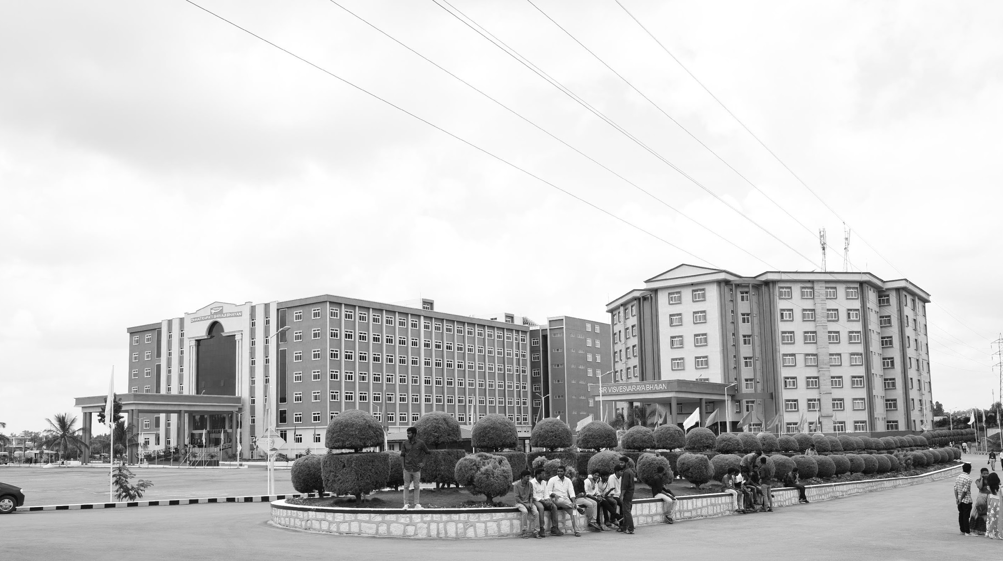

Smart Bridge using IOT
Mid-Review 1
Major Project
Project ID: Alpha 22
AY 2021-25
GITAM (Deemed-to-be) University
Project Team:
J Yugandhar Reddy - BU21EECE0100418
T Praveen - BU21EECE0100451
K Balaji - BU21EECE0100453
Department of Electrical Electronics and Communication Engineering
Project Mentor:
Dr. Ajith Kumar
Project In-charge:
Dr. Ambar Bajpai
www.gitam.edu

Slide 2
Objective and Goals
Objective
Implement IoT-based sensors to monitor water levels and soil moisture in real time.
Automate bridge movement using servo motors based on environmental conditions.
Integrate the Blynk app for remote monitoring, control, and real-time alerts.
Optimize system reliability with accurate sensor calibration and seamless communication.
Goals
Establish seamless integration with the Blynk app to enable remote monitoring and control of the smart bridge's operations through a user-friendly mobile interface.
Incorporate a water level sensor to monitor and respond to potential flooding scenarios, ensuring real-time data acquisition and improved safety.
Improve automation and system responsiveness by expanding the existing prototype's capabilities based on feedback from multiple review phases.

Slide 3
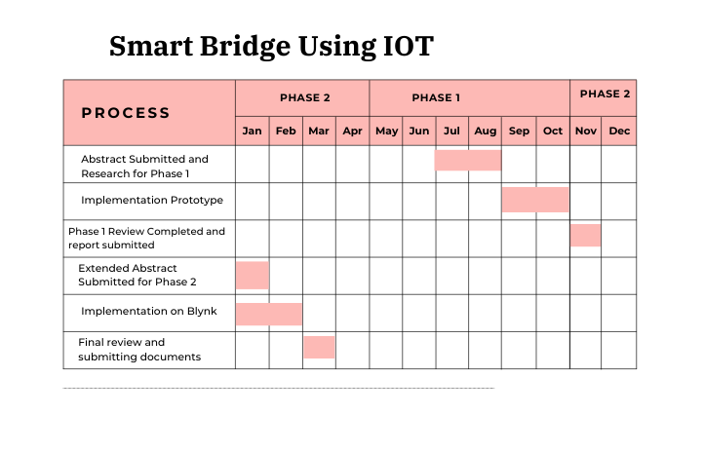
Project Plan
Gant Chart - Milestones and Activities

Slide 4
Literature Survey (Improved post minor project)
Key Publications
The 7th International Conference on Computational Intelligence and Digital Technology (ICCIDT-2K25) to be held during 16th and 17th May 2025.
The 11th IEEE CONECCT, a premier international conference on Electronics, Computing, and Communication Technologies, will be held from July 10-13, 2025, at Sterlings Mac Hotel, Bangalore, India.
Key Resources – Literature Survey
Title | Author and Date | Methodology
Development of an IoT-based Bridge Safety Monitoring System | Jin-Lian Lee , Yaw-Yauan Tyan , Ming-Hui Wen1 , Yun-Wu Wu- 17 May 2017 | The system consists of monitoring devices installed on the bridge, which collect data on water levels, pressure, pipeline conditions, and gas levels. This data is transmitted to a cloud-based server through wireless communication for real-time analysis. The system is powered by photovoltaic units with a sun-tracking mechanism, providing supplementary energy.
IoT Based Bridge Automation with Hybrid Power Supply | Suchismita Dutta, Kingsuk Majumdar, Dola Sinha - 12 November 2022 | The bridge uses solar PV arrays and a MAGLEV windmill as a hybrid power supply, ensuring energy efficiency and automation. The control system is managed via an Android app, with an Arduino UNO, relay module, and Bluetooth, enabling wireless operation. LEDs provide smart illumination controlled by daylight intensity, and the bridge's movements are monitored in real-time using sensors.

Slide 5
Components Used
NodeMCU ESP8266
Water Level Sensor
Ultrasonic Sensor
Two Servo Motors
Blynk App
Connecting Wires and Prototype Materials

Slide 6
Working Principle
The smart bridge system operates based on sensor readings and automated controls to ensure smooth and safe operation. The water level sensor plays a crucial role in detecting any rising water levels.
If the water level crosses a predefined threshold, it sends signals to the NodeMCU, which processes the data to determine whether the bridge needs to be opened or remain closed.
Meanwhile, the ultrasonic sensor continuously measures the distance of approaching vehicles near the bridge. When a vehicle is detected within a certain range, the system evaluates whether the bridge is safe to pass or should be lifted for safety reasons.
The NodeMCU acts as the central processing unit of the system, gathering data from both the water level sensor and the ultrasonic sensor. Based on predefined conditions, it triggers the servo motors to either open or close the bridge, ensuring that water levels and vehicular movement are taken
The integration with the Blynk app further enhances the system's functionality, allowing real-time monitoring and remote control. Users can access water level information and bridge status through the app, enabling informed decision-making and enhanced safety measures.

Slide 7
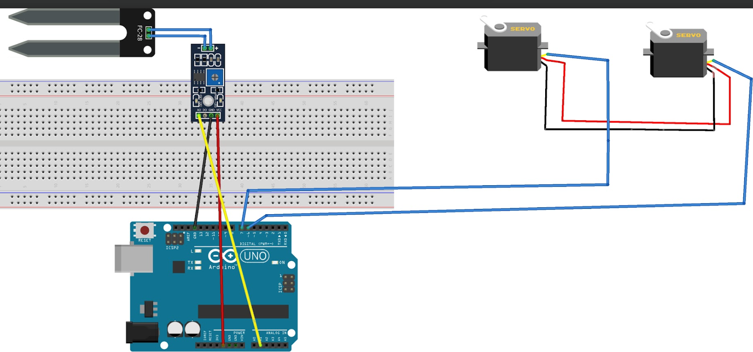
Hardware Architecture
Here is the hardware connection diagram for your Smart Bridge IoT system.

Slide 8
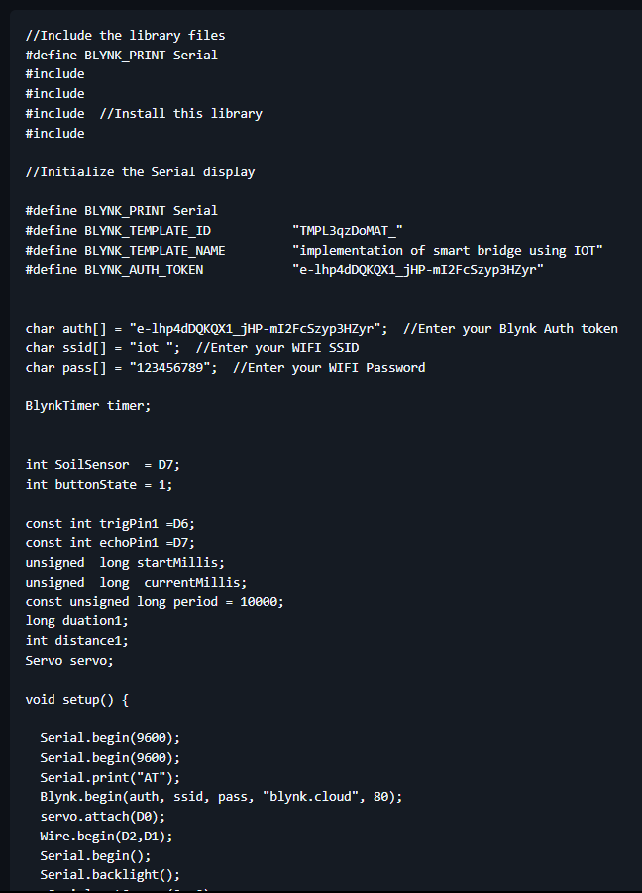
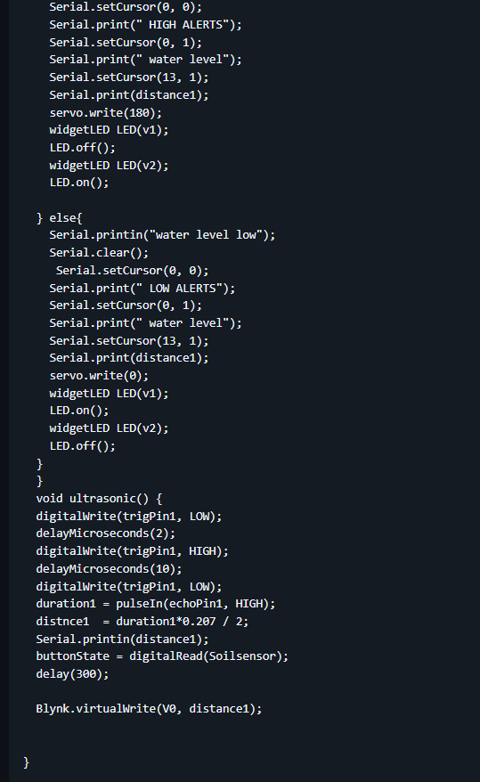
Code Implementation

Slide 9
Implementation on Blynk App
Blynk is a comprehensive software suite that enables the prototyping, deployment, and remote management of connected electronic devices at any scale.
Blynk Console is a feature-rich web application catering to different types of users. Its key functionalities include:
1) Configuration of connected devices on the platform, including application settings.
2) Device, data, user, organization, and location management.
3) Remote monitoring and control of devices.

Slide 10
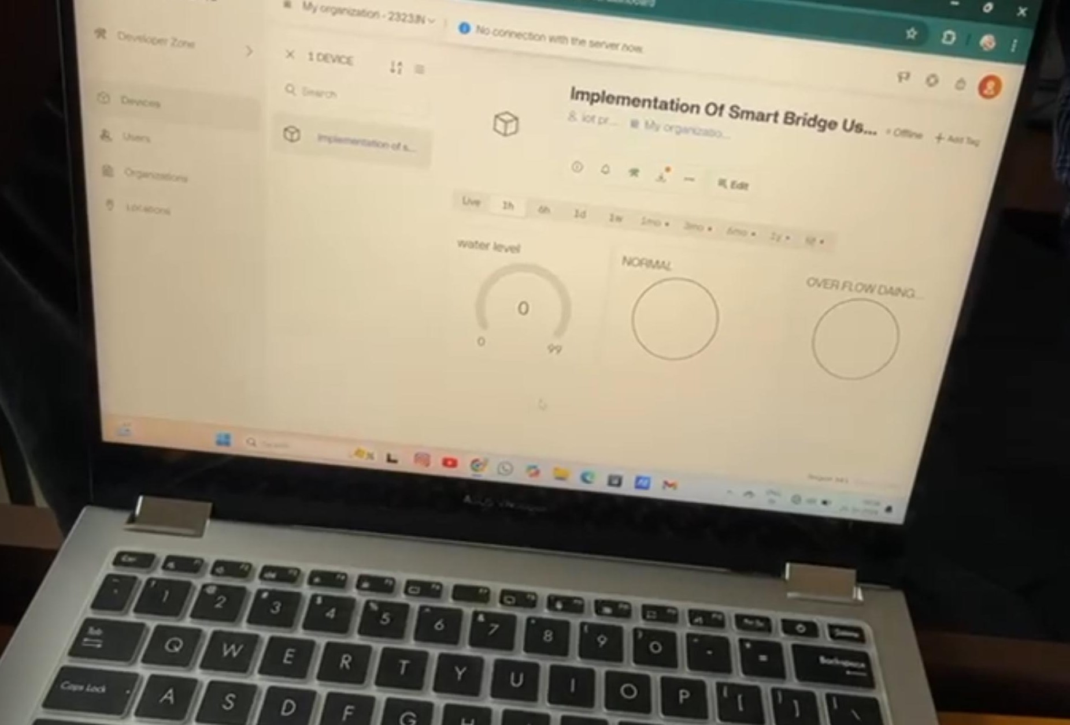
Implementation on Blynk

Slide 11
Conclusion & Future Work
Summary and Conclusion
The smart bridge system successfully integrates IoT technology to enhance safety and automation by monitoring water levels and vehicle movement, reducing manual intervention.
The use of NodeMCU and the Blynk app ensures real-time data visualization, making it a reliable and user-friendly solution for smart infrastructure.
Future enhancements could include AI-based predictive analytics, solar-powered operation, and integration with smart city networks for improved efficiency and sustainability.
Future Work
Fine-tune the water level sensor for accurate flood detection, and conduct extensive testing to ensure reliable data acquisition and real-time automated responses, such as raising the bridge during high water levels.
Test the complete system under simulated environmental conditions to validate performance, followed by final integration of all components (hardware and software) and thorough documentation.
Establish seamless connectivity between the Arduino and the Blynk app, while designing and testing a user-friendly dashboard for remote monitoring and control of the smart bridge's functions.

Slide 12
THANK YOU
Have a Great Day !

