Slide 1

Course Project
Cloud Computing based Supply Chain Managemnet in Agriculture using Blockchain
Team: 07
Pradeep Chegur | 01FE19BCS294
Praveen Thakkannavar | 01FE19BCS298
Swagat Ingalagaon | 01FE19BCS299
Naveen Doddamani | 01FE19BCS305
Naman Matoliya | 01FE19BCS183
Under the Guidance of : Mr. Somashekar Patil
2021-2022, Even Semester
SoCSE, KLE Technological University, Hubballi

Slide 2

Outline
Introduction
Challenges identified
Problem statement
Objectives
Key performance indicators
System diagram
Service Model

Slide 3
Introduction
Nowadays Food safety problems are raising considerably.
Food processing is done using Supply Chain Management(SCM) technology.
SCM does not assures quality of food products.
For the assurance of quality of food there is a need of new technology to be implemented in the traditional SCM.
There is also a need of storage facility to store record of land, agricultural products and details of farmers to fetch production history and result.
The technology that can be used is “Cloud Computing based Blockchain technology”.

Slide 4
Challenges Identified
Illegal production of food.
Lack of trust and credibility.
Unable to handle large amount of data.
Lack of assurance in the quality of food products.
Maintaining manual records are vulnerable to inaccurate updating.
SCM is a centralised system.
Not enough sales and distribution information.
Deficient production information.

Slide 5
Problem statement
“To develop a system which tracks a farm product from former to consumer and to store immutable transactions in cloud database using Blockchain”

Slide 6
Objectives
To create a cloud based blockchain platform where the farmers and consumers could implement a co-operative farming method.
To list the potential crops and the expected yield on the cloud based distributed public ledger by famer.
To create a transparent and tamper-proof digital market platform for farm products.
To increase the efficiency of current supply chain using block chain and cloud technology.

Slide 7
Key Performance Indicators
Application response time (time)
Available products (%).
User Experience
Cost/Time Savings
Time to remediate security violations (time)
Service availability (%)

Slide 8
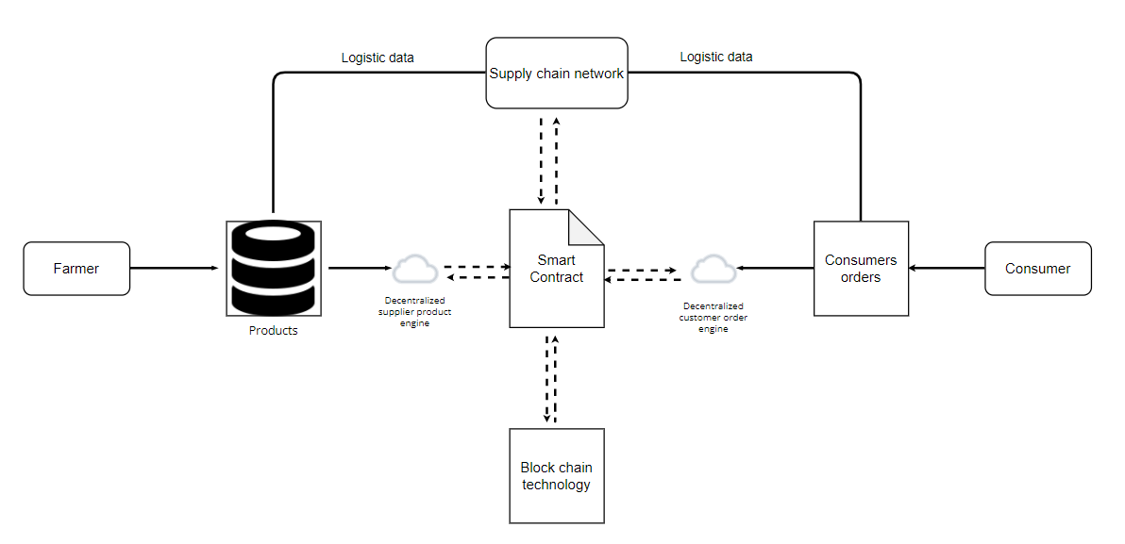
System Diagram

Slide 9
Service Model
SaaS(Software as a Service):
Advantages
Supply chain management
Prominent use of data driven decision making
Climate-smart agriculture
Prevention of wastage of resources
Food security

Slide 10
Thank You

