Slide 1
DMA Course project
G2Net Gravitational Wave Detection
Team members :
Pradeep Chegur – 01fe19bcs294
Praveen Thakkannavar – 01fe19bcs298
Swagat Ingalagaon – 01fe19bcs299
Naveen Doddamani – 01fe19bcs305

Slide 2
Introduction :
A gravitational wave is an invisible (yet incredibly fast) ripple in space. Gravitational waves travel at the speed of light.
Some examples of events that could cause a gravitational wave are:
when a star explodes asymmetrically (called a supernova).
when two big stars orbit collide with each other.
when two black holes merge.
G2Net is a network of Gravitational Wave, Geophysics and Machine Learning. G2Net aims to create a broad network of scientists in space.
G2Net is provided by European Cooperation in Science and Technology which is a funding agency for research and innovation.

Slide 3
Problem Statement :
Detecting of Gravitational Waves from binary black holes collisions.
Objective :
Detecting and analyzing the information carried by gravitational waves, allowing us to observe the Universe in a way never before possible, providing astronomers and other scientists with their first glimpses of literally un-seeable wonders.
Challenge Deadline:
September 29, 2021.

Slide 4
Understanding of DATA :
The size of our dataset is 72.06 GB.
It includes 786k files and 4 columns.
Sample submission consists of id and target columns.

Slide 5
References :
https://www.kaggle.com/c/g2net-gravitational-wave-detection/overview – Challenge link.
https://www.frontiersin.org/articles/10.3389/fspas.2020.00028/full - Information about Binary black hole.
https://spaceplace.nasa.gov/gravitational-waves/en/#:~:text=How%20are%20gravitational%20waves%20detected,it%20squeezes%20and%20stretches%20space.&text=A%20passing%20gravitational%20wave%20causes,to%20detect%20these%20tiny%20changes – Information about gravitational wave.

Slide 6



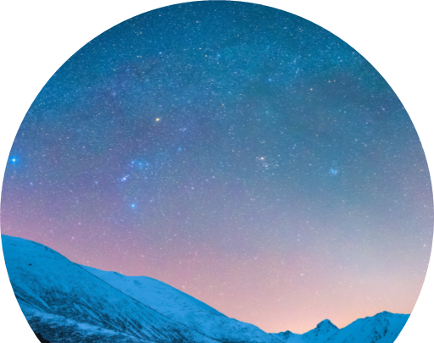
Thank you

