Slide 1
DMA Course project
G2Net: Gravitational Wave Detection
Team Members :
Pradeep Chegur – 01fe19bcs294
Praveen Thakkannavar – 01fe19bcs298
Swagat Ingalagaon – 01fe19bcs299
Naveen Doddamani – 01fe19bcs305

Slide 2
Problem Statement:
Detecting of Gravitational Waves from binary black holes collisions.
Challenge Deadline:
September 30, 2021.

Slide 3
Understanding of Dataset:
Train DATA:
Test DATA:
Number of rows : 560000
Number of Columns : 2
Attributes : ID, Target.
Number of rows : 226000
Number of Columns : 2
Attributes : ID, Target.
Attributes | Description
ID | Unique value for every wave
Target | The value for detecting when Gravitational Wave signal is present in data

Slide 4
Pre-processing of Data:
Training set of time series data contains simulated gravitational wave measurements from a network of 3 gravitational wave interferometers (LIGO Hanford, LIGO Livingston, and Virgo).
Each time series contains either detector noise or detector noise plus a simulated gravitational wave signal.
There is a Python package called GWPY that has all functions that are needed for data pre-processing.
Data cleaning here is about cleaning of digital signals - applying standard steps specific to “Digital Signal Processing” to avoid noise.
The 3 steps are:
Applying a window function (Tukey - tapered cosine window) to suppress spectral leakage
Whitening the spectrum
Bandpass

Slide 5
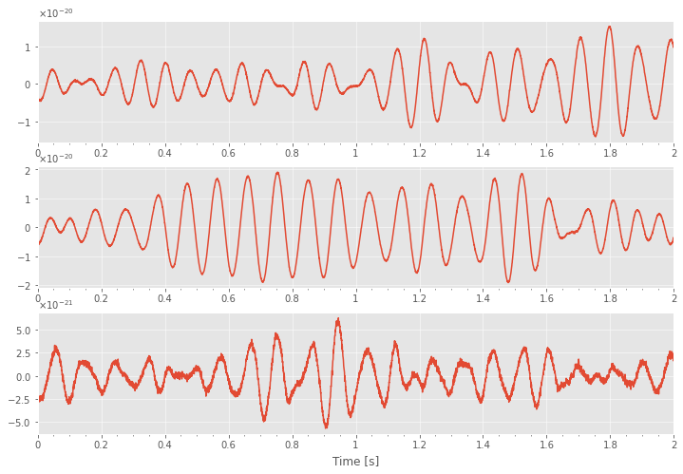
Before Pre-processing of a Single Data:
Selecting 000a5b6e5c.npy signal.
As signal is largely expandable across the ends, there is a need of window function to suppress spectral damage.

Slide 6
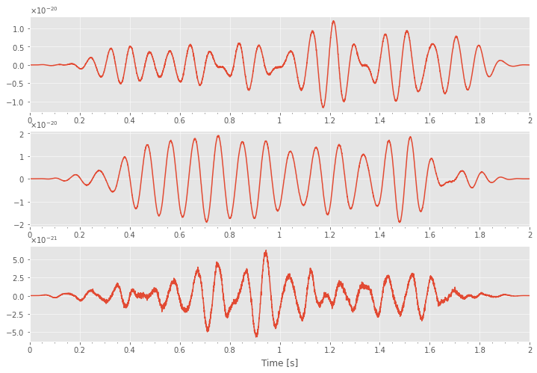
Applying Pre-processing steps:
APPLYING A WINDOW FUNCTION: window = signal.tukey(4096);
Successfully suppressed spectral leakage.

Slide 7
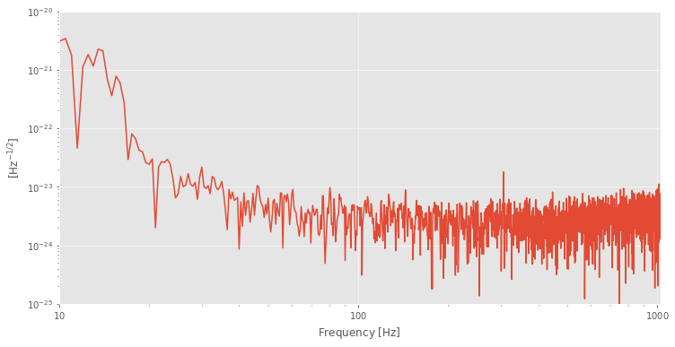
Before Applying further steps:
Signal Spectrum before applying Whitening and Bandpass.
From above spectrum we can conclude that there is a lot of low frequency noise. Hence moving on to next steps.

Slide 8
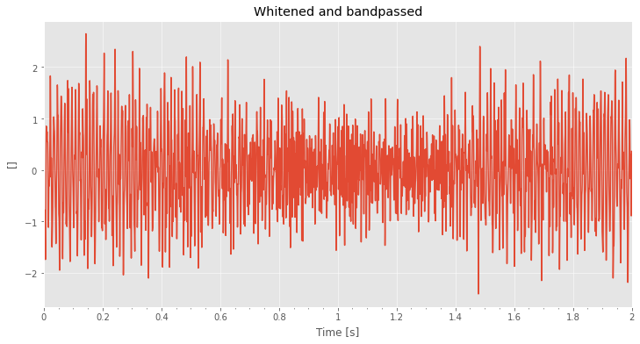
Applying Pre-processing steps:
Applying Whitening and Bandpass.
Above spectrum indicates that it is in steady state.

Slide 9
References :
https://www.kaggle.com/c/g2net-gravitational-wave-detection/overview – Challenge Link.
https://www.frontiersin.org/articles/10.3389/fspas.2020.00028/full – Information about Binary black hole.
https://spaceplace.nasa.gov/gravitational-waves/en/#:~:text=How%20are%20gravitational%20waves%20detected,it%20squeezes%20and%20stretches%20space.&text=A%20passing%20gravitational%20wave%20causes,to%20detect%20these%20tiny%20changes – Information about Gravitational Wave.
https://iopscience.iop.org/article/10.1088/1361-6382/ab685e – A guide to LIGO–Virgo detector noise and extraction of transient gravitational-wave signals.
https://gwpy.github.io/docs/latest/index.html – Basics of GWPY.
https://youtu.be/UeI4-kyuAwI – Reference video for the project.

Slide 10




Thank you

