Slide 1
DMA Course project
G2Net: Gravitational Wave Detection
Team Members :
Pradeep Chegur – 01fe19bcs294
Praveen Thakkannavar – 01fe19bcs298
Swagat Ingalagaon – 01fe19bcs299
Naveen Doddamani – 01fe19bcs305

Slide 2
Problem Statement:
Detecting of Gravitational Waves from binary black holes collisions.
Challenge:
To build a model that analyze and detect Gravitational Wave time-series data from a network of Earth-based detectors.
Challenge Deadline:
September 30, 2021.

Slide 3
Understanding of Dataset:
Train DATA:
Test DATA:
Number of rows : 560000
Number of Columns : 2
Attributes : ID, Target.
Number of rows : 226000
Number of Columns : 2
Attributes : ID, Target.
Attributes | Description
ID | Unique value for every wave
Target | The value for detecting when Gravitational Wave signal is present in data

Slide 4
Pre-processing of Data:
Training set of time series data contains simulated gravitational wave measurements from a network of 3 gravitational wave interferometers (LIGO Hanford, LIGO Livingston, and Virgo).
Each time series contains either detector noise or detector noise plus a simulated gravitational wave signal.
There is a Python package called GWPY that has all functions that are needed for data pre-processing.
Data cleaning here is about cleaning of digital signals - applying standard steps specific to “Digital Signal Processing” to avoid noise.
The 3 steps of data pre-processing are:
Applying a window function (Tukey window) to suppress spectral leakage.
Whitening the spectrum.
Bandpass.

Slide 5
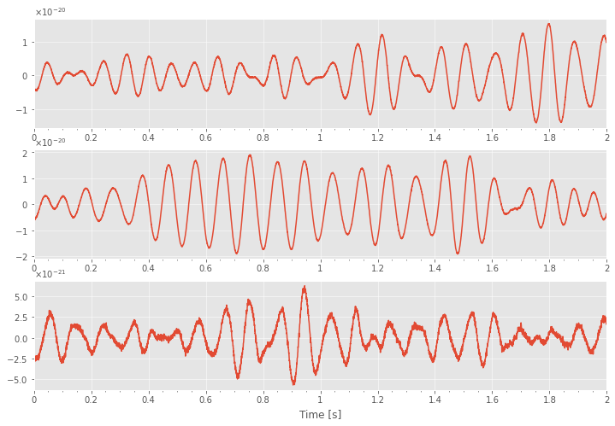
Before Pre-processing of a Single Data:
Selecting 000a5b6e5c.npy signal.
As signal is largely expandable across the ends, there is a need of window function to suppress spectral damage.

Slide 6
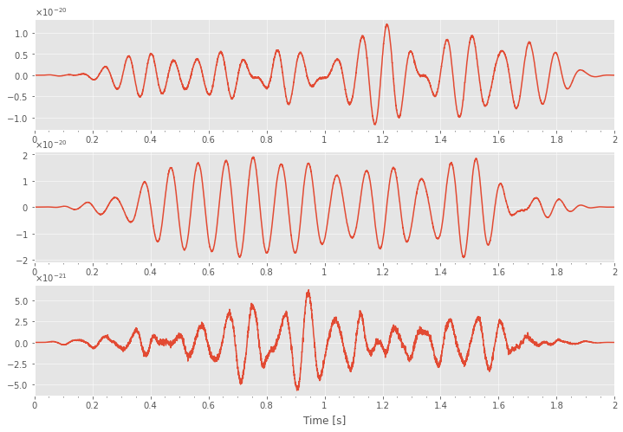
Applying Pre-processing steps:
APPLYING A WINDOW FUNCTION: window = signal.tukey(4096);
Successfully suppressed spectral leakage.

Slide 7
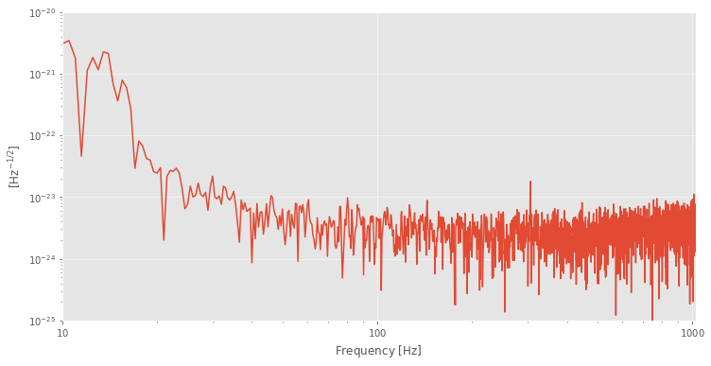
Before Applying further steps:
Signal Spectrum before applying Whitening and Bandpass.
From above spectrum we can conclude that there is a lot of low frequency noise. Hence moving on to next steps.

Slide 8
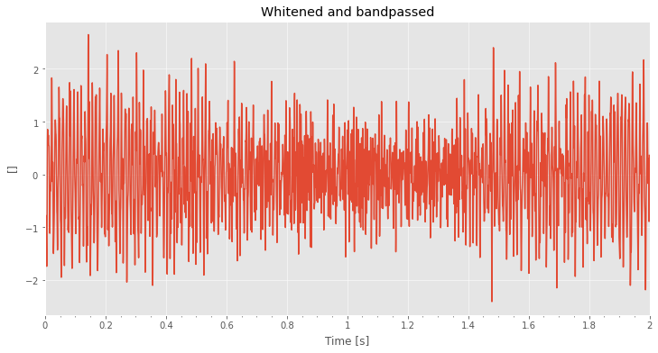
Applying Pre-processing steps:
Applying Whitening and Bandpass.
Above spectrum indicates that it is in steady state.

Slide 9
Model Building :
Keras Model:
Keras is a powerful and easy-to-use free open source Python library for developing and evaluating deep learning models.
Keras can be used to build a neural network to solve a classification problem.
There are two ways to build Keras models:
Sequential API
Functional API
Sequential API allows to create models layer-by-layer for large data.
Sequential API is easy to create multiple layers.
In Sequential API, each layer has exactly one input and one output.
Functional API is for multiple inputs and multiple outputs.

Slide 10
Data Generator Class for Keras Sequential Model building:
Data Generator class is to handle large data with batching, so the RAM does not need to handle the full data at once.
Arguments passed to the class are:
1.Path
2.ID
3.Data
4.Batch Size
Functions used are:
1. Length : Returns the number of steps in an epoch.
2. Getitem : To obtain a given batch of data.
3. Data Generation : To produce batches of data.

Slide 11
From data generator class we created
Train generator
Validation generator
Test generator
By test generator we created sample submission.
Our Sample Submission is consists of
Id
Target

Slide 12
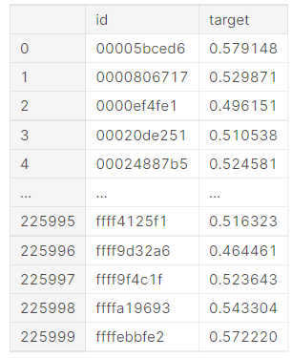
We got Sample Submission like this:
Validation Accuracy : 0.4983
Score : 0.4966
Rank : 1165

Slide 13
References :
https://www.kaggle.com/c/g2net-gravitational-wave-detection/overview – Challenge Link.
https://www.frontiersin.org/articles/10.3389/fspas.2020.00028/full – Information about Binary black hole.
https://spaceplace.nasa.gov/gravitational-waves/en/#:~:text=How%20are%20gravitational%20waves%20detected,it%20squeezes%20and%20stretches%20space.&text=A%20passing%20gravitational%20wave%20causes,to%20detect%20these%20tiny%20changes – Information about Gravitational Wave.
https://iopscience.iop.org/article/10.1088/1361-6382/ab685e – A guide to LIGO–Virgo detector noise and extraction of transient gravitational-wave signals.
https://gwpy.github.io/docs/latest/index.html – Basics of GWPY.
https://youtu.be/UeI4-kyuAwI – Reference video for the project.

Slide 14




Thank you

