Slide 1
Database Management Systems
By
Nadeeshani Aththanagoda

Slide 2
Outline Syllabus
Basic concepts
Database Architectures
Database design
Relational Database systems
Database Normalization
Physical Database implementation-(Mysql Practical)

Slide 3
Assessment & Weighting
In class assignments 20%
Mysql Practical Assignment 20%
Group Project-20%
End of semester examination Structured examination paper 40%

Slide 4
Lecture 01

Slide 5
Sub Topics
Data , Information & Processing
Types of Databases
Problems of File base data processing
History of Database Systems
Database models
Common Uses of Databases
Components of DBMS Environment

Slide 6
Data , Information & Processing

Slide 7
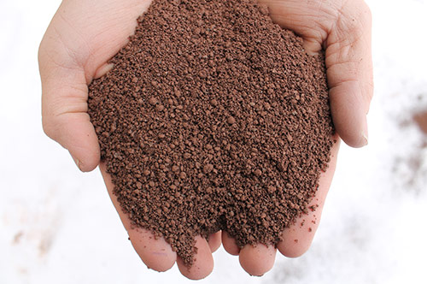

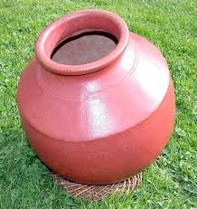
Data ,information & processing
Processing
Today:- 2013/05/06
DOB :-1990/05/06
23-0-0
Data processed
DOB:-1990/05/06
AGE:23
c
Data
Information
Raw material
processing
Final product

Slide 8
Data ,information & processing
User Query
DBMS
(processing)
Store the data with well organized form
Retrieve the data by user query
Information distribution
Data Collection
Database

Slide 9

Data vs. Information
0
Data
raw facts
no context
Useless
Before processed
No value-added
just numbers and text etc .. without meaning
Information
Final result
with context
Useable
processed data
value-added to data
Summarized, organized, Analyzed
just numbers and text etc .. with meaning

Slide 10
What is Data?
Data is a stream of raw facts representing things or events that have happened.
In ICT, we usually say that data is made up from four basic types:
Numbers
Text
Images
Sound

Slide 11
Storing Data?
Inside the computer, however, all data is stored as numbers(binary):
Numbers…
Text…
Images…
Sounds…

Slide 12
What is Information?
Information is data that has been processed to make it meaningful and useful
Data + Meaning = Information

Slide 13
Why DBMS?
Suppose we need to develop a Information system.
How do we
store the data? (use file structures…)
query the data? (write programs…)
Update data safely? (write more programs…)
provide different views on the same data?
(staff & students different)
deal with crashes?
DBMS helps to above activities.

Slide 14
Types of Databases
Manual file Processing (paper based)
Time Consuming
Does not support large volumes of data
File based Processing
Database Management system
Notes:
Emphasize the idea that a computer file system stores data in independent, unrelated files on disk. The sharing, security and integrity of the data can't be enforced efficiently because of data dependence and data redundancy problems.

Slide 15
File Based Processing
ID 001
Name mery
Address colombo
TelNo 747374
Marks 34
Data Entry | File Processing
Student System Files
ID 001
Name mery
Address colombo
TelNo 747374
Books-bor 6
Data Entry | File Processing
Data Duplication
Library System Files
Notes:
Same data in two different place

Slide 16
File Based Processing
ID 001
Name mery
Address colombo
TelNo 747374
Marks 34
Change request
Data Entry | File Processing
Student System Files
ID 001
Name mery
Address colombo
TelNo 747374
Books-bor 6
Data Entry | File Processing
Library System Files
Notes:
This diagram shows two departments sales and leases with each department having their own set of files and programs written for them. The really important point about this is that the physical structure and storage of the data files are defined in the program code.
E.g. COBOL - data is defined in the data section of the program

Slide 17
File Based Processing
ID 001
Name mery
Address Kandy
TelNo 747374
Marks 34
Address Change request
Data Entry | File Processing
Student System Files
ID 001
Name mery
Address colombo
TelNo 747374
Books-bor 6
Data Entry | File Processing
Inconsistent Data
Library System Files
Notes:
This diagram shows two departments sales and leases with each department having their own set of files and programs written for them. The really important point about this is that the physical structure and storage of the data files are defined in the program code.
E.g. COBOL - data is defined in the data section of the program

Slide 18
Problem in file based system
Inconsistent data
Data duplication
Security
Inflexibility
Limited data sharing
Excessive program maintenance
How do we resolve these problems?

Slide 19
Solution is DBMS
DBMS is solution to rectify file based processing problems

Slide 20
Database Processing
Change Request
stno Name address
001 mery colombo …………….
Data Entry &
Reports
Students
Application
Programs
DBMS
Data Entry &
Reports
Database
Library
App. Programs
Notes:
This diagram simply illustrates database processing. Each department still has its own application programs, but the storage of data is now handled by the DBMS.

Slide 21
Database Processing
Change Request
stno Name address
001 mery Kandy …………….
Data Entry &
Reports
Students
Application
Programs
DBMS
Data Entry &
Reports
Database
Library
App. Programs
Notes:
This diagram simply illustrates database processing. Each department still has its own application programs, but the storage of data is now handled by the DBMS.

Slide 22
DATABASE
DEFINITION
A shared collection of logically related data designed to meet the information requirements of an organisation.

Slide 23
Database Management System (DBMS)
A software system that enables users to define, create and maintain the database and which provides controlled access to the database.

Slide 24
History of Database Systems
1950s and early 1960s:
Data processing using magnetic tapes for storage
Tapes provide only sequential access
Punched cards for input
Late 1960s and 1970s:
Hard disks allow direct access to data
Network and hierarchical data models in widespread use
Ted Codd defines the relational data model
Would win the ACM Turing Award for this work
IBM Research begins System R prototype
UC Berkeley begins Ingres prototype
High-performance (for the era) transaction processing

Slide 25
History (cont.)
1980s:
Research relational prototypes evolve into commercial systems
SQL becomes industry standard
Parallel and distributed database systems
Object-oriented database systems
1990s:
Large decision support and data-mining applications
Large multi-terabyte data warehouses
Emergence of Web commerce
2000s:
XML and XQuery standards
Automated database administration
Increasing use of highly parallel database systems
Web-scale distributed data storage systems

Slide 26
Database models
Early Types of DBMS
Hierarchical
Network
Current Generation
Relational
Advanced Systems
- Object Based
Notes:
This module will be concentrating on relational databases, because that’s what ORACLE is and because this is the type of database that is mainly used in businesses today. However, there is an earlier generation of DBMS that still exist in a lot of organisations. The main two of these are the hierarchical and the network database model. The systems that rely on these are called navigational systems. Often they are also called legacy systems.

Slide 27

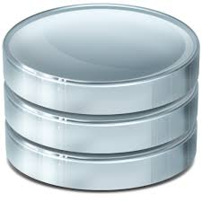
What is a Database System?
Database System = Database + DBMS
A Database is
A large, integrated collection of data
Models (represents) a real-world enterprise.
Entities (e.g., students, courses)
Relationships (e.g., Mary takes CS123)
A Database Management System (DBMS) is
A software package designed to store and
Manages databases easily and efficiently.

Slide 28
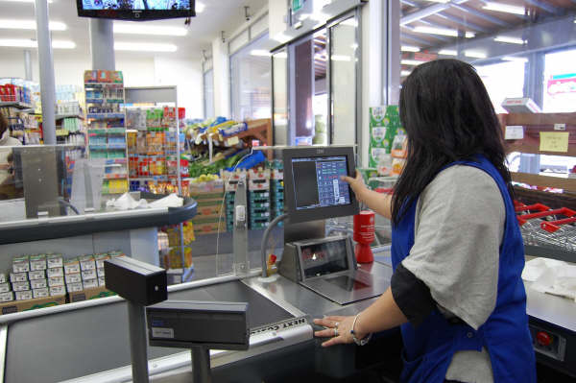
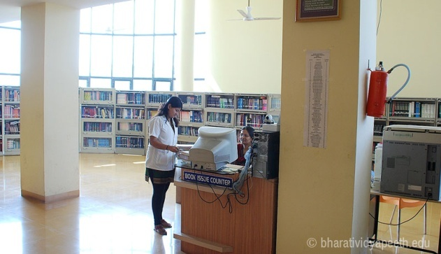
Common Uses of Databases
Try to think why each of these need to use a database:
Supermarkets
Insurance
Credit Cards/Banking
Libraries
Travel Agents
Universities
Notes:
Supermarkets - When you go to do your shopping its usual that a database is accessed. The checkout assistant runs a barcode over your purchases. This is linked to a database which uses the bar code to find out the price of the item from a products database. Then it will reduce the number of items in stock by 1
Insurance - When you buy car insurance, the broker may access several different databases to find the best price for you
Credit cards - Whenever you buy goods using a credit card the assistant may check that you have sufficient credit etc.

Slide 29
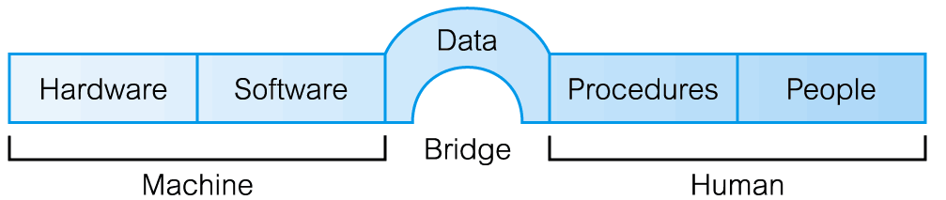
Components of DBMS Environment

Slide 30
Components of DBMS Environment
Hardware
Can range from a PC to a network of computers.
Software
DBMS, operating system, network software (if necessary) and also the application programs.
Data
Used by the organization and a description of this data called the schema.

Slide 31
Components of DBMS Environment
Procedures
Instructions and rules that should be applied to the design and use of the database and DBMS.
People
Data Administrator (DA), Database Administrator (DBA), Database Designers (Logical and Physical), Application Programmers, End Users (naive and sophisticated)

Slide 32
Examples: DBMS
Oracle
MySQL
Microsoft SQL Server
PostgreSQL
MongoDB
Redis
IBM DB2
Elasticsearch
SQLite
Microsoft Access
Common features:
Relational model
SQL as query language
Server-client architecture

Slide 33
Advantages of using a DBMS
Minimal data redundancy
Efficient data access
Data integrity and security
Data administration
Concurrent access, recovery from crashes
Reduced application development time

Slide 34
Disadvantages
Complexity
Additional Hardware costs
Experts – Specialised personnel
Higher impact of failure
Simple applications may not need DBMS at all

Slide 35
When not to use a DBMS
High initial investment in hardware, software, and training.
Generality that a DBMS provides for defining and processing data.
Overhead for providing security, concurrency control, recovery, and integrity functions.

Slide 36
Main Characteristics of the Database Approach
Self-describing nature of a database system
Insulation between programs and data
Data Abstraction
Support of multiple views of the data

Slide 37
Main Characteristics of the Database Approach
Self-describing nature of a database system:
A DBMS catalog stores the description of the database.
called meta-data).
allows the DBMS software to work with different databases.
Database
Raw data
Meta data
Systems Catalog
Notes:
Direct the students' attention to the text's Section 1.4, then discuss how the DBMS functions address each of the file system's problems. Emphasize that a proper database system eliminates data dependence and improves data integrity by minimizing data redundancy. Especially note that the good database design is the key to reaping the rewards of a proper database system. Remind the students that the best programmers and applications developers cannot rescue a database system from the effects of poor database design. (Just as hiring the best bricklayers will not produce a good house from a poor blueprint.)

Slide 38
Main Characteristics of the Database Approach
Insulation between programs and data: Called program-data independence.
Allows changing data storage structures and operations without having to change the DBMS access programs.

Slide 39

Data independence
Application programs are independent of data representation and storage details.
The structure of data files is stored in the DBMS catalog separately from the access programs.
E.g. a file access program may be written in such a way that it can access only STUDENT records of the structure.
First Year
SLIIT-2006
39

Slide 40
Main Characteristics of the Database Approach
Data Abstraction: A data model is used to hide storage details and present the users with a conceptual view of the database.

Slide 41
Quick review
Discuss the capabilities that should be provided by a DBMS.
Discuss the differences between database systems and information retrieval systems.

Slide 42
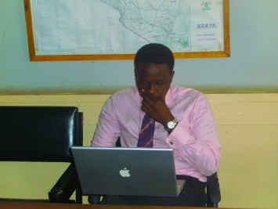

Main Characteristics of the Database Approach
Support of multiple views of the data: Each user may see a different view of the database, which describes only the data of interest to that user.
stno | name | gpa | program | regDate | payment
100 | Mira | 3.8 | BSc. IT | 2005 - JAN | Full
200 | Janet | 2.5 | BSc IS | 2004- JAN | Half
300 | Ravi | 2.7 | M.Sc IT | 2006- JAN | Full
stno | name | gpa
100 | Mira | 3.8
200 | Janet | 2.5
300 | Ravi | 2.7
stno | regDate | pay
100 | 2005 - JAN | Full
200 | 2004- JAN | Half
300 | 2006- JAN | Full
Lecturer view
Administrative staff view

Slide 43
Questions?

