Slide 1
Database Management Systems
Database Schema ,Three-Level Schema Architecture and database Languages

Slide 2
Sub Topics
What is database schema?
Three-level architecture
Database Languages

Slide 3
Database Schema
A database schema is the skeleton structure that represents the logical view of the entire database. It defines how the data is organized and how the relations among them are associated. It formulates all the constraints that are to be applied on the data.
It’s the database designers who design the schema to help programmers understand the database and make it useful.

Slide 4
Three-Level Schema Architecture
Internal schema (one view)
describes physical storage structures
access paths, indexes used
Typically uses a physical data model
Conceptual schema at the conceptual level ( one view)
describes the logical structure and constraints for the whole database for a community of users
Uses a conceptual or an logical data model
External schemas (many view)
Many views describe how users see data
Information about schemas is stored in the system catalog

Slide 5
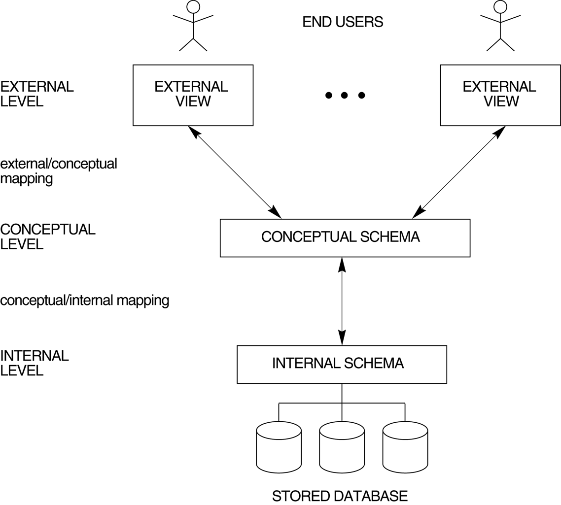
Three-Schema Architecture (Contd.)
Mappings among schema levels are needed to transform requests and data. Programs refer to an external schema, and are mapped by the DBMS to the internal schema for execution ➔ data independence

Slide 6
Three-Schema Architecture (Contd.)
Proposed to support DBMS characteristics of:
Program-data independence.
Support of multiple views of the data.
Mappings among schema levels are needed to transform requests and data. Programs refer to an external schema, and are mapped by the DBMS to the internal schema for execution. - data independence

Slide 7
Conceptual/logical schema
Describes the stored data in terms of the data model of the DBMS
In a relational DBMS, the conceptual schema describes all relations that are stored in the database
First Year
7

Slide 8
Physical/internal schema
Describe storage details.
Summarizes how the relations described in the conceptual schema are actually stored on secondary storage devices such as disks and tapes.
Decide what file organizations used to store the relations.
Create indexes to speed up data retrieval operations.
8

Slide 9
External schemas
Allow data access to be customized (and authorized) at the level of individual users or groups of users.
Any given database has exactly one conceptual schema and one physical schema because it has just one set of stored relations, but it may have several external schemas.
First Year
9

Slide 10
Data Independence
data independence fully support in DBMS,
When a schema at a lower level is changed .
Only the mappings need to be changed between this schema and higher-level schema(s).
The higher-level schemas themselves are unchanged.
The application programs need not be changed since they refer to the external schemas.

Slide 11
Data Independence (Contd.)
Logical Data Independence: The capacity to change the conceptual schema without having to change the external schemas and their application programs.
Physical Data Independence: The capacity to change the internal schema without having to change the conceptual schema.

Slide 12
DBMS Languages
Data Definition Language(DDL)
Data Manipulation language(DML)
Data Control Language(DCL)
Transaction Control Language(TCL) –this is also another type

Slide 13
Data Definition Language (DDL)
A data definition language or data description language (DDL) is a syntax similar to a computer programming language for defining data structures, especially database schemas.
For DBA and database designers
to specify the conceptual schema
also used to define internal and external schemas (views).
In some DBMSs, separate storage definition language (SDL) and view definition language (VDL) are used to define internal and external schemas.

Slide 14
Data Definition Language (DDL)
Used to create and modify database objects
Create
Drop
Alter

Slide 15
Data Manipulation Language (DML):
A data manipulation language (DML) is a family of syntax elements similar to a computer programming language used for inserting, deleting and updating data in a database. Performing read-only queries of data is sometimes also considered a component of DML.
DML commands can be embedded in a general-purpose programming language (host language), such as COBOL, C, Java or an Assembly Language.
Alternatively, stand-alone DML commands can be applied directly (query language).

Slide 16
Data Manipulation Language (DML)
Used to create, modify and retrieve data
Insert
Select
Update
Delete

Slide 17
Data Control Language
A data control language (DCL) is a syntax similar to a computer programming language used to control access to data stored in a database. In particular, it is a component of Structured Query Language (SQL).
Examples of DCL commands include:
GRANT to allow specified users to perform specified tasks.
REVOKE to cancel previously granted or denied permissions.

Slide 18
Transaction Control Language
Transaction Control Language (TCL) - Transaction control commands manage changes made by DML commands. These SQL commands are used for managing changes affecting the data. These commands are COMMIT, ROLLBACK, and SAVEPOINT.

Slide 19
DBMS Languages - SQL
Structured Query Language
SQL - (also pronounced SEQUEL)
Used as DML,DDL and DCL (TCL)
Used in ORACLE and other DB systems
Non-procedural - i.e. Specify what you want not how to get it
Used with RELATIONAL DBMS
Simple to use
Notes:
The standard query language used in relational database systems. The next slide will show some simple example queries.

Slide 20
Example SQL Queries
select branchNo, city
from branch;
select *
from branch
where branchNo = ‘B003’;
select branchNo, name
from branch, staff
where branch.branchNo = staff.branchNo;
Notes:
Here we have three sample queries, using the tables given earlier. The first will show the branchNo and city for each row in the table. The next will show all information for branchNo B003, and the third shows how to relate information from two tables. Get the students to think of the answers, and ask them why the third query has the where clause

Slide 21
Questions?

