Slide 1
Database Management Systems
ER model

Slide 2
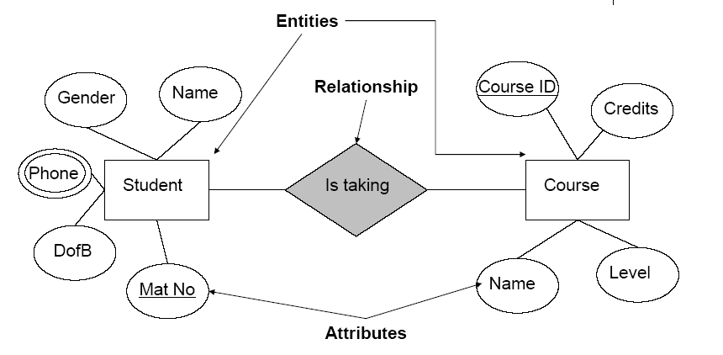
ER Diagrams

Slide 3
Conceptual Design
Model data independent of DBMS, application programs, programming languages, hardware platform etc.
We want to have a common understanding of how data is viewed and used by different people in client’s organization.
Understanding the structure and meaning of data in the domain
Each user’s perspective of the data
Nature of the data itself, independent of its physical representations
Use of data across user views
The output model may well be used for other purposes
Such as offering a paper based data management!!!!
Conceptual design = ER Modelling

Slide 4
ER Modelling
Models a domain of discourse
Central Ideas
Domains are made up of entities
Relationships link associated Entities
Entities and relationships have properties called attributes
Certain attributes are special, call them primary keys and alternate keys
Need integrity constraints to preserve domain consistency
Deliverables
ER Models - documented diagrammatically
Data dictionary
Documentation is an important component of ER modelling

Slide 5
Entity-Relationship (ER) Model
The two main constructs of the Entity-Relationship model are
entities &
relationships.*
* different author use different graphical notation.

Slide 6
NOTATION FOR E-R
ENTITY TYPE
Attribute
WEAK ENTITY TYPE
Key Attribute
RELATIONSHIP TYPE
Multi value attribute
IDENTIFYING RELATIONSHIP TYPE
E₁
R
E₂
composite
E₁
R
N
E₂
(min,max)
Derived attribute
R
E

Slide 7
Entity Type
A group of objects with the same properties, which are identified by the enterprise as having an independent existence
not a formal definition
Different designers may identify different entities
Can have physical existence or conceptual existence
Students , lecturers,
course, subjects
An entity is an object in the real world
A collection of similar entities is called an entity set.
Graphically,
Rectangle
ENTITY

Slide 8
Entity type - Diagrammatic representation
A rectangle labelled with the name of the entity
First letter of entity name is uppercase
E.g., Student
Normally an entity type is named using a ‘noun’ or ‘noun phrase’
Student

Slide 9
Attributes
An entity is described using a set of attributes Oval.
A property of an entity or a relationship type.
Graphically,
For example staff has 4 attributes
StaffNo
Name
Position
Salary
attribute
name
Staff
position
salary

Slide 10
Entity Set
Example: name, id, age & salary are attributes in EMPLOYEE entity
salary
salary
name
e1
e2
e3
e4
e5
e6
…
age
id
age
EMPLOYEE
id
name
Employee Entity set

Slide 11
Composite attributes
Composite attributes can be divided into subparts.
EMPLOYEE
name
surname
middle_name
first_name

Slide 12
Try!
Give an example of composite attribute.
Sub divide it into atomic attributes

Slide 13
domain
The domain of an attribute specifies the set of possible values that the attribute can have.
For example, the domain for age could be values from 0 - 120

Slide 14
multivalued attributes
Attributes containing multiple values are called multivalued attributes.
Double lines
Graphically,
(Direct phone ), extension, mobile no
EMPLOYEE
phone
surname
first_name

Slide 15
Derived attribute
EMPLOYEE
age
name
Derived attribute

Slide 16
An exercise
stuNO
stuName
stuSub
stuDob
stuHrs
stuYr
stuGpa
stuGpa
stuAge
1
Anne Joy
IT, Fine Art
22 Feb 1990
23
2
2.26
24
2
Boon yugan
IT
30 Jun 1990
33
3
2.59
23
3
Chlaiga Puvana
IT, Education
9 Oct 1981
27
1
3.87
33
3
Arts
18 Aug 1995
16
1
0
19
Emldenmeery
4
Gunaratna Silva
Arts, Teaching
25 Nov 1992
35
2
2.83
22
5
loy Perera
IT
30 Jul 1991
28
2
3.67
23

Slide 17
Tick where applicable
Attribute
simple
unique-valued
composite
multivalued
derived
stuNum
stuName
stuMajor
stuDob
stuHrs
stuYr
stuGpa
stuAge

Slide 18
key attribute
A key attribute uniquely identifies an entity in the entity set.
Underlined
salary
name
e1
e2
e3
e4
e5
e6
…
age
id
EmpId
Employee
Employee Entity set

Slide 19
candidate keys- primary key.
There can be multiple key attributes called candidate keys in a single entity.
A single candidate key is designated as the primary key.

Slide 20
E-R Model (contd.)
Name
Graphically,
Primary key is underlined
NID – candidate key
EMPLOYEE
NID
eid

Slide 21
E-R Model (contd.)
Sometimes, a group of attributes make up the key. This is called a composite key.
Always, the minimal set of attributes are considered for the key.
Therefore,
A key is a minimal set of attributes whose values uniquely identify an entity in the set.

Slide 22
Relationship Types
A relationship is an association among two or more entities. diamond
A collection of similar relationships is called a relationship set .
For example, ‘Branch’ and ‘Staff’ can be associated with a relationship ‘Has’.
Relationship occurrence – a uniquely identifiable association, which includes one occurrence from each participating entity type.

Slide 23
Relationship type – diagrammatic representation
Shown as a line connecting the associated entity types, labelled with the name of the relationship.
First letter of each word in the entity name is uppercase.
Normally a relationship is named using a ‘verb’ or ‘verb group’.
The direction in which the relationship makes sense is marked using an ‘arrow’.
Works in
N
1
EMPLOYEE
DEPARTMENT
relationship

Slide 24
Degree of Relationship type
The number of participating entity types in a relationship.
Relationships can be classified based on their degree into
Binary – relationship with two participants
Ternary – relationship with three participants
Quaternary – relationship with four participants
Degree of a relationship is the number of participating entities in the relationship.
A relationship of degree two is called a binary relationship (e.g. Works In).
A relationship with degree three is called ternary.

Slide 25
Diagrammatic representation of relationships with degree > 2
A diamond is used to represent ternary and quaternary relationships
Works in
EMPLOYEE
DEPARTMENT
LOCATION

Slide 26
descriptive attributes
Sometimes, relationships can also have attributes called descriptive attributes that record information about the relationship.
since
N
Works in
1
EMPLOYEE
DEPARTMENT

Slide 27
cardinality ratio
The cardinality ratio for a binary relationship specifies the number of relationship instances that an entity can participate in.
There are three types of cardinality ratios for binary relationships.
one-to-one (1: 1)
one-to-many (1 : N)
many-to-many. (N : M)

Slide 28
one-to-many
For example, an employee works in at most one department.
Graphically,
This is a one-to-many (or many-to-one) relationship
N
Works in
1
EMPLOYEE
DEPARTMENT

Slide 29
Your Turn !!
Give an example of a 1:N relationship

Slide 30
E-R Model (contd.)
One-to-One relationship
Example: An employee manages at most one department. A department can have only one manager managing it.
Manage
1
1
EMPLOYEE
DEPARTMENT

Slide 31
Exercise!!
Give an example of a 1:1 relationship

Slide 32
Many-to-many
Many-to-many relationship
Example: An employee can work on several projects. A project can have many employees working on it.
M
Works on
N
EMPLOYEE
PROJECT

Slide 33
try!!
Give an example of a N:M relationship

Slide 34
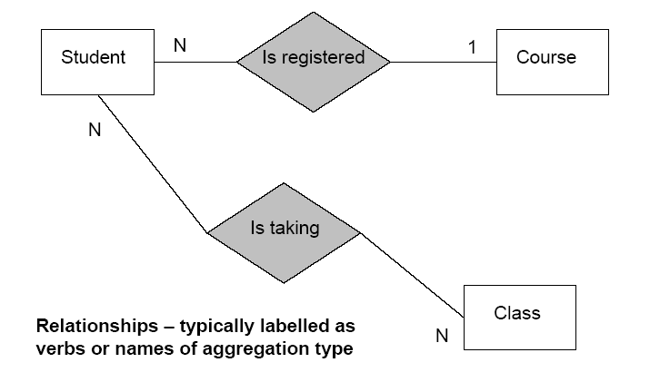
Cardinality

Slide 35
Participating constraint
Participating constraint specifies whether the existence of an entity depends on its being related to another entity via the relationship type.

Slide 36
Total participation
For example, if we specify that an employee must always work for a department.
Then we say that the relationship “works in” is in total participation from employee entity to department entity. (double lines)
Graphically,
Works in
EMPLOYEE
DEPARTMENT
Employee must work in a department
Department may or may not have employees

Slide 37
partial
If the relationship is not in total participation, then it is known as in partial.
For example, from DEPARTMENT to EMPLOYEE
Department may or may not have employees

Slide 38
Participation Constraints
Participation Constraint
Student?

Slide 39
Composite Entity
M:N relationships
Relational model can not handle M:N
composite entity or bridge entity
used to transform M:N relationships into sets of 1:M relationships.
The composite entity's primary key consists of the combination of primary keys from the entities it connects.

Slide 40
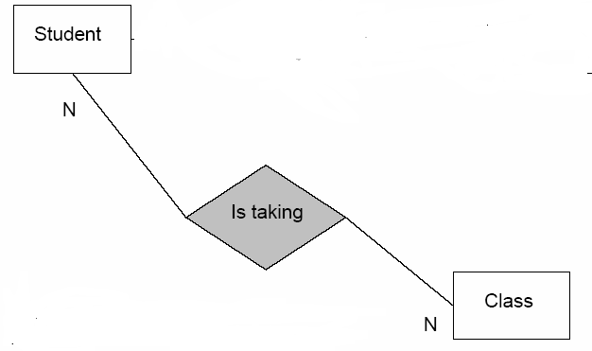
Composite Entity
Class-students
Class
Student
stno
1
N
N
1
classid
Key = student No + Class Id

Slide 41
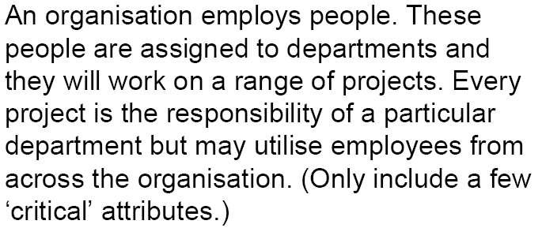
Exercise!

Slide 42
Your Turn !!!
Identify the entities -> nouns
Identify the relationships -> verbs
Determine
Cardinality
Participation (total / partial)

Slide 43
E-R Model (contd.)
Entity types without any key attributes is called weak entity types. Double lined box
A weak entity is uniquely identified by considering some of its attributes with the primary key of another entity called the identifying owner.
The attributes in the weak entity participating in the key are called partial keys.

Slide 44
A weak entity is one that has TWO identifying characteristics:
It is existence-dependent on another entity, i.e., it cannot exist without the entity with which it has a relationship.
It inherits at least part of their primary key from the entity to which it is related.

Slide 45
E-R Model (contd.)
The owner entity and the weak entity participates in an identifying relationship.
The cardinality of the identifying relationship is either one-to-one or one-to-many from owner entity to weak entity.
The weak entity must have total participation in the identifying relationship.

Slide 46
E-R Model (contd.)
Identifying relationship
Weak entity
1
Policy
M
EMPLOYEE
DEPENDENTS
id
name
age
Strong entity
Partial key

Slide 47
Recursive relationships
Entities participating in a relationship need not be distinct. Such relationships are called recursive relationships.
Each entity in the relationship play a role in the relationship. It is recommended to state the role in recursive relationships.

Slide 48
E-R Model (contd.)
Example,
manages
supervisor
subordinate
EMPLOYEE

Slide 49
When does an attribute become an entity?
An attribute has key importance to the organisation/model
When an attribute is multi valued

Slide 50
Exercise
Draw an ER diagram for the following requirements.
A company database needs to store information about employees (identified by NIC, salary, position, phone, office);
departments (identified by dno, with department name and annual budget);
children of employees (with name, and age as attributes).
Employees work in departments; each department is managed by an employee; a child must be identified uniquely by name when the parent (who is an employee; assume that only parent works for the company) is known. We are not interested about a child once the parent leaves the company.

