Slide 1
Satellite Image classification using svm
By
Praveena Silmala
Waseema Begum

Slide 2
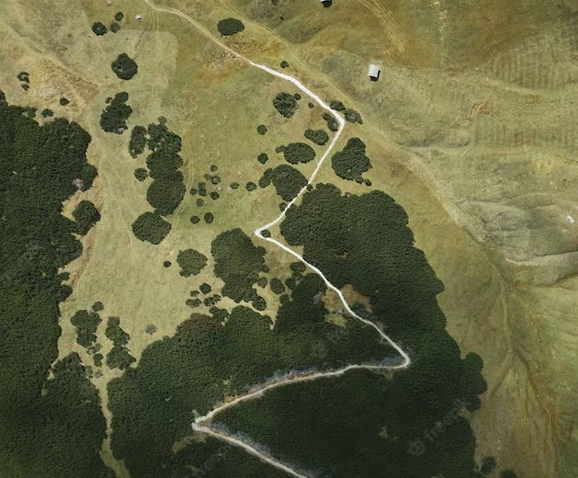
;m;
Introduction
Satellite imagery can be used to create detailed maps of large areas, including terrain, land use, and land cover. This information can be used to improve GPS accuracy by providing more detailed information about the terrain and environment.
The importance of satellite image collection is so significant that it is often seen as a necessary investment for businesses and governments that rely on accurate location and navigation information.
We have used Kaggle dataset
https://www.kaggle.com/datasets/mahmoudreda55/satellite-image-classification

Slide 3

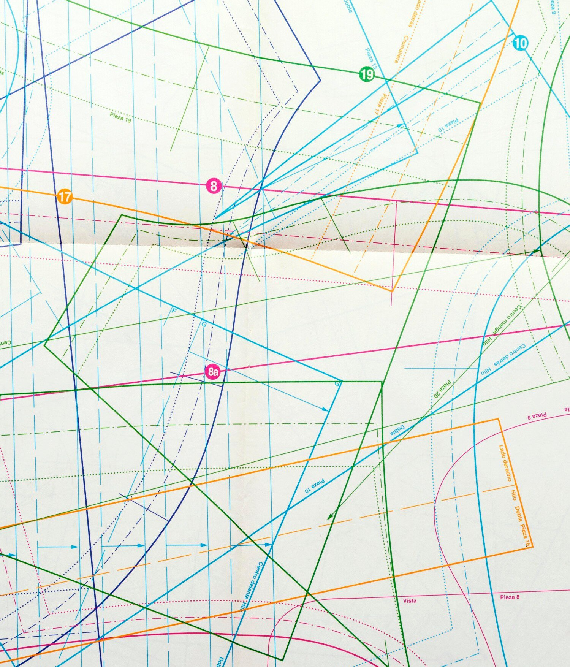
Support Vector Machines
SVMs are machine learning algorithms that can be used for classiﬁcation or regression analysis. They work by creating a boundary between different classes of data points, allowing them to be classiﬁed correctly.
In image classification, each image is represented as a set of features, which could be pixel values or higher-level features extracted from the image. SVM then tries to find the best hyperplane that can separate the different classes based on these features.
SVM‘s performance can be improved by selecting appropriate features and tuning hyperparameters such as the regularization parameter and the kernel function.

Slide 4
methodology
In image classification, each image is represented as a set of features, which could be pixel values or higher-level features extracted from the image. SVM then tries to find the best hyperplane that can separate the different classes based on these features.
During training, the SVM algorithm finds the optimal hyperplane by maximizing the margin between the classes. In cases where the classes are not linearly separable, SVM uses kernel functions to transform the data into a higher-dimensional feature space where the classes can be linearly separated.
Once the SVM model is trained, it can be used to predict the class labels for new images. The new images are transformed into the same feature space used during training and their class labels are predicted based on which side of the hyperplane they lie.
To compare accuracies we trained SVM algorithm with imbalance sampling and without ‘data pre-processing’ and then with balanced sampling plus pre-processed data.

Slide 5
Data pre-processing
Dataset has imbalance sampling as ‘desert’ class has less number of images compared to other classes
‘ImageDataGenerator’ is used to create an image data generator with several augmentation settings, such as rotation, shifting, shearing, zooming, flipping, and filling. Then, the ‘flow_from_directory’ method is used to load the image data from a directory and apply the augmentation transformations on the fly. Finally, the `fit` method is used to train the model on the augmented data.
Next images are resized to a standard size of 64x64 pixels using the `resize` function from the `PIL` library. resized images are converted to arrays using the `img_to_array` function from the `Keras` library. This is necessary as the SVM algorithm can only work with numerical data.
Encoding is done to convert the categorical labels to numerical values. And image data is flattened using the ‘reshape’ function to convert it into a 1-dimensional array. This is required as SVM can only take in 1-dimensional data

Slide 6
Model building
Model building involved the following steps:
The preprocessed data is split into training and testing sets using the train_test_split() function from the scikit-learn library. The training set is used to train the SVM model and the testing set is used to evaluate the model's performance.
The SVM model is defined using the SVC() function from the scikit-learn library. The kernel parameter is set to 'linear' to use a linear kernel for classification. The C parameter is set to 1.0 which controls the tradeoff between maximizing the margin and minimizing the classification error.
The SVM model is trained using the fit() function from the scikit-learn library. The training data is passed as input to this function.

Slide 7
Model evluation
The trained SVM model is evaluated using the testing data. The accuracy, precision, recall and F1-score of the model are calculated using the scikit-learn library.
Accuracy: It is the percentage of correctly classified samples out of the total number of samples. It is computed using the ‘accuracy_score’ function.
Precision: It is the fraction of true positives out of all positive predictions. In this code, precision is computed using the ‘precision score’ function.
Recall: It is the fraction of true positives out of all actual positive samples. In this code, recall is computed using the ‘recall_score’ function.
F1-score: It is the harmonic mean of precision and recall. It provides a single metric that balances both precision and recall. In this code, F1-score is computed using the `f1_score` function.

Slide 8
results
Classification report before data pre-processing
Classification report after data pre-processing
Imbalanced Sampling
Accuracy: 0.646
Precision: 0.672
Recall: 0.6178
F1-score: 0.609
Balanced Sampling
Accuracy: 0.65
Precision: 0.696
Recall: 0.6379
F1-score: 0.6266
Balanced Sampling
Accuracy: 0.7958
Precision: 0.812
Recall: 0.7928
F1-score: 0.7860

Slide 9
conclusion
From above observations we can conclude SVM classifies better with 80% accuracy when data sampling is balanced and data is pre-processed finely.
In this case, a precision of 0.812, recall of 0.793, and F1-score of 0.786 indicate that the model is performing well and is able to correctly predict the positive class (i.e., the classes with fewer samples) without sacrificing too much on the overall accuracy.

Slide 10
Thank you

