Slide 1
Employee Data Analysis using Excel
STUDENT NAME: PRAVEENA M
REGISTER NO:422200250
DEPARTMENT: B.COM (INFORMTION SYSTTEM MANAGEMENT
COLLEGE:ANNAI VIOLET ARTS ND SCIENCE COLLEGE

Slide 2
PROJECT TITLE
Employee Performance Analysis using Excel

Slide 3


AGENDA
Problem Statement
Project Overview
End Users
Our Solution and Proposition
Dataset Description
Modelling Approach
Results and Discussion
Conclusion
3/21/2024 Annual Review

Slide 4

PROBLEM STATEMENT
Analyzing employee salaries helps ensure fair compensation, identify wage disparities, and align pay structures with industry standards. It also aids in budgeting and financial planning, ensuring that salary expenses are sustainable.

Slide 5

PROJECT OVERVIEW
. The Employee Salary Analysis project aims to evaluate and optimize employee compensation within the organization. This involves collecting, cleaning, and analyzing salary data to identify trends, disparities, and correlations with factors such as job roles, performance, and experience. The analysis will help ensure competitive and fair compensation, inform HR policies, and support budget planning. The project will conclude with actionable insights and recommendations for salary adjustments.

Slide 6

WHO ARE THE END USERS?
-HUMAN RESOURCES (HR)
-MANAGEMENT & EXECUTIVES
-MANAGEMENT & EXECUTIVES
-TEAM LEADER

Slide 7

OUR SOLUTION AND ITS VALUE PROPOSITION
Quickly and easily connect to various data sources and import data into Excel.
- Improve data accuracy and integrity with data validation and quality control features.

Slide 8
Dataset Description
1. Dataset Name: Provide a concise and descriptive name for the dataset.
2. Source: Identify where the data originated (e.g., survey, database, external source).
3. Date Collected: Specify the date(s) when the data was collected.

Slide 9

THE "WOW" IN OUR SOLUTION
1.Executive Summary
2. Interactive Dashboards
3. Data Visualization
4. Key Findings and Recommendations
5. Data-Driven Insights
3/21/2024 Annual Review
9

Slide 10
MODELLING
DATA COLLECTION:
•COLLECTED FROM KAGGLE.
FEATURE COLLECTION:
•CONDITIONAL FORMATTING
SYMBOLS
•MERGE&CENTER
PERFORMANCE LEVEL:
•WITH USING EMPLOYEE RATING COLUNM TO GET PERFORMANCE LEVEL.
10

Slide 11
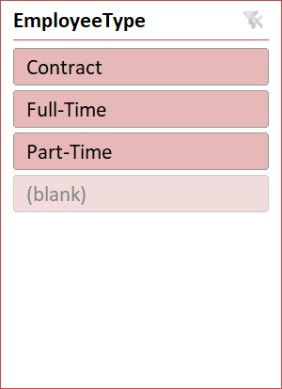
RESULTS
GenderCode | (Multiple Items)
Count of FirstName | Column Labels
Row Labels | HIGH | LOW | MED | VERY HIGH | Grand Total
BPC | 16 | 34 | 85 | 15 | 150
CCDR | 18 | 47 | 65 | 15 | 145
EW | 21 | 41 | 78 | 14 | 154
MSC | 17 | 39 | 92 | 9 | 157
NEL | 21 | 41 | 77 | 15 | 154
PL | 29 | 33 | 69 | 12 | 143
PYZ | 26 | 41 | 75 | 15 | 157
SVG | 26 | 43 | 82 | 16 | 167
TNS | 21 | 45 | 71 | 13 | 150
WBL | 25 | 34 | 84 | 13 | 156
Grand Total | 220 | 398 | 778 | 137 | 1533
11

Slide 12
conclusion
IN THIS SALARY ANALYSIS THE SOME OF EMPLOYEES ARE GET HIGHER SALARY IN THE DEPARTMENT OF QUALITY AND SALES.

