Slide 1

A Project abstract presentation on A Deep Siamese Framework for Predicting Harmful Drug Interactions
Presented by CSE(AIML)B3 Batch-14
S. BHAVANI SHANKAR 22101A010169
A. PALLAVI 22101A010201
V. NAGA PRAVEENA 22101A010182
M JAYAPRAKASH REDDY 22101A010244
COMPUTER SCIENCE AND ENGINEERING (AIML)
Under the guidance of
Ms. K. Harika,
Assistant Professor,
Dept. of CSE-AIML.
Program Head
Dr. G. Sunitha,
Professor & Head,
Dept. of CSE-AIML.

Slide 2
CONTENTS
Abstract
Introduction
Problem Statement
Objectives
Existing System and Limitations
Proposed System
Methodology
Architecture
Dataset
Results
Conclusion & Future Work
References

Slide 3

ABSTRACT
Drug–drug interactions (DDIs) present significant risks in modern multi-drug therapies, making accurate and early prediction crucial for patient safety. This work proposes a deep learning–based framework using a Siamese neural network to predict harmful DDIs from molecular structure data. Each drug is represented as a molecular fingerprint vector that captures its chemical substructures and properties. The model learns latent similarity relationships between drug pairs and estimates the probability of adverse interactions through a classification layer. Experimental results demonstrate high predictive accuracy, outperforming traditional machine learning methods on large-scale datasets. The proposed system offers a scalable and efficient solution for enhancing clinical decision-making and supporting safer drug development.

Slide 4
INTRODUCTION
Combination drug therapies are widely used to treat complex diseases but increase the risk of harmful drug–drug interactions (DDIs), which may reduce effectiveness or cause serious side effects. Traditional detection methods, such as clinical trials, are costly and impractical for evaluating the vast number of drug combinations. With the growth of biomedical data, computational approaches—especially deep learning—offer efficient alternatives. This work proposes a Siamese neural network that uses molecular fingerprint representations to learn drug similarities and predict interactions. The model improves generalization for unseen drug pairs and provides a scalable solution for clinical decision support and pharmaceutical research.

Slide 5
PROBLEM STATEMENT
The rapid increase in available drugs has led to a vast number of possible drug combinations, making it impractical to experimentally identify all harmful drug–drug interactions (DDIs). Traditional methods are time-consuming, expensive, and limited in scalability, posing risks to patient safety due to undetected interactions. Therefore, there is a need for an efficient computational approach that can accurately predict potential DDIs. The challenge lies in learning complex nonlinear relationships between drug structures while ensuring strong generalization to unseen drug pairs.

Slide 6
OBJECTIVES
Design and develop a robust deep learning framework for accurate prediction of harmful drug–drug interactions using molecular structure data
Implement a Siamese neural network architecture to effectively learn similarity relationships between drug pairs in a shared embedding space
Enhance predictive performance by capturing complex nonlinear patterns beyond traditional machine learning approaches
Ensure strong generalization capability for identifying interactions among previously unseen drug combinations
Provide a scalable and reliable solution to support clinical decision-making and improve patient safety in pharmaceutical applications

Slide 7
EXISTING SYSTEM AND LIMITATIONS
Year | Model | Algorithms Used | Accuracy | Drawback
2024 | Deep Neural Network for DDI Prediction | Deep Neural Networks (DNN), Molecular Fingerprints | ~94% | Requires large labeled data; limited interpretability of learned features
2023 | Machine Learning-Based DDI Prediction | Random Forest, SVM, Gradient Boosting | ~91–93% | Cannot capture complex nonlinear biochemical relationships effectively
2022 | Similarity-Based DDI Models | Molecular Similarity, Feature Engineering | ~89–91% | Depends heavily on handcrafted features; limited scalability
2021 | Statistical & Data Mining Approaches | Association Rules, Clinical Data Mining | ~85–88% | Incomplete data coverage; high false positives and delayed detection

Slide 8
EXISTING SYSTEM AND LIMITATIONS
Model | Accuracy | Precision | Recall | F1 Score
Random Forest | 0.91 | 0.89 | 0.92 | 0.90
SVM | 0.90 | 0.88 | 0.91 | 0.89
Deep Neural Network | 0.94 | 0.93 | 0.95 | 0.94
Siamese Model (Proposed) | 0.9712 | 0.9557 | 0.9911 | 0.9731

Slide 9
PROPOSED SYSTEM
The proposed system adopts a pairwise learning strategy to predict harmful drug–drug interactions by directly modeling the relationship between two drugs rather than analyzing them independently. It leverages molecular fingerprint representations to encode chemical structure information into numerical form. A Siamese neural network with shared parameters processes both drugs simultaneously, enabling the model to learn deep structural similarities and interaction patterns in a unified embedding space. These learned representations are then combined and evaluated by a classification layer to determine the likelihood of an adverse interaction. This approach enhances the model’s ability to capture complex biochemical relationships, improves prediction reliability, and ensures strong performance even on previously unseen drug combinations, making it suitable for real-world clinical and research applications.

Slide 10
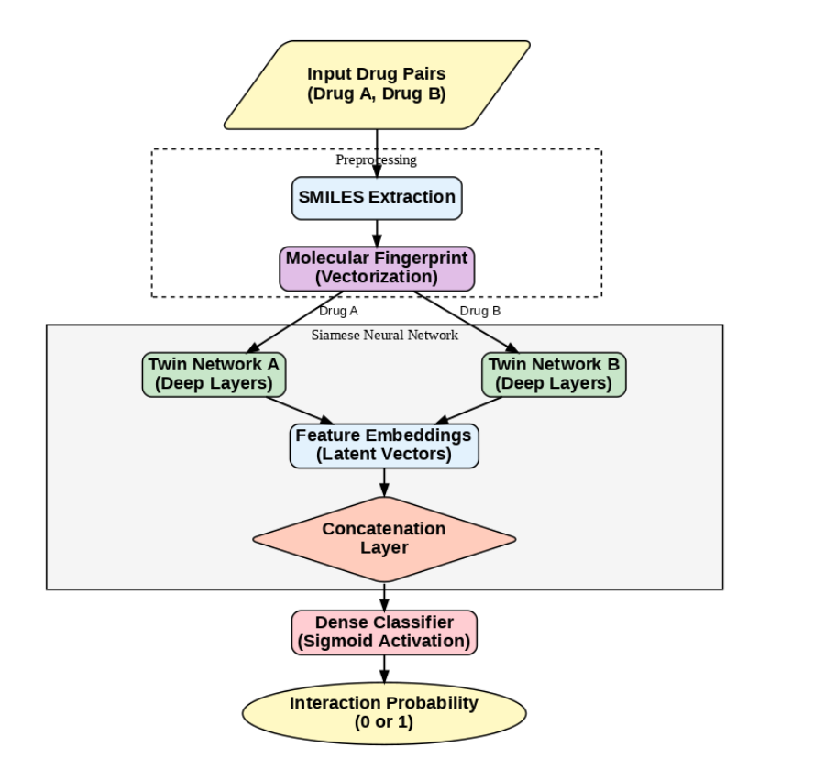
ARCHITECTURE

Slide 11
DATASET DESCRIPTION
The dataset consists of multiple structured files representing different stages of drug interaction data processing
Drug metadata files include drug IDs, names, and chemical structures (SMILES format)
Molecular fingerprint data provides numerical vector representations of each drug for model input
Interaction dataset contains drug pair combinations labeled for potential drug–drug interactions
A balanced dataset is created to ensure equal representation of interacting and non-interacting drug pairs
Preprocessed data is split into training and validation sets stored in optimized .npz format
Chunked data files are used to efficiently handle large-scale training data and improve computational performance
ATASET

Slide 12
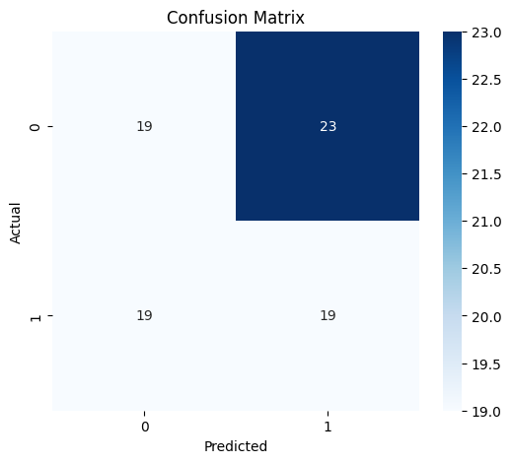
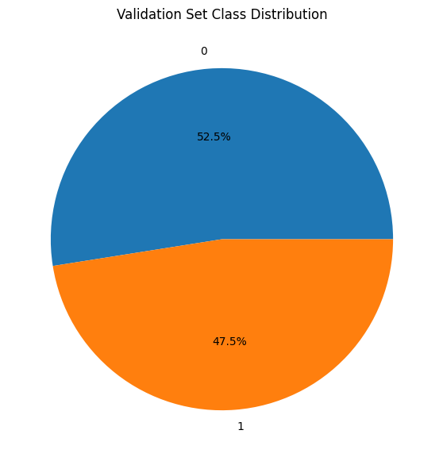
EXPERIMENTAL RESULTS
Fig. 1 Condusion Matrix
Fig.2 class Distribution

Slide 13
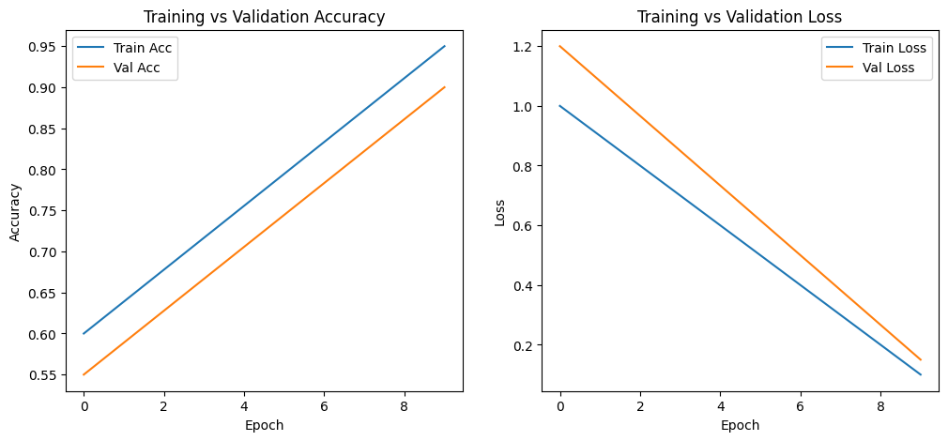
EXPERIMENTAL RESULTS
Fig. 1 Training & Validation Accuracy
Fig. 2 Training & Validation Loss

Slide 14
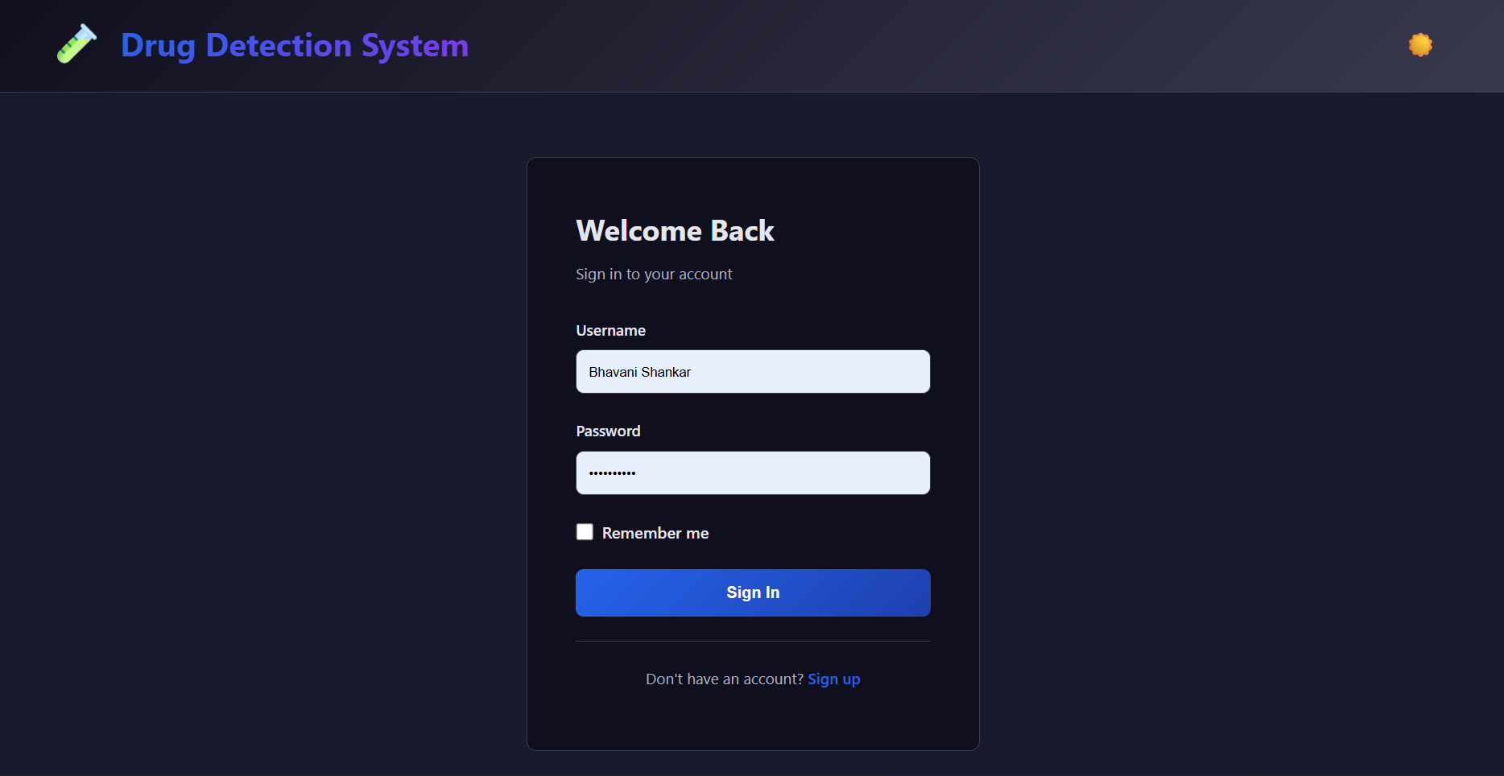
SCREENSHOTS
LOGIN PAGE
This is the login page which gets showed when user runs try to predict

Slide 15
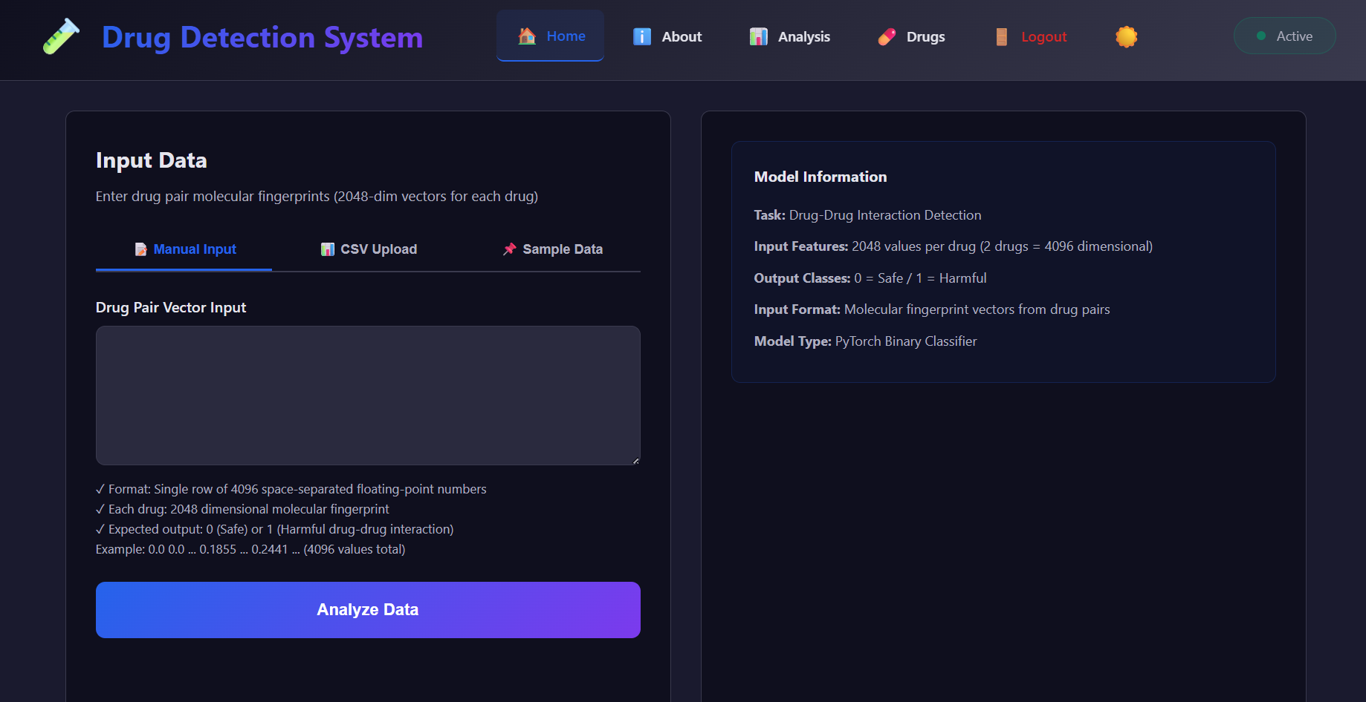
SCREENSHOTS
HOME PAGE

Slide 16
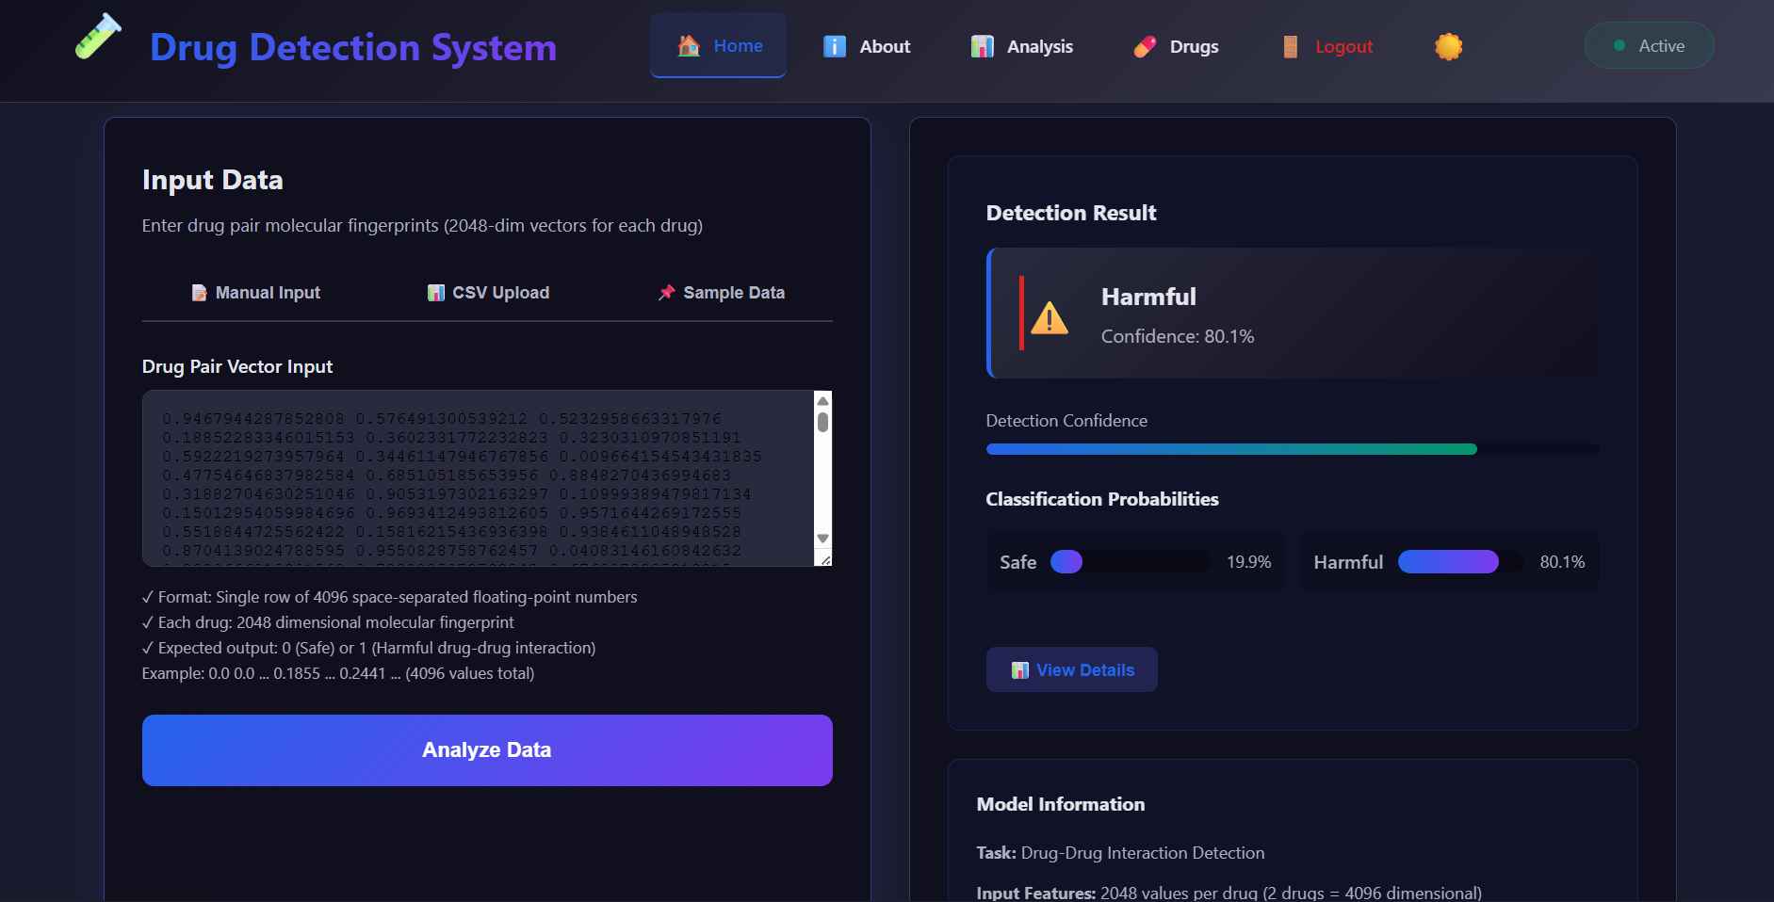
SCREENSHOTS
DATASET

Slide 17
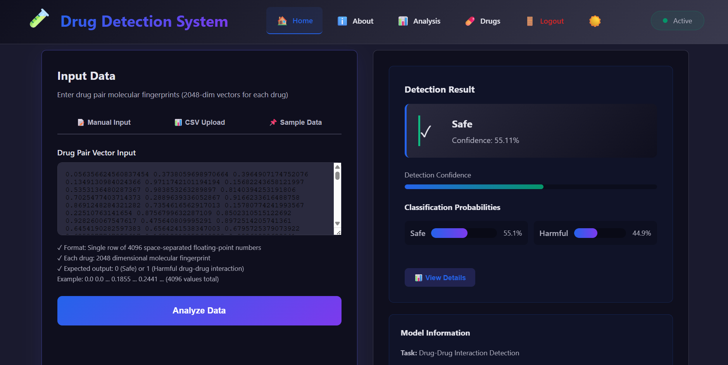
SCREENSHOTS
DATASET

Slide 18

THANK
YOU

