Slide 1
Key logger
Presented By:
1. Praveen V
College of Engineering Guindy
Department of Information Science and Technology

Slide 2
OUTLINE
Problem Statement
Proposed System/Solution
System Development Approach
Algorithm & Deployment
Result
Conclusion
Future Scope
References

Slide 3
Problem Statement
In today's digital age, where cybersecurity threats loom large, one of the significant concerns is the proliferation of keyloggers, stealthy software tools designed to monitor and record keystrokes on a user's computer without their knowledge. Keyloggers pose a severe threat to individuals and organizations as they can capture sensitive information such as passwords, credit card details, and other personal data, leading to identity theft, financial loss, and privacy breaches.

Slide 4
Proposed Solution
Importing Necessary Libraries:
- Utilize the `tkinter` library for creating a graphical user interface (GUI) to interact with the keylogger.
- Import the `keyboard` module from the `pynput` library for capturing keyboard events.
Defining Variables:
- Initialize variables such as `keys_used`, `flag`, and `keys` to store keystroke data and control keylogger behavior.
Functions for Logging Keystrokes:
- Create functions `generate_text_log` and `generate_json_file` to log keystrokes in text and JSON formats, respectively.
- Implement `on_press` and `on_release` functions to capture and record keyboard events, distinguishing between pressed and released keys.
Starting and Stopping Keylogger:
- Develop functions `start_keylogger` and `stop_keylogger` to initialize and terminate the keylogger, respectively.
- Configure GUI buttons to trigger these functions and update the user interface accordingly.
User Interface:
- Design a user-friendly GUI using `tkinter` with buttons to start and stop the keylogger.
- Display informative messages to the user indicating the status of the keylogger (running or stopped).

Slide 5
System Approach
The system approach involves analyzing and addressing problems or challenges by considering the interrelated components and interactions within a system. It focuses on understanding the system's structure, functions, and behaviors to identify dependencies and potential areas for improvement. By taking a holistic view, the system approach aims to optimize the performance and efficiency of the entire system, rather than focusing solely on individual elements. It emphasizes the importance of considering the broader context, relationships, and impacts of decisions to achieve optimal outcomes and address complex issues effectively.

Slide 6
Algorithm & Deployment
Deployment Process:
1. Packaging: Bundle the keylogger into a format like an executable or Python package for easy distribution.
2. Testing: Conduct thorough testing across various environments to ensure proper functionality.
3. Distribution: Share the keylogger via direct download, software repositories, or enterprise platforms.
4. Documentation: Provide clear documentation detailing usage instructions and potential risks associated with the keylogger.
5. Security Considerations: Implement measures to safeguard user privacy and data, preventing misuse of the keylogger.
6. Monitoring and Updates: Continuously monitor the keylogger for performance issues, security vulnerabilities, and user feedback. Release updates and patches as needed to enhance functionality and address concerns.
Algorithm
- Begin by acknowledging the importance of addressing cybersecurity threats like keyloggers.
- Conduct thorough research and planning to select appropriate tools and libraries for development.
- Design the keylogger algorithm, focusing on logging keystrokes, controlling behavior, and creating a user-friendly interface.

Slide 7
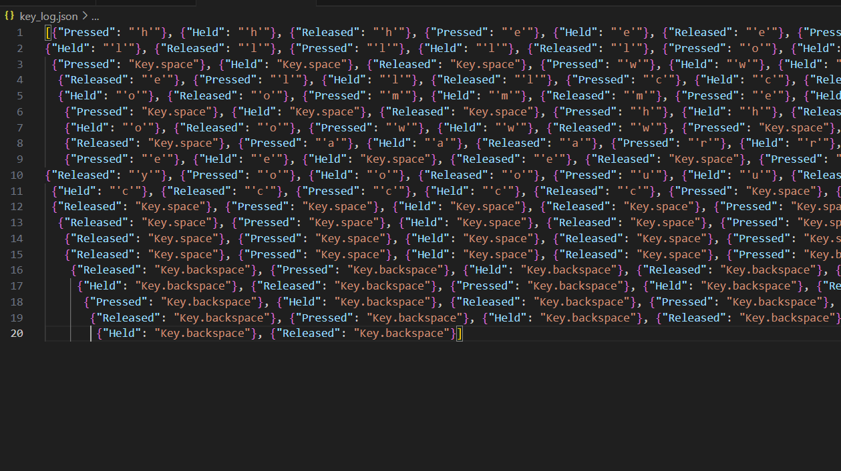
Result
Summary:
The keylogger operates stealthily, capturing keystrokes and logging them into two file formats: text (key_log.txt) and JSON (key_log.json). It provides insights into user activities without visible indications to users.

Slide 8
Conclusion
By implementing this keylogger using Python, users can enhance their security measures by monitoring and logging keyboard activities. This proactive approach helps in detecting suspicious behavior, potential security breaches, and mitigating cyber threats effectively.

Slide 9
Future scope
1. Behavioral Analysis: Implement advanced algorithms for behavioral analysis to detect anomalous keystroke patterns and identify potential threats more accurately.
2. Cloud Integration: Explore the integration of cloud-based storage and analysis capabilities to securely store keystroke logs and perform advanced analytics for threat detection.
3. Mobile Device Support: Extend the keylogger's capabilities to monitor keystrokes and user activities on mobile devices, including smartphones and tablets, to provide comprehensive surveillance across platforms.
4. User Anonymization: Develop features to anonymize user data collected by the keylogger, ensuring privacy compliance and mitigating concerns about data misuse.
5. Real-Time Alerts: Implement real-time alerting mechanisms to notify administrators of suspicious activity detected by the keylogger, enabling prompt response and mitigation of potential threats.

Slide 10
References
1. K. C. Yang, "An Improved Keylogging Detection and Prevention System," IEEE Xplore, 2017. [Online]. 2. G. Kaspersky, "How to Protect Yourself Against Keyloggers," Kaspersky, 2021.
3. A. Carvey, "Forensic Analysis of Keystroke Dynamics," SANS Institute, 2005. [Online].
4. M. Deshmukh, "Detecting Keylogger Attacks Using Machine Learning Techniques," International Journal of Advanced Research in Computer Science, 2017.
5. C. Silver, "Keylogging and User Privacy," Association for Computing Machinery, 2013.

Slide 11
THANK YOU

