Slide 1

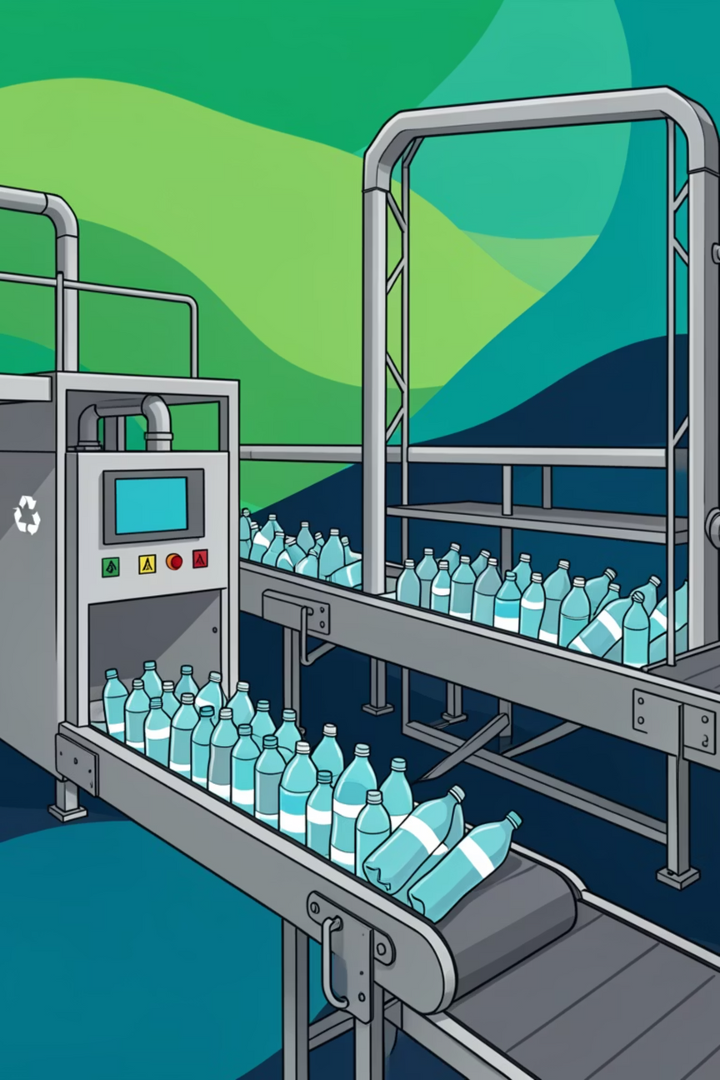

AG 43
PET Bottle Analysis System
An intelligent end-to-end solution combining computer vision, API orchestration, and interactive analytics to detect, classify, and analyze PET bottles in images

Slide 2
ARCHITECTURE OVERVIEW
Three-Tier System Architecture
API Service Layer
ML Service Layer
Frontend Layer
Node.js Express server handling image uploads, orchestrating ML calls, and computing analytics with Multer middleware for multipart processing
FastAPI service powered by Ultralytics YOLOv8 for object detection, with specialized endpoints for classification and estimation
React 19 + Vite application with TailwindCSS providing an intuitive upload interface and comprehensive analytics dashboard

Slide 3





DATA FLOW
Request Processing Pipeline
Image Upload
Client submits image via multipart form-data to API service endpoint /api/upload
Object Detection
API forwards image to ML service /infer endpoint, receiving initial detection results with bounding boxes and confidence scores
Parallel Processing
Detection JSON sent simultaneously to /colorpet and /wtestimate endpoints for classification and measurement estimation
Response Merging
API merges results per detection using bbox matching, computes summary analytics, and returns enriched data to frontend

Slide 4
API Service Architecture
Core Capabilities
Express server exposing RESTful /api/* endpoints
Multer middleware for efficient multipart file handling
Parallel ML service calls with response merging logic
Real-time analytics computation over detection results
CORS-enabled for seamless frontend integration
Key Endpoints
GET /health — service health check
POST /upload — single image analysis
POST /batch — multiple image processing

Slide 5

ML Service: Detection & Classification
01
02
Object Detection (/infer)
Classification (/colorpet)
YOLOv8 model identifies bottles, returning bbox_xyxy coordinates, class_id, class_name, and confidence scores for each detection
Analyzes bottle color properties and determines PET material classification with binary is_pet flag
03
Estimation (/wtestimate)
Calculates physical properties including estimated_length_cm and estimated_weight_g based on visual analysis

Slide 6
ML SERVICE
ML Service: Initialization & Startup
Initialization Process
Health Check Endpoint
The ML Service ensures efficient operation by performing critical setup tasks during startup, making it ready to process requests immediately. This process includes:
A dedicated endpoint allows for monitoring the service's health and availability, confirming it is operational and ready to serve requests.
FastAPI application initialization
Health-check endpoint (/health) returning {"status": "OK"}
YOLO model loading (best.pt) at startup
Class labels storage from model.names
@app.get("/health")
async def health_check():
return {"status": "OK"}
Two rule dictionaries: one for bottle color mapping, one for PET classification
from fastapi import FastAPI
from ultralytics import YOLO
app = FastAPI()
# YOLO model loading (best.pt) at startup
model = YOLO("best.pt")
# Class labels storage from model.names
class_labels = model.names
# Rule dictionary for bottle color mapping
BOTTLE_COLOR_MAP = {
"clear": "clear_bottle",
"green": "green_bottle",
"blue": "blue_bottle",
"brown": "brown_bottle"
}
# Rule dictionary for PET classification
PET_CLASSIFICATION_RULES = {
"clear_plastic": True,
"green_plastic": True,
"other_plastic": False
}

Slide 7





YOLO INFERENCE
YOLO Inference Pipeline: The `/infer` Endpoint
The /infer endpoint orchestrates a sophisticated pipeline to process uploaded images and return detailed object detection results. This process ensures accurate and efficient identification and classification of PET bottles.
Image Upload
Client uploads image file to the API service.
NumPy Array Conversion
Server reads raw bytes from the uploaded image and converts them into a NumPy array.
OpenCV Decoding
OpenCV decodes the NumPy array into an image format suitable for model inference.
YOLO Model Prediction
The YOLO model performs object prediction with a confidence threshold of conf = 0.25.
Detection JSON Output
Extraction of bounding box (xyxy format), class_id, class_name, and confidence score for each detected object, then formatted as JSON.
Sample Detection Output
Below is an example of the JSON structure returned by the /infer endpoint for a single detected object:
{
"detections": [
{
"bbox_xyxy": [150.2, 200.5, 300.8, 450.1],
"class_id": 0,
"class_name": "clear_bottle",
"confidence": 0.987
}
]
}

Slide 8
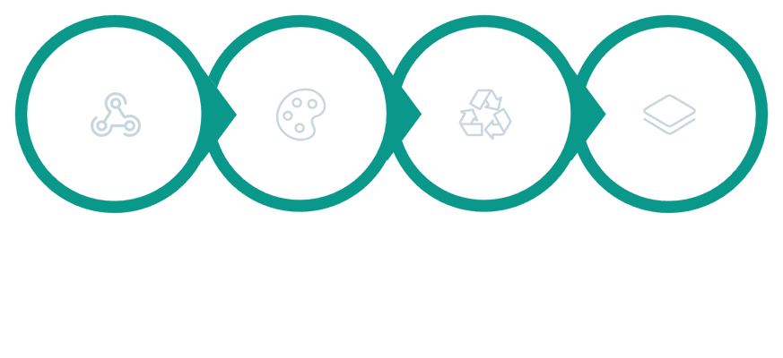




DATA ENRICHMENT
ML Service: Rule-Based Enrichment (`/colorpet`)
The /colorpet endpoint provides a crucial rule-based data enrichment step, appending vital classification information to each detected bottle without the need for additional machine learning inference. It leverages predefined dictionaries established during service initialization to quickly determine bottle color and PET recyclability status.
Rule-Based Lookups
Predefined Dictionaries
PET Classification
No model re-running required; classification is performed via efficient rule-based lookups.
Utilizes predefined dictionaries for accurate bottle color mapping (e.g., 'clear', 'green', 'blue').
Employs predefined dictionaries for binary PET classification (is_pet: true/false).
Input from /infer
Enriched Output
Takes detection JSON output directly from the /infer endpoint as its primary input.
Appends two additional fields: bottle_color (string) and is_pet (boolean) to each detection.
Enrichment Process Flow
Detection JSON
Rule Lookup (Color)
Rule Lookup (PET)
Enriched JSON
Sample JSON: Input vs. Enriched Output
The /colorpet endpoint enriches the initial detection data with critical classification fields, as demonstrated below:
Input Detection JSON (from /infer)
{
"detections": [
{
"bbox_xyxy": [150.2, 200.5, 300.8, 450.1],
"class_id": 0,
"class_name": "clear_bottle",
"confidence": 0.987
}
]
}
Enriched Output JSON (from /colorpet)
{
"detections": [
{
"bbox_xyxy": [150.2, 200.5, 300.8, 450.1],
"class_id": 0,
"class_name": "clear_bottle",
"confidence": 0.987,
"bottle_color": "clear",
"is_pet": true
}
]
}

Slide 9





DATA ENRICHMENT
ML Service: Weight Estimation (`/wtestimate`)
The /wtestimate endpoint provides critical physical property estimations for each detected bottle. It leverages bounding box data from the initial detection, applying geometric calculations and predefined parameters to estimate bottle length and weight without further ML inference.
Takes bounding box from each detection
Computes diagonal length in pixels
Fixed conversion factor to convert diagonal to real-world bottle length in centimeters
Simplified cylindrical approximation for weight estimation
Assumes fixed bottle diameter and fixed plastic area density
Lateral surface area computed and multiplied by area density
Estimated weight in grams
Returns estimated_length_cm and estimated_weight_g for each detection
Weight Estimation Calculation Process
Bounding Box Input
The endpoint receives the bbox_xyxy coordinates (x1, y1, x2, y2) for each detected bottle.
Pixel Diagonal Calculation
The diagonal length of the bounding box in pixels is computed to represent the bottle's size in the image.
Length Conversion (cm)
A fixed conversion factor (PIXEL_TO_CM_FACTOR) translates the pixel diagonal into a real-world estimated length in centimeters.
Cylindrical Surface Area
Assuming a simplified cylindrical bottle shape with a fixed diameter (BOTTLE_DIAMETER_CM), the lateral surface area is calculated.
Weight Estimation (g)
The estimated weight in grams is derived by multiplying the calculated surface area by a fixed plastic area density (PLASTIC_AREA_DENSITY_G_CM2).
Sample Enriched Output JSON
The /wtestimate endpoint appends the estimated_length_cm and estimated_weight_g fields to the detection object, as shown below:
{
"detections": [
{
"bbox_xyxy": [150.2, 200.5, 300.8, 450.1],
"class_id": 0,
"class_name": "clear_bottle",
"confidence": 0.987,
"bottle_color": "clear",
"is_pet": true,
"estimated_length_cm": 25.5,
"estimated_weight_g": 32.1
}
]
}

Slide 10

ARCHITECTURE OVERVIEW
ML Service: Overall Architecture Flow
The complete ML service architecture orchestrates the processing of uploaded images through a series of dedicated endpoints, culminating in a fully enriched JSON output with object detection, color classification, PET recyclability, and physical property estimations.
Client
FastAPI Application
/infer (YOLO Inference)
/colorpet (Rule-based Enrichment)
The FastAPI application is typically deployed using Uvicorn on 0.0.0.0:8000, making it accessible for client requests.

Slide 11

DETECTION SCHEMA
Merged Detection Response
Each bottle detection combines data from all three ML endpoints into a comprehensive result object:
{
"bbox_xyxy": [615, 165, 917, 350],
"class_id": 2,
"class_name": "bottle-dark",
"confidence": 0.9861,
"color": "black",
"is_pet": true,
"estimated_length_cm": 25.76,
"estimated_weight_g": 16.75
}
The API intelligently merges responses by matching bounding box coordinates, with fallback to index-based matching when bbox alignment fails

Slide 12
Comprehensive Analytics Engine
Distribution Analytics
5
95.67%
Class distribution tracking (bottle-dark, bottle-transp-full, etc.)
Total Bottles
Avg Confidence
Color distribution analysis across all detections
Detected in image
Detection accuracy
PET vs non-PET material classification counts
Statistical aggregations for confidence, weight, and dimensions
79.2g
24.3cm
All analytics computed server-side in analyticsService.js for optimal performance
Total Weight
Avg Length
Combined estimate
Mean bottle size

Slide 13




Frontend: Interactive Analytics Dashboard
Upload Interface
Intuitive drag-and-drop or click-to-browse experience with real-time upload progress and validation feedback
Detection Table
Comprehensive table displaying bottle type, color, PET status, confidence scores, and physical measurements for each detection
Visual Overlay
Interactive image viewer with bounding box overlays, color-coded classifications, and hover-to-inspect functionality
Analytics Cards
Real-time summary statistics including totals, distributions, confidence metrics, and weight/length aggregations

Slide 14




GETTING STARTED
Quick Setup Guide
Start Frontend
Configure API Service
Navigate to frontend directory, install dependencies with npm install, launch with npm run dev
Launch ML Service
Copy .env.example, set ML_SERVICE_URL=http://localhost:8000, then run npm install && npm run dev
Start FastAPI server with YOLOv8: uvicorn main:app --host 0.0.0.0 --port 8000
Prerequisites: Node.js 18+, Python 3.10+. API service runs on port 3000, ML service on port 8000 by default. Ensure all environment variables are properly configured before starting services.

Slide 15
Project Impact & Next Steps
What We Built
A production-ready system demonstrating modern full-stack architecture with AI/ML integration, processing images through three specialized microservices to deliver

