Slide 1
Milestone 1: Financial Market Sentiment Analysis
Weeks 1–2 | Introduction & Initial Training

Slide 2
Objective
Set up the project infrastructure, introduce team members to LLM tools (like OpenAI GPT, Meta LLaMA), and gather initial data for training models.

Slide 3
Milestone 1 Tasks
Set up the environment for market data collection (Twitter API integration)
Train team members on using LLMs for sentiment analysis of news and social media
Begin collecting initial data from platforms such as Twitter and news sources

Slide 4
Implementation Overview (Steps 3–7)
Step 3: Setup API Connection using Tweepy
Step 4: Collect Twitter Data (stock market tweets)
Step 5: Apply LLM-Based Sentiment Analysis using Transformers
Step 6: Visualize Sentiment Distribution
Step 7: Document Team Training Notes

Slide 5
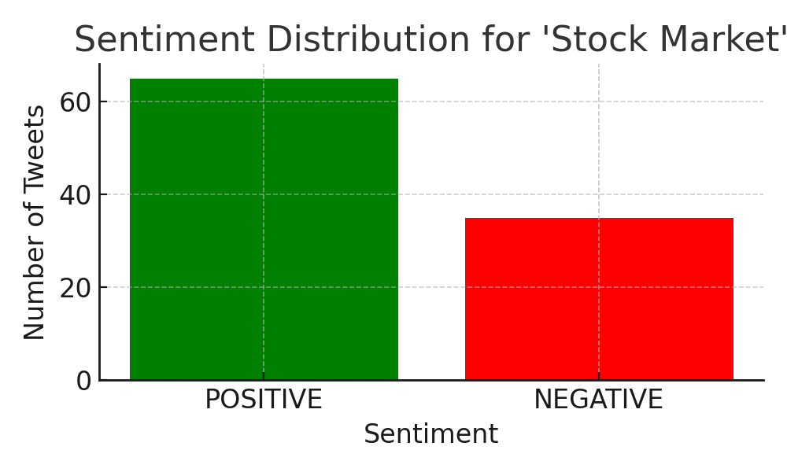
Results & Visualization
The collected tweets were analyzed for sentiment (Positive/Negative) using a pretrained DistilBERT model. A visualization of the sentiment distribution is shown below:
• Tweepy: Fetches Twitter data via API
• Transformers: Provides pretrained LLM models for sentiment analysis
• Matplotlib: Used for visualizing sentiment results
Model: distilbert-base-uncased-finetuned-sst-2-english
Output: twitter_sentiment_data.csv + sentiment chart ✅

Slide 6
Team Training Notes
Tweepy: Fetches Twitter data via API
Transformers: Provides pretrained LLM models for sentiment analysis
Matplotlib: Used for visualizing sentiment results
Model: distilbert-base-uncased-finetuned-sst-2-english
Output: twitter_sentiment_data.csv + sentiment chart
✅ Milestone 1 completed successfully.

Slide 7
Conclusion
The milestone successfully established the data pipeline, performed sentiment analysis using LLMs, and generated useful insights through visualization.
Next Step: Automate data updates and integrate extended model training.

