Slide 1
Natural Language Processing
#COKE

Slide 2
NATURAL LANGUAGE PROCESSING
LANGUAGE
PROCESSING
Natural Language Processing (NLP) is the process of a machine to understand human language and converts it into useful information.
Technically, NLP is defined as the automatic manipulation of natural language, like speech and text, by software.

Slide 3
BUSINESS OBJECTIVE
To perform sentiment analysis on “coke” and attain customer’s review on the product.
To know the positive and negative aspects from tweets.
To gain business insights from tweets and understand the product from people’s point of view .

Slide 4
DATA FLOW
SENTIMENT ANALYSIS & TOPIC MODELLING
Gathering tweets from twitter for NLP
Tokenization Stemming & Lemmatizing
DATA COLLECTION
DATA PREPROCESSING
To understand the positive,negative and neutral sentiments of people.
Analysing the frequently discussed topics in twitter
Understand the overall summary of the product
AUTOMATIC SUMMARIZATION
DATA CLEANSING
Stopwords removal Duplicates,Punctuations & Special Characters Removal

Slide 5
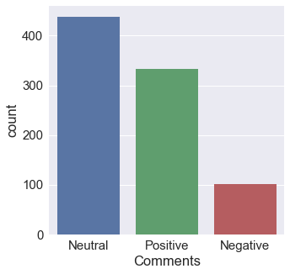
SENTIMENTAL ANALYSIS
Sentiment Analysis is a technique used in text mining.
The main purpose is to show the sentiment of the text (tweet) in the form of positive, negative and neutral.

Slide 6
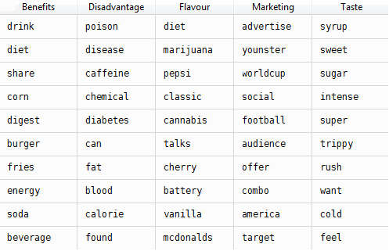
TOPIC MODELLING

Slide 7
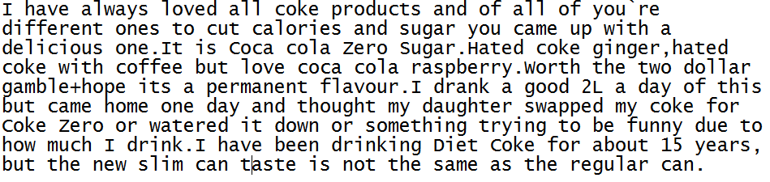
AUTOMATIC SUMMARIZATION

Slide 8
Business Outcome
Based on the sentiment analysis we infer that “coke” has mixed reviews across twitter.
Through Topic Modelling, we can infer that coke is concentrating more on marketing to make more customers.
Also through summarizing, it is clear from the tweets that the new flavors of coke are not much liked by people compared to the regular coke.

Slide 9
Thank You !

