Slide 1
PowerCore ( Solution Engineering ) CoE
Placeholder confidentiality disclosure.

Slide 2
Topic
PowerCore Agile Framework
Refine support process flow
Deployment
Move more towards deployment automation
Development
Develop automated testing framework

Slide 3
PowerCore Agile Framework
Rally User Story Intake workflow
Business
Stakeholder
Technical Enhancement
Production Defect
Production Alert
Ketan
PowerCore Team Review
Janet
Support Team
Janet
Dev Team
Dev Team
( OnCall
Dev resource )
Aha
Add stakeholder value
Pure Technical
Janet
Janet
Aha
Dev Team
Janet
Rally

Slide 4
PowerCore Sprint Cycle
Daily Standup update
User Story worked on yesterday
User story will work on today
Blocker for today’s work including any deviation from planned task **Important**
Should not have more than 2-3 “InProgress” tasks at a given time
Call out early if you will miss any task due to some reason ( e.g. Due to deviation from original task )
Each Sprint Goal
Demo your deliverable
Software State: Ready for prod release
Some point in future, release on every sprint
Sprint backlog
Refer Intake Process
( previous slide )
Backlog grooming
&
Sprint Planning
Middle of
Active sprint
( Once in 2 weeks
2 hours )
Assume Role of Scrum Master
Dev Team member Rotation
on each sprint
Active Sprint
2 weeks sprint
( daily standup
15 minutes )
Sprint Demo
Last day of
the sprint
( Once in 2 weeks
30 minutes )
Sprint End

Slide 5
PowerCore Support process flow
Source
PowerCore L3 Support Team
L4 Triage
GED SRE Team
Analyze Alert Priority
P1
Troubleshoot alert as per document
Issue Resolved
Yes
GED
PowerCore L4 Team
No, call L4
P1 alert
Not P1 Alert
APM Support Team ( salesforce case)
Post resolution
Not P1
Create a story on Rally
Create a story on Rally
Troubleshoot issue
Create a story on Rally
Application Email Alert
Prioritize story
Issue Resolved
Troubleshoot alert as per document
Issue Resolved
No, assign
story to L4
Environment Access related request
Troubleshoot issue
Close story on Rally
Yes
Update confluence page with new steps that is not documented yet
Issue Resolved
AWS Support
Non PowerCore Team
PowerCore Team

Slide 6
Support Ticket creation approach
Each start of the sprint, create a user story “KLO ( Keeping Light On )”
The KLO story point will be “20” . On each sprint, we will evaluate the story point value bases on production issues we received on last sprint
Support team will create task for each alert which they are working
If support can’t resolve the issue, they will assign the task to specific Dev support resource for that week
The Dev support resource rotation will occur every Thursday ( based on current sprint cycle )
If Dev support resource can’t resolve this issue, he/she will create a new story in backlog with actual production defect/enhancement. Mention appropriate Priority in the story.
Should create tasks under “KLO“ to track time spent helping transformer team or other teams
Use judgement call to create tasks (e.g., if hours spend more than ~4hrs, then create tasks. Otherwise, you will spend lot more time just creating Rally tasks )

Slide 7
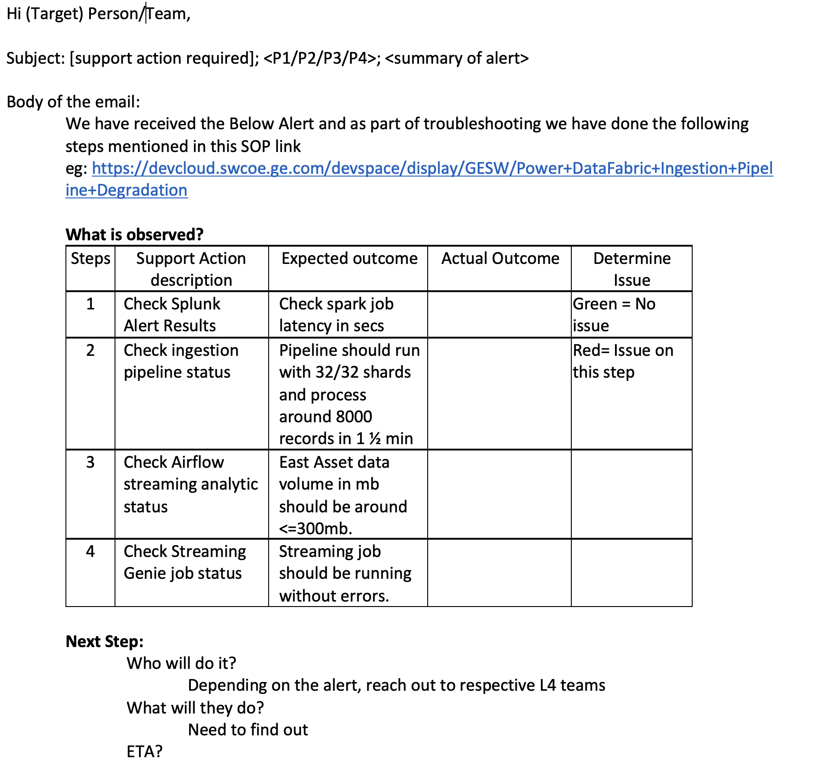
Support Team Alert Email Template

Slide 8
Dev support resource responsibility
One person from dev team will be designated support resource for the week
Work on tasks under KLO that assigned to the resource
Be expert on the platform, components, Infrastructure, and deployment
Create a task called “application documentation” under KLO. Work on the documentation if there is no support task assigned to the individual.
Review Confluence page for each component, if not up-to-date, then update the confluence page content
At the end of the week support handover, email @PowerCore with summary of updates that you worked on during that week
Objective : Help support team with more information so that they will resolve majority of production issues by themselves which will help dev team focus on application/infrastructure development

