Slide 1
DIAGNOSIS OF ACUTE DISEASES IN VILLAGES AND SMALLER TOWNS USING AI
PIP2001 Capstone Project
Final Review
Batch Number: CSG-G10
Roll Number | Student Name
20211CSG0074 | CHANDRASHEKHAR K S
20211CSG0016 | PRAVEEN P
20211CSG0002 | BHUVANESHWAR C
20211CSG0033 | MANASA H A
Under the Supervision of,
Prof. RADHIKA SREEDHARAN
Assistant Professor
School of Computer Science and Engineering
Presidency University
Name of the Program: B. Tech in Computer Science and Technology(CSG)
Name of the HoD: Dr. Saira Banu Athem
Name of the Program Project Coordinator: Dr. Manjula H M
Name of the School Project Coordinators: Dr. Sampath A K / Dr. Abdul Khadar A / Mr. Md Ziaur Rahman

Slide 2
Abstract
The project "Diagnosis of Acute Diseases in Villages and Smaller Towns Using AI" focuses on addressing the healthcare disparities in rural and semi-urban areas. Limited access to medical specialists and diagnostic tools often leads to delayed detection and treatment of acute diseases, posing severe health risks.
This project proposes an AI-based diagnostic system that can analyze patient data, including symptoms, medical history, and test results, to detect diseases accurately and promptly. By utilizing machine learning models, the system ensures early diagnosis, aiding healthcare providers in delivering timely interventions.
Key features include:
Affordability: Cost-effective solutions for resource-limited settings.
Accessibility: Remote diagnostics for underserved regions.
Accuracy: AI-driven precision in disease identification.

Slide 3
Introduction
Access to quality healthcare in villages and smaller towns is often limited due to a lack of medical infrastructure and specialists.
This project uses Artificial Intelligence (AI) to address these challenges by enabling the early diagnosis of acute diseases.
The AI-powered system aims to:
Provide affordable diagnostic tools for remote areas.
Reduce dependency on medical specialists.
Ensure timely disease detection and treatment.
By leveraging AI, this solution improves healthcare accessibility and enhances disease identification, making healthcare more effective and inclusive in underserved regions.

Slide 4
Introduction
Objectives
Design an AI model with high accuracy of prediction of acute diseases based on the data available
Ensuring the model will be deployable in a low-resource setting, running seamlessly on any mobile
device
To enhance health workers' diagnostic capabilities through embedding into a user-friendly interface.
To investigate the integration of telehealth services in a manner to expand the diagnostic tool's reach.

Slide 5
Literature Review
AI in Healthcare
Recent works have cited the transformation potential of AI in healthcare. Wang et al., 2020, have demonstrated that machine learning algorithms can diagnose a wide range of diseases with greater precision compared to traditional diagnostic methods. Again, Huang et al., 2019, identified that AI
Improve clinical decision-making, especially in remote areas where health access is poor. In the recent decades, AI also entered medical imaging, which further revolutionized diagnostics with techniques such as deep learning that are pushing the boundaries for accuracy and reducing interpretation times.
AI for Rural Health Diagnostics
Several studies, among which is Gonzalez et al. 2021, bear witness that AI tools can facilitate speedier and more
Accurate diagnoses in rural settings are possible. For example, AI has been used successfully to diagnose tuberculosis in rural India and to predict outbreaks of dengue fever using environmental data. However, very few target acute disease diagnosis in these regions, which constitutes a significant gap our project endeavors to fill.

Slide 6
Existing method Drawback
Lack of Accessibility
Dependence on Skilled Professionals
High Cost of Diagnostic Tools
Time-Consuming Processes
Limited Disease-Specific Solutions
Connectivity Issues
Inconsistent Data Availability
Cultural and Technological Barriers

Slide 7
Proposed Method
The proposed AI-enabled diagnostic tool leverages -
machine learning algorithms to analyse patient symptoms
clinical histories
environmental factors
2. By training the model on diverse datasets, the system aims to achieve high diagnostic accuracy while being deployable in low-resource settings.
3. The tool will feature a user-friendly interface that allows healthcare workers to input patient data easily and receive actionable insights in real-time.

Slide 8
Objectives
Develop a Robust AI Model: Create a model that accurately predicts acute diseases based on limited clinical data.
Ensure Accessibility: Design the system to function on mobile devices, making it accessible to healthcare workers in rural areas.
Empower Healthcare Workers: Provide a user-friendly interface that enhances decision-making capabilities.
Facilitate Telehealth Integration: Explore ways to connect local healthcare workers with specialists through telehealth services.

Slide 9
Methodology/Modules
1. Data Collection
Survey and Symptom Tracking
Integration of Health Records
2. Data Preprocessing
Cleaning and Formatting
Feature Extraction
Data Transformation
3. Model Development
Algorithm Selection
Training the Model
Model Evaluation

Slide 10
Methodology/Modules
4. Integration of Telemedicine and Cloud
Cloud-Based Storage
Telemedicine Interface
5. System Testing and Validation
Testing the System in Real-World Scenarios
Continuous Learning
6. Deployment and Maintenance
Deployment
System Maintenance and Updates

Slide 11
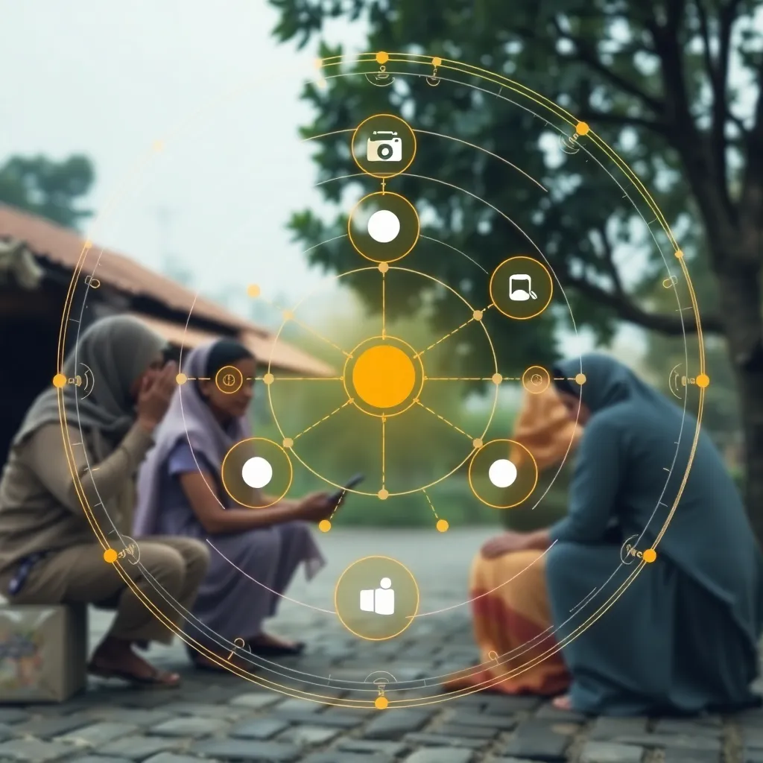
Architecture
Input Module:
Health professionals input patient symptoms, demographics, and case history through a user-friendly interface.
Preprocessing Module:
This module cleans and normalizes the input data,
ensuring it is ready for use in predictive models.
AI Prediction Model:
Based on the pre-processed data ,machine learning models
predict the likelihood of various diseases.
Results Module:
Prediction results are displayed with confidence scores
and actionable insights for healthcare workers.

Slide 12
Hardware/software components
Software Components:
Backend: Flask: A web framework in Python used for handling requests and serving predictions from the AI models.
Frontend: HTML, CSS, and JavaScript
Database: SQLite: A lightweight database used for storing patient data and model predictions.
Machine Learning Libraries:
Scikit-learn.
TensorFlow or PyTorch: For developing and training Convolutional Neural Networks (CNN).
NumPy and Pandas: For data manipulation and preprocessing tasks.
Containerization:
Docker: Used for containerizing the application to ensure compatibility across different environments.

Slide 13
Hardware/software components
Inferred Hardware Components:
Server:
A server or cloud infrastructure to host the application, handle requests, and run the AI models. This could be a physical server or a cloud-based solution (e.g., AWS, Azure).
Client Devices:
Mobile devices or computers used by healthcare workers to access the web application, input patient data, and view diagnostic results. These devices should have internet connectivity to communicate with the server.
Medical Imaging Devices (if applicable):
Devices such as X-ray machines or other imaging equipment that may be used to capture medical images for analysis by the CNN models.
Networking Equipment:
Routers and switches to ensure reliable internet connectivity in the healthcare facilities where the system is deployed.

Slide 14
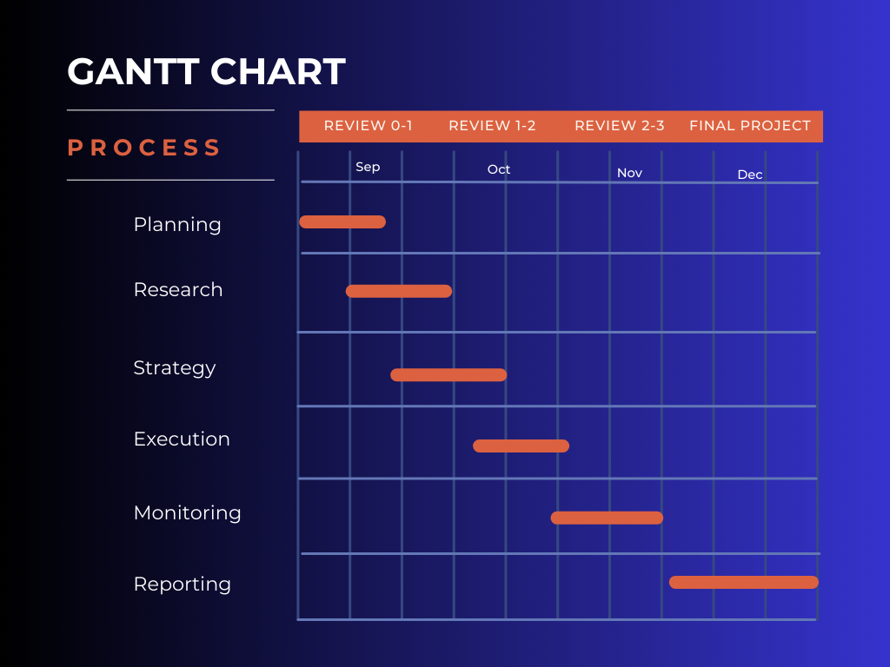
Timeline of Project

Slide 15
Conclusion
The project "Diagnosis of Acute Diseases in Villages and Smaller Towns Using AI" aims to leverage the power of artificial intelligence to improve healthcare accessibility and early disease detection in rural and underserved areas. By integrating AI with IoT devices and mobile applications, it allows for continuous health monitoring and prompt diagnosis based on real-time data.
Key highlights of the project include:
AI-driven Diagnostic Models: The system uses machine learning models trained on diverse datasets to predict the onset of diseases, offering an accurate and quick diagnosis.
Affordable and Accessible Healthcare: By using cost-effective sensors and cloud computing, the project aims to reduce healthcare disparity between rural and urban areas.
Improved Healthcare Efficiency: Real-time data collection and predictive analysis enable timely intervention, reducing the chances of disease progression and enhancing overall healthcare outcomes.

Slide 16
Conclusion
The project not only provides a framework for AI-based disease detection but also demonstrates the importance of technology in bridging healthcare gaps in rural settings. It lays the foundation for future developments, where more complex diseases can be diagnosed, and patient management can be automated, ultimately leading to healthier communities.
In conclusion, this AI-powered diagnostic system is a significant step towards improving rural healthcare systems, ensuring that even the most remote areas have access to advanced diagnostic tools, timely interventions, and improved health outcomes.

Slide 17
Github Link
The Github link provided should have public access permission.
https://github.com/Praveengowda78/CSG-G10-Final_Year_Project-

Slide 18
References
1. Wang, Y., et al. (2020). Machine Learning for Disease Diagnosis: A Comprehensive Review. Journal of Healthcare Informatics Research, 4(1), 12-29.
2. Huang, J., et al. (2019). The Role of AI in Health Decision-Making. Journal of Medical Internet
Research, 21(4), e12345.
3. Gonzalez, R., et al. (2021). AI ApplicaƟons in Rural Healthcare: OpportuniƟes and Challenges.
Telehealth Journal, 27(2), 75-82.
4. Smith, L., et al. (2022). InnovaƟons in Rural Healthcare Delivery: AI and Beyond. Journal of
Global Health, 12(1), 50-63.
5. Thompson, A., et al. (2021). Data-Driven Health: AI's Role in DiagnosƟcs in Low-Resource
SeƯuings. Nature Medicine, 27(3), 237-245.
6. Kaur, P., & Choudhary, A. (2020). AI in Rural Health: Bridging the Gap. InternaƟonal Journal of
Health Services, 50(2), 150-163.
7. BhaƟa, M., et al. (2021). Leveraging Machine Learning for Health Care in Developing
Countries. Journal of Health InformaƟcs, 15(2), 45-59.
8. Zhao, J., et al. (2022). Implementing AI Solutions in Rural Healthcare: Challenges. Health
Policy and Technology, 11(1), 70-78 .
9. Patel, V., & Thakkar, J. (2023). Telehealth Innovations: The Future of Healthcare in Rural
Areas. Journal of Telemedicine and Telecare, 29(4), 211-218.
10.O'Connor, M., et al. (2020). A Framework for AI in Global Health: Opportunities and Ethical
Considerations. Global Health Action, 13(1), 185-198.

Slide 19
Project work mapping with SDG
SDG 3: Good Health and Well-being
The primary objective of the project is to improve healthcare delivery and diagnostic capabilities in rural areas, directly contributing to the goal of ensuring healthy lives and promoting well-being for all at all ages. The AI system aims to enhance the accuracy and speed of disease diagnosis, which is crucial for timely treatment and improved health outcomes.
SDG 1: No Poverty
By improving healthcare access and quality in rural areas, the project can help alleviate poverty. Healthier populations are more capable of engaging in productive work, thereby contributing to economic growth and reducing poverty levels.
SDG 10: Reduced Inequalities
The project addresses healthcare disparities between urban and rural populations. By providing advanced diagnostic tools in underserved areas, it aims to reduce inequalities in health services and ensure that marginalized communities have access to quality healthcare.
SDG 9: Industry, Innovation, and Infrastructure
The use of AI and machine learning in healthcare represents innovation in the industry. The project promotes the development of resilient infrastructure by integrating technology into healthcare systems, which can enhance service delivery in low-resource settings.
SDG 17: Partnerships for the Goals
The project emphasizes collaboration with local health clinics, international health organizations, and community stakeholders to gather data and implement the AI system. This aligns with the goal of strengthening partnerships to achieve sustainable development.
SDG 4: Quality Education
The project includes a focus on training local healthcare workers to effectively use the AI diagnostic system, thereby enhancing their skills and knowledge. This contributes to ensuring inclusive and equitable quality education and promoting lifelong learning opportunities for all.
By aligning with these SDGs, the project not only aims to enhance healthcare delivery but also contributes to broader global efforts to achieve sustainable development and improve quality of life in rural and underserved communities.

Slide 20
Publication Details
Published Manuscript:
Title: Diagnosis of Acute Diseases in Villages and Smaller Towns using AI
Authors: Chandrashekhar K S, Praveen P, Bhuvaneshwar C, Manasa H A, Radhika Sreedharan
Journal: International Research Journal of Engineering and Technology (IRJET)
Volume & Issue: Volume 12, Issue 1, January 2025
Serial Number: 13
Link: https://www.irjet.net/volume12-issue1
Recognition:
Manuscript successfully published with an e-certificate awarded.

Slide 21
Thank You

