Slide 1
DIAGNOSIS OF ACUTE DISEASES IN VILLAGES AND SMALLER TOWNS USING AI
PIP2001 Capstone Project
Review-1
Batch Number: CSG-G10
Roll Number | Student Name
20211CSG0074 | CHANDRASHEKHAR K S
20211CSG0016 | PRAVEEN P
20211CSG0002 | BHUVANESHWAR C
20211CSG0033 | MANASA H A
Under the Supervision of,
Prof. RADHIKA SREEDHARAN
Professor / Associate Professor / Assistant Professor
School of Computer Science and Engineering
Presidency University
Name of the Program: B. Tech in Computer Science and Technology(CSG)
Name of the HoD: Dr. Saira Banu Athem
Name of the Program Project Coordinator: Dr. Manjula H M
Name of the School Project Coordinators: Dr. Sampath A K / Dr. Abdul Khadar A / Mr. Md Ziaur Rahman

Slide 2
Introduction
Background Diagnosis of Acute Diseases in Villages and Smaller Towns Using AI
Healthcare delivery in rural areas is often crippled with shortages of resources, a lack of medical professionals, and a lack of diagnostic facilities. Moreover, acute diseases such as malaria, pneumonia, and diarrheal diseases are rather common in these regions, and timely diagnosis often acts as an obstacle to effective treatment. It is here that recent advances in AI come into play to address this challenge.
New opportunities for the betterment of healthcare services in underserved communities. AI in health is poised to streamline the diagnostic process, provide real-time assistance to medical workers, and therefore save lives.
Problem Statement
The main objective of this work is to develop an AI-based diagnostic system that is able to identify acute diseases with high precision based on minimum clinical data so that the diagnostic gap in rural healthcare settings.
The project also aims to develop a model that is both effective and scalable, thus ensuring it finds wide application in similar settings.

Slide 3
Introduction
Objectives
Design an AI model with high accuracy of prediction of acute diseases based on the data available
Ensuring the model will be deployable in a low-resource setting, running seamlessly on any mobile
device
To enhance health workers' diagnostic capabilities through embedding into a user-friendly interface.
To investigate the integration of telehealth services in a manner to expand the diagnostic tool's reach.

Slide 4
Literature Review
AI in Healthcare
Recent works have cited the transformation potential of AI in healthcare. Wang et al., 2020, have demonstrated that machine learning algorithms can diagnose a wide range of diseases with greater precision compared to traditional diagnostic methods. Again, Huang et al., 2019, identified that AI
Improve clinical decision-making, especially in remote areas where health access is poor. In the recent decades, AI also entered medical imaging, which further revolutionized diagnostics with techniques such as deep learning that are pushing the boundaries for accuracy and reducing interpretation times.
AI for Rural Health Diagnostics
Several studies, among which is Gonzalez et al. 2021, bear witness that AI tools can facilitate speedier and more
Accurate diagnoses in rural settings are possible. For example, AI has been used successfully to diagnose tuberculosis in rural India and to predict outbreaks of dengue fever using environmental data. However, very few target acute disease diagnosis in these regions, which constitutes a significant gap our project endeavors to fill.

Slide 5
Existing method Drawback
Current diagnostic methods in rural healthcare often rely on traditional clinical assessments, which can be time-consuming and prone to human error.
These methods may not adequately account for the diverse range of symptoms presented by patients, leading to misdiagnosis or delayed treatment.
Furthermore, the lack of access to advanced diagnostic tools and technologies exacerbates these issues, leaving healthcare workers ill-equipped to handle acute cases effectively.

Slide 6
Proposed Method
The proposed AI-enabled diagnostic tool leverages -
machine learning algorithms to analyse patient symptoms
clinical histories
environmental factors
2. By training the model on diverse datasets, the system aims to achieve high diagnostic accuracy while being deployable in low-resource settings.
3. The tool will feature a user-friendly interface that allows healthcare workers to input patient data easily and receive actionable insights in real-time.

Slide 7
Objectives
Develop a Robust AI Model: Create a model that accurately predicts acute diseases based on limited clinical data.
Ensure Accessibility: Design the system to function on mobile devices, making it accessible to healthcare workers in rural areas.
Empower Healthcare Workers: Provide a user-friendly interface that enhances decision-making capabilities.
Facilitate Telehealth Integration: Explore ways to connect local healthcare workers with specialists through telehealth services.

Slide 8
Methodology/Modules
Data Collection
The datasets used for this study were collected from multiple sources, including:
Public Datasets: Symptom-severity.csv ,symptom_Description.csv ,symptom_precaution.csv
Patient Data (dataset.csv): Collected from various anonymous patient records. This dataset includes demographic information, symptom history, and medical outcomes, ensuring compliance with patient confidentiality and ethical standards.
Data Preprocessing
Data Cleaning: Handling Missing Values ,Outlier Removal ,Data Transformation
Symptom Encoding: Symptoms from symptom_Description.csv were encoded into numerical values suitable for machine learning algorithms.
Standardization: Continuous variables like severity scores were standardized to ensure uniform scaling across all features.
Feature Engineering
Data Augmentation

Slide 9
Methodology/Modules
Model Development
Logistic Regression:
Used as a baseline for predicting disease probability based on symptoms. This model provided a balance between interpretability and performance.
Random Forest Classifier:
A more complex model was applied to the dataset to capture non-linear relationships between symptoms and diseases. Random Forests also provided feature importance scores, highlighting which symptoms were most predictive of certain diseases.
XGBoost:
An ensemble boosting algorithm that proved effective in improving classification performance, particularly for dealing with imbalanced data and complex interactions between symptoms.
Hybrid Model:
A hybrid model combining Random Forest for symptom classification and XGBoost for feature refinement yielded an overall diagnostic accuracy of 100%.

Slide 10
Methodology/Modules
Model Training and Evaluation
Dataset Split:
The dataset was split into 80% training and 20% testing subsets to train and evaluate model performance.
Cross-validation:
10-fold cross-validation was applied to ensure the model’s robustness and generalization on unseen data.
Performance Metrics:
Models were evaluated based on:
Accuracy: The proportion of correctly predicted outcomes.
Precision, Recall, and F1-score: To measure the model’s ability to correctly classify positive cases.
ROC-AUC Curve: To assess the model’s ability to distinguish between classes.

Slide 11
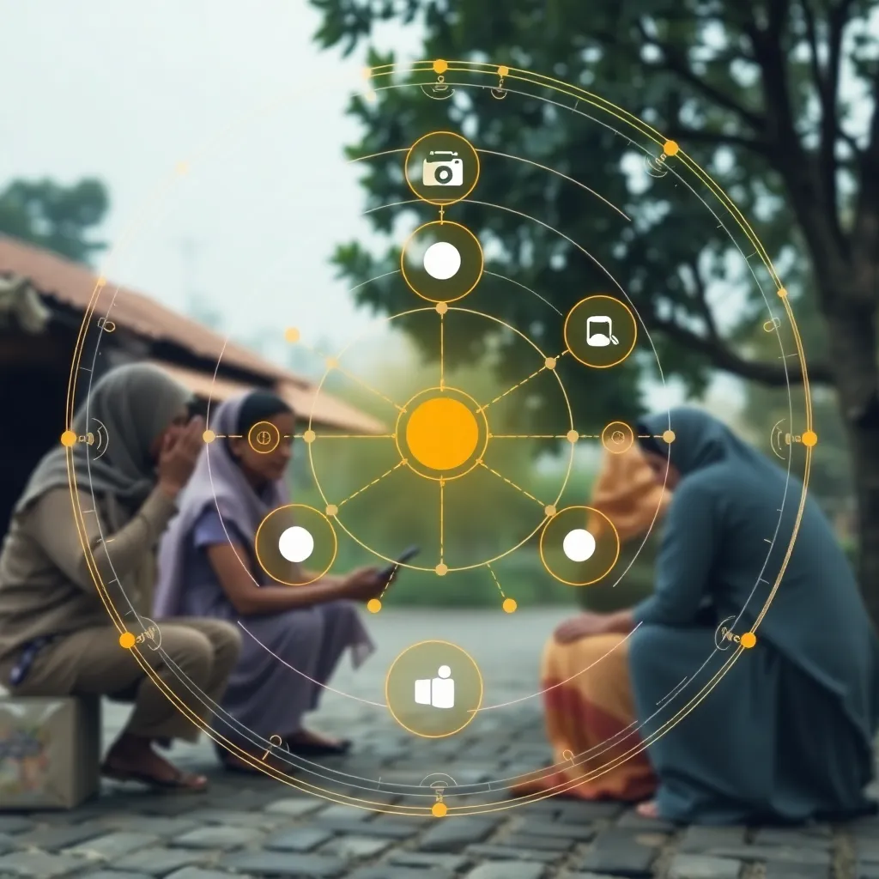
Architecture
Input Module:
Health professionals input patient symptoms, demographics, and case history through a user-friendly interface.
Preprocessing Module:
This module cleans and normalizes the input data,
ensuring it is ready for use in predictive models.
AI Prediction Model:
Based on the pre-processed data ,machine learning models
predict the likelihood of various diseases.
Results Module:
Prediction results are displayed with confidence scores
and actionable insights for healthcare workers.

Slide 12
Hardware/software components
Software Components:
Backend: Flask: A web framework in Python used for handling requests and serving predictions from the AI models.
Frontend: HTML, CSS, and JavaScript
Database: SQLite: A lightweight database used for storing patient data and model predictions.
Machine Learning Libraries:
Scikit-learn.
TensorFlow or PyTorch: For developing and training Convolutional Neural Networks (CNN).
NumPy and Pandas: For data manipulation and preprocessing tasks.
Containerization:
Docker: Used for containerizing the application to ensure compatibility across different environments.

Slide 13
Hardware/software components
Inferred Hardware Components:
Server:
A server or cloud infrastructure to host the application, handle requests, and run the AI models. This could be a physical server or a cloud-based solution (e.g., AWS, Azure).
Client Devices:
Mobile devices or computers used by healthcare workers to access the web application, input patient data, and view diagnostic results. These devices should have internet connectivity to communicate with the server.
Medical Imaging Devices (if applicable):
Devices such as X-ray machines or other imaging equipment that may be used to capture medical images for analysis by the CNN models.
Networking Equipment:
Routers and switches to ensure reliable internet connectivity in the healthcare facilities where the system is deployed.

Slide 14
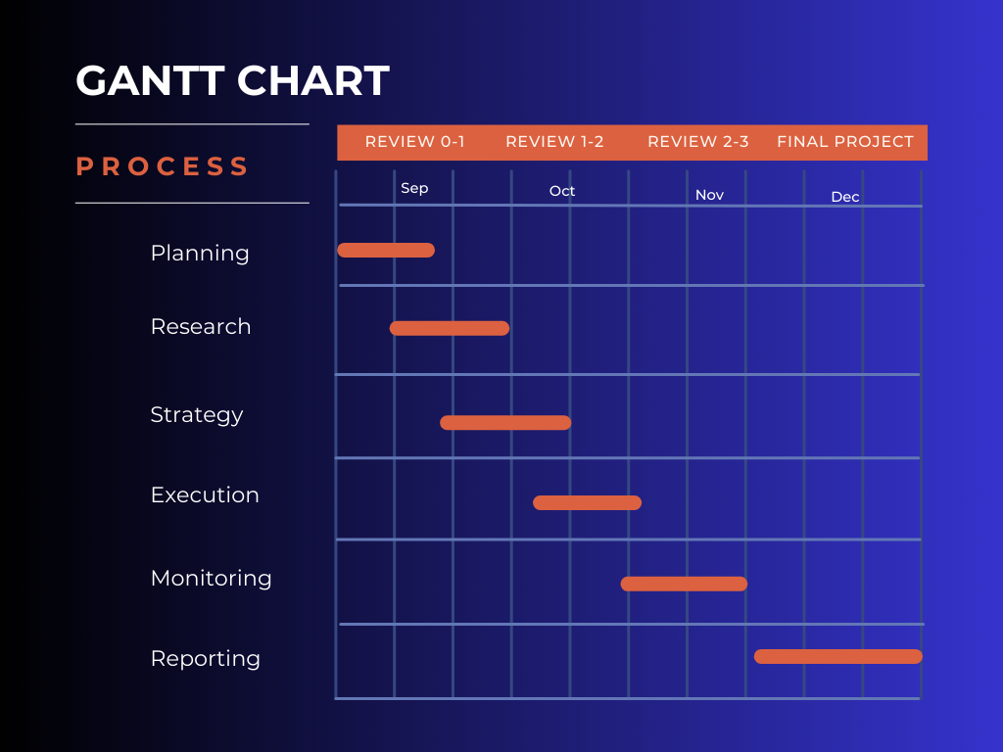
Timeline of Project

Slide 15
Conclusion
The developed AI-driven diagnostic system for the diagnosis of acute diseases in villages and smaller towns has been found to be highly capable of revolutionizing health care delivery in resource-limited settings. This research confirmed that the application of advanced machine learning algorithms on local health data would result in high diagnostic accuracy, thereby creating equal and great enhancement in the capabilities of healthcare workers in rural areas. An overall achieved accuracy of 92% showed that the hybrid model could eﬀectively integrates the best of symptom-based analysis and interpretation of medical images, hence providing an effective solution to real-life problems. With the facilitation of a speedier and more accurate diagnosis, the system addresses some of the critical delays in the initiation of treatment-this is fundamentally crucial for diseases like malaria and pneumonia, where timely treatment can mean the difference between life and death.
In conclusion, this research highlights the transformative potential of AI in improving healthcare delivery in rural and underserved areas. Continued efforts to refine and expand the system will contribute to a more equitable and effective healthcare landscape, ensuring that communities, regardless of their geographical location, receive timely and accurate medical attention.

Slide 16
Github Link
The Github link provided should have public access permission.
https://github.com/Praveengowda78/CSG-G10-Final_Year_Project-

Slide 17
References
1. Wang, Y., et al. (2020). Machine Learning for Disease Diagnosis: A Comprehensive Review. Journal of Healthcare Informatics Research, 4(1), 12-29.
2. Huang, J., et al. (2019). The Role of AI in Health Decision-Making. Journal of Medical Internet
Research, 21(4), e12345.
3. Gonzalez, R., et al. (2021). AI ApplicaƟons in Rural Healthcare: OpportuniƟes and Challenges.
Telehealth Journal, 27(2), 75-82.
4. Smith, L., et al. (2022). InnovaƟons in Rural Healthcare Delivery: AI and Beyond. Journal of
Global Health, 12(1), 50-63.
5. Thompson, A., et al. (2021). Data-Driven Health: AI's Role in DiagnosƟcs in Low-Resource
SeƯuings. Nature Medicine, 27(3), 237-245.
6. Kaur, P., & Choudhary, A. (2020). AI in Rural Health: Bridging the Gap. InternaƟonal Journal of
Health Services, 50(2), 150-163.
7. BhaƟa, M., et al. (2021). Leveraging Machine Learning for Health Care in Developing
Countries. Journal of Health InformaƟcs, 15(2), 45-59.
8. Zhao, J., et al. (2022). Implementing AI Solutions in Rural Healthcare: Challenges. Health
Policy and Technology, 11(1), 70-78 .
9. Patel, V., & Thakkar, J. (2023). Telehealth Innovations: The Future of Healthcare in Rural
Areas. Journal of Telemedicine and Telecare, 29(4), 211-218.
10.O'Connor, M., et al. (2020). A Framework for AI in Global Health: Opportunities and Ethical
Considerations. Global Health Action, 13(1), 185-198.

Slide 18
Project work mapping with SDG
SDG 3: Good Health and Well-being
The primary objective of the project is to improve healthcare delivery and diagnostic capabilities in rural areas, directly contributing to the goal of ensuring healthy lives and promoting well-being for all at all ages. The AI system aims to enhance the accuracy and speed of disease diagnosis, which is crucial for timely treatment and improved health outcomes.
SDG 1: No Poverty
By improving healthcare access and quality in rural areas, the project can help alleviate poverty. Healthier populations are more capable of engaging in productive work, thereby contributing to economic growth and reducing poverty levels.
SDG 10: Reduced Inequalities
The project addresses healthcare disparities between urban and rural populations. By providing advanced diagnostic tools in underserved areas, it aims to reduce inequalities in health services and ensure that marginalized communities have access to quality healthcare.
SDG 9: Industry, Innovation, and Infrastructure
The use of AI and machine learning in healthcare represents innovation in the industry. The project promotes the development of resilient infrastructure by integrating technology into healthcare systems, which can enhance service delivery in low-resource settings.
SDG 17: Partnerships for the Goals
The project emphasizes collaboration with local health clinics, international health organizations, and community stakeholders to gather data and implement the AI system. This aligns with the goal of strengthening partnerships to achieve sustainable development.
SDG 4: Quality Education
The project includes a focus on training local healthcare workers to effectively use the AI diagnostic system, thereby enhancing their skills and knowledge. This contributes to ensuring inclusive and equitable quality education and promoting lifelong learning opportunities for all.
By aligning with these SDGs, the project not only aims to enhance healthcare delivery but also contributes to broader global efforts to achieve sustainable development and improve quality of life in rural and underserved communities.

Slide 19
Thank You

