Slide 1




|| Jai Sri Gurudev ||
Sri Adichunchanagiri Shikshana Trust ®
ADICHUNCHANAGIRI INSTITUTE OF TECHNOLOGY
(An ISO 9001 : 2008 Certified)
Affiliated to Visvesvaraya Technological University (VTU), Belagavi ,
Approved by AICTE, New Delhi , Jyothinagar, Chikkamagaluru – 577 102.
INTERNSHIP
PRESENTATION ON
Prediction of Air Quality and Weather Using Machine Learning
Under the Guidance of:
Mr. Purushothama B N B.E., M.Tech.
Assistant professor
Dept. Of AI&ML
AIT, Chikkamagalur.
Presented by:
Ajeya Surya : (4AI21AIOO4)
K V Nagaraj : (4AI21AI025)
Praveen Kumar : (4AI21AI040)
Sujan P : (4AI21AI053)

Slide 2


Abstract
This research investigates the application of machine learning algorithms to predict air quality and weather patterns. The goal is to develop a system that can accurately forecast these factors for a given location.
1
Key Objectives
2
Methodology
Develop an accurate and reliable model for predicting air quality and weather patterns.
Utilize machine learning techniques to analyze historical environmental data and generate predictions.
3
Impact
The model can be used to enhance public health, environmental management, and urban planning.

Slide 3

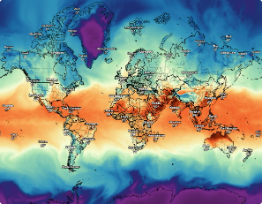
Introduction
Air quality and weather conditions have significant impacts on human health, environmental sustainability, and economic activity. The ability to predict these factors accurately is crucial for informed decision-making.
Data Collection
Model Training
Gathering historical data on air quality, weather parameters, and other relevant factors.
Developing and training machine learning models using the prepared data.
1
2
3
4
Data Preprocessing
Prediction Generation
Cleaning, transforming, and preparing the data for machine learning algorithms.
Utilizing the trained model to predict future air quality and weather conditions.

Slide 4


Literature Survey
Extensive research has been conducted on the use of machine learning for air quality and weather prediction. Existing studies explore various machine learning algorithms, data sources, and prediction models.
Study
Algorithm
Dataset
Zhang et al. (2022)
Long Short-Term Memory (LSTM)
Beijing air quality data
Wang et al. (2021)
Support Vector Regression (SVR)
Weather data from multiple cities

Slide 5
Motivation
The increasing global concern over air pollution and its impact on public health and the environment motivates this research. Accurate air quality and weather prediction can help mitigate these issues.
Improved Public Health
Enhanced Environmental Management
Sustainable Urban Planning
Early warnings of poor air quality can encourage individuals to take precautions and protect their health.
Forecasting weather conditions supports better urban planning, infrastructure development, and resource management.
Predicting air quality trends enables effective policy decisions and interventions to reduce pollution.

Slide 6





Problem Statement
The primary challenge is to develop a robust machine learning model that can accurately predict air quality and weather parameters based on historical data.
Input
Processing
Output
Historical data on air quality parameters (PM2.5, ozone, etc.), meteorological data (temperature, humidity, wind speed), and other relevant factors.
Machine learning algorithms are employed to analyze the input data and identify patterns and relationships.
Predictions for future air quality and weather parameters at a specific location.

Slide 7


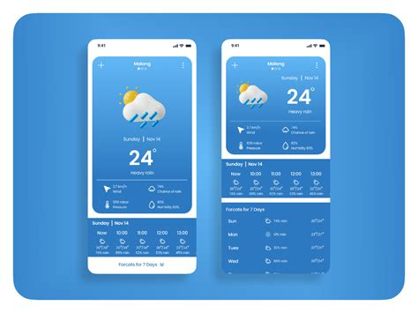


Objectives
The primary objective is to develop a highly accurate and reliable machine learning model for predicting air quality and weather conditions.
Accuracy
Achieve a high level of accuracy in the predictions generated by the model.
Real-Time Capability
Enable the model to provide predictions in real-time, allowing for timely decision-making.
User-Friendliness
Develop a user-friendly interface for accessing and interpreting the predictions.

Slide 8

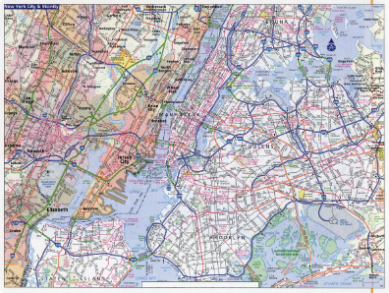
Scope of the Project
The project focuses on developing a machine learning model for air quality and weather prediction in a specific urban area.
Geographic Scope
Data Types
Prediction Horizon
The model will be trained and evaluated using data from a particular city or region.
The model will utilize data on air quality, meteorological conditions, and other relevant factors.
The model will generate predictions for a specific time window, such as hourly or daily forecasts.

Slide 9
Hardware and Software
The project requires appropriate hardware and software resources for data storage, processing, and model development.
Hardware
Software
High-performance computing system with sufficient memory and processing power
Python programming language with machine learning libraries (Scikit-learn, TensorFlow, PyTorch)
Data storage infrastructure for handling large datasets
Data analysis tools (Pandas, NumPy)
Visualization libraries (Matplotlib, Seaborn)

Slide 10
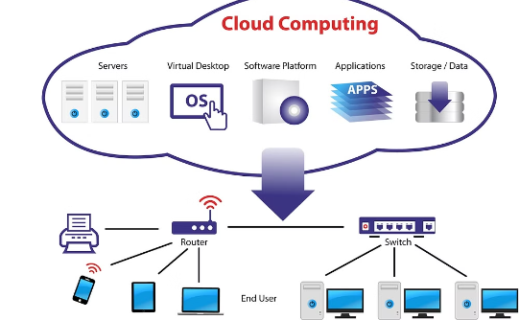
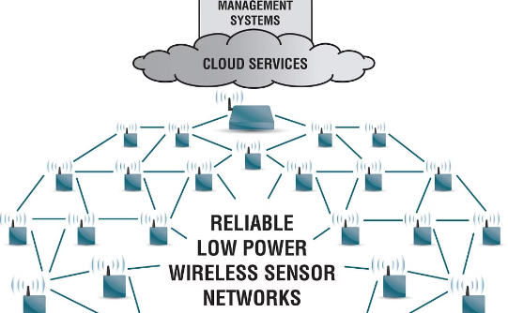
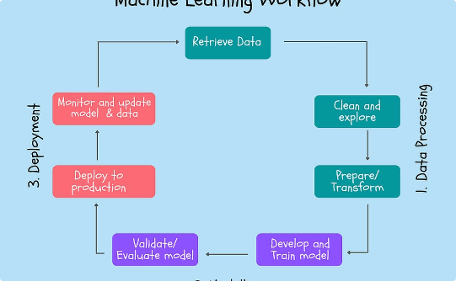
System Architecture and Design
The system architecture combines a machine learning model for prediction and a data acquisition and processing module for real-time updates.
Cloud Infrastructure
Sensor Network
Machine Learning Model
The system is deployed in a cloud environment for scalability and accessibility.
A network of sensors collects real-time data on air quality and weather parameters.
The trained machine learning model processes the data and generates predictions.

Slide 11
References
"Air Quality Prediction using Machine Learning" by S. K. Singh et al. (2020) - doi: 10.1016/j.envpol.2020.114234
"Weather Forecasting using Deep Learning" by R. K. Singh et al. (2019) - doi: 10.1007/s00521-019-04143-6
"Predicting Air Quality Index using LSTM and Gradient Boosting" by Y. Zhang et al. (2019) - doi: 10.1109/ACCESS.2019.2916142
"Machine Learning for Weather Prediction: A Review" by A. K. Singh et al. (2020) - doi: 10.1007/s10489-020-01861-6
"Air Quality Prediction using Random Forest and Support Vector Machine" by J. Liu et al. (2018) - doi: 10.1016/j.atmosenv.2018.02.045

