Slide 1
End-to-End ETL Workflow with Azure Data Factory and Databricks
Building an efficient data processing pipeline

Slide 2
Introduction
This presentation discusses the implementation of an end-to-end ETL workflow using Azure Data Factory and Databricks.
Discusses about the prerequisites to perform the project.
It also includes the Tools and technologies which are used in the project and also the overview of the execution process.

Slide 3
Overview of the end-to-end ETL workflow
Data Extraction
Data Transformation
Data Loading
The process begins with extracting data from various sources such as databases, applications, and files.
Transforming and cleaning the extracted data is crucial for ensuring its quality and usability.
This step involves standardizing formats, cleaning up inconsistencies, and preparing the data for the loading phase.
After the transformation process, the data is loaded into a target destination such as a data warehouse, database, or data lake.

Slide 4
Prerequisites
Azure Subscription
Azure Data Factory
Azure databricks Workspace
Azure Storage Account

Slide 5
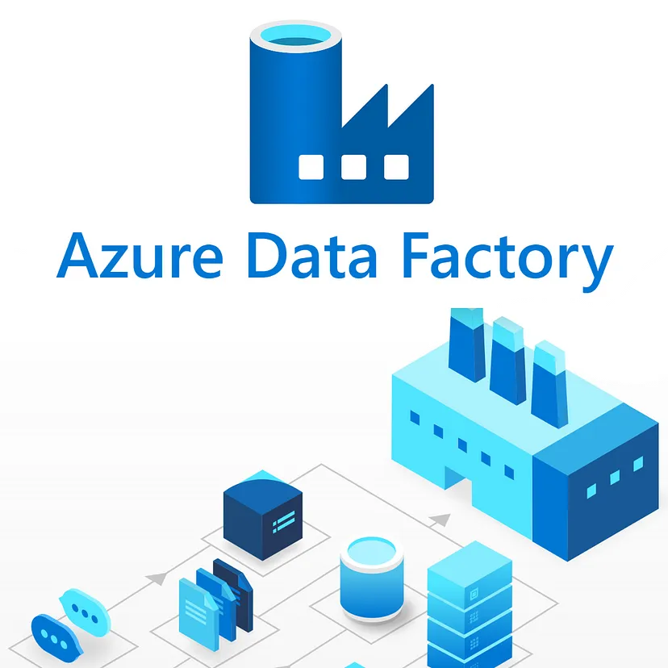
Azure data factory
Azure Data Factory is a cloud-based ETL and data integration service that allows you to create, schedule, and orchestrate data workflows.
It provides a platform for building end-to-end data pipelines that can extract data from various sources and load it into a target destination.

Slide 6
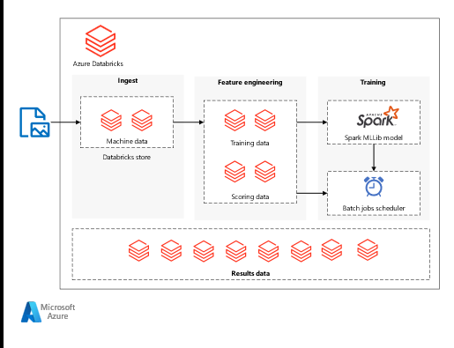
Azure databricks
Azure Databricks provides tools that help you connect your sources of data to one platform to process, store, share, analyze, model the datasets with solutions
Azure Databricks supports Python, Scala, R, Java, and SQL, as well as data science frameworks and libraries including TensorFlow, PyTorch, and scikit-learn.

Slide 7
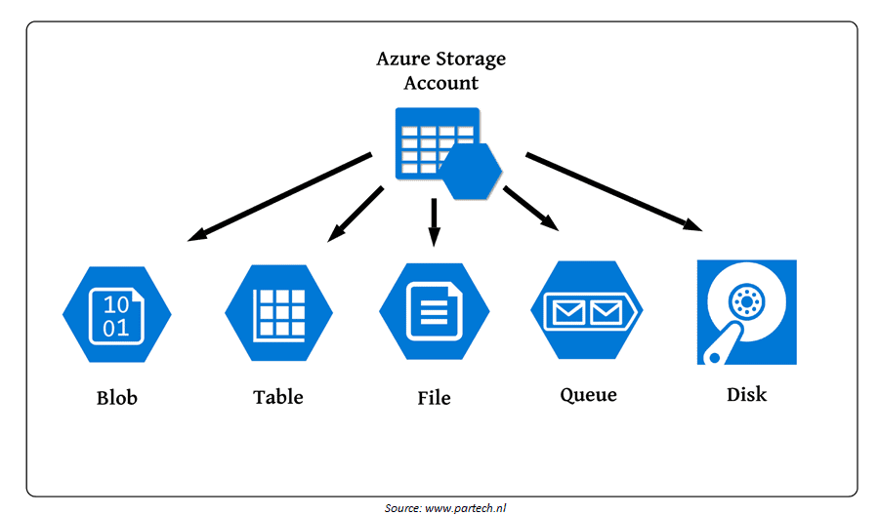
Storage account
An Azure storage account contains all of your Azure Storage data objects: blobs, files, queues, and tables.
The storage account provides a unique namespace for your Azure Storage data that's accessible from anywhere in the world over HTTP or HTTPS.
Data in your storage account is durable and highly available, secure, and massively scalable.

Slide 8
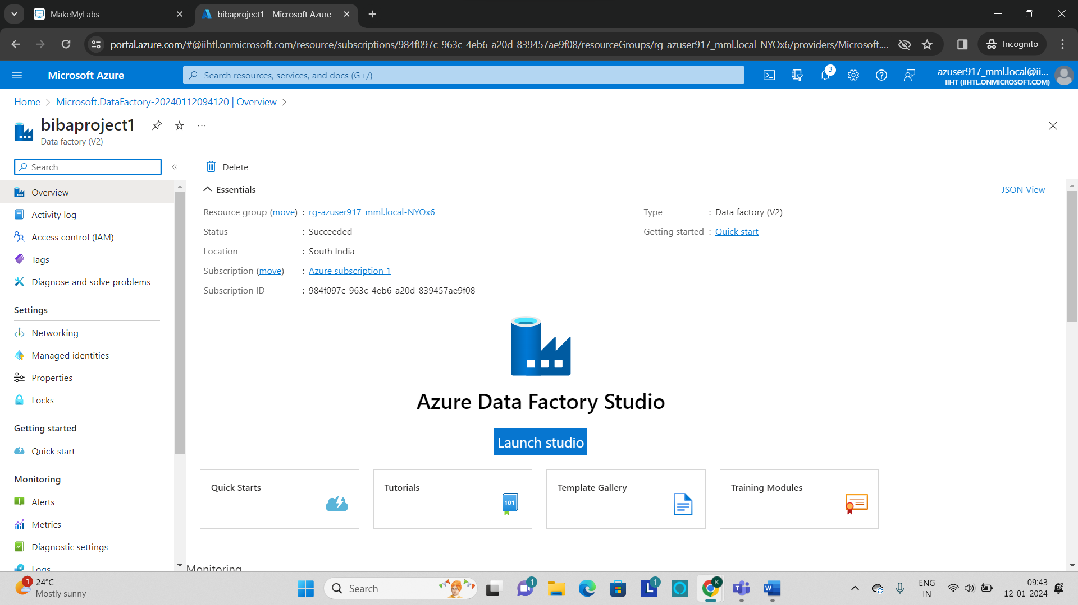
Execution overview
Step 1: Extracting data from various sources
Begin by setting up an Azure Data Factory instance which involves creating a new Data Factory and defining linked services to establish connections with your data sources and destinations.
Construct pipelines in the ADF interface to orchestrate the entire ETL workflow.
Within each pipeline, incorporate activities such as Copy Data to facilitate the movement of raw data from source to destination.

Slide 9
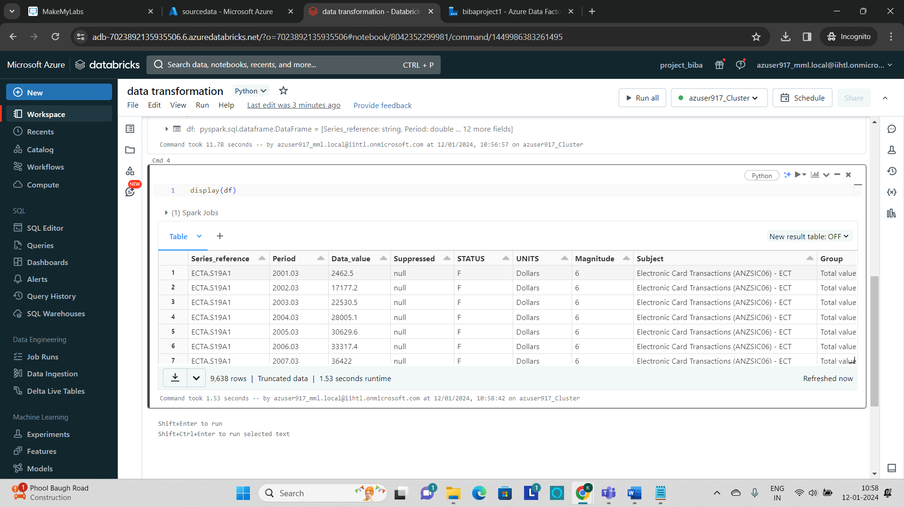
Step 2: Transformations in Azure databricks
To perform data transformations, integrate Azure Databricks into the workflow by Creating a cluster within your Azure Databricks workspace and develop Spark-based notebooks for complex transformations

Slide 10
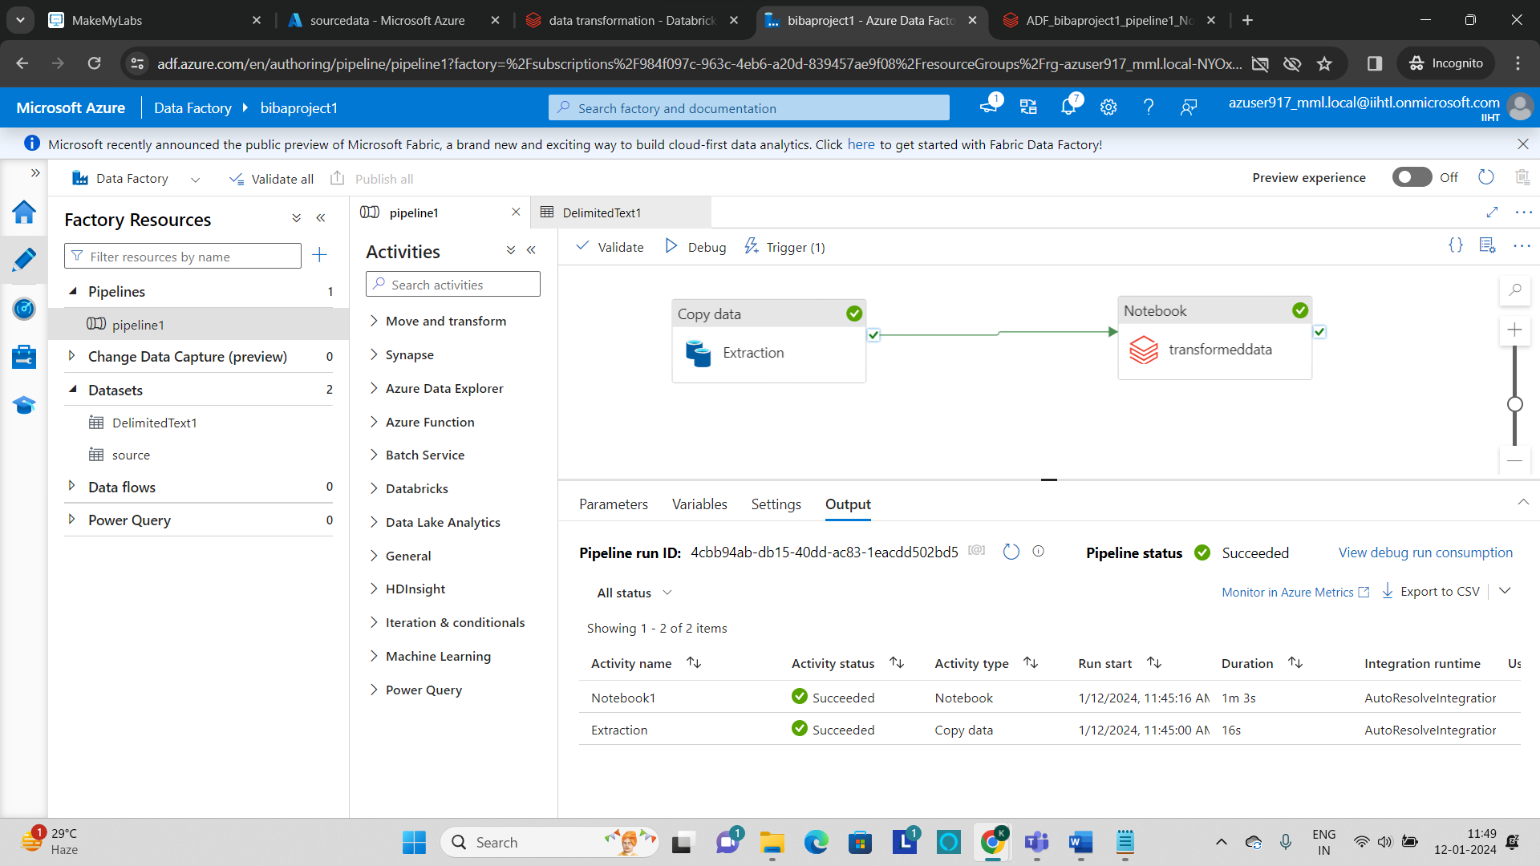
Step 3: Integrate ADF with ADB to load the data
Incorporate Databricks activities within the ADF pipeline to trigger the execution of Databricks notebooks.
After the transformations in Databricks, use ADF's copy data activities again to load the processed data into the destination storage or data warehouse.

Slide 11
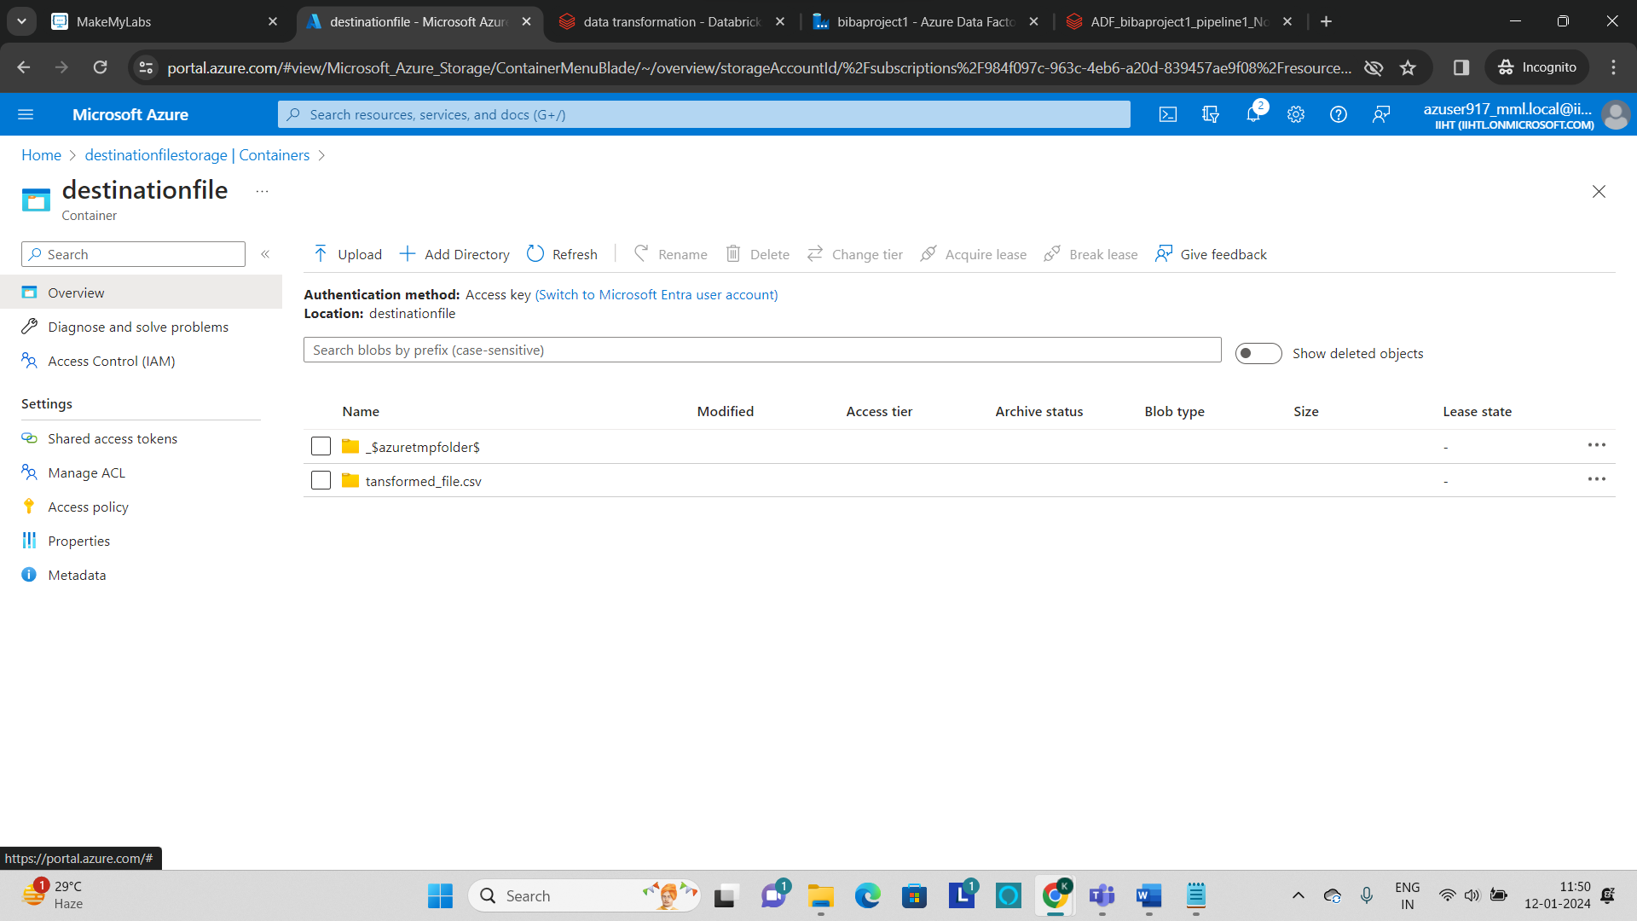
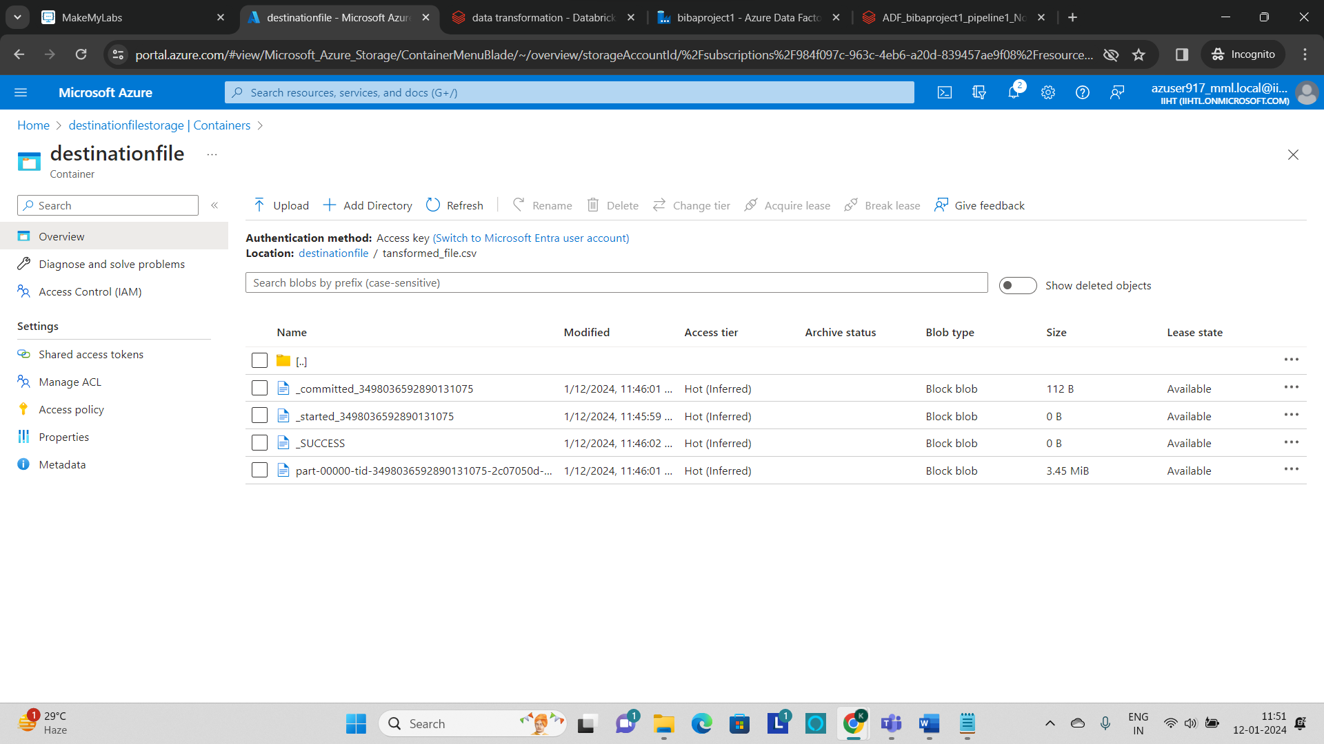
Output
The Transformation csv file is loaded into the destination storage container

Slide 12
Future enhancement
Connect to Azure Synapse Analytics to run the SQL Queries on top of the transformed data to get the insights and visualization.
Connect to Power bi:
Data visualization such as power bi will be more useful to get a good understanding of data and their insights.
Power bi has a lot of connectors to connect with external storage accounts to fetch the data and do the visualization.

Slide 13
THANK YOU

