Slide 1

Fixed-wing UAV guidance law for ground target over-flight Tracking
AE271
GUIDANCE THEORY AND APPLICATIONS
Authors: ZHANG Min, ZHENG Chenming, and HUANG Kun.
Nanjing University of Aeronautics and Astronautics, Nanjing China
Presented By: Praveen Kottari SR No: 22896 Robert Bosch centre for Cyber Physical Systems
Submitted to: Prof. Ashwini Ratnoo

Slide 2
Contents
Introduction
Motivation and Background
Problem statement
Guidance Law design
Simulation Results
Conclusion
References

Slide 3
Introduction
UAV large potential applications
Fixed wing UAV enhanced our capabilities in surveillance, monitoring , etc
UAVs are equipped with sophisticated guidance laws
Tracking ground target both stationary and in motion
New Algorithm have been tested through numerical simulations

Slide 4
Motivation and Background
Challenges in track a ground Target
In Ref[1] proposed LOS based guidance law
In Ref[2] Indirect overflight tracking method
Proposed Direct design method compared to existing

Slide 5
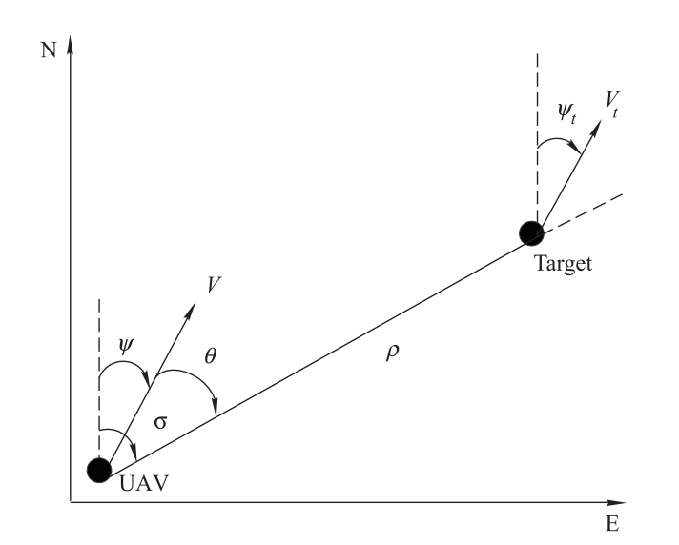


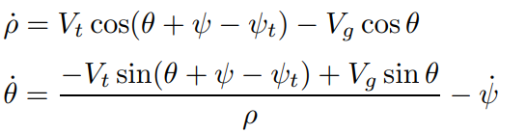
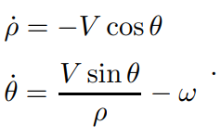
Problem statement
Assumptions
Inner loop already designed
Well response to the outer loop
UAV flying at the constant altitude
UAV considered as point mass
ω is the control input to be designed
When the ground targe is fixed then,

Slide 6
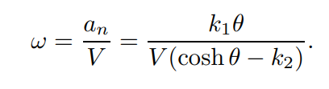
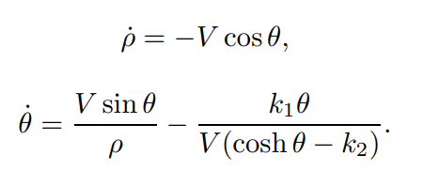
Guidance Law design
k1 and k2: Navigation gains
k1>0 and k2 >0
Dynamics of UAV in Closed loop system for static target

Slide 7
Simulation Setup
Motion of ground target
Stationary
Linear with variable speed
Circular with constant speed
The velocity of the UAV is set 10 m/s
The Gain adopted k1 =5.5, k2 =0.5
UAV initial position (-100,20)
UAV initial heading pointing of the south-east direction
Other initial conditions assumed

Slide 8
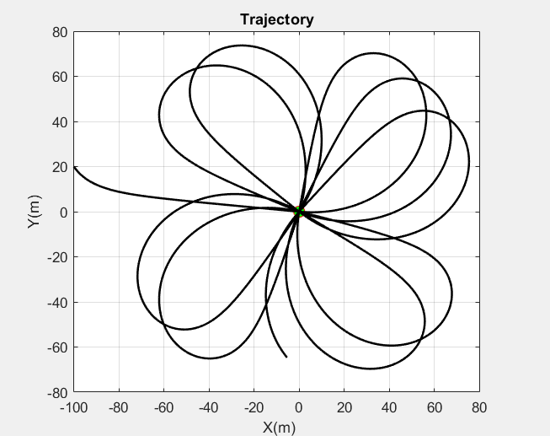
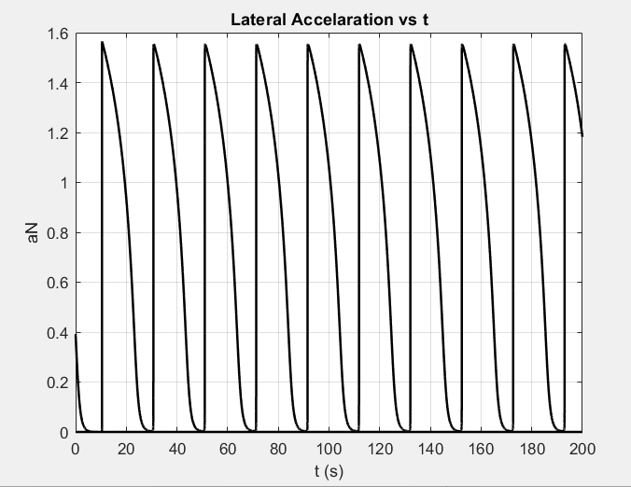
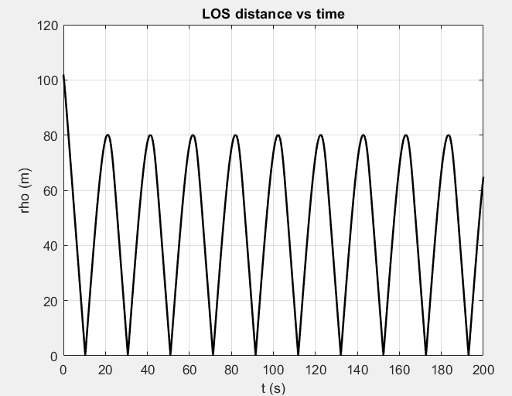
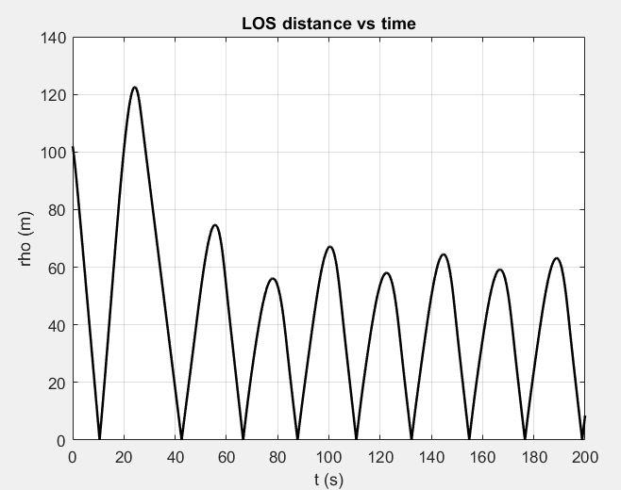
Simulation Results: Stationary Target

Slide 9
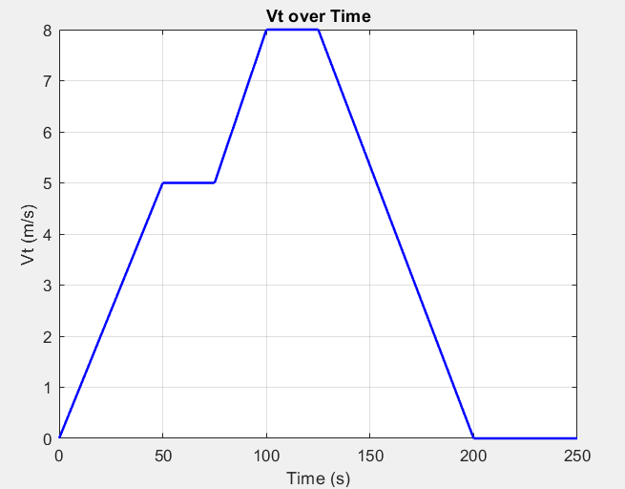
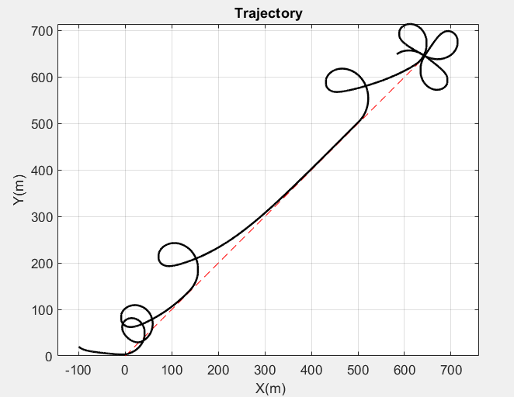
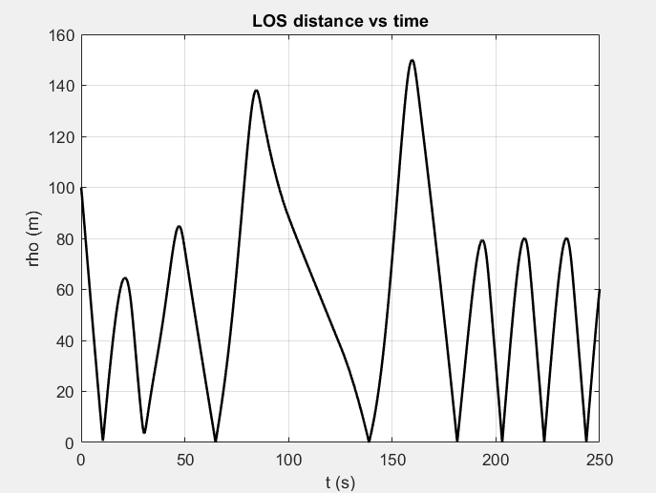
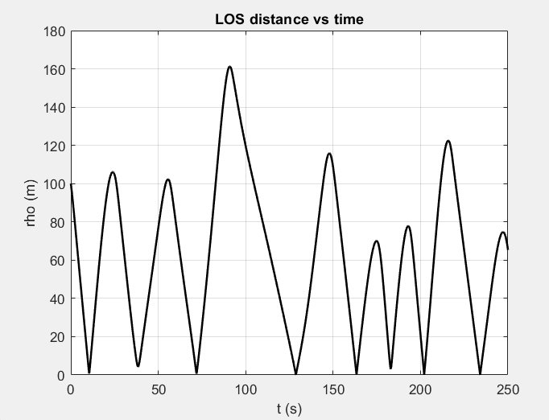
Simulation Results: Linear with variable speed

Slide 10
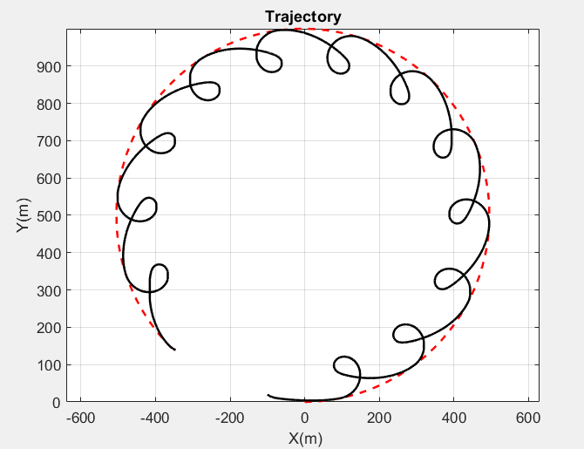
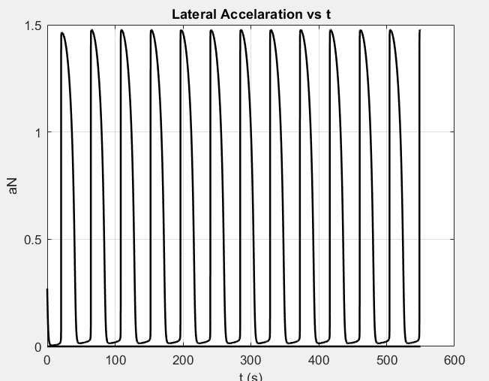
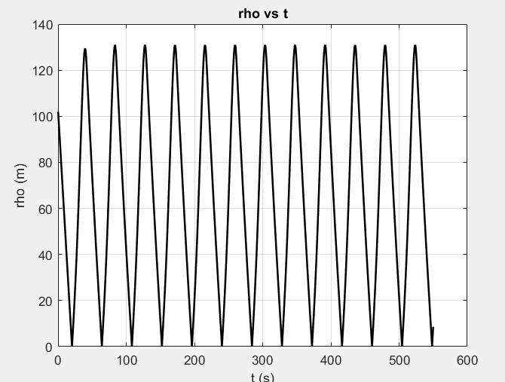
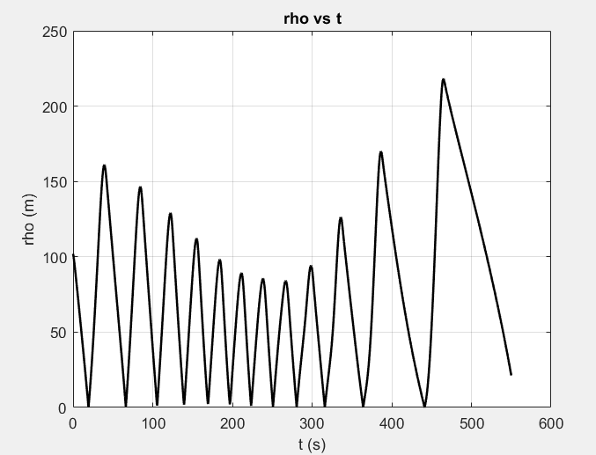
Simulation Results: Circular with constant speed

Slide 11
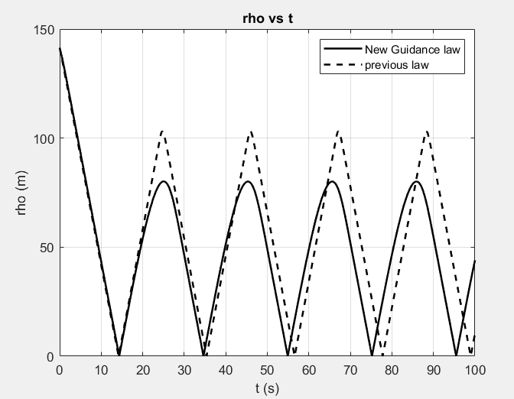
Conclusion
Tracking Performance Analysis
Performance evaluation done by comparing with Ref[1]
Distance between UAV & Target taken as criterion
Average Distance comparison
The new guidance law closer to approaching the target than existing one.
The Guidance law uses the LOS signal and satisfies UAV flight constrains
The proposed guidance law does not require piecewise function
Simulation results are presented to demonstrate the effectiveness

Slide 12
References
[1] REGINA N, ZANZI M. A novel solution for overflight and surveying of a collaborative target with fixed wing UAV. Proc. of the AIAA Guidance, Navigation, and Control Conference, 2012: 1627 – 1652.
[2] NIKI R, MATTEO Z. UAV guidance law for ground-based target trajectory tracking and loitering. Proc. of the Aerospace Conference, 2011: 1 – 9.
[3] ZHANG Min*, ZHENG Chenming, and HUANG Kun. Fixed-wing UAV guidance law for ground target over-flight tracking

Slide 13
Thank You !

