Slide 1

Hotel Booking Data Analysis and Business Intelligence Dashboard
34,407
bookings analysed
₹38.29 Cr
confirmed revenue
Occupancy, cancellations and revenue for two hotels, built in Power BI
30.8%
of bookings cancelled
Presented by Your Name
Notes:
Introduce the project: an end-to-end Power BI analysis of two hotels, built from requirement analysis through to a dashboard. The three numbers on the right are the headline results.

Slide 2
Why this project: cancellations cost revenue
The problem
30.8%
Hotels earn money only when rooms are filled at a good rate, yet about one booking in three is cancelled. Management has raw booking records but no single view of occupancy, cancellations and revenue.
of bookings are cancelled
₹21.28 Cr
Objectives
revenue lost to cancellations
Clean and model the booking data as a star schema
Measure bookings, revenue, ADR, occupancy and RevPAR
Find which guests, channels and lead times drive cancellations
Deliver an interactive dashboard with clear recommendations
52.6%
average occupancy
Notes:
A hotel only earns when rooms are filled. Roughly one booking in three is cancelled, which cost about 21 crore rupees. The objectives show how the project answers that.

Slide 3
The dataset: two hotels over three years
File | Rows | Description
hotel_bookings.csv | 34,662 | Fact table, one row per booking
dim_hotel.csv | 2 | Hotel name, type, location, rooms
dim_room_type.csv | 4 | Room type code and description
dim_country.csv | 10 | Country code, name and region
2
2022 to 2024
hotels
arrival period
31
INR
columns per booking
currency
Hotels: Chennai City Hotel (60 rooms) and ECR Beach Resort (40 rooms).
Simulated, realistic data built for this project, with planted errors to clean.
Notes:
Four CSV files: one fact table and three small dimension tables. The data is simulated but follows real hotel behaviour, and it includes deliberate errors so that cleaning is a real step.

Slide 4

Cleaning removed 255 faulty rows
Cleaning step | Rows
Removed duplicate bookings | -150
Removed zero-guest bookings | -60
Removed negative prices | -25
Removed extreme price outliers | -20
Blank children replaced with 0 | 300
Blank country set to Unknown | about 500
Added 6 columns, such as Total Guests and Booking Revenue | new
34,662
raw rows
34,407
clean rows
Zero-price stays were kept: they are valid complimentary bookings.
Notes:
All cleaning was done in Power Query. Duplicates, invalid bookings and price errors were removed, blanks were filled, and six new columns were added.

Slide 5
Star schema and DAX measures
dimhotel
Cancellation Rate
Cancelled bookings ÷ total bookings
Total Revenue
ADR × nights, confirmed bookings only
dimcountry
factbookings
DimDate
Avg ADR
Average daily rate of confirmed stays
Occupancy %
Room-nights sold ÷ rooms available
RevPAR
dimroomtype
Revenue ÷ rooms available
Revenue Lost
One fact table, four dimension tables
ADR × nights, cancelled bookings
Notes:
Four relationships connect the fact table to hotel, country, room type and a DAX date table. Eleven measures sit on top; these six drive the dashboard cards.

Slide 6
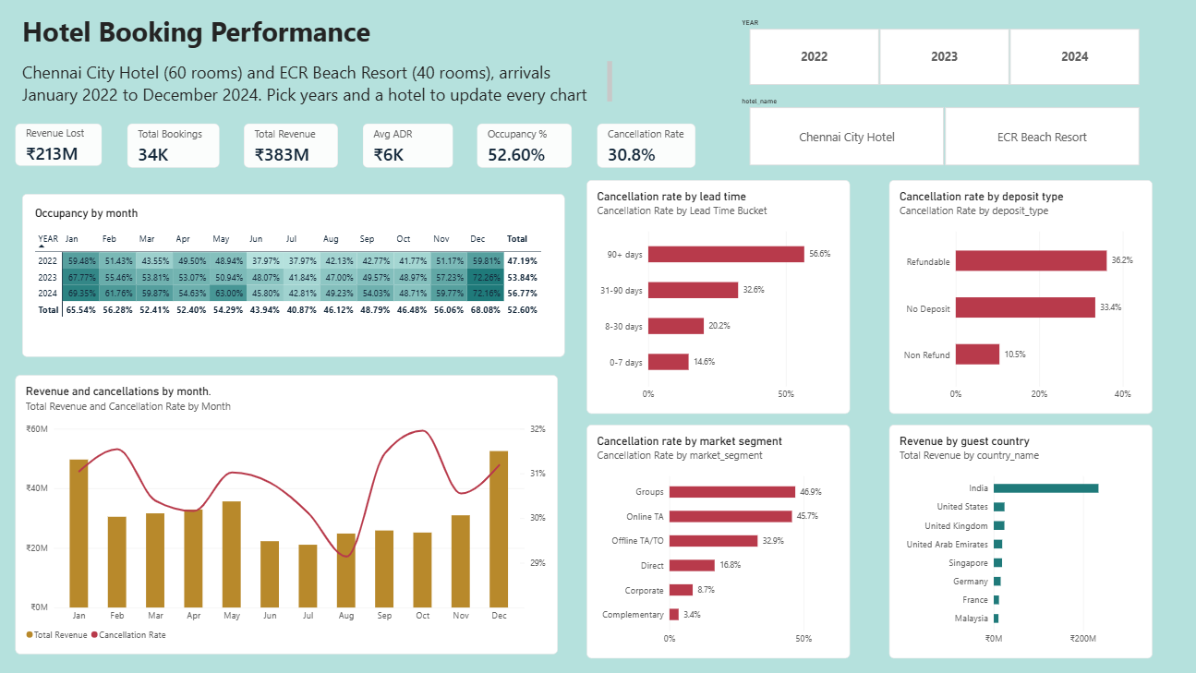
The Power BI dashboard
Slicers
Year and hotel filter every card and chart
KPI cards
Revenue, bookings, ADR, occupancy and cancellation rate
Charts
Occupancy heatmap, monthly trend, cancellations, countries
Notes:
One interactive page. Click a year or a hotel and every number updates. Walk through the cards first, then the heatmap and the charts.

Slide 7
Seasonality: December peaks, July dips
December: ₹5.25 Cr
strongest month
July: ₹2.11 Cr
weakest month
Pricing and staffing should follow this swing.
Notes:
Revenue is counted in the month of arrival. December is the busiest month and July the quietest, so pricing and staffing should follow that pattern.

Slide 8
Early and flexible bookings cancel most
46.9%
45.7%
8.7%
61.2%
Groups cancel
Online TA cancel
Corporate cancel
revenue from India
Notes:
Bookings made 90 or more days ahead cancel 56.6 percent of the time. Non-refundable bookings cancel only 10.5 percent. Groups and online agents cancel most; corporate guests least; India brings 61 percent of revenue.

Slide 9




Four recommendations
Require deposits early
Review overbooking limits
Use deposits or non-refundable rates for bookings made far in advance.
Plan for higher cancellations from group and online agent bookings.
Price for the seasons
Grow direct and corporate
Raise rates around the December peak and discount in July.
These segments cancel the least, so they give steadier revenue.
Notes:
Each recommendation comes straight from a finding: deposits for lead time, overbooking for groups and agents, pricing for seasonality, and growing the segments that cancel least.

Slide 10
Limitations and next steps
Limitations
Next steps
Simulated data shows typical hotel behaviour, not a real company
Occupancy uses a fixed room count per hotel
Revenue is counted in the month of arrival
Cancellation prediction model
Monthly demand forecast
Market-segment page and mobile layout
Thank you
Questions welcome
Your Name
github.com/your-username/hotel-booking-bi-dashboard
Notes:
Be open about limits: the data is simulated. Then outline next steps and invite questions.

