Slide 1
PRAVEEN KUMAR T
Final Project

Slide 2
PROJECT TITLE
SENTIMENT ANALYSIS

Slide 3


AGENDA
Problem Statement
Introduction
Objective
Understanding Facial expressions and emotions
Proposed Approach
Future Direction
Conclusion
3/21/2024 Annual Review

Slide 4

PROBLEM STATEMENT
The integration of human facial expressions into text for sentiment analysis poses a significant challenge due to the inherent complexity of interpreting visual cues and converting them into textual representations. While deep learning techniques have shown promise in analyzing both text and visual data separately, combining these modalities introduces unique challenges. The problem we aim to address is the development of a robust deep learning system capable of accurately analyzing human facial expressions and translating them into text-based sentiment classifications. This system must navigate the intricacies of facial emotion recognition, contextual understanding, and language processing to provide meaningful insights into the emotional content conveyed by individuals. By overcoming these challenges, we can unlock new opportunities for sentiment analysis in various domains, including social media monitoring, customer feedback analysis, and human-computer interaction.

Slide 5

PROJECT OVERVIEW
INTRODUCTION:
Sentiment analysis has evolved beyond textual data to encompass various modalities, including human facial expressions. By integrating deep learning techniques, particularly neural networks, we can decode and interpret emotions conveyed through facial cues and translate them into textual form. This interdisciplinary approach bridges the gap between visual and textual sentiment analysis, offering a richer understanding of human emotions expressed across digital platforms. In this presentation, we will explore the fusion of deep learning and facial expression analysis, delving into its applications, challenges, and the potential for enhancing sentiment analysis in diverse contexts. Through this innovative synthesis, we aim to unlock new avenues for extracting and comprehending sentiment from human interactions in the digital realm.

Slide 6
OBJECTIVE:
The objective of sentiment analysis with human face expression into text using deep learning is to accurately interpret and translate facial expressions into textual form, capturing emotional cues effectively. This encompasses developing deep learning models for facial expression recognition, classifying emotions into positive, negative, or neutral categories, and converting them into coherent textual representations. It also involves ensuring semantic understanding to account for contextual nuances and individual differences. The goal is to achieve high accuracy and robustness across diverse datasets and real-world scenarios, enabling real-time processing for timely analysis and response in applications like customer service and human-computer interaction.

Slide 7
UNDERSTANDING FACIAL EXPRESSIONS AND EMOTIONS
Understanding facial expressions and emotions through deep learning revolutionizes human-computer interaction, enhancing machines' ability to interpret and respond to human sentiments. Leveraging CNNs and RNNs, deep learning models adeptly capture subtle facial features and temporal dynamics, enabling accurate emotion recognition. Analyzing cues like eyebrow movements and lip curvature, these models decipher a spectrum of emotions, from happiness to anger, with precision. Integration of deep learning with extensive labeled datasets ensures robust emotion recognition across diverse cultural contexts and individual variations. This advancement holds vast potential across applications such as personalized user experiences, mental health monitoring, and market research, fostering empathetic and responsive interactions between humans and machines.

Slide 8
PROPOSED APPROACH:
Our proposed deep learning architecture aims to revolutionize facial expression analysis by seamlessly integrating advanced CNNs and RNNs. This architecture is meticulously designed to capture not only intricate facial features but also the temporal dynamics inherent in facial expressions. By combining the strengths of CNNs in feature extraction with the temporal modeling capabilities of RNNs, our approach achieves superior accuracy in emotion recognition. With a focus on capturing subtle changes over time, our architecture enables nuanced understanding of emotions, paving the way for more empathetic and responsive human-computer interactions.

Slide 9
FUTURE DIRECTION:
sentiment analysis is poised to undergo significant advancements, particularly through the integration of multi-modal approaches that combine text, audio, and visual cues for more comprehensive emotion understanding. Additionally, the refinement of deep learning architectures, coupled with the availability of larger and more diverse datasets, will likely lead to even greater accuracy and generalization in sentiment analysis tasks. Furthermore, emerging technologies such as federated learning and privacy-preserving techniques will enable sentiment analysis models to be deployed in sensitive contexts while preserving user privacy. Ultimately, these developments promise to revolutionize how we understand and respond to human emotions, ushering in an era of more empathetic and intelligent systems.

Slide 10
CONCLUSION:
sentiment analysis powered by deep learning has already made significant strides in deciphering human emotions from textual and visual data. By leveraging advanced techniques and models, we've gained valuable insights into user sentiments, driving improvements in various applications ranging from customer feedback analysis to mental health monitoring. As we look ahead, continued innovation and collaboration will be key to unlocking the full potential of sentiment analysis, enabling us to create more empathetic, responsive, and inclusive technologies that enrich human experiences and interactions.

Slide 11

WHO ARE THE END USERS?
Market Researchers: Market researchers can utilize sentiment analysis with human face expression to gauge consumer reactions to products or services, allowing them to make data-driven decisions regarding marketing strategies and product development.
Customer Service Departments: Customer service departments can benefit from understanding the emotions expressed by customers through facial expressions in their feedback or complaints. This insight can help them tailor responses and improve overall customer satisfaction.
Advertising Agencies: Advertising agencies can leverage sentiment analysis with human face expression to measure the effectiveness of ad campaigns by analyzing viewer reactions captured through facial expressions in videos or advertisements.

Slide 12
WHO ARE THE END USERS?-CONT.
Social Media Platforms: Social media platforms can incorporate sentiment analysis with human face expression to enhance user experience by providing personalized content based on emotional responses and sentiment expressed in users' posts or interactions.
Healthcare Professionals: Healthcare professionals can utilize sentiment analysis with human face expression to assess the emotional well-being of patients, enabling them to provide better care and support, especially in mental health settings.
Educational Institutions: Educational institutions can use sentiment analysis with human face expression to gauge student engagement and emotional responses in online learning environments, facilitating personalized learning experiences and interventions.

Slide 13

YOUR SOLUTION AND ITS VALUE PROPOSITION
Our sentiment analysis solution utilizes deep learning to provide accurate insights from textual and visual data, enabling informed decision-making and driving competitiveness. By fostering empathetic interactions, it enriches user engagement and loyalty, while pioneering innovations in mental health monitoring and personalized recommendations. Committed to ethical deployment, our solution prioritizes user privacy, building trust and fostering sustained business success.

Slide 14

THE WOW IN YOUR SOLUTION
1.Precision: Our deep learning model accurately captures nuanced emotions, ensuring reliable sentiment analysis.
2. Efficiency: Leveraging advanced CNNs and RNNs, our solution achieves fast and efficient processing of large volumes of data.
3. Adaptability: Our model can effectively handle diverse cultural contexts and individual differences, enhancing its applicability across various scenarios.
4. Insightfulness: By integrating temporal dynamics in facial expressions, our solution offers deeper insights into emotional states, enabling more nuanced understanding and interpretation.
5. Versatility: Our approach can be seamlessly integrated into existing systems and applications, enriching user experiences across domains such as marketing, healthcare, and entertainment.
6. Ethical Considerations: We prioritize user privacy and ethical data handling practices, ensuring responsible deployment of sentiment analysis technology.
3/21/2024 Annual Review

Slide 15
MODELLING
Data Collection: Collect a diverse dataset comprising images of human faces expressing various emotions alongside corresponding textual sentiment labels (positive, negative, neutral) to train the model effectively.
Preprocessing: Prepare the image data by resizing, normalizing pixel values, and augmenting the dataset to enhance model generalization. Similarly, preprocess textual data by tokenizing and applying techniques like stemming or lemmatizing for model input readiness.
Feature Extraction: Employ deep learning techniques such as CNNs or pretrained models like VGG, ResNet, or EfficientNet to extract meaningful features from facial images that effectively capture emotional cues.
Model Architecture: Design a deep learning architecture that integrates both image and text modalities. Options include multimodal architectures like Multimodal CNNs or transformer-based models like BERT, or fusion strategies like late or early fusion to combine image and text features.
Training and Evaluation: Train the model on the labeled dataset using appropriate loss functions and optimization algorithms, monitoring key performance metrics such as accuracy, precision, recall, F1-score, and confusion matrix analysis to evaluate its effectiveness in accurately classifying sentiment from facial expressions into textual form.

Slide 16
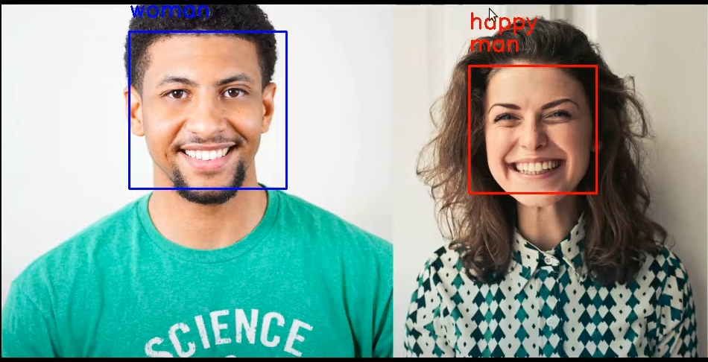
RESULTS

