Slide 1
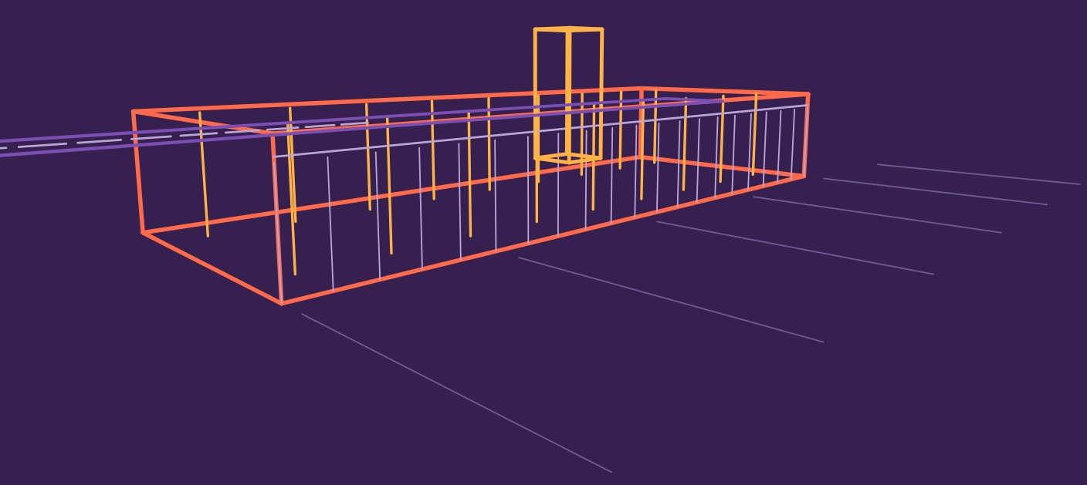
MINI PROJECT | PROJECTION + HSR
3D Airport Terminal Visualization and Navigation
Perspective projection and hidden surface removal for a walkable airport built in Blender with Python
Terminal wireframe drawn with the same projection maths this project is about
Praveen Kumar A
Reg. No. 2411021061557
Notes:
Introduce the topic: a 3D airport terminal you can walk through. Two graphics ideas drive it: perspective projection (3D to 2D) and hidden surface removal (which surface is nearest). The wireframe on the right was drawn with those projection equations.

Slide 2
A walkable airport must be re-projected every frame
80 × 30 m
18
16
terminal floor with a 12 m ceiling, glass facades front and back
structural columns plus glass walls that hide what is behind them
animated NPCs by default, each built from articulated body parts
Visualization problem: turn 3D world coordinates into a 2D image (projection) and decide which surface is nearest at every pixel (hidden surface removal), while the camera moves under keyboard and mouse control.
Goal: an interactive terminal with realistic camera navigation, built from basic projection and visibility techniques.
Notes:
Numbers come straight from the Blender script: the terminal shell is 80 by 30 metres, 12 metres high; columns are on a 9 m grid in two rows (9 x 2 = 18); NPC_COUNT defaults to 16.

Slide 3
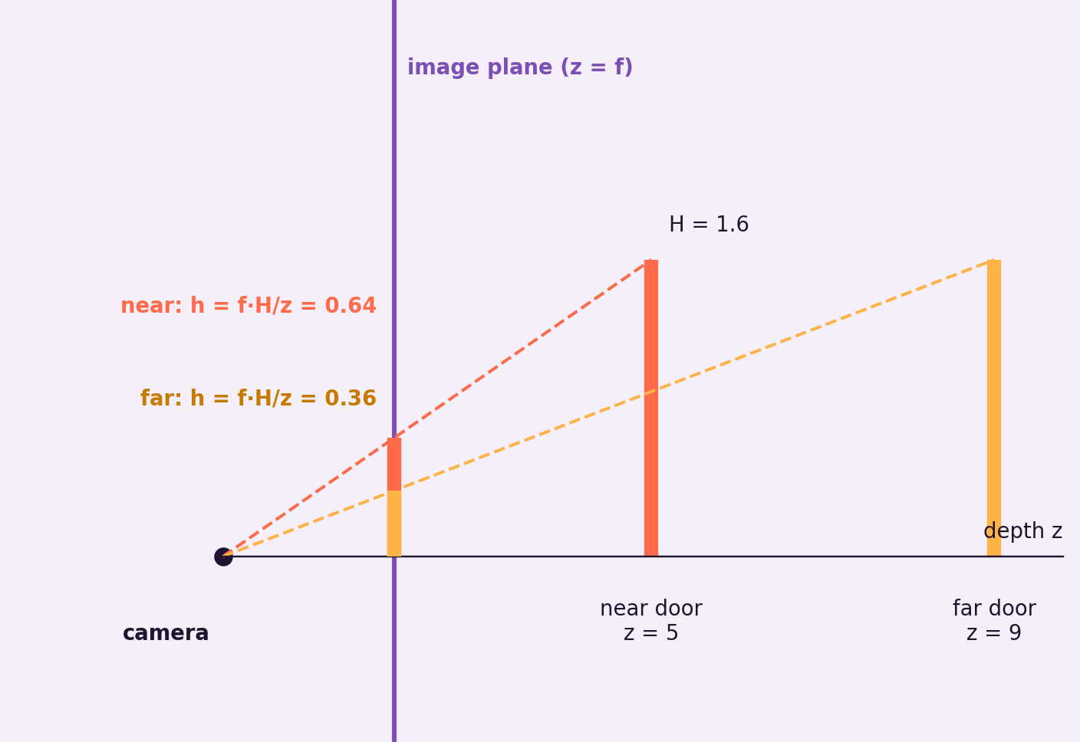
Projection: similar triangles map 3D points to 2D
1
Move to camera space
Subtract the camera position and rotate so the camera looks straight down the depth axis.
2
Perspective divide
x' = f·x / z and y' = f·y / z. The same door looks smaller the farther away it is.
3
Map to the screen
Scale and shift to pixel coordinates; anything outside the view frustum is clipped.
Example: a 3.6 m door at 10 m depth is about 336 px tall on a 1080p, 60° view.
Notes:
Similar triangles: the ratio of projected height to focal length equals real height to depth. f is about 935 px for a 1080p image with a 60 degree vertical field of view (540 / tan 30).

Slide 4
From model to pixels: the projection pipeline
Model space
World space
Camera space
Clip space
Screen space
Each mesh is built around its own origin
Model matrix places it in the terminal
View matrix puts the player camera at the origin
Projection matrix applies the lens and frustum
Divide by depth, then map to pixels
Screen position of a camera-space point (x, y, z)
Who does what
Blender's renderer runs these steps on the GPU. Our script builds the world and drives the camera.
x_s = W/2 + f · x / z
y_s = H/2 − f · y / z
Notes:
Model, view and projection matrices are the standard chain. The perspective divide by z is the step that gives foreshortening.

Slide 5
Hidden surface removal: only the nearest surface may win
1
Back-face culling
2
Painter's algorithm
3
Z-buffer
Skip polygons that face away from the camera. Switched on for every opaque material in the script.
Sort polygons far to near and draw in that order. Simple, but needs a sort and fails on cyclic overlap.
Keep the nearest depth at each pixel. Order-independent, and what the viewport uses to resolve visibility.
Technique | Sorting needed | Handles cycles | Role in this project
Back-face culling | None | Not applicable | Enabled on all opaque materials
Painter's algorithm | Every frame | No | Reference idea only
Z-buffer | None | Yes | Resolves visibility in the viewport
Glass is the exception: facades and doors are alpha-blended with culling off, so they show what is behind them.
Notes:
In the script, mat() sets use_backface_culling to True when alpha is 1 and False for glass. Hidden surfaces among opaque objects are resolved by the depth buffer in the renderer.

Slide 6
Navigation: a third-person camera and a mission to finish
W A S D
Mouse
Shift
Space
Wheel
move
orbit camera
sprint
jump
camera distance
E
R
M
L
Esc
talk to nearest
respawn
voices on/off
performance mode
exit
Mission
Talk to the check-in agent
Go through Security
Talk to the officer
Reach Gate B1
Three start modes: PLAY (game), TOUR (automatic guided walk that can be rendered to video) and WALK (simple first-person).
Notes:
Controls and mission are as defined in the script header. Finishing the mission at Gate B1 shows MISSION PASSED.

Slide 7
Why it looks right, and how it stays smooth
Shared meshes
One mesh per shape and material is reused by every object.
Cheap people
NPC_COUNT and HIGH_DETAIL_PEOPLE cut object counts on slow PCs.
Performance mode
Press L in game, or start in solid viewport mode.
Culled faces
Back faces of opaque surfaces are never shaded.
Computed from y = f·H/z (f ≈ 935 px). A calculation, not a benchmark.
Notes:
Left: pure maths. Doubling the distance halves the projected size. Right: the performance switches that exist in the script (NPC_COUNT, HIGH_DETAIL_PEOPLE, START_IN_SOLID_MODE, L key). No frame-rate measurements are claimed.

Slide 8
One Python script builds the airport and runs the game
Scene builders
From the script
Helpers such as mk(), build_plane() and build_car() create the terminal, tower, runway, aircraft and cars.
# hidden-surface helper
m.use_backface_culling = alpha >= 1.0
# one mesh per (shape, material)
key = (kind, m.name)
if key in _mesh:
return _mesh[key]
Articulated people
Hip, knee, shoulder, elbow and head pivots drive walk, idle and talk poses.
Game layer
NPC behaviour, subtitles, voice lines and PA announcements react to the player.
Run: Alt+P in Blender's Scripting workspace (Blender 3.2+, 4.x, 5.x)
Notes:
The script is a single file. Mission, NPC conversation and the modal game loop sit on top of the scene builders.

Slide 9
Conclusion
Project
Remove
Navigate
Perspective projection turns 3D terminal coordinates into the 2D view with one divide by depth.
Back-face culling and the depth buffer keep only the nearest surface at each pixel.
A third-person camera and a short mission make the terminal explorable in real time.
Limits and next steps: culling works per face, not per room. Next: portal or occlusion culling for terminal zones, level of detail for people, and baked lighting.
Notes:
Close by tying the three ideas together, then mention the limits honestly.

