Slide 1


Retail Data Analytics
Surendra Bhargava
Praveen. M
Likhitha. G
Shravani. A
Shushma. J

Slide 2
Agenda
Problem statement
EDA and Data challenges
Approach
Solution

Slide 3
Problem Statement
The store has a loyalty program and wants to provide offers on products during non-sale period on certain categories of interest. Based on the Black day sales data, recommend the top 100 products it must prioritize for loyalty rewards to customers. Please give a business and statistical reasoning.

Slide 4
EDA

Slide 5
Attributes’ Information
Customer Details
User_ID
Gender
Age
Occupation
Product Details
User_ID
Product_ID
Product_Category_1
Product_Category_2
Product_Category_3
Purchase
Locations
User_ID
City_Category
Stay_In_Current_City
Data set: (537577, 11)
Number_Categorical : 5
Missing Values: Product_Category_2 : 166986
Product_Category_3 : 373299

Slide 6
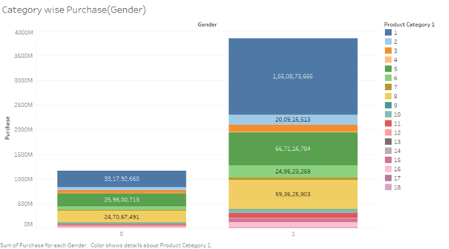
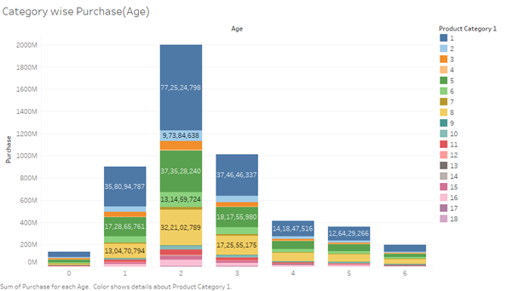
Insights
Purchase behaviour of gender and age groups in every category

Slide 7
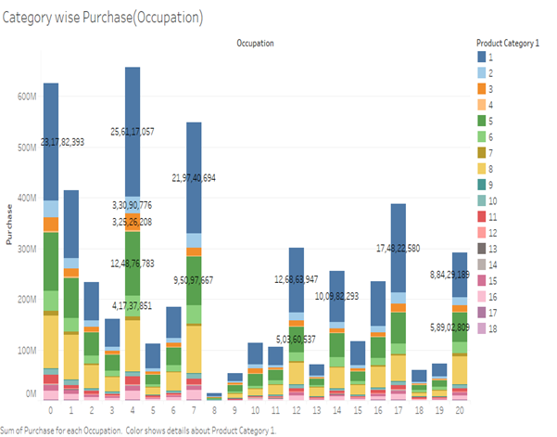
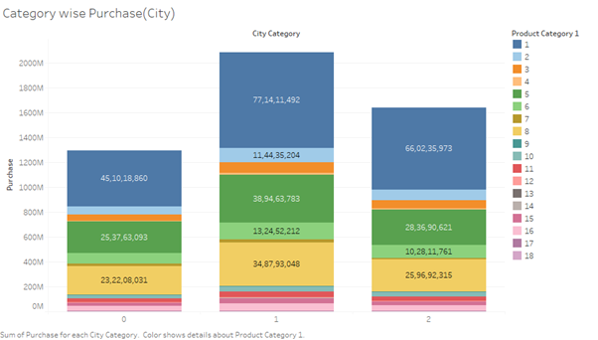
Purchase behaviour occupation wise and city wise in every category

Slide 8
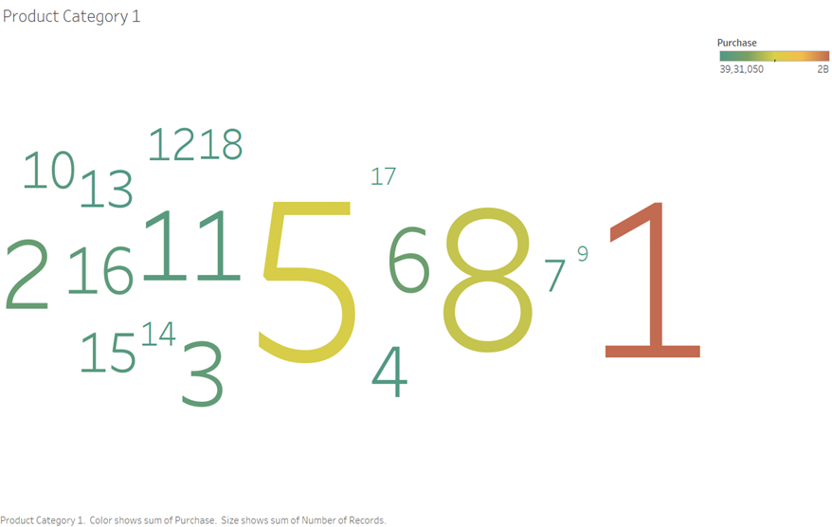
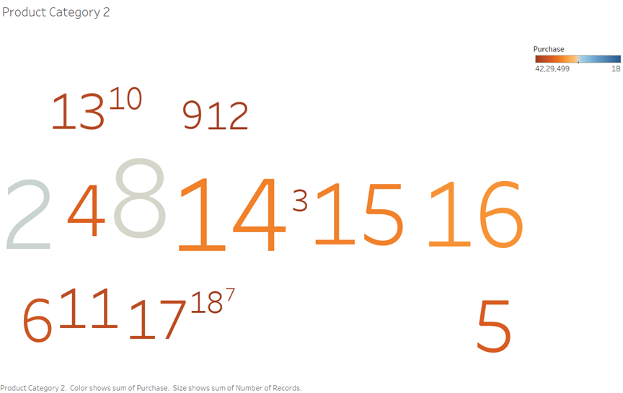
Category wise purchase behaviour
Size : category with more products
Colour : Category in which highest purchase is made

Slide 9
Data Challenges
Only sale period data
Data in seperate sheets
Null value treatment

Slide 10
Approach
Product Segmentation
Data preparation
Clustering
Analysis of clusters
Market Basket Analysis
Loyalty program

Slide 11
Data Preparation
Frequency-monetary analysis
Frequency : Maximum number of times a product is purchased
Monetary : Overall purchase made per product
Data scaling

Slide 12
Clustering
Algorithm used : K-means
Optimal number of clusters : 3
Through elbow method
Clusters formed:
Cluster 0 : Low frequency high monetary
Cluster 1 : High frequency high monetary
Cluster 2 : Low frequency low monetary

Slide 13
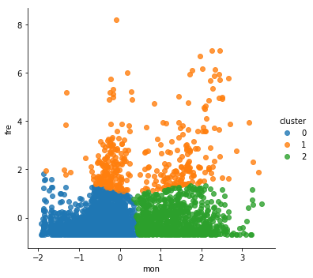
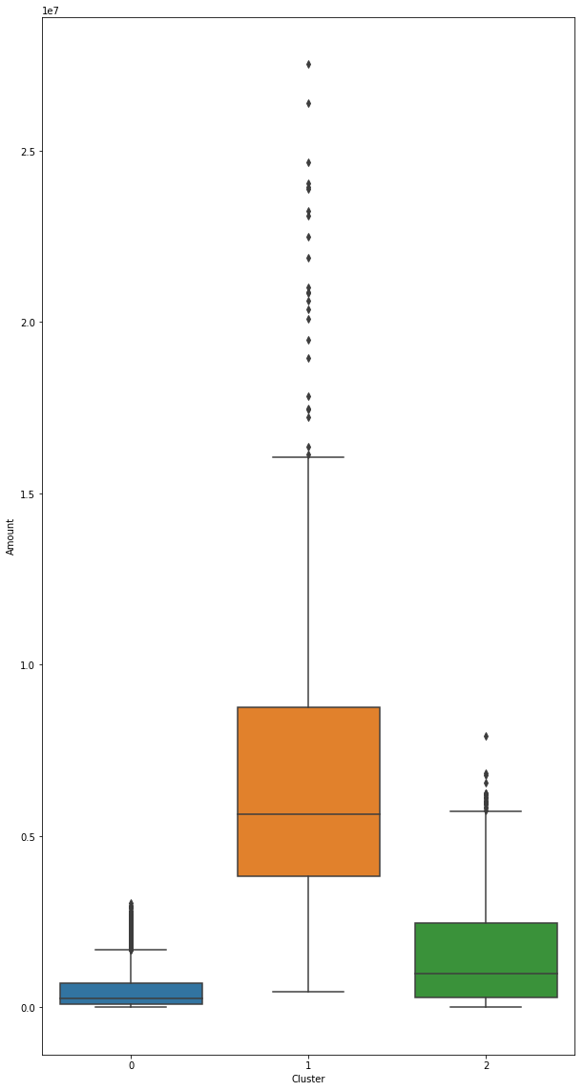
Analysis of Clusters
Top 100 products prioritized from cluster 1
Cluster wise Purchase Behaviour

Slide 14

Market Basket Analysis
Used to determine what items are frequently bought together or placed in the same basket by customers
Helps to improve store layouts and recommendation systems
Cluster consideration for market basket:
high frequency high monetary
low frequency low monetary

Slide 15
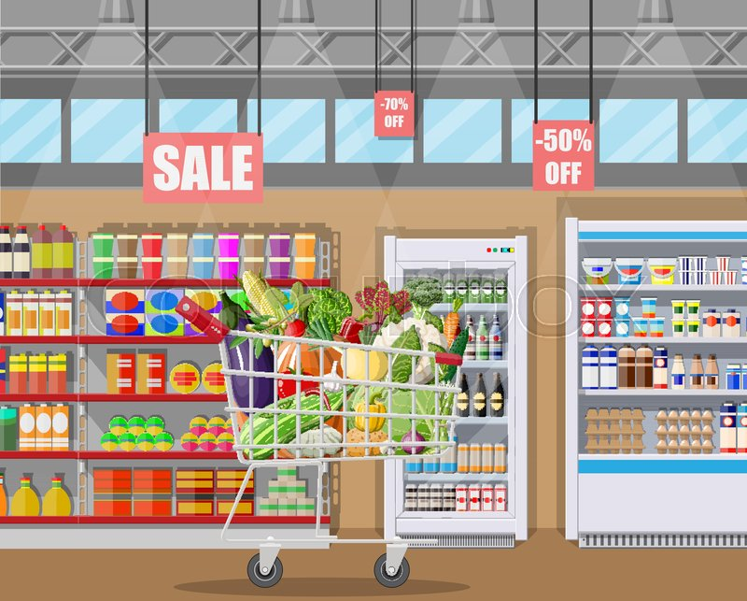
Solution
Loyalty program
PLAN:
Reward points for the cluster of highly purchased products
Basket recommended products from cluster of low purchased products can be given as rewards

Slide 16


