Slide 1
COA COURSE PROJECT

Slide 2
1. Name: Praveen Naik
Roll no: 178
USN: 01fe18bcs153
Mobile NO: 6362859384
Email ID: praveennaik8887@gmail.com
2. Name: Prajwalkumar A G
Roll no: 172
USN: 01fe18bcs147
Mobile NO: 9916495175
Email ID: prajwal26g@gmail.com
3. Name: Prasad V Patil
Roll no: 173
Mobile NO: 7406432203
USN: 01fe18bcs148
Email ID: patilprasad0404@gmail.com
4. Name: Prashant Roy
Roll no: 175
USN: 01fe18bcs150
Mobile NO: 7300295683
Email ID: prashantraj328@gmail.com

Slide 3
PROBLEM STATEMENT :
WRITE AN ASSEMBLY PROGRAM TO XOR TWO
4-BIT NUMBERS ONE OF WHICH IS IN MEMORY LOCATION A AND THE OTHER IN THE PROCESSOR REGISTER R1. STORE THE RESULT BACK IN MEMORY LOCATION B. DESIGN A RISC BASED DATA PATH FOR ABOVE AND SIMULATE THE SAME USING SUTIABLE TOOL.
DESCRIPTION:
For the given problem ,first we need to load the number present in memory location A (direct addressing) to processer register RA.
LOAD R2, 0001
Then we need to compute the XOR operation for the values in the registers RA and RB
EOR R2,R1,R2
Then we have to store the result back in to the main memory
STORE R2 ,0010

Slide 4
ANALYSIS
For the given problem, first the data present in the main memory is loaded to the processer register file and the another data is already present in the register.
For loading the data into register we compute the memory address by adding immediate value to the register data in the ALU and sent to processor memory inter face and data is accessed by the PMI and loaded to the register.
Next we perform the XOR for the given data which are stored in the temporary registers(RA & RB). The result is fed to another temporary variable RZ. Then again the result is fed back to register file through temporary register RY.
At last the we need to store the result back into main memory. Hence we again compute the address where the result should be stored in the main memory by adding the immediate value to the to the data in the given register in the ALU.
The result present in the register file is loaded to the temporary register RB and then to the RM. Later the resulting address and the result is sent to processer memory interface and then stored in the main memory.

Slide 5
Block diagram of data flow
Data in Mem. Loc A
Load to RB
Register file data
RA
XOR operation
Result (stored in R.F.)
Memory address of Loc B
Memory Write
Store the result in Loc B

Slide 6
Sequence of actions
For EOR R2 R1 R2
Fetch the instruction and increment the program counter.
Decode the instruction and read RA<-[R1] AND
RB<-[R2].
Compute XOR of RA and RB. The result is stored in Rz
Ry<-[Rz]
R2<-[Ry]

Slide 7
Block Diagram:-
Address
Register file
Address
RA
RB
RM
Immediate
value
0
1
MuxB
ALU
operation
Memory data
RZ
Memory address

Slide 8
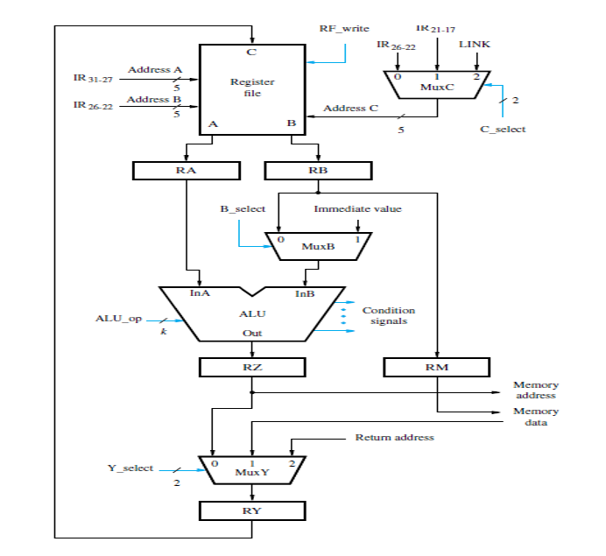
Datapath Diagram:-

Slide 9
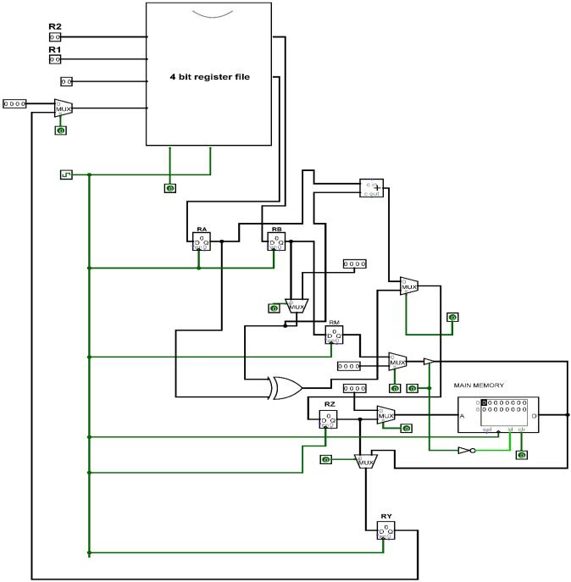
CONTENTS ARE MAPPED TO PROCESSOR :

Slide 10
Thank You……..

