Slide 1
DBA Open ended experiment Presentation on P-four Logistics
Team Members:
Praveen Naik
Prasad Patil
Prajwal Gouli
Prashant Roy

Slide 2
Problem Statement :
This project aims to design and Implement the database for P-FOUR Logistics to maintain the following activities.
The logistics company has multiple departments , each department is identified by a unique ID.
Logistics company also keeps every employees name, address, sex and salary. Every employee is uniquely identified by the unique employee ID.
The logistic company keeps name, contact number, address of every customer. Every customer is assigned with unique number.
Logistics company has many vehicles and each vehicle is identified by its unique Vehicle number.
Logistics company also keeps track of the order details of the customer , with each order having unique order ID.

Slide 3
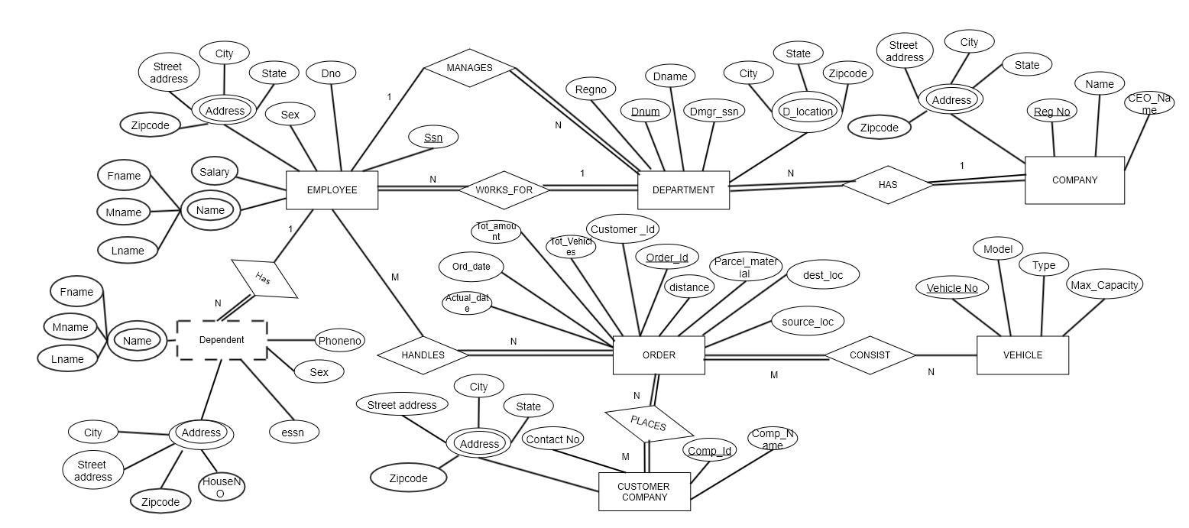
ER Diagram:

Slide 4
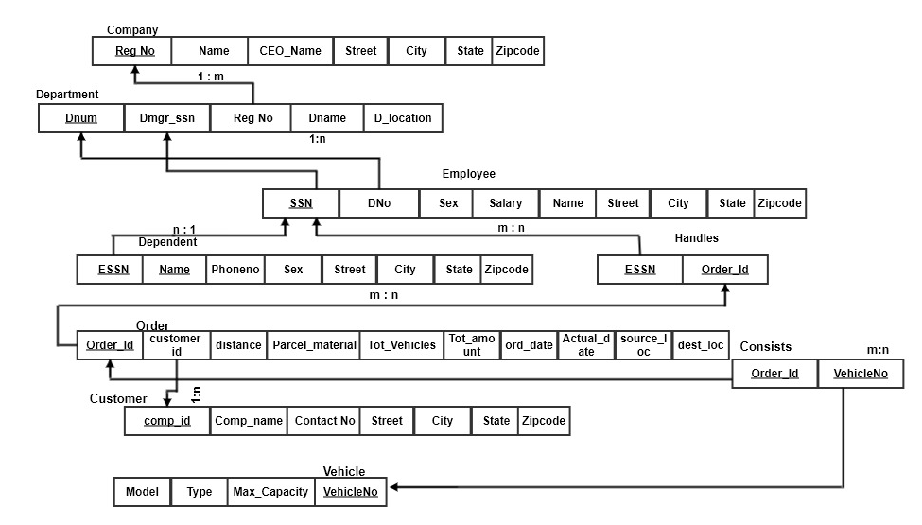
Relation Schema:

Slide 5
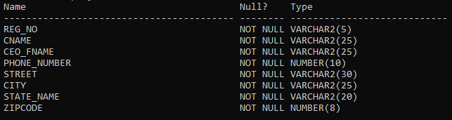
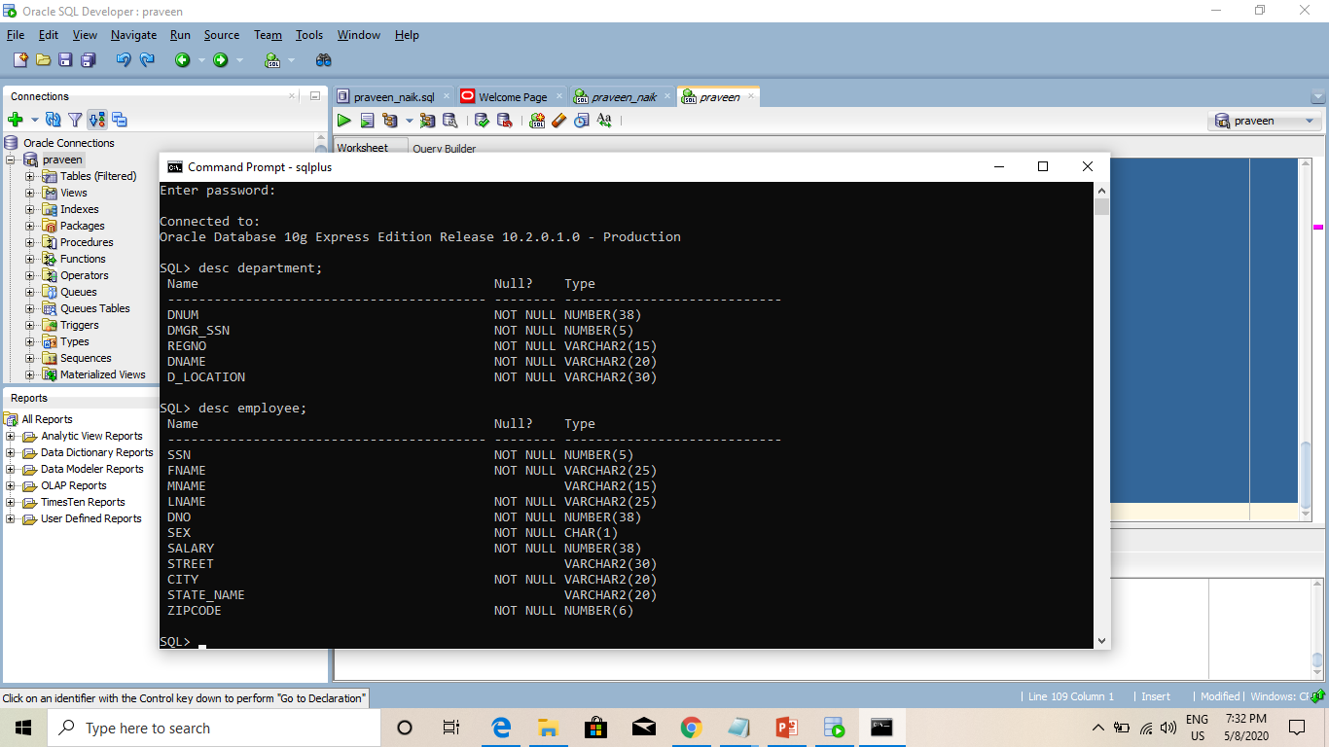
Table Description:
Company
Department

Slide 6
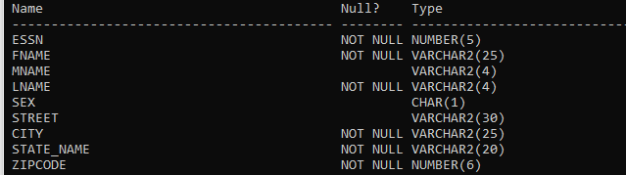
Employee
Dependent

Slide 7
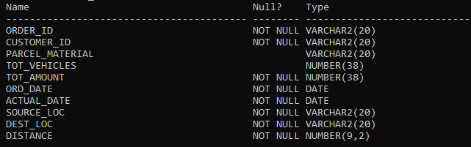

Order_details
Customer

Slide 8
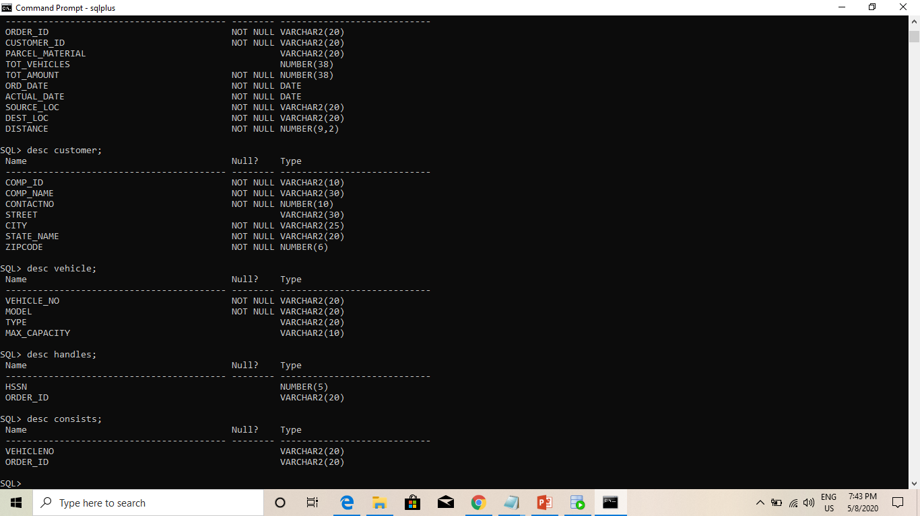
Vehicles
Handles
Consists

Slide 9
THANK YOU….!!!!

