Slide 1
CHAT data analysis
PRAVEEN RAMESH

Slide 2
Overview
Insights from customer interactions can lead to valuable insights for the business and lead to operational efficiency
Three major channels for communication – Chat/Email/Voice calls
In scope for analysis – voice data
Voice data transcribed using AWS – Transcribe.
Comprises of interactions between customers and agents.
Provides us ample opportunities to address process, agent performance and general customer experience improvements.
Data Consideration for prototype
All transcriptions of voice data from October 2020 to January 2021
Topic modelling

Slide 3
Pipeline
Data preparation
EDA
Data Pre-processing
Topics extraction
Modelling
Remove system messages
User commands
Generic responses
Chat/Voice shortcuts or regulatory portions
Non-customer data removal
Assess different types of conversations by length, time of day
Serves as a good pre-cursor for pre-processing
Meta data analyses
Remove new-line characters, emails etc.,
Tokenize the words
Bigrams/trigrams
Remove stop-words
Lemmatize
Create the dictionary and term document frequency
Iterate over a range of number of topics
Tweak hyperparameters
Visualize the topics
Obtain coherence scores to pick optimal number of topics model
Eye-ball most representative documents to ascertain topics

Slide 4
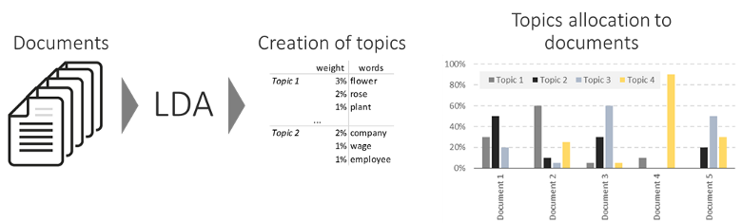
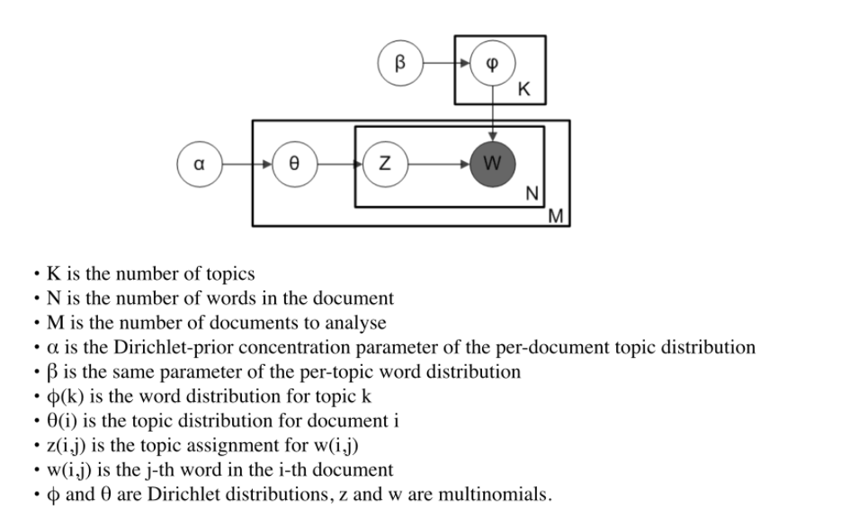
Modelling

Slide 5
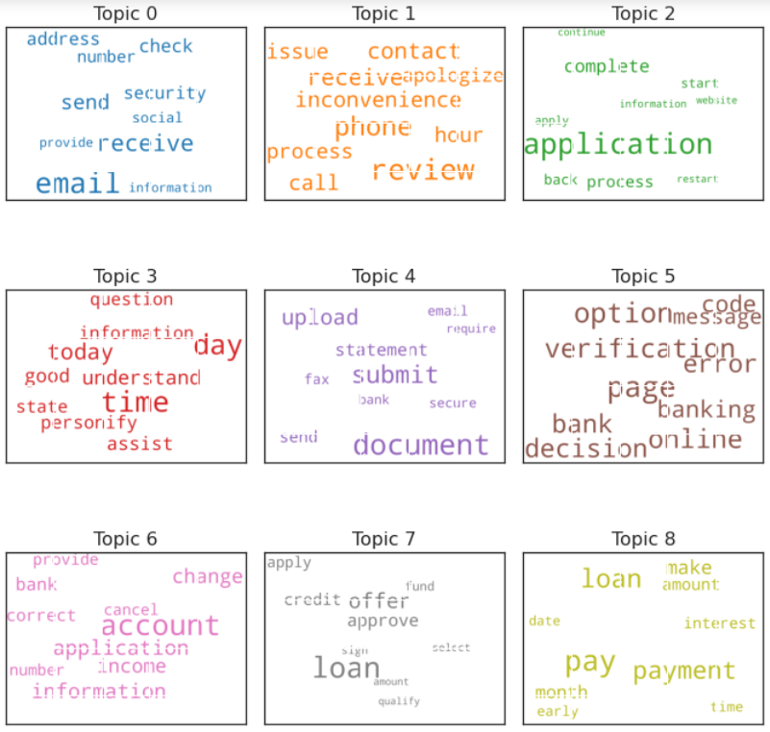
Demonstration Distribution of 9 topics on Chat data
8,772 chat conversations between Sept ’19 and Nov ‘20 at an average rate of 20 chats per day and each chat comprising of at least 8 conversations between visitors and agents.
Topic # | Topic Identified
0 | Email Communication Issues
1 | Issue & Escalations - Delays
2 | Application completion Assistance
3 | Application FAQ
4 | Document Submission - Doubts
5 | Decision Logic page - Issues & Doubts
6 | Application Changes/Cancellations
7 | Offer Details - Enquiries
8 | Loan Terms - Doubts

Slide 6
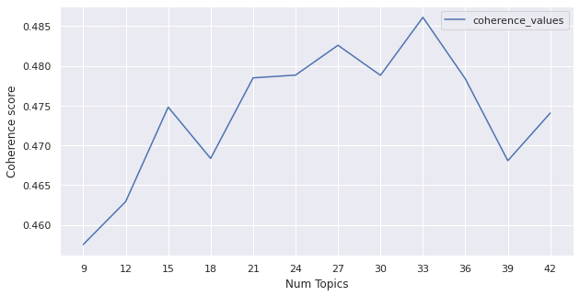
Model Validation
Size (# of tokens assigned)
Within-doc rank
Similarity to corpus-wide distribution
Locally-frequent words
Co-doc Coherence

