Slide 1
Praveen Ramesh
Working with stakeholders to use data for decision making

Slide 2
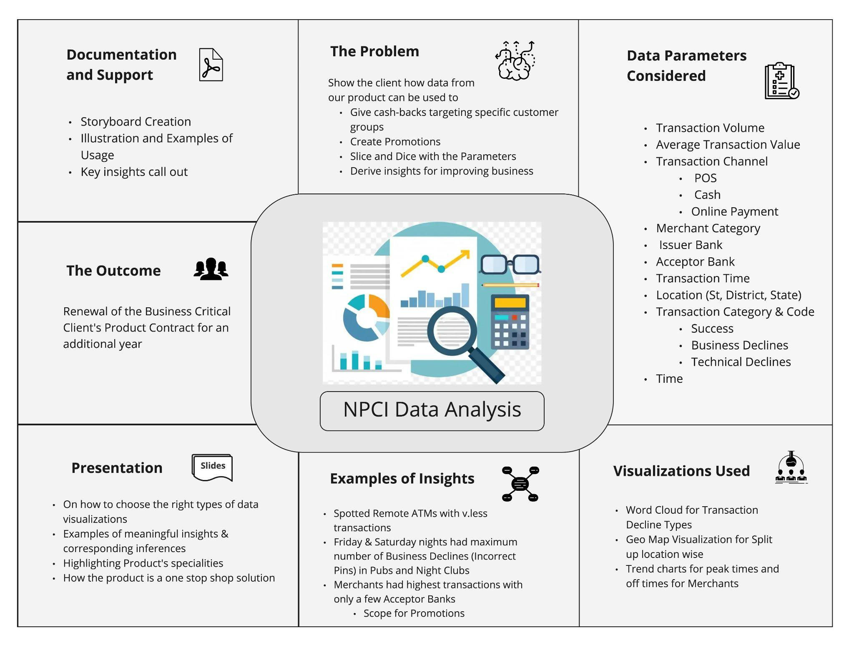
Project I

Slide 3

PROJECT II - Reddit Engagement Analysis
Had access to two new Reddit feeds, extracted interesting engagement thresholds and analysed to determine the overall value of the posts
Data Analyzed
Questions Addressed
Is there a correlation between score count and post quality?
Reddit Engagement Score Feed
An hourly score update for every Reddit post over a 7-day span
1
Does each subreddit have a unique interesting score?
What is the overall value of the popular feed?
Reddit Popular Feed
Curated feed by Reddit to highlight popular posts — mirror of r/popular
2
How often are Corporate companies mentioned in the popular feed?

Slide 4
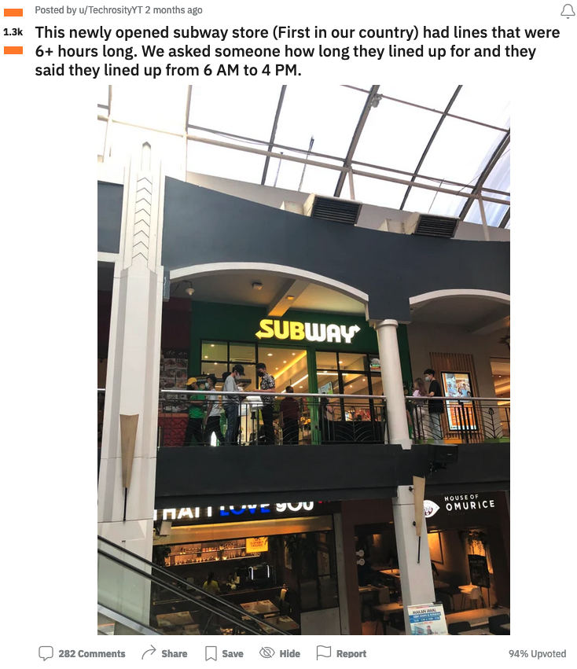
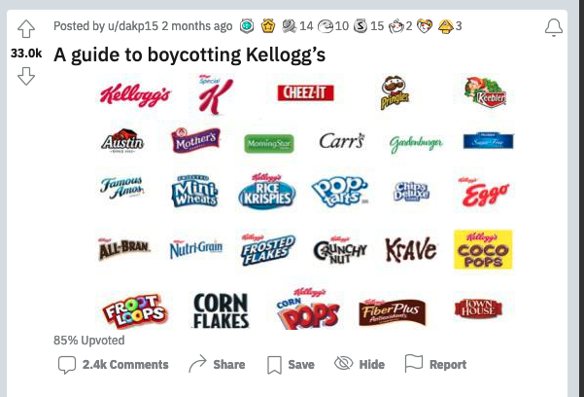
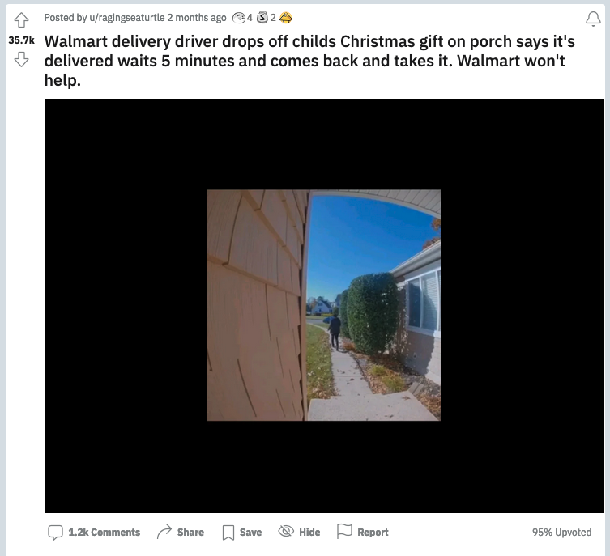
Sample High Score Valuable Posts
Highly engaged Reddit posts give clients a window into high-exposure conversations surrounding their brands — including boycotts, potential negative employee conduct and other unexpected moments
Viral post calling for boycott of Kellogg’s products amid public labor dispute
Viral video showing Walmart driver stealing child’s Christmas gift
Viral photo highlighting six-hour long lines at Subway store opening in Indonesia

