Slide 1
INTEL UNNATI INDUSTRIAL TRAINING
Project Title: AI Classroom Assistant
Team Name : Neural nexus
Team Members :
K P PRANAV
PRAVEEN K N
PRANAV R K

Slide 2
PROBLEM STATEMENT
Automate Classroom Monitoring and Learning Support using AI Build a smart assistant that enhances classroom interaction and assists teachers/students through AI. Use AI to: - Count students in real-time using webcam (OpenVINO). - Enable voice/text-based Q&A. - Allow document/image upload and ask questions from them. - Generate quizzes automatically from user content. - Provide real-time Text-to-Speech feedback.

Slide 3
Unique IdeA
Proposed Solution: AI Classroom Assistant
Multimodal AI Chatbot - Accepts text/voice input and gives AI-based answers. - Supports offline (Mistral via Ollama) and online (OpenAI GPT-3.5) models. Student Detection - Real-time student counting using OpenVINO and webcam input. File-Based Q&A - Upload PDF/Text/Image files and ask contextual questions. Quiz Generator - Automatically creates quizzes from uploaded study material.

Slide 4
Key Goals
Accessible AI Learning Platform: Built using Python + React with Flask backend
Offline/Online AI Model Switching: Uses local LLMs via Ollama (Mistral, LLaVA, CodeLLaMA). Real-Time Voice Interaction: Includes speech-to-text and text-to-speech features. Visual Understanding: Accepts image input and answers questions based on image content. Student Monitoring: Counts number of students live from webcam input.

Slide 5
Technical Approach
Frontend
- Built in React (Vite) with clean UI. - Features: chat interface, voice input button, file upload, model toggle, export chat, dark mode. Backend - Flask + Python. - Routes for AI Q&A, file/image upload, quiz generation, student count. - Model routing for offline (Ollama) and online (OpenAI). Models & Tools - Ollama (Mistral, LLaVA, CodeLLaMA) - OpenVINO for student detection - TTS & STT via Web Speech API

Slide 6
Technologies Used
Frontend: React, TailwindCSS, JavaScript Backend: Flask, Python AI Models: Ollama (local), OpenAI API Voice Tech: Web Speech API Computer Vision: OpenVINO Toolkit File Handling: PyPDF2, base64 Deployment: Local system, GitHub repo

Slide 7
Components
Frontend: React, Tailwind CSS, Vite Backend: Flask, Python, OpenVINO Models: Mistral, LLaVA, CodeLLaMA (via Ollama), GPT-3.5 Voice & Audio: Web Speech API (TTS & STT) Other: PyMuPDF, OpenCV, Base64, Chat Export, PDF parsing

Slide 8
Features Offered
Text + Voice-Based AI Q&A Image-Based Q&A File Upload (PDF/TXT) and Ask Student Counter using Webcam Quiz Generator from File Offline/Online AI Model Toggle Chat Export & Dark Mode

Slide 9
Process Flow
User Interaction ↓ Input via Text / Voice / File / Image ↓ AI Model Processing (Mistral/OpenAI/CodeLLaMA/LLaVA) ↓ Answer Generation / Student Count / Quiz Creation ↓ Output Shown with Option to Export / Listen (TTS)

Slide 10
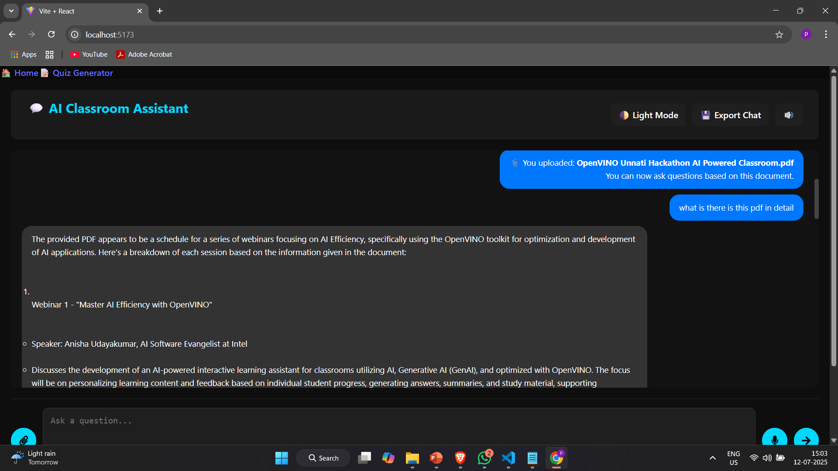
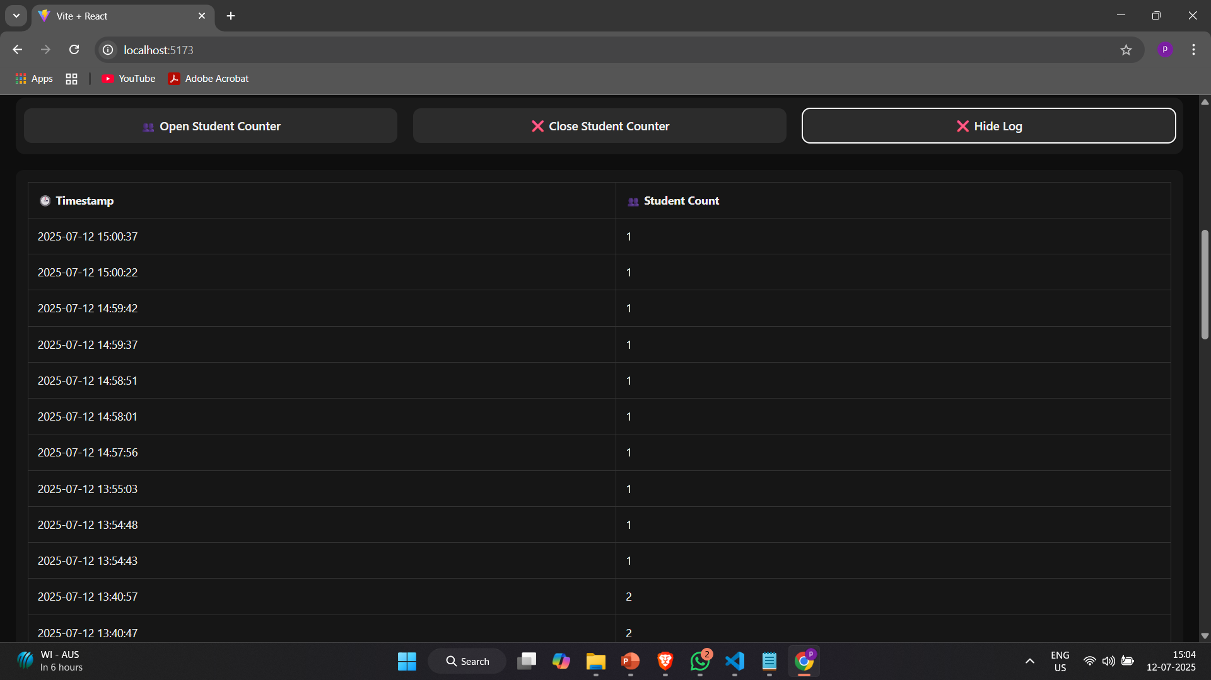
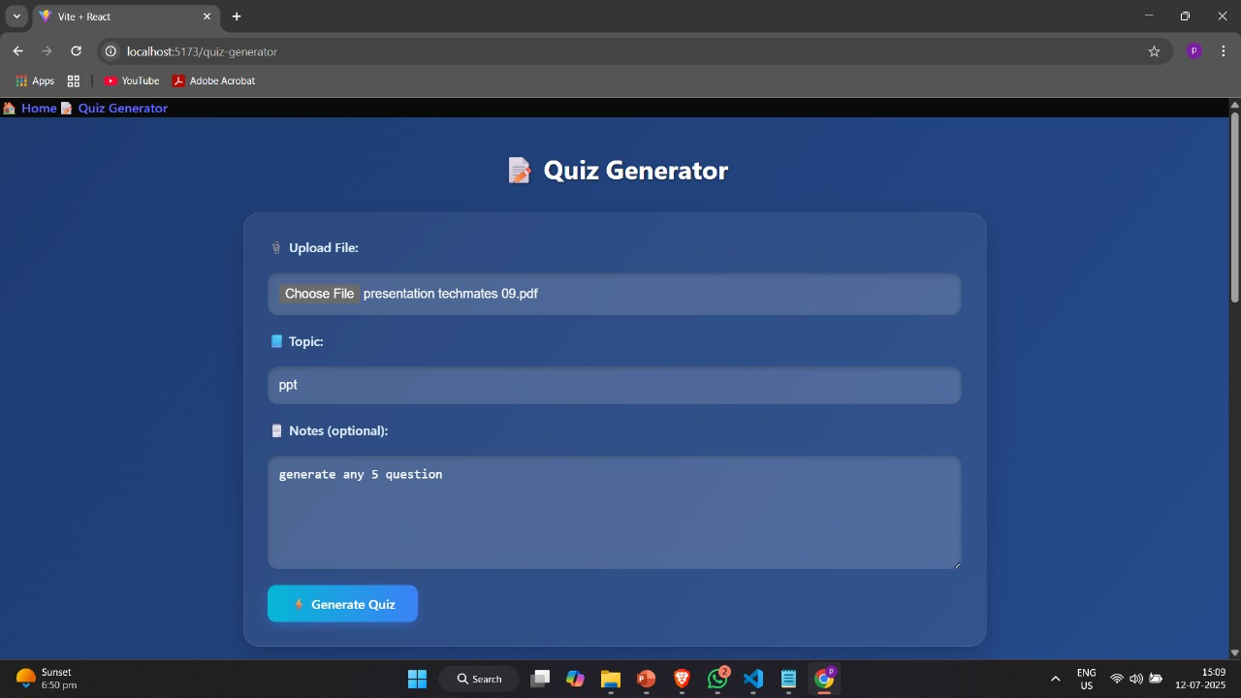
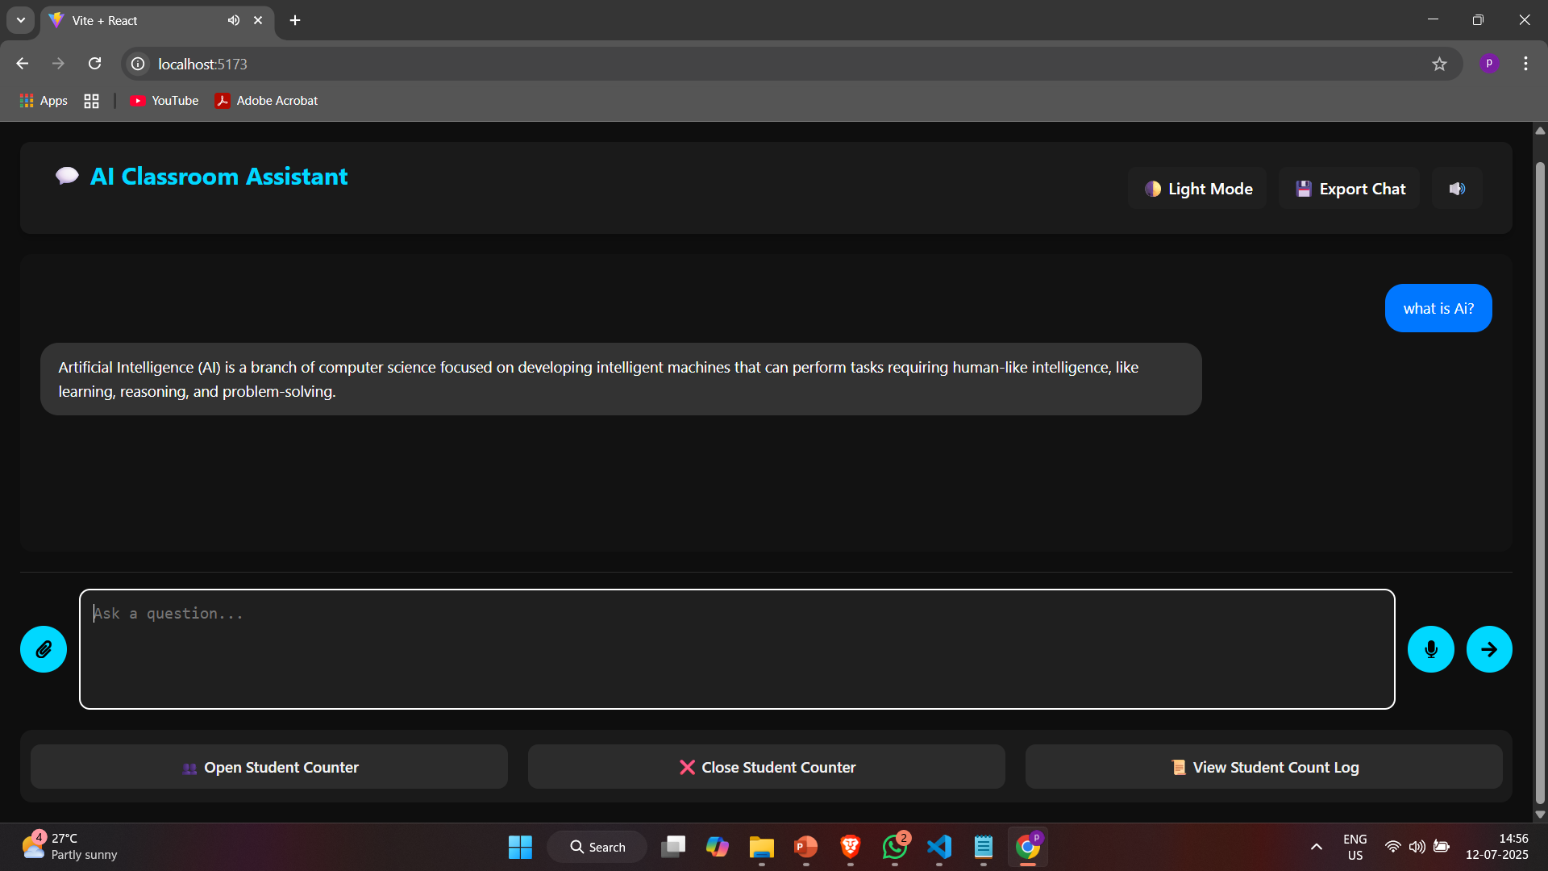
Images from the Project

Slide 11
Conclusion
Summary
- Built a fully functional AI-based Classroom Assistant. - Integrated features like voice/text input, student monitoring, file/image-based Q&A. - Achieved modular offline/online AI model integration. Future Work : - Add real-time performance analytics. - Deploy as a web or desktop app. - Train custom student engagement models.

Slide 12


