Slide 1
Global Superstore: Sales & Profit
By: Praveen Vijayan
CPDA (Batch-1)

Slide 2
Content
Performance Analysis (Sales & Profit Trends)
Margin Improvement
Operational Efficiency
Customer Profiling

Slide 3
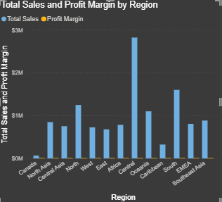
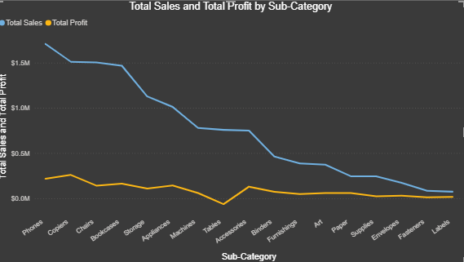
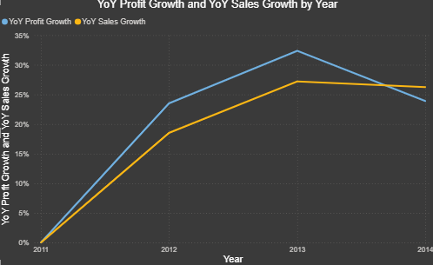
Performance Analysis (Sales & Profit Trends)
Top 3 sub-categories regarding Sales & Profit are Phones, Copiers, and Chairs.
The top 3 regions in terms of sales and profit are Central, South, and North.
In 2014, there was a drop in both year-over-year profit by 26% and year-over-year sales by 23%.

Slide 4
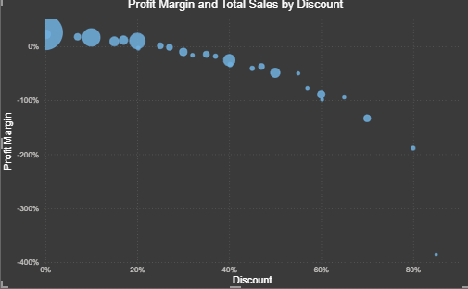
Margin Improvement
Profitability drops sharply when discounts exceed 20%
An optimal discount range is 0–10% for most segments

Slide 5
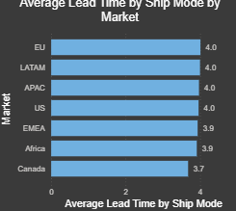
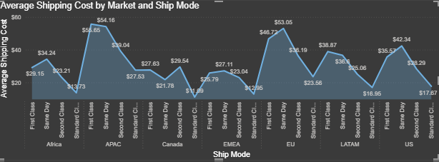
Operational Efficiency
Among all the regions, the First Class and Same Day shipping modes are fast but significantly more expensive.
Standard Class provides the best balance between cost and lead time.

Slide 6
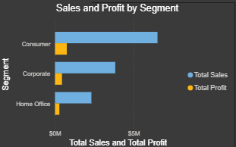
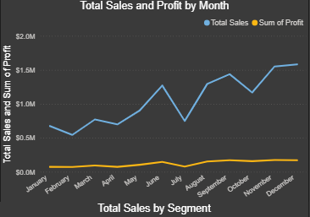
Customer Profiling
LATAM and Africa regions consistently show underperformance
Q4 (Oct–Dec) consistently shows peak sales — ideal for promotions and inventory ramp-up.
Consumer Segment is the largest contributor to the Total Sales.

