Slide 1
STREAMING SERVICES DATA ANALYSIS
By- PRAVEEN VIJAYAN
CPDA_B1

Slide 2

CONTENT
Process
Subscription & Revenue Analysis
User Engagement Metrics
Demographic & Behavioural Insight
Retention & Loyalty
Payment Preferences & Regional

Slide 3

PROCESS
Data Cleaning:
Created a data final sheet for the final values to be used.
Check for duplicates using the column User_ID. Use DATA > REMOVE DUPLICATES.
Used Proper Function on User_Name, Favorite_Genre, Country, Language_Preference.
Checked for any blank cells using COUNT and COUNTA Function
Removed inconsistencies in Date by using Text to Column and the using the date function to join the dates
Renamed the subscription type using VLOOKUP([@[Monthly_Price]],$AI$3:$AJ$5,2,0)
Data Visualization:
Used MS Excel features like Pivot Tables and Pivot Charts in order to create charts and analyzing the data.
Presentation:
This ppt contains the summary of the analysis done on the streaming service data.

Slide 4
Subscription & Revenue Analysis

Slide 5
Subscription & Revenue Analysis
Key Takeaways:
Total Monthly Revenue: $12,026
Mid-range plan ($11.99) is mostly preferred.
The premium plan has the highest contribution in the revenue
Top 3 Revenue-Generating Countries are USA, UK and France. The revenue distribution shows strong performance in Western markets.

Slide 6
User Engagement Metrics

Slide 7
User Engagement Metrics
Key Takeaways:
Average Watch Hours per User:
Users spend an average of 254.5 hours watching content. This reflects moderate to high engagement.
Movies vs. Series Consumption:
Movies Watched: 516
Series Watched: 100
Users show a strong preference for movies over series which is almost 5x.
Correlation between recommended content and watch hours:
-0.03, this weak negative correlation suggests that recommended content isn't driving significant additional engagement.

Slide 8
Demographic & Behavioral Insights

Slide 9
Demographic & Behavioral Insights
Key Takeaways:
Preferred Genres by Age Group:
18-24: Documentary content is highly popular in the group.
25-34: Horror and Action is most preferred in this group.
35-44: Horror, Action and Romance tops in this group.
45-54: High numbers in Action and Romance.
55+: Comedy and Documentary tops in this group.
Device Usage Trends:
Tablet the most popular device.
Tablet and Smartphone usage dominance suggests portability is a key factor in content consumption.
Peak Watch Time Trends:
The most active viewing period is Late Night and Evening time which shows that most of the viewer prefer to engage when they are most relaxed.

Slide 10
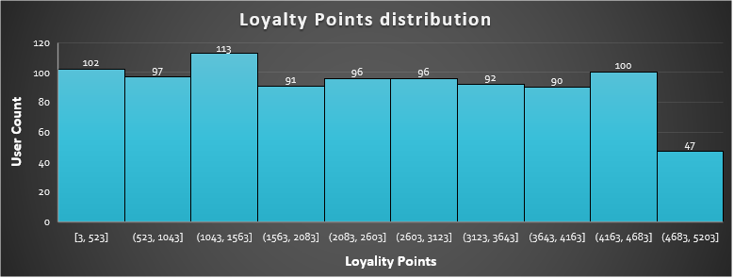
Retention & Loyalty

Slide 11
Retention & Loyalty
Key Takeaways
100% members are Active members.
There is a 50-50 split which suggests that content downloads are a popular feature but not adopted by everyone.
The Loyalty Point Distribution shows a balanced distribution but get low for the highly loyal customers.

Slide 12
Payment Preferences & Regional Trends

Slide 13
Payment Preferences & Regional Trends
Key Takeaways
Preferred Payment Methods by Region:
Australia shows a strong preference for Cryptocurrency and Debit Cards.
Debit Cards is the most common payment method in India.
Cryptocurrency shows a significant contribution in the payment method and offers can be made in this segment.
Subscription Trends by Country:
USA leads in user count with 158 users follower by France and UK.
Language Preferences & Engagement:
French content has the highest average watch hours. Spanish and Hindi speakers also show higher engagement. Language specific contents can be made to increase traction and revenue.

Slide 14

THANK YOU

