Slide 1
INTEGRATION OF HEURISTIC TECHNIQUES IN THE GAME OF GO
Chinmay Majithia
Rahul Makhija
Pravek Khata
Abhay Mukul
Supervised by Dr Jayant Gadge
Group 52

Slide 2
ABSTRACT
Go is a board game in which two players compete against each other to gain more space or territory by placing stones on a board of 9 X 9 dimension. There are two main rules to the game.
The capture rule states that if a territory is covered by stones of the same color on all sides then the territory would belong to the player of that color.
The KO rule states that players are not allowed to make moves that cause unending repetition.
The game ends when there is no space left on the board.
Our project is a computer Go Bot that one can play against on an interactive User Interface.

Slide 3
PROBLEM STATEMENT AND METHODOLOGY
The aim of our project is to develop a fully functional Computer Go Bot that one can play against free of cost and that is accessible by everyone. Our aim is also to deliver such an intelligent agent that provides various levels of intellect and difficulty. By doing this, we also try to promote this game as it is one of the oldest board games while also being one that uses intellect and knowledge.

Slide 4
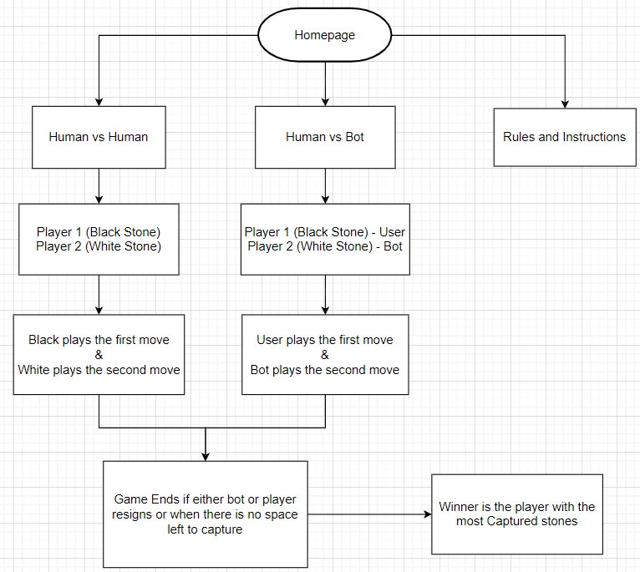
WORKFLOW OF THE GAME

Slide 5
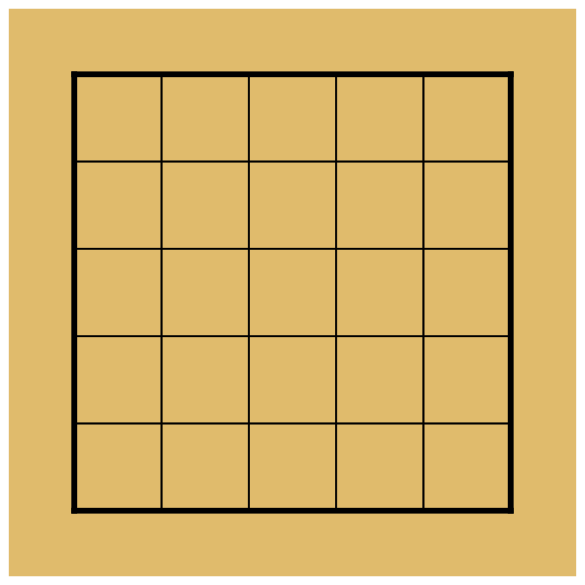

CAPTURE RULES
If a player surrounds an opposing stone or stones by playing on all adjacent points, those opposing stone(s) are captured and are removed from the board.
Case 1:
General Case
Case 2 :
Edge Case
Case 3 :
Corner Case

Slide 6
Chain Rule
a "solidly connected
group of stones"
is also called a chain.
A chain with no liberty is said to be captured as can been seen.

Slide 7
ILLEGAL MOVES
The given move is considered
illegal as the move can lead
to a loop and thus an endless cycle.

Slide 8
IMPLEMENTATION OF MINIMAX ALGORITHM
We have implemented a go playing program that would use the minimax algorithm with alpha beta pruning to find an optimal move in a particular position. This is done by considering the position to be a node itself in the game state tree and finds the optimal move, but in order to do so, it calculates the best possible move for the opponent.
If depth of calculations has not yet been reached then this process is repeated until the depth is reached.
The parameters on which the algorithm depends are current node state of the board, the depth of calculations and player’s stone color.
We have considered space occupied by the player as a major factor in determining the move that would be played by the bot, that is, it would try to increase its own space also while looking for opportunities to decrease the opponent’s space.

Slide 9
IMPLEMENTATION
DESCRIPTION OF AVAILABLE MOVE FUNCTION :-
The move generation function is responsible for finding all the available and possible moves in the game state tree.
Only those moves will be considered by this function that satisfy the following criteria :-
First it would check for every empty intersection on the board.
After checking for every empty intersection, it will check for those empty intersections that are not completely surrounded by opponents stones.

Slide 10
IMPLEMENTATION
DESCRIPTION OF EVALUATION FUNCTION CHOSEN :-
The evaluation function is responsible for assigning values to the nodes in the game state tree.
These values will then be used by the algorithm to prune useless moves and find optimal move.
The parameter that this evaluation function uses is equal to the sum of the number of stones placed on the board by the player and the number of empty intersections completely surrounded by the player’s stone.
That is, we are using the total space occupied as a parameter. Hence the bot will play only those moves that increase its space and thus will take the opportunity to capture the opponent’s stones and make less mistakes that would cause a reduction in its own space.

Slide 11
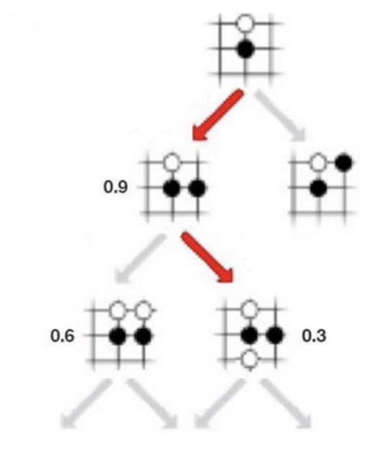
For example, in this case first when it was black’s turn, black played the move on the left to maximize its score, and then it predicted white to play the move on the right with a score of 0.3 to minimize white’s score.

Slide 12
TECHNOLOGY USED
These technologies will be used to implement the Graphical User Interface:-
HTML: HTML is the foundation of a website it contains the information that tells the browser what is on the page in terms of text, links, where to find images.
CSS: CSS is used for defining the styles for web pages. It describes the look and formatting of a document which is written in a markup language. It provides an additional feature to HTML. It is generally used with HTML to change the style of web pages and user interfaces.
Javascript: JavaScript is used for Show or hide more information with the click of a button, change the color of a button when the mouse hovers over it, slide through a carousel of images on the homepage, zooming in or zooming out on an image, displaying a timer or count-down on a website, playing audio and video in a web page, displaying animations and using a drop-down menu.

Slide 13
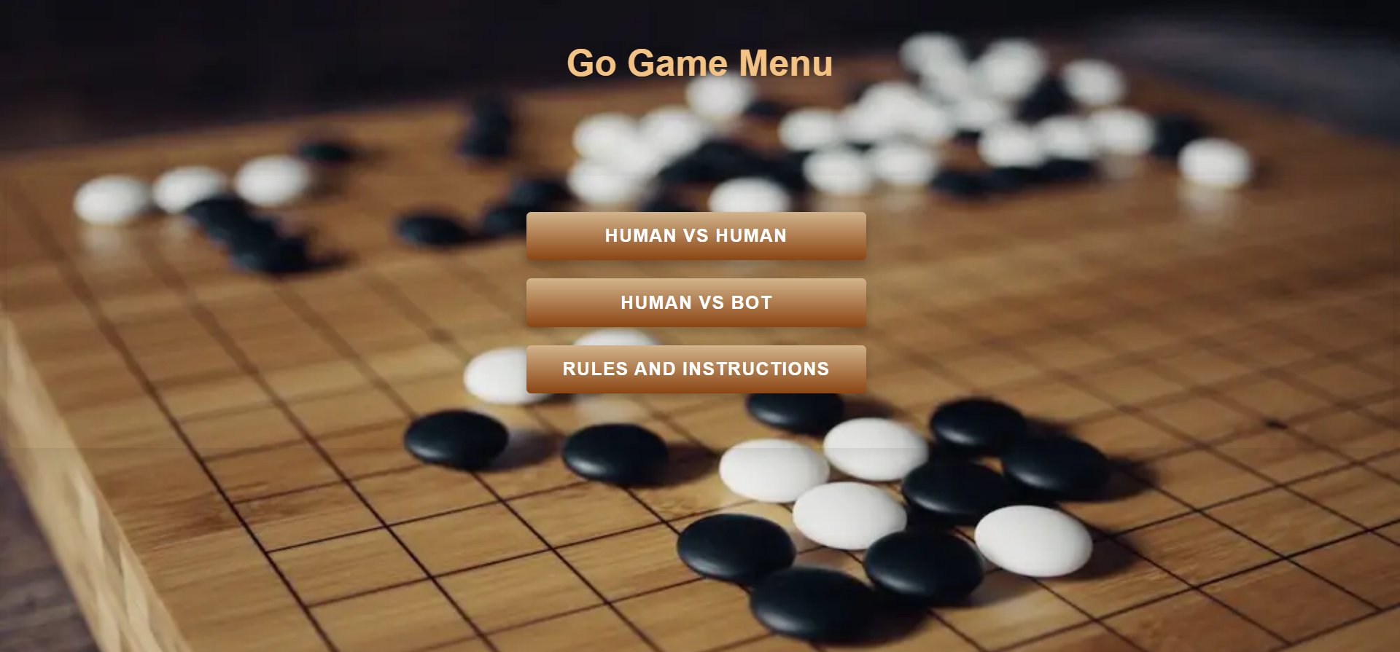
Results: Game Menu

Slide 14
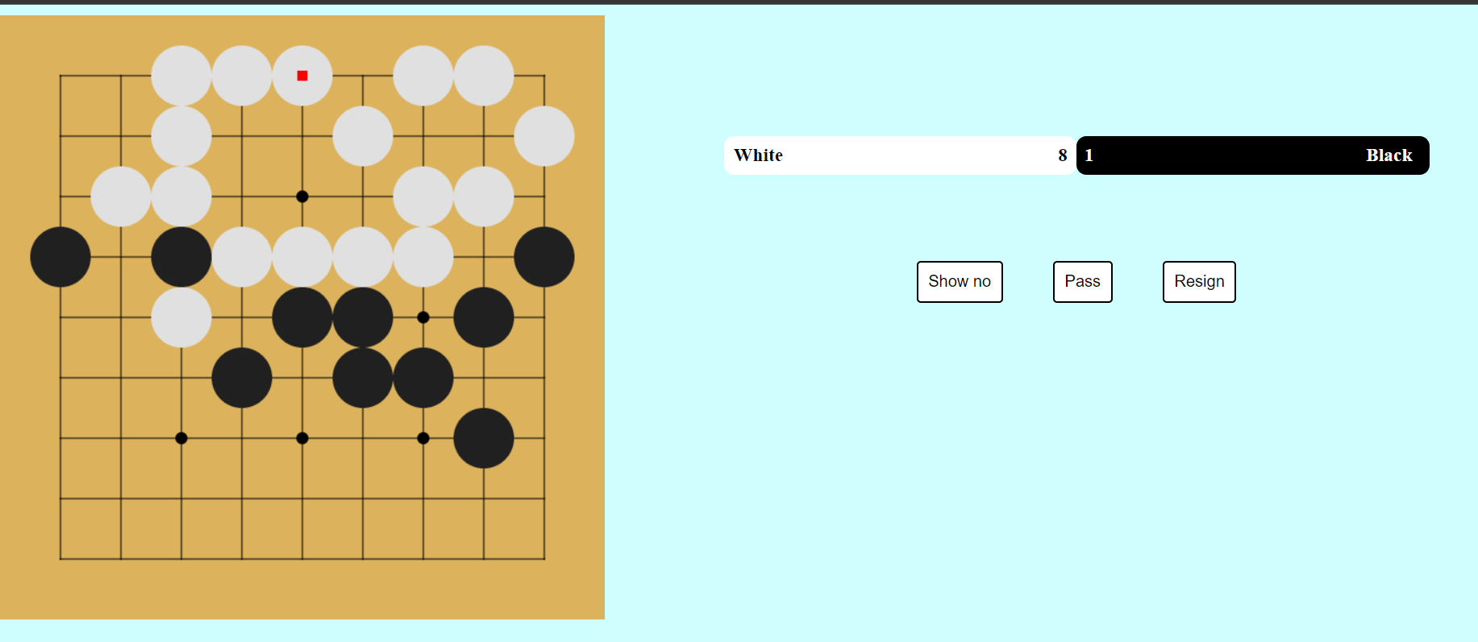
Results: Human vs Human

Slide 15
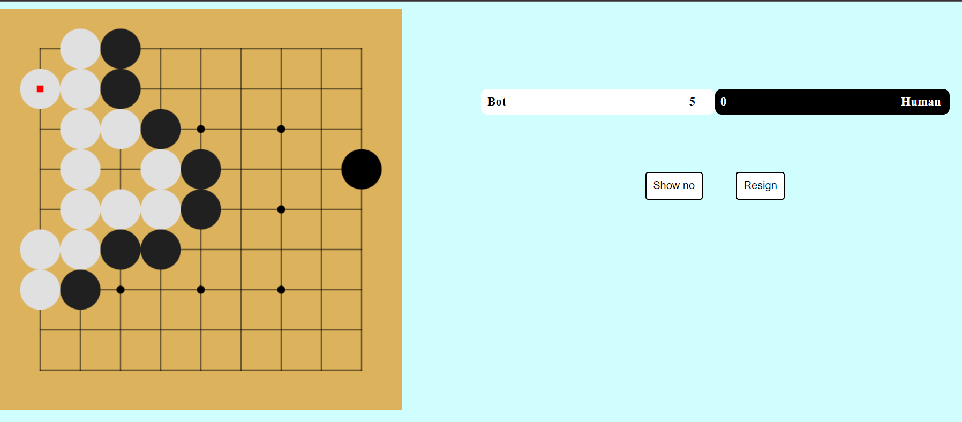
Results: Human vs Bot

Slide 16
CONCLUSION AND FUTURE SCOPE
The future scope of this project includes the use of advanced Go techniques and strategies like tenuki (which is the art of playing at a distance for a greater purpose).
The scope also includes the addition of various levels of difficulty for the bot according to the user’s requirement.
In addition, we would like to make the bot more intelligent by using Reinforcement Learning Algorithms and Neural Networks.
Furthermore, the future scope includes adding more features to the User Interface as well as beautifying the current UI.

Slide 17
References
https://citeseerx.ist.psu.edu/viewdoc/download?doi=10.1.1.118.5927&rep=rep1&type=pdf
https://webdocs.cs.ualberta.ca/~mmueller/ps/2013/2013-gochapter-preprint.pdf
https://www.britgo.org/intro/history
https://www.wired.com/2014/05/the-world-of-computer-go/
https://webdocs.cs.ualberta.ca/~mmueller/ps/goeval.pdf
https://www.davidsilver.uk/wp-content/uploads/2020/03/master-level-go.pdf

