Slide 1
UE19CS334 – NLP Project Approval
Project Title : Automatic MCQs generator from text
Project ID : 8
Project Team Students Name : B Pravena, Spoorthi R, Varna S

Slide 2
Outline
Problem Statement
Scope and Feasibility study
Applications/Use cases
Expected Deliverables
Any other information

Slide 3
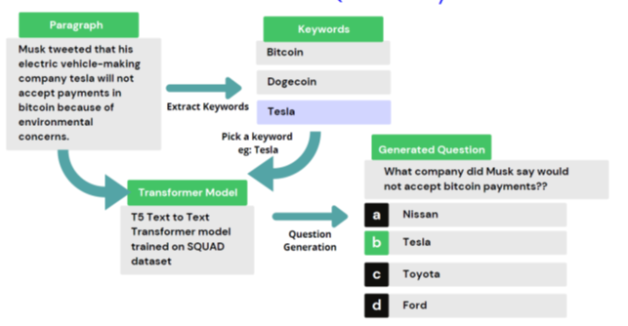
Problem Statement
Automatic generation of multiple choice questions based on a given piece of text.

Slide 4
Scope and Application of the Problem
The use of automated systems in second-language learning could substantially reduce the workload of human teachers and test creators. Automatic multiple choice question (MCQ) generation from a text is a popular research area. MCQs are widely accepted for large-scale assessment in various domains and applications. However, manual generation of MCQs is expensive and time-consuming. Therefore, researchers have been attracted toward automatic MCQ generation. Many systems have been developed for MCQ generation.

Slide 5
Scope and Application of the Problem
Multiple-choice questions are the most popular assessment questions created whether it is for a school test or a graduate competitive exam. Given the increased volume of workload on teachers/assessment creators due to online learning, it would be very helpful if we can create an automated system to create MCQs.

Slide 6
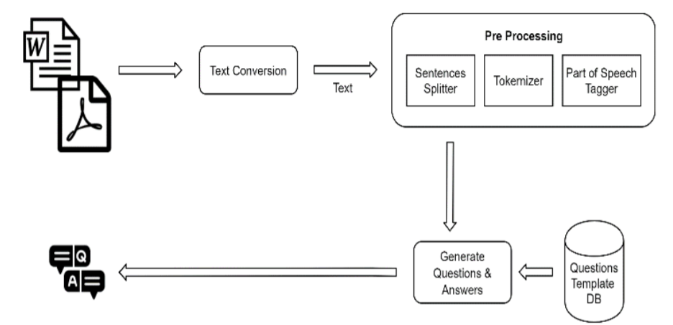
High level design
Text Extraction & Question Generation Process

Slide 7
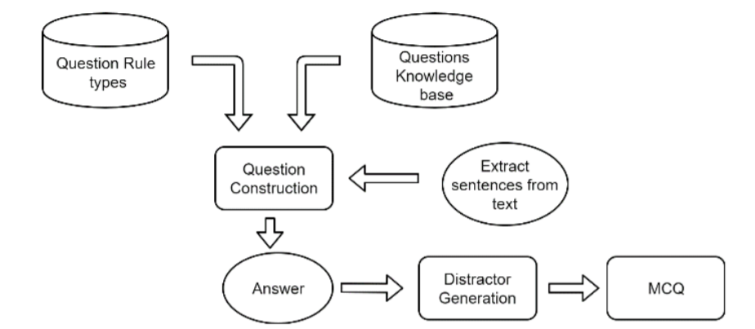
High level design
MCQ Generation Process

Slide 8
NLP Concept used in this Project
WordNet:
Wordnet labels the semantic relations among words and also captures the different senses of the word. We plan to use this for distractor generation.
ConceptNet:
Conceptnet is good for generating distractors for things like locations, items, etc. which have a “Partof” relationship.

Slide 9
NLP Concept used in this Project
Sense2Vec:
A neural network algorithm is trained with millions of sentences to predict a focus word given other words or predict surrounding words given a focus word. Through this, we generate a fixed size vector or array representation for each word. We call these word vectors.
POS tagging to find focus word

Slide 10
Any other information
We plan on first identifying focus words based on which we will produce apt questions.
We also plan to produce good distractors/wrong choices for each generated MCQ.

Slide 11
Thank You

