Slide 1









FIEURAL IftTERFACE
UNIT // P—EfJG—BOX
X // 18.23
Guiding Large Language Models from Probabilistic Guesses to Precision Outputs
DATA Z/0 PORTS //
AMALOGfDIGITAL
DATA I /0 PORTS //
ANALOG/DI6ITAL
A gu*de to des:tgning,
st ructur:tng , and ref1ning AI inputs .
3258
185 aS

Slide 2
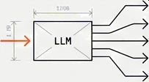

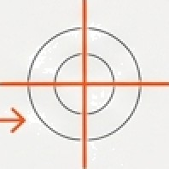






PRECISION INPUTS FOR GENERAL-PURPOSE MODELS
// | PROMPT ENGINEERING:
// | The practice of DESIGNING, | STRUCTURING, | and | REFINING | inputs
to gu1de Large Language 8ode1s
(LLHs)
toward accurate ,
ze1evanf , and ze11ab1e outputs.
[REF: SYS.INPUT. 01 v1.2]
THE CONTEXT
LLPs aze general- purpose. The same nodel yields vast1y
THE REALITY
Models do not ”reason” independently. They are probabilistic engines requiring explicit guidance.
THE VALUE
Fine-tuning is expensive and slow. Prompts act as a lightweight, immediate control layer.
d1@ezent outputs based entirely
on the 1nput stzuctuze.
FINE—TUNIKG [EXPE1SSVE ,
SL0\¥]
OUTPUT VARIATION [A/B/CJ
PROBABILIS TIC ENGSME
// REQUIRES EXPLICIT
CUI9AkCE
FP(0utpvt I znPvt ]
,‘
EFFICIENCY
GAIN
INPUT
IFINEDIATE CONTROL]
G NotebookLM

Slide 3
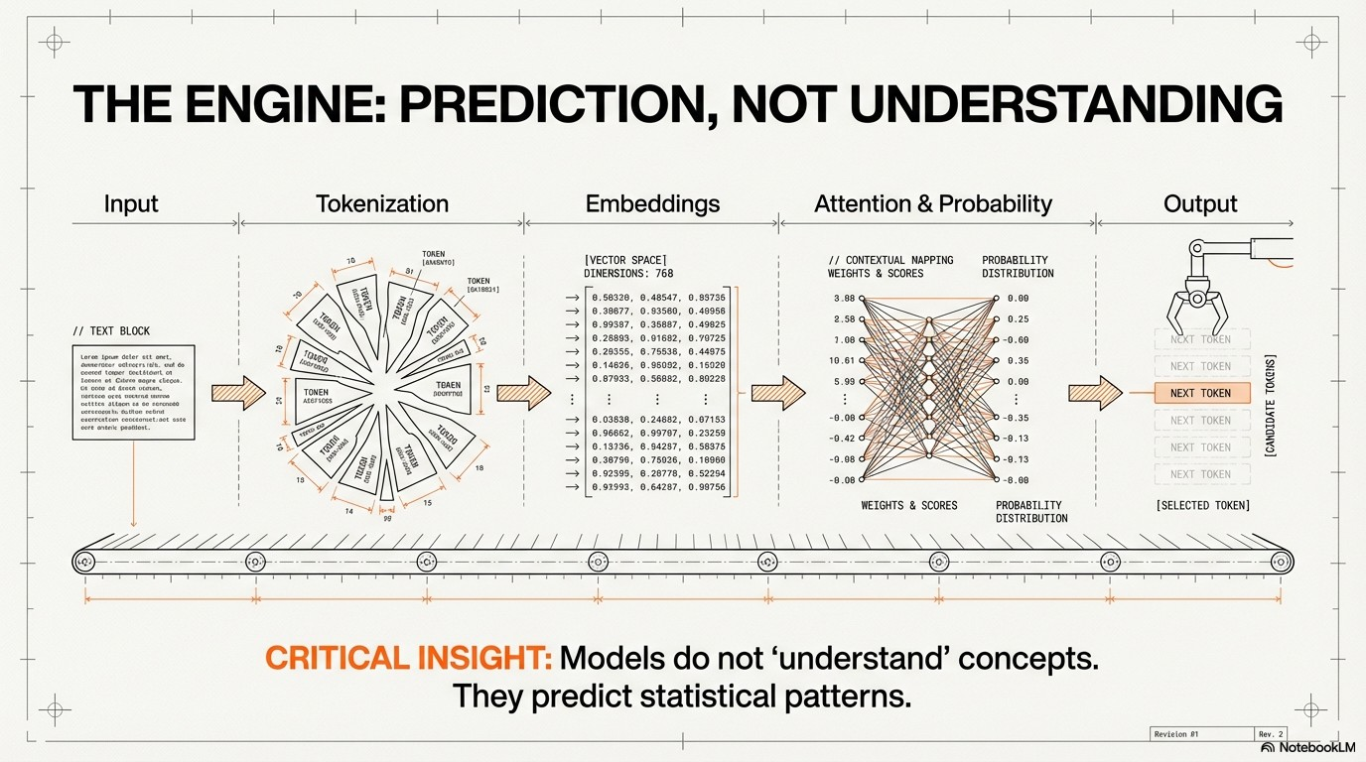

Slide 4
ENGINEERING THE INPUT VS. TRAINING THE MODEL
CATEGORY | PROMPT ENGINEERING | MODEL TRAINING
COSt | Low (0perat1onal Expense) | Very H1gh (Compute/Capital)
Speed | Immediate Iteration | Weeks to Nonths
Flexibility | High / Dynamic | R1g1d / Stat1c Snapshot
Skill Required | Domain & Linguistic Expertise | Machine Learning Engineering
Prompt engineering offers agility and precision without the heavy infrastructure costs.
G NotebookLM

Slide 5
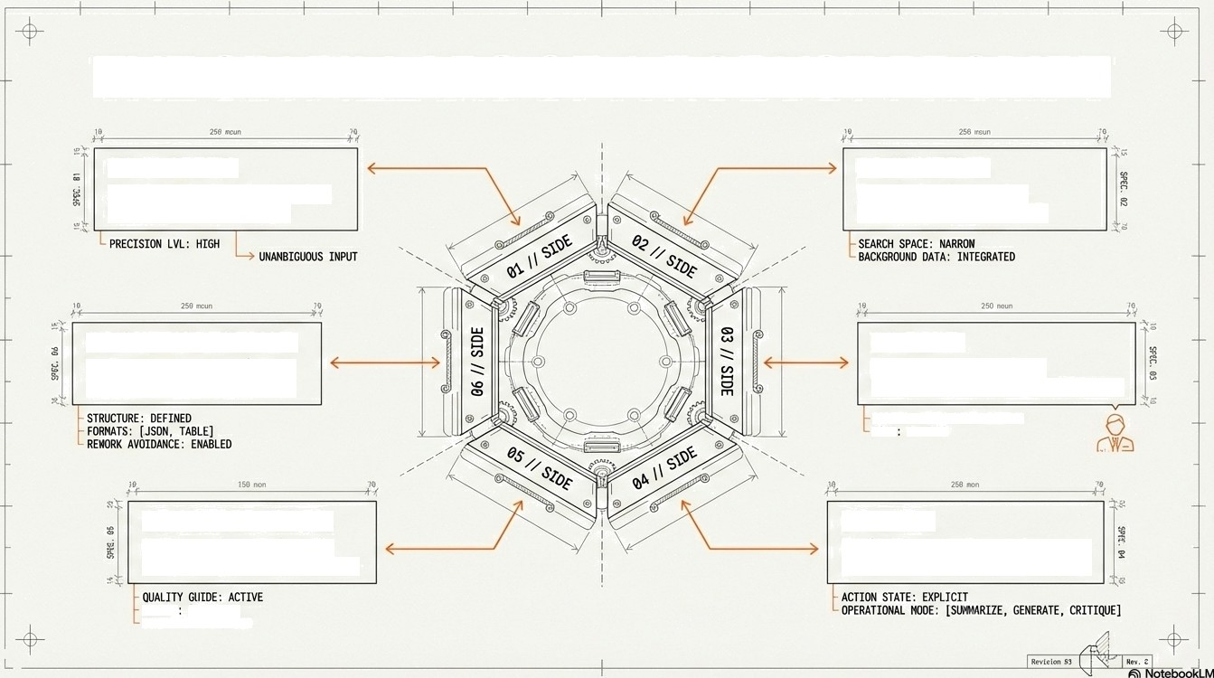




THE SIX PILLARS OFA ROBUST PROMPT
01 CLARITY.
Avoid ambiguity. Use precise,
unambiguous language.
02 CONTEXT.
Provide background to
narrow the search space.
06 OUTPUT FORNAT.
Define the structure (J SON,
Table) to avoid rework.
03 ROLE.
ssign a persona (e.g., Professor, Architect) to set tone.
65 CONSTRAINTS.
Guide quality via length,
complexity, and boundaries.
04 TASK.
Explicitly state the actions
(Summarize, Generate, Critique).

Slide 6





















FROM AMBIGUITY TO PRECISION
THE SIMPLE PROMPT THE ENGINEERED PROMPT
CONSTRAINT t
Cpulexity : LV / OEF ZhEb
1
Explain machine learning
İ
Explain machine learning
in sînp1e terøs for
undergraduate students
us1ng rea1-wor1d examples.
ming!
AUDIENCE/CONTEXT
UNDERGRAD / TARGETED
Result: Generic, broad, textbook definition lacking specific utility.
CONTENT REQUIREMENT
type: PRACTICAL SPECIFIC
Quality of Input = Quality of Output.
G NotebookLM

Slide 7
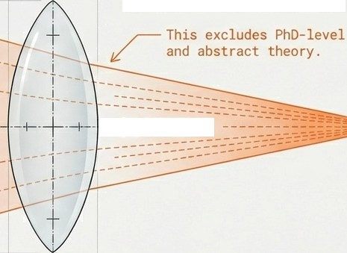
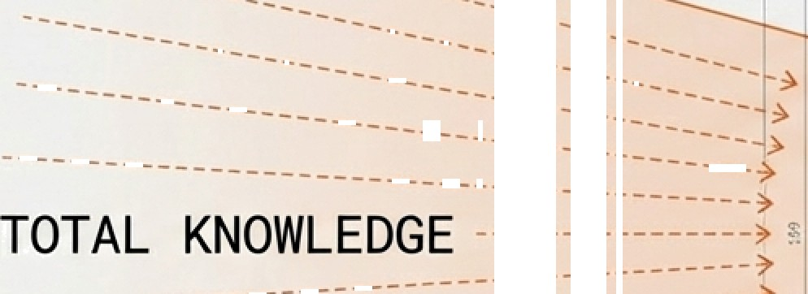

NARROWING THE SEARCH SPACE: CONTEXT & ROLE
THE CONTEXT LENS
Input: “You are teaching an undergraduate AI course. Explain neural networks.”
CONTEXT
- • OUTPUT
THE ROLE PERSONA
1. “Act as a Professor” —+ Educat:fona1 Tone .
2. “Act as a Ned1caI Expert” —+ CI1n1ca1 Tone .
3. “Act as a Software Architect” —+ St ructural Tone .
W NotebaokLM

Slide 8
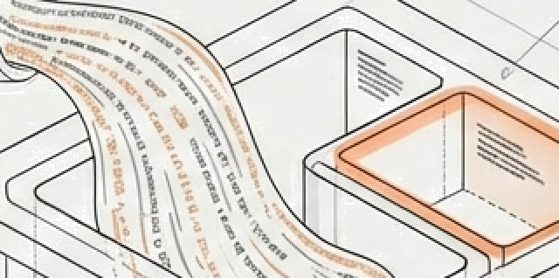
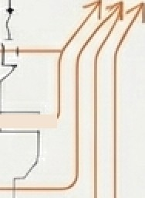
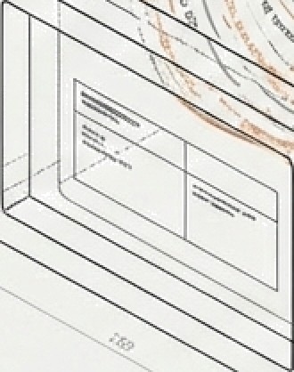
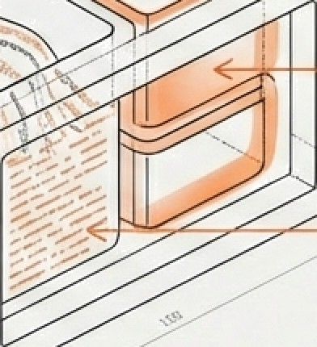



SHAPING THE OUTPUT: TASKS & CONSTRAINTS
THE TASK VERBS THE CONSTRAINTS - THE MOLD
4
Explain. Summarize. Compare.
Generate.
Critique.
— Length: 150 words
- Complexity: Simple language
—’ j—
Format:
JSON / Table /
Bullet Points
If you do not define the format,
the model will guess—and often guess wong.
G
NotebookLtVi

Slide 9
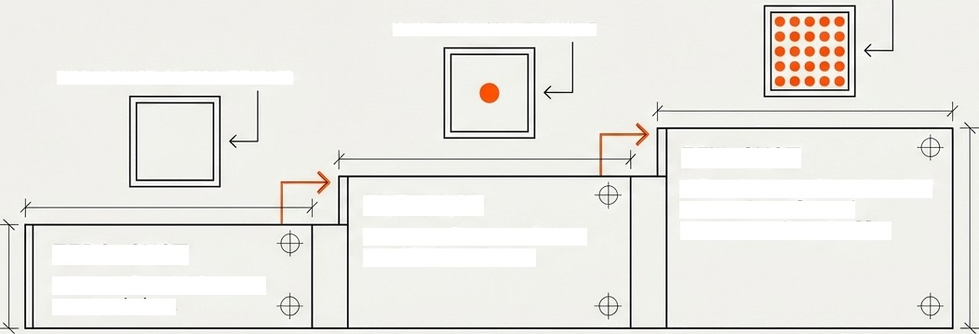






THE STRATEGY OF"SHOTS"
DOT PATTERN // MULTIPLE EXAMPLES
SINGLE DOT // ONE EXAMPLE
EMPTY SQUARE
// ZER0 EXAMPLES
FEW-SHOT
Multi le exam les p rovided to teach style and structure dynamically.
ONE-SHOT
One example prov1ded to establish pattern.
ZERO-SHOT
No examples . Re1ies on
pre-t raining .
FEW—SHOT MECHANISM FLOW
Output (Sample Sunma ry)
Input (Alex Text)
PREDICTED
OUTPUT

Slide 10


PATTERN 1: CHAIN-OF-THOUGHT
Forcing Reasoning to Reduce Error
Ouest1on Ouest1on
Step 1
Analysis
Standard Generation
Step 2
Calculation
Cnain-of-Thought
Step 3 Verification
Nrong Answer
(Ha1lucinat1on)
Co r rect Answer
pop
p p
Externalizing the thought process reduces logic errors.
g
Revision 03// Rev. 1
G NotebookLM

Slide 11
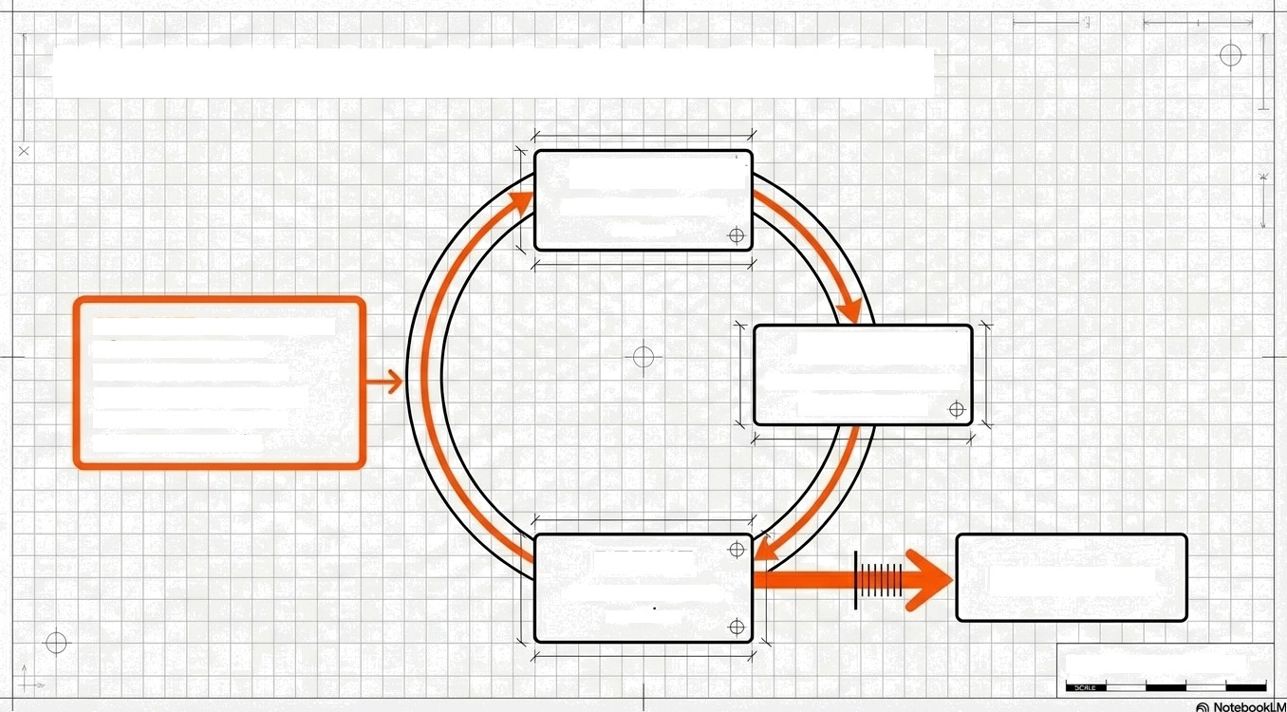
PATTERN 2: CRITIOUE & REFINE
GENERATE
Ask for in1tia1
answer
SIDE NOTE // LLMs are often better at verification than initial generation.
Use them to check their own work.
CRITIQUE “
Rev:few this answer
for accuracy
REFINE
Final Output
Generate final
version
Revision 04// Rev.1

Slide 12








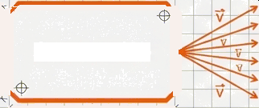

BEYONDWORDS: PROMPT TUNING
Moving from art to mathematical optimization.
MANUAL ENGINEERING
Summarize
Explain
Context
Machine Optimization
SOFT PROMPTS / TUNING
(e.231, —1.402,
[-6.554, 1.128,
[—0.384, 6.717,
(-0. 554, 1.128,
[-0.333, 6.266,
(8. 23J , —1 . 402,
6.992]
0 0031
0.093]
6.863 ]
6.893]
8. 992 ]
[ 1.742, —6.883, 2. 561 ]
..., [ —8.113, 6.567, 1.882 ]
” —a• [2.339, -1.BB9, 0. 44S]
[6. 991, 6.222,
-1.447]
2.5B1]
-1.447]
-1.447]
Summarize
_{Explain} -* {0.791. 0.883,
_{Context} —+ [2 .339, -1.B09, 6.853]
[0. 991, 6.222,
[1.782, 8.222,
[-8.113, 8. 567, 1.882]
[2.339, 8567, 8445
[1.742, —6.883, 2.581 ]
“ [—6.113, 6.567, B. 445]
Prompt Tuning is the systematic optimization of inputs. Instead of words,”Soft Prompts” use learnable vectors found during training.
Revision 05 // Rev. 1
I
I
G NotebooklM

Slide 13





”--”” T-.
CHALLENGES & RISKS
>// SENSITIVITY
Slight wording changes can drastically
alter
results.
HALLUCINATIONS
Confidently stating false information.
BIAS AHPLIFICATION
Reflecting training data prejudices.
PROHPT | LEAKAGE
The model | revealing its | own | system | instructions.
LACK OF ROBUSTNESS
Inconsistent performance across sessions.
Revision 06 // Rev. 1
G NotebookLM

Slide 14
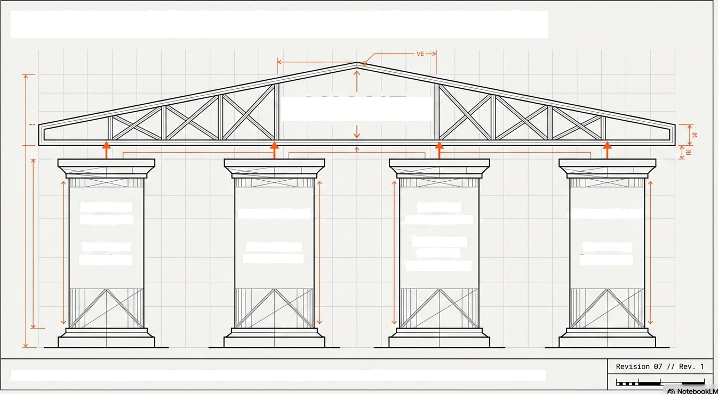
BUSINESS & ACADEMIC IMPACT
VALUE
DECISION
SUPPORT
AUTOMATION
DOMAIN
SPECIFICITY
Expertise without retraining.
EXPERIENCE
Reliable
ins i ght s .
Text/Code work f 1ows .
Enhanced learning.
Prompt engineering transforms AI from a novelty into reliable business infrastructure.

Slide 15
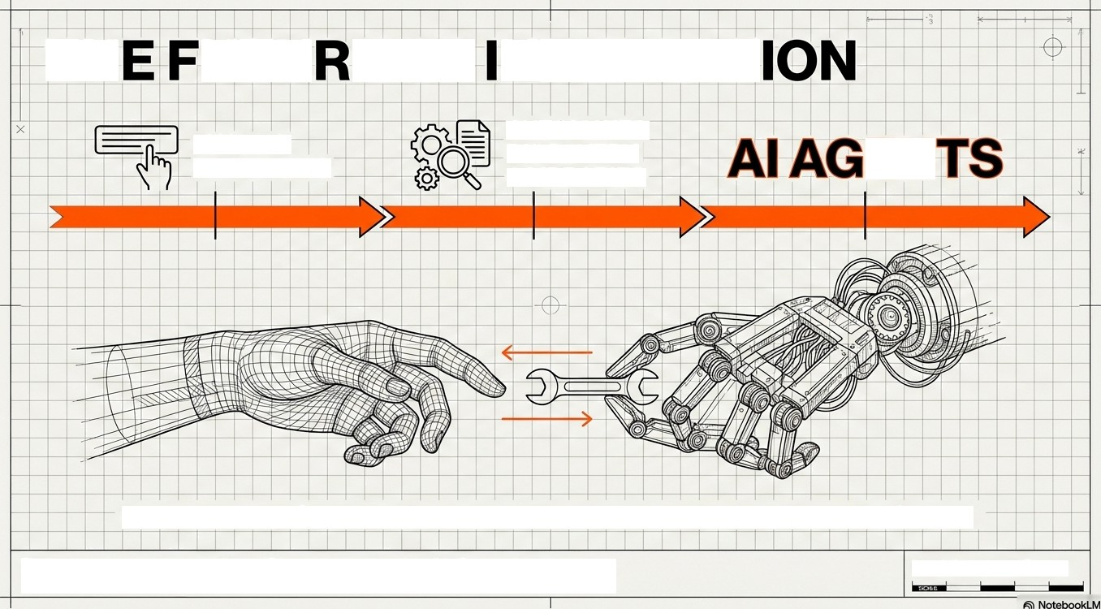


TH UTU EOF
NTERACT
AUTOMATED DISCOVERY & LIBRARIES
MANUAL
PROMPTING
We are moving from talking TO AI, to designing Agents that ACT for us.
The prompt is the code of the future.
Re'*ono8“Re’ 1

