Slide 1
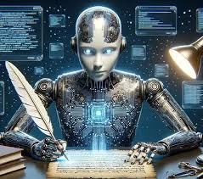
UNIT : 5
GENERATIVE AI & ETHICS

Slide 2
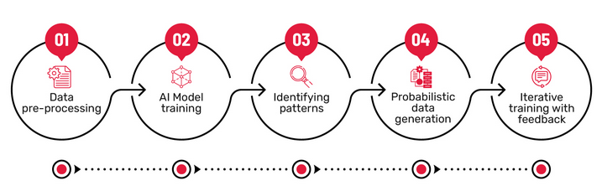
What is Generative AI?
Generative Artificial Intelligence (Generative AI) refers to a class of AI systems that are capable of creating new data instances that resemble a given training dataset.
Unlike traditional AI models that focus only on prediction or classification, generative AI learns the underlying data distribution and uses it to generate novel but realistic outputs.

Slide 3
Key Characteristics
Learns patterns and structure of data
Produces new content rather than selecting from existing data
Outputs may include:
Text (stories, code, reports)
Images (art, medical images)
Audio (speech, music)
Video and 3D content
Patterns and Structures
New Conent

Slide 4
Examples
ChatGPT generating human-like text
DALL·E or Stable Diffusion generating images
GANs generating synthetic medical images
Music and speech synthesis systems

Slide 5
Discriminative Models
Discriminative Models
Discriminative models learn decision boundaries between classes by modeling the conditionaL probability:
P(y∣x) where: x = input data, y = class label
What they do
Focus on classification or regression
Directly map inputs to outputs
Do not generate new data

Slide 6
Discriminative Models
Examples:
Logistic Regression
Support Vector Machines (SVM)
Decision Trees
Random Forest
Traditional CNN classifiers
Use Cases:
Spam detection
Face recognition
Disease classification
Sentiment analysis

Slide 7
Generative Models
Generative models learn the joint probability distribution:
P(x,y) or P(x)
This allows them to generate new samples.
What they do:
Learn how data is generated
Can create new data points
Can also be used for classification

Slide 8
Generative Models
Examples:
Naïve Bayes
Hidden Markov Models
Variational Autoencoders (VAE)
GANs
Diffusion Models
Large Language Models (LLMs)
Use Cases:
Data synthesis
Image generation
Text generation
Data augmentation
Simulation and creativity

Slide 9
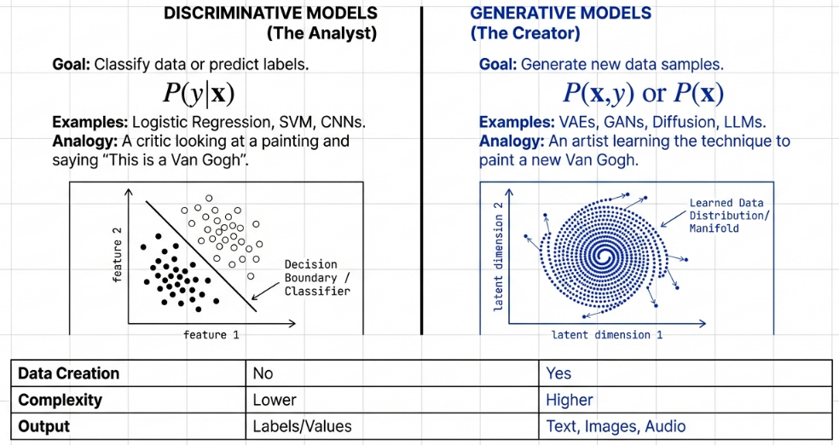
Generative vs Discriminative Models

Slide 10
Generative vs Discriminative Models
Feature | Discriminative Models | Generative Models
Probability Modeled | P(y∣x) | P(x,y) or P(x)
Main Goal | Classify or predict | Generate new data
Output | Labels / Values | Text, images, audio
Data Creation | No | Yes
Complexity | Lower | Higher
Examples | SVM, CNN, Random Forest | GANs, VAEs, LLMs

Slide 11
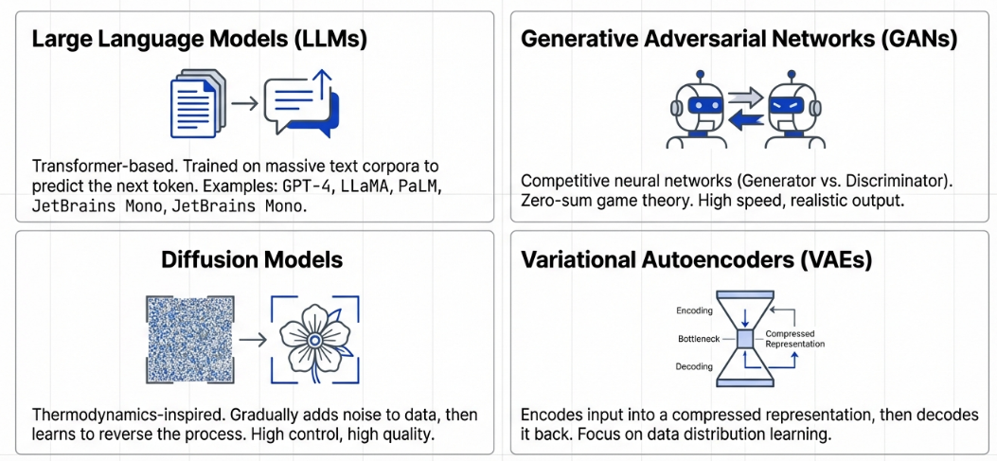
Core Architectures of Generative AI

Slide 12
Large Language Models (LLMs)
Neural networks trained on massive text corpora
Predict the next token in a sequence
Based on Transformer architecture
Examples:
GPT series
BERT (masked generation)
LLaMA
PaLM

Slide 13
Large Language Models (LLMs)
Transformer Architecture (High-Level):
Core components:
Tokenization
Embeddings
Self-Attention Mechanism
Multi-Head Attention
Feed-Forward Networks

Slide 14
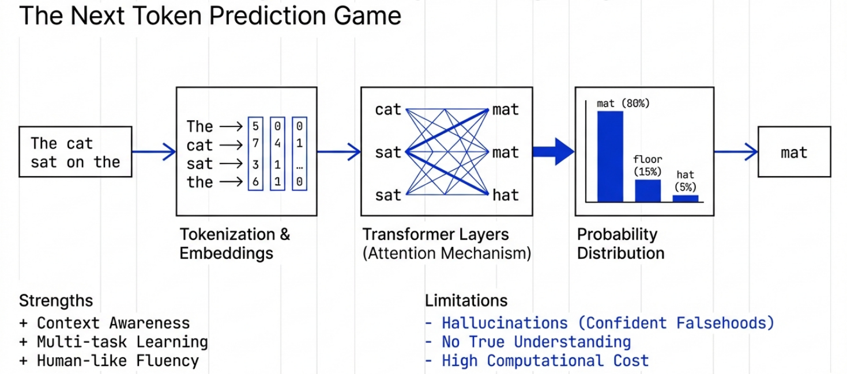
Large Language Models (LLMs)

Slide 15
Large Language Models (LLMs)
Strengths & Limitations of LLMs
Strengths
Human-like text generation
Context awareness
Multi-task learning
Limitations
Hallucinations
Bias propagation
Lack of true understanding
High computational cost

Slide 16
Generative Adversarial Networks (GANs)
Introduced by Ian Goodfellow (2014)
Two competing networks:
Generator – creates fake data
Discriminator – distinguishes real vs fake
Example: A game-theoretic approach (minimax game).

Slide 17
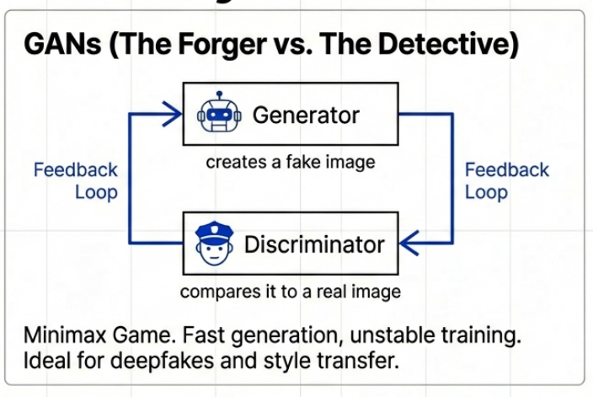
Generative Adversarial Networks (GANs)

Slide 18
Generative Adversarial Networks (GANs)
GAN Training Process
Generator produces fake samples
Discriminator evaluates real vs fake
Generator improves to fool discriminator
Discriminator improves to detect fakes
Generator’s Output:
Generator produces highly realistic samples

Slide 19
Generative Adversarial Networks (GANs)
Applications of GANs:
Image synthesis
Medical imaging augmentation
Super-resolution
Deepfakes
Style transfer

Slide 20
Diffusion Models
Inspired by thermodynamics
Gradually add noise to data
Learn to reverse the noise process
Popular in:
Image generation
Medical imaging
Art creation

Slide 21
Diffusion Models
How Diffusion Models Work
Two Phases:
Forward diffusion (adding noise)
Reverse diffusion (denoising)
Model learns to:
Remove noise step by step
Recover realistic data

Slide 22
Diffusion vs GANs
Aspect | GANs | Diffusion
Training | Unstable | Stable
Output quality | High | Very high
Speed | Fast | Slower
Control | Limited | Strong control

Slide 23
Ethics of Generative AI
Why Ethics Matters in Generative AI
Scale of impact is massive
Outputs influence opinions and decisions
Automation of misinformation
Key Ethical Challenges
Bias & discrimination
Misinformation & deepfakes
Privacy violations
Intellectual property issues
Lack of accountability

Slide 24
Ethics of Generative AI
Bias in Generative AI:
Gender bias
Racial bias
Cultural bias
Root causes:
Skewed training data
Historical inequalities

Slide 25
Ethics of Generative AI
Privacy & Data Security:
Training on scraped data
Risk of memorization
Leakage of personal information
Compliance with GDPR, HIPAA, etc., is critical.

Slide 26
Ethics of Generative AI
Deepfakes & Misuse
Fake videos
Political manipulation
Identity fraud
High social and legal risk.

Slide 27
Responsible Use of Generative AI
Principles of Responsible AI:
Fairness
Transparency
Accountability
Privacy
Safety
Human oversight

Slide 28
Responsible Use of Generative AI
Ethical AI Frameworks:
OECD AI Principles
UNESCO AI Ethics
EU AI Act
Company-level AI governance

Slide 29
Responsible Use of Generative AI
Mitigation Strategies:
Bias auditing
Human-in-the-loop systems
Content moderation
Watermarking AI-generated content
Explainable AI (XAI)

