Slide 1


PROBABILITY & BAYESIAN LEARNING
Reasoning Under Uncertainty
From Probability to Networks
🎲 Probability | 🧠 Bayesian Inference
Probability, Bayes Theorem, Bayesian Networks, Probabilistic Learning
LEARN
APPLY
MASTER
www.lpu.in Lovely Professional University

Slide 2
Topics to be Discussed
Part 1: Probability Basics
Foundation: P(A), P(A|B), Joint, Marginal
Part 2: Bayes Theorem
How to update beliefs: Prior to Posterior
Part 3: Bayesian Networks
Complex reasoning with multiple variables
Part 4: Probabilistic Learning
Learning from data: Naive Bayes, HMM, etc.
Summary & Applications
Real-world systems and when to use each

Slide 3
1. Probability Basics - Layman's View
Intuitive Understanding
Probability measures uncertainty
Coin flip: 50% heads, 50% tails
Die roll: Each number 1/6 = 16.7%
Weather: 80% chance of rain
These are EVERYDAY predictions
Technical Definition
P(Event) = number between 0 and 1
P(A) = 0: Never happens
P(A) = 1: Always happens
P(A) = 0.5: 50-50 chance
Must sum to 1 across all outcomes
Coin: P(H) + P(T) = 0.5 + 0.5 = 1

Slide 4
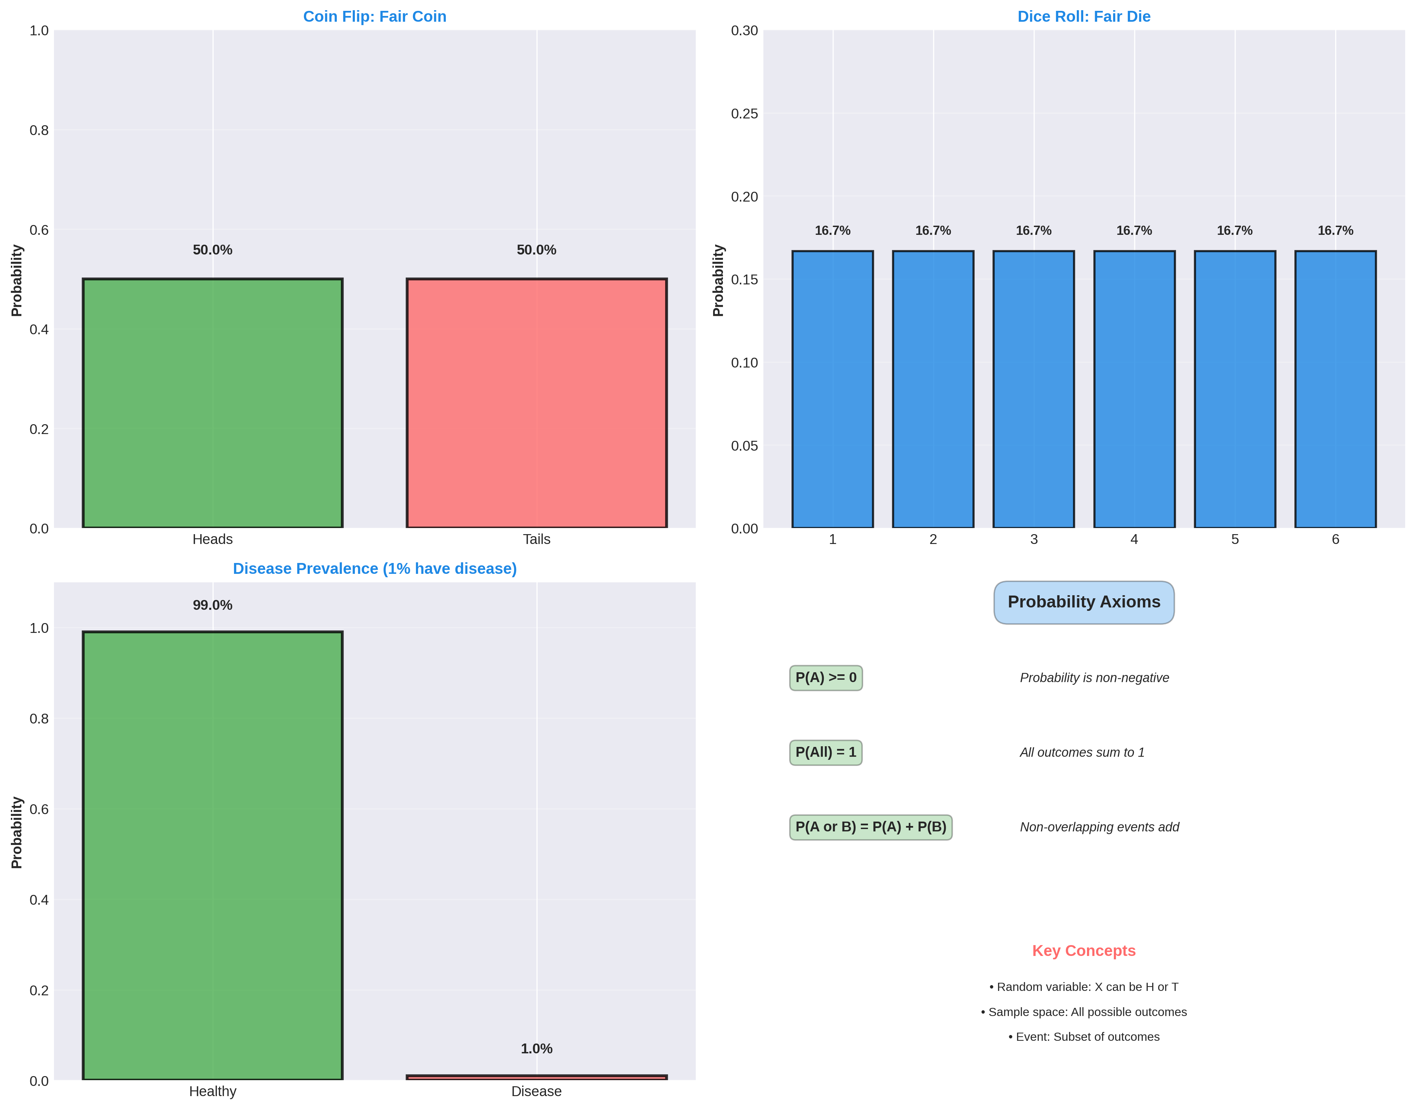
2. Probability Examples

Slide 5
3. Conditional Probability - 'Given That'
Layman's View
Probabilities CHANGE with new info
Without knowing weather:
P(Happy) = 50%
If I know it's SUNNY:
P(Happy|Sunny) = 80%
If I know it's RAINY:
P(Happy|Rainy) = 20%
Same person, different probabilities!
Technical Definition
P(A|B) = Probability of A given B
Formula:
P(A|B) = P(A and B) / P(B)
Example:
P(Disease|Test+) = P(T+|D)*P(D)
/ P(T+)
The denominator P(B) normalizes
the conditional probability

Slide 6
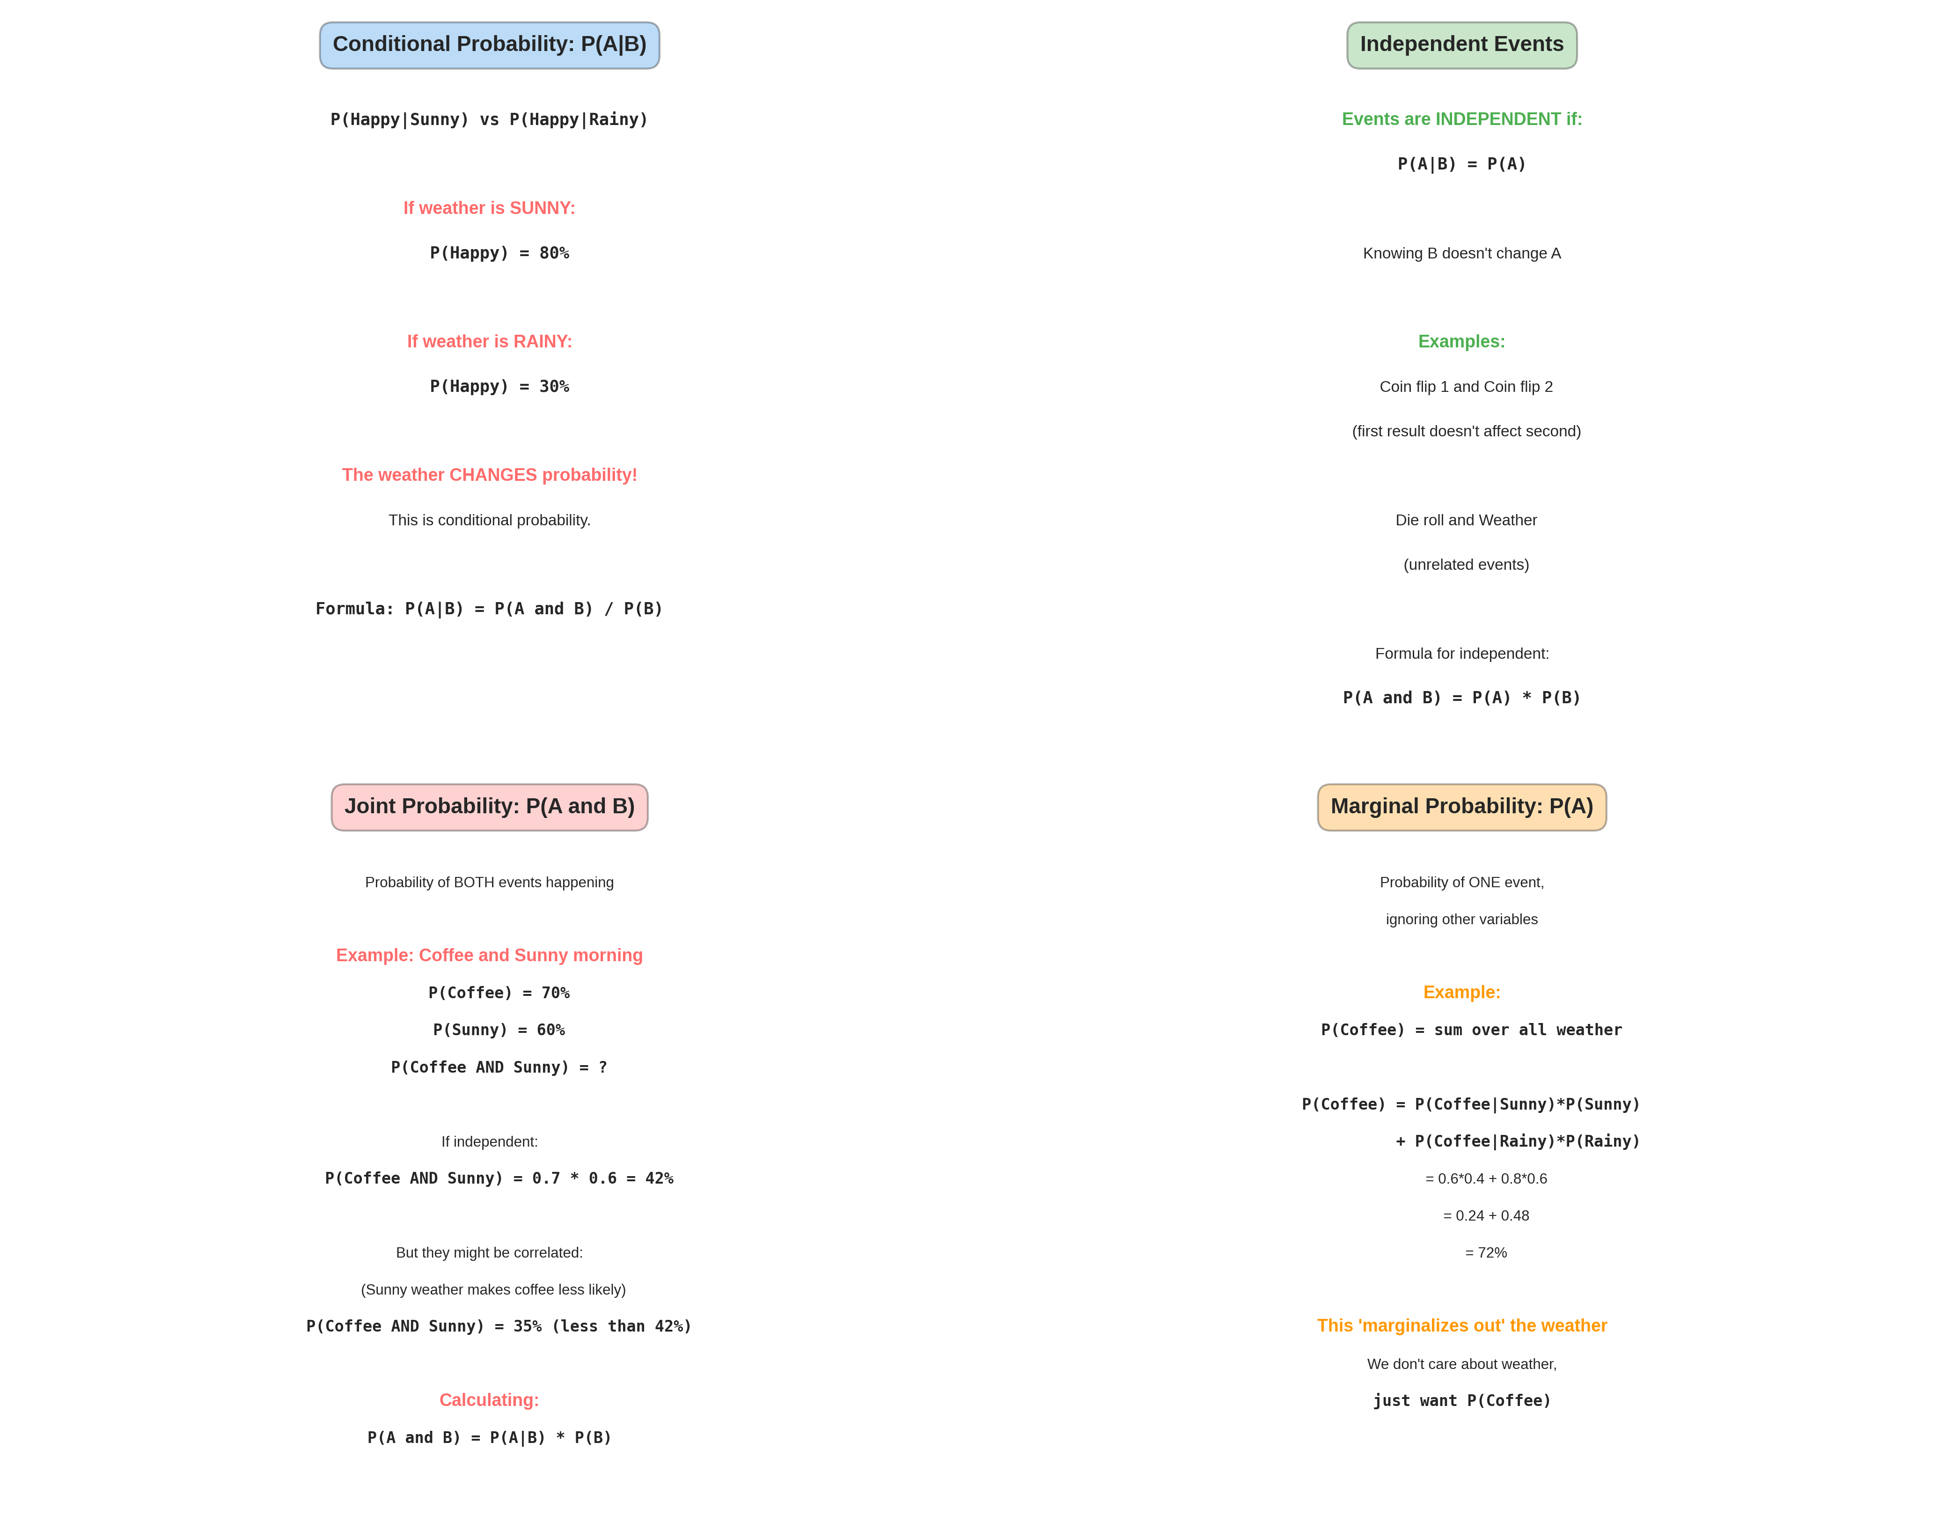
4. Conditional & Joint Probability

Slide 7
5. Independence - Key Concept
Two events are INDEPENDENT if knowing one doesn't affect the other
EXAMPLES OF INDEPENDENT:
Coin flip 1 and Coin flip 2
Result of flip 1 doesn't affect flip 2
P(Heads flip 2 | Heads flip 1) = P(Heads flip 2) = 0.5
Die roll and Weather
Getting a 6 has nothing to do with rain
P(Die=6 | Rain) = P(Die=6) = 1/6
EXAMPLES OF DEPENDENT:
Disease and Test result
Test is designed to detect disease
Having disease affects test result
P(Test+ | Disease) ≠ P(Test+)

Slide 8
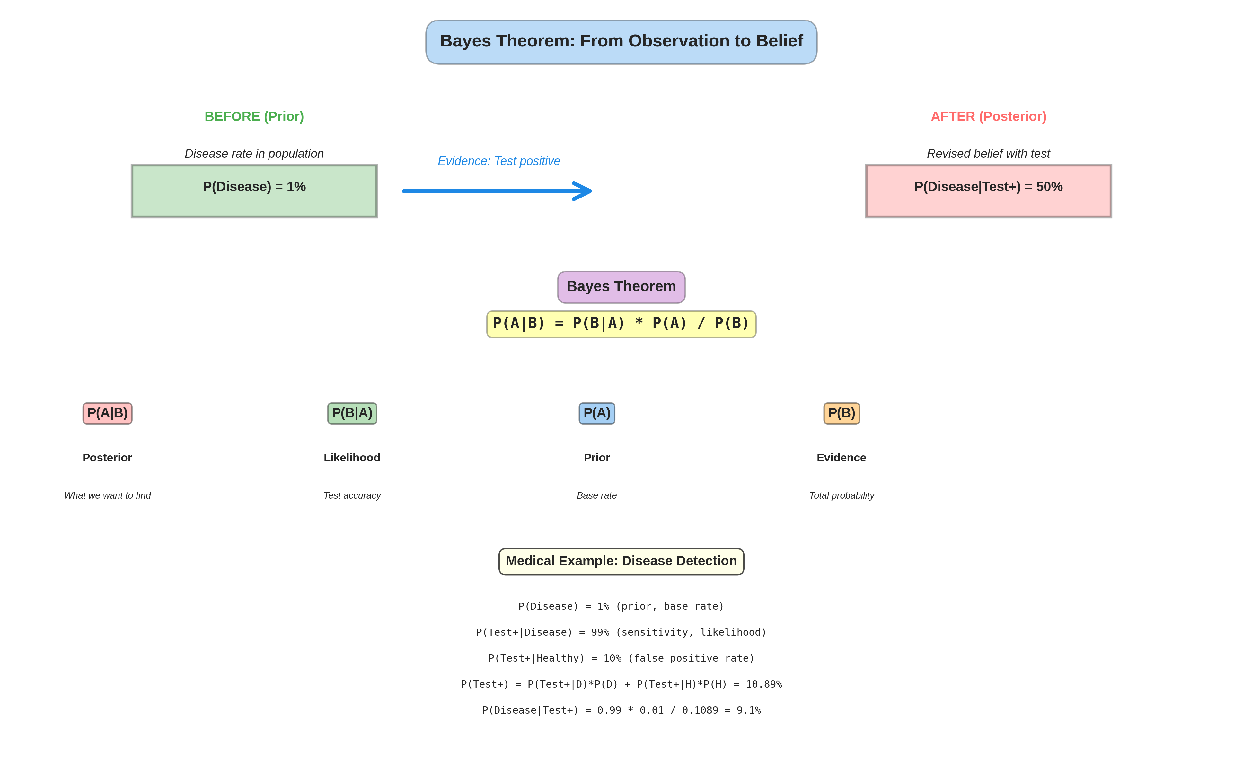
6. Bayes Theorem - From Observation to Belief

Slide 9
7. Bayes Theorem Explained
BAYES THEOREM is about UPDATING BELIEFS
Before test: P(Disease) = 1% (most people healthy)
You take a test and it's POSITIVE
Question: Now what's P(Disease | Test Positive)?
BAYES THEOREM ANSWER:
P(Disease | Test+) = P(Test+ | Disease) * P(Disease) / P(Test+)
Components:
P(Test+ | Disease) = 99% (test accuracy, sensitivity)
P(Disease) = 1% (prior, base rate)
P(Test+) = all ways test can be positive
= 99% * 1% + 10% * 99% = 10.89%
Result: P(Disease | Test+) = 0.99 * 0.01 / 0.1089 = 9.1%
Still only 9%, not 50% or 99%!
Why? Because disease is RARE (1% base rate)

Slide 10
8. Bayes in Real World - Medical Diagnosis
SCENARIO: New disease screening test available
FACTS:
Disease prevalence: 1 in 100 people (1%)
Test sensitivity: 99% (catches 99% of sick)
Test specificity: 90% (correct 90% of healthy)
QUESTION: You test POSITIVE. What now?
INTUITION (often wrong):
Test is 99% accurate, so I probably have disease!
BAYES THEOREM (correct):
P(Disease | Positive) =
P(Positive | Disease) * P(Disease) / P(Positive)
= 0.99 * 0.01 / (0.99*0.01 + 0.10*0.99)
= 0.0099 / 0.1089
= 9.09%
RESULT: Only 9% chance you have disease!
Why so low despite positive test?
Disease is rare (1%), so false positives outnumber true positives

Slide 11
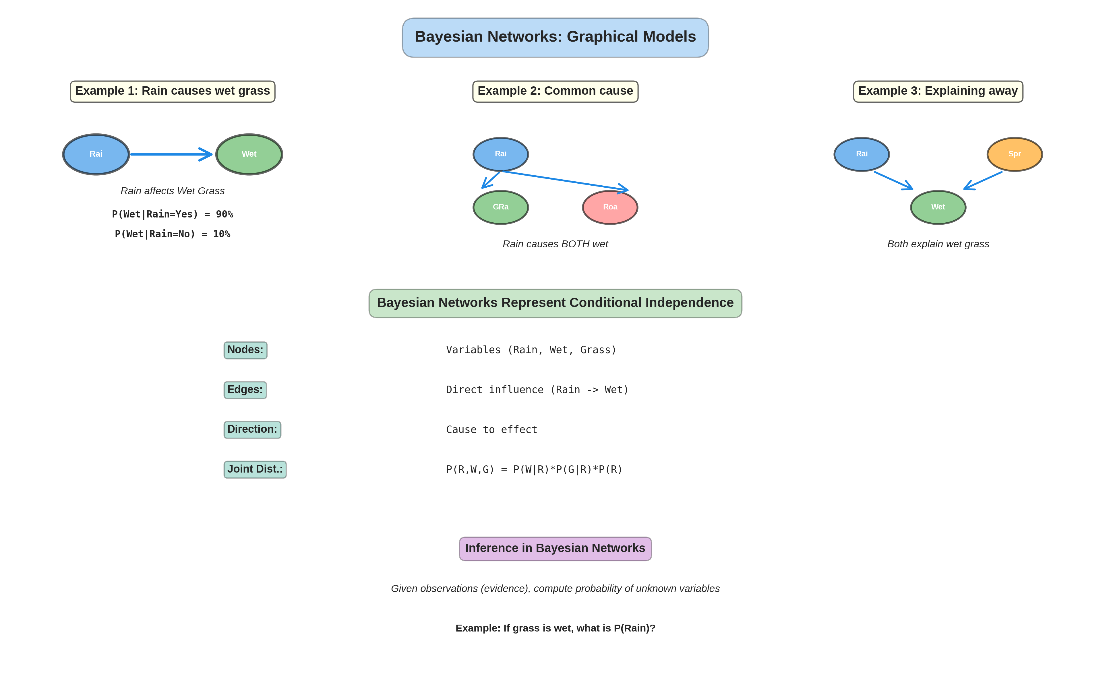
9. Bayesian Networks - Graphical Models

Slide 12
10. Bayesian Networks - Multiple Variables
PROBLEM: Real world has many variables (weather, sprinkler, grass)
NAIVE APPROACH: Model all combinations
P(W, Spr, G) needs huge number of probabilities
With 3 binary variables: 2^3 = 8 probabilities
With 10 variables: 2^10 = 1024 probabilities
With 100 variables: 2^100 = impossible!
BAYESIAN NETWORKS SOLUTION:
Use structure to reduce number of parameters
EXAMPLE: Rain -> Wet Grass
Rain causes wet grass, but wet grass doesn't cause rain
This STRUCTURE lets us write:
P(W, Sp, G) = P(G | W) * P(W | Sp) * P(Sp)
Only need 3 conditional probability tables!
Far fewer parameters to learn from data
NODES: Variables (Rain, Wet, Grass)
EDGES: Direct influence (Rain affects Wet)
DIRECTION: Cause to effect (not bidirectional)

Slide 13
11. Inference in Bayesian Networks
INFERENCE: Computing probabilities given observations
EXAMPLE: Smart Home Rain Detection
Network structure:
Rain -> Grass Wet, Rain -> Roof Wet
Known probabilities:
P(Wet Grass | Rain) = 99%
P(Wet Grass | No Rain) = 10% (sprinkler)
P(Rain) = 30%
OBSERVATION: Grass is wet!
QUESTION: What's P(Rain | Grass Wet)?
BAYES THEOREM on the network:
P(Rain | GrassWet) = P(GW|R)*P(R) / P(GW)
= 0.99 * 0.30 / (0.99*0.30 + 0.10*0.70)
= 0.297 / 0.367
= 81%
RESULT: 81% chance it rained!
Much smarter than just looking at wet grass

Slide 14
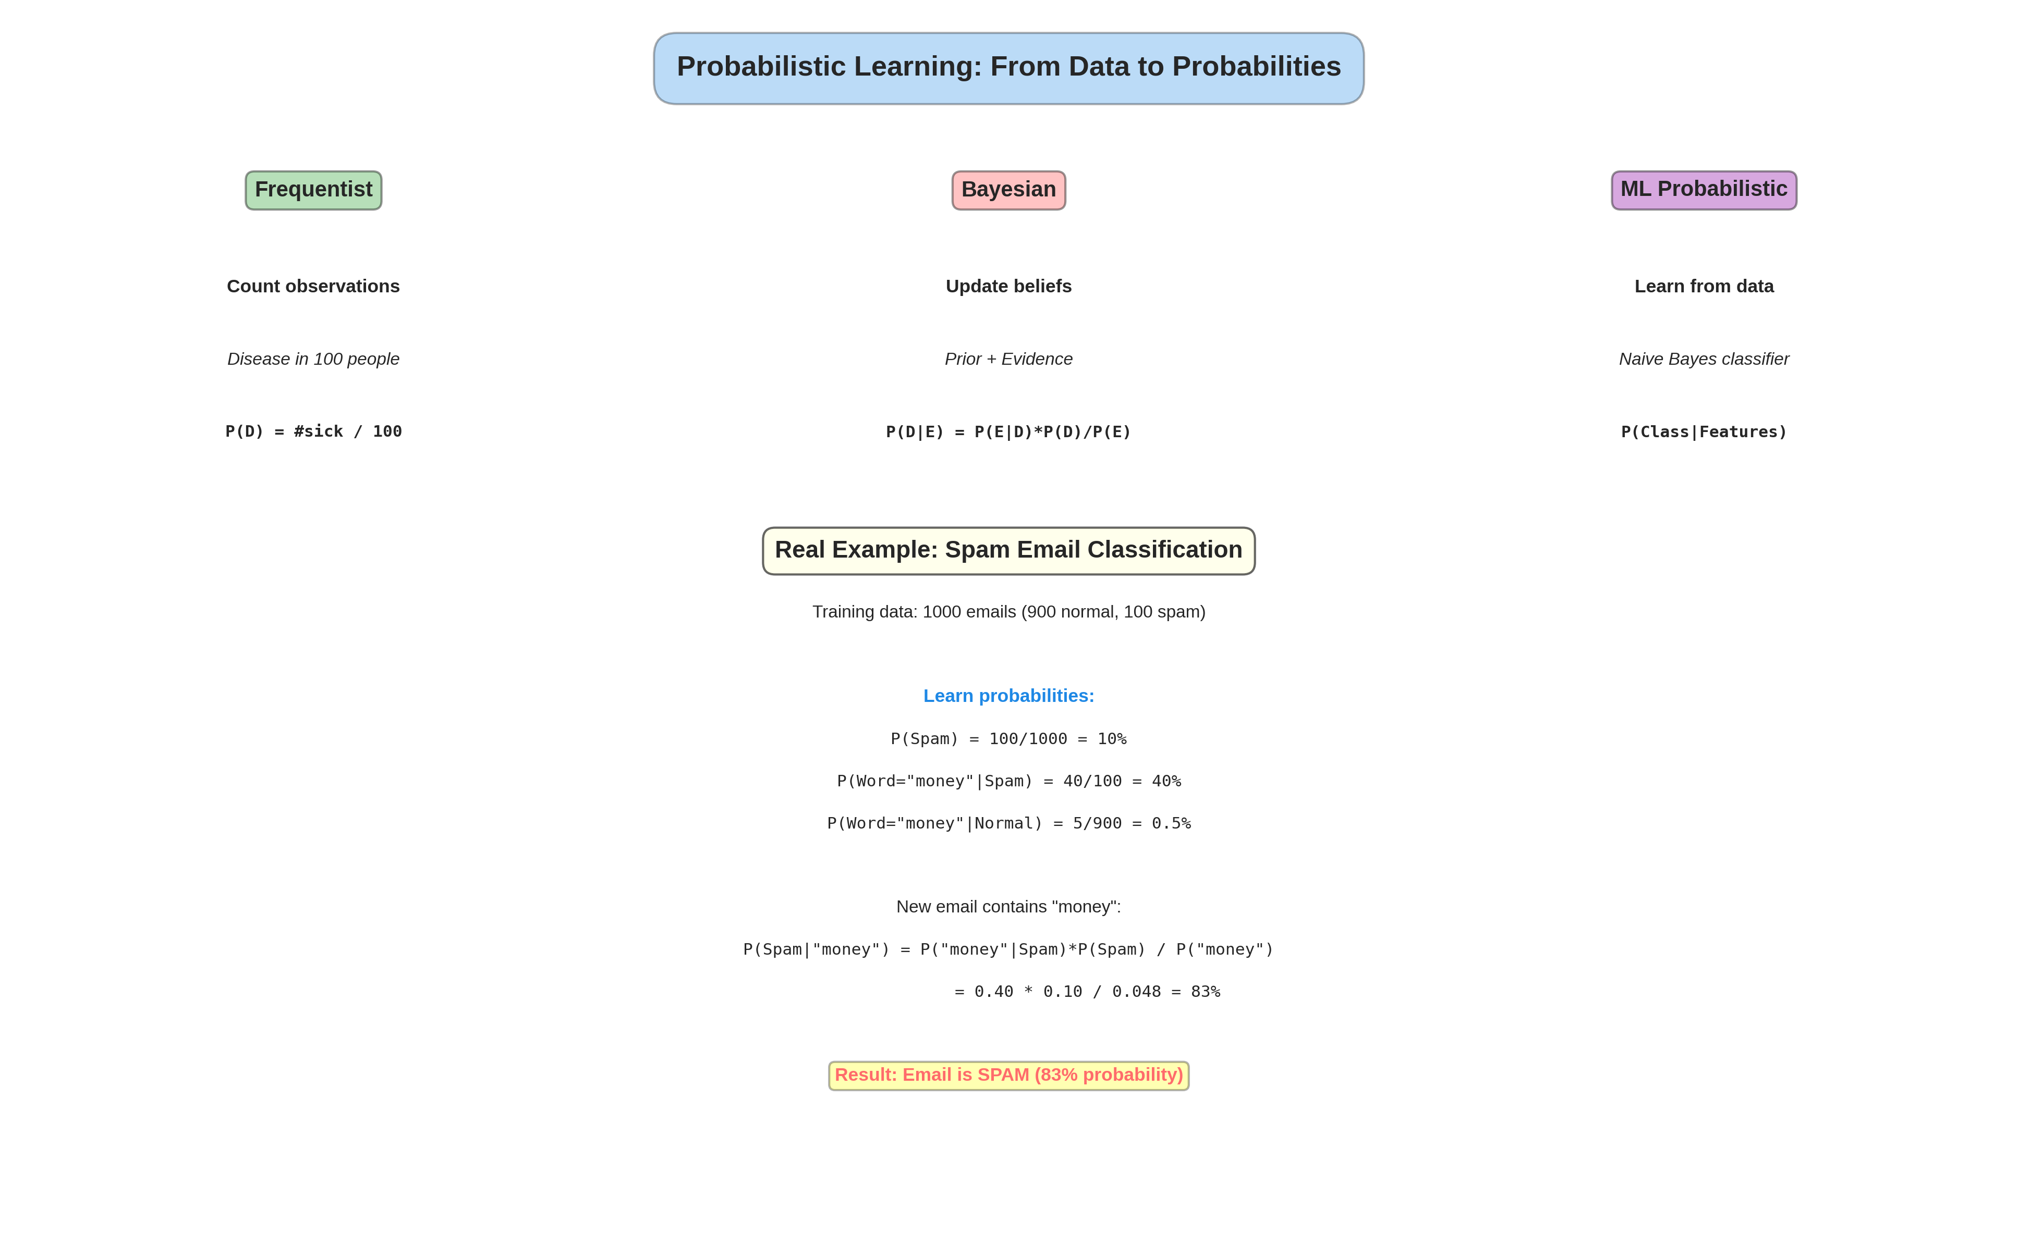
12. Probabilistic Learning - Learning from Data

Slide 15
13. Naive Bayes Classifier
NAIVE BAYES: Learn to classify using Bayes theorem
IDEA: Simple, fast, surprisingly effective!
TRAINING: Learn probabilities from data
Dataset: 1000 emails (700 normal, 300 spam)
P(Spam) = 300/1000 = 30%
P(Normal) = 700/1000 = 70%
P("money"|Spam) = how many spam contain "money"
= 200/300 = 67%
P("money"|Normal) = 20/700 = 3%
CLASSIFICATION: Email has "money" + "urgent"
P(Spam | "money", "urgent") =
P("money"|Spam) * P("urgent"|Spam) * P(Spam)
/ P("money", "urgent")
If result > 0.5, classify as SPAM
NAIVE ASSUMPTION:
Words are independent (unrealistic but works well!)

Slide 16
14. Hidden Markov Models (HMM)
HIDDEN MARKOV MODEL: Probabilistic model for sequences
USE CASE: Speech recognition, DNA sequencing
EXAMPLE: Predicting weather over time
HIDDEN STATE: Actual weather (not observed directly)
Sunny -> 80% Sunny tomorrow, 20% Rainy
Rainy -> 30% Sunny tomorrow, 70% Rainy
OBSERVATION: What we see (wet grass, umbrella use)
If Sunny: 80% chance I see people outside
If Rainy: 90% chance I see umbrellas
INFERENCE: What's the actual weather sequence
Given observations: {outside}, {outside}, {umbrella}
Find most likely hidden states: {Sunny, Sunny, Rainy}
DYNAMIC: Probabilities change over time
Previous weather affects current weather (not independent!)
VITERBI ALGORITHM: Efficient computation
Find most likely sequence without checking all possibilities

Slide 17
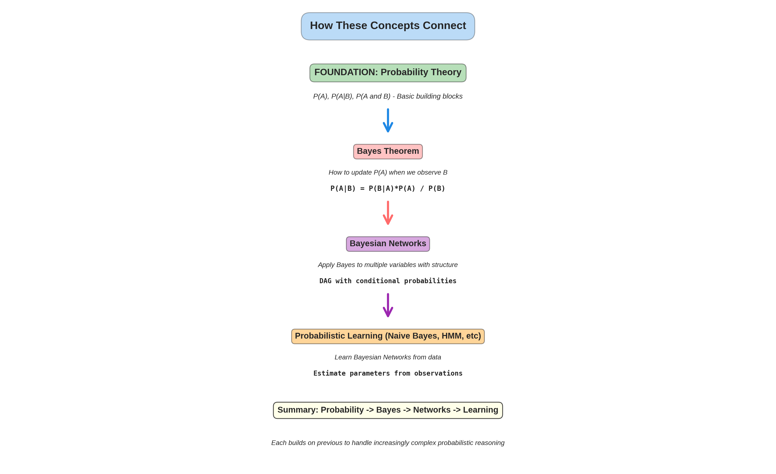
15. How Everything Connects

Slide 18
16. Real-World Applications
Where These Concepts Actually Work
Medical Diagnosis: Bayes theorem
P(Disease | symptoms, tests)
Email Spam: Naive Bayes
P(Spam | words in email)
Speech Recognition: HMM
Hidden words, observed sounds
Recommendation: Bayesian Networks
Movie preferences, user history
Autonomous Driving: Prob. Graphical Models
Object detection, trajectory
NLP Translation: Prob. Models
Hidden meaning, observed words

Slide 19
17. Key Takeaways
Golden Rules of Probabilistic Reasoning
Probability = Uncertainty
Between 0 (never) and 1 (always)
Conditional P(A|B) Changes
New info updates probabilities
Bayes Theorem Updates Beliefs
Prior + Evidence -> Posterior
Base Rate Matters!
Rare events stay rare despite evidence
Networks Handle Complexity
Structure reduces parameters
Learning Estimates Probabilities
Naive Bayes from data is practical
www.lpu.in Lovely Professional University

