Slide 1


STATISTICS & PROBABILITY
Understanding Data Through Numbers
The Bell Curve
📊 Normal Distribution | 📏 Std Deviation
Mean, Median, StdDev, Variance, Distributions, Hypothesis Testing
μ Mean
π Dist
σ StdDev
α Test
σ² Var
P Value

Slide 2
Statistics Fundamentals
Two Branches
Descriptive Statistics
• Summarize data
• Mean, median, mode
• Standard deviation
• Visualizations
Inferential Statistics
• Make predictions
• Hypothesis testing
• Confidence intervals
• Generalize from sample
Key Measures
Mean (μ)
Average value
Median
Middle value
Mode
Most frequent
Variance (σ²)
Spread squared
Std Dev (σ)
Typical distance
Correlation (r)
Relationship -1 to +1

Slide 3
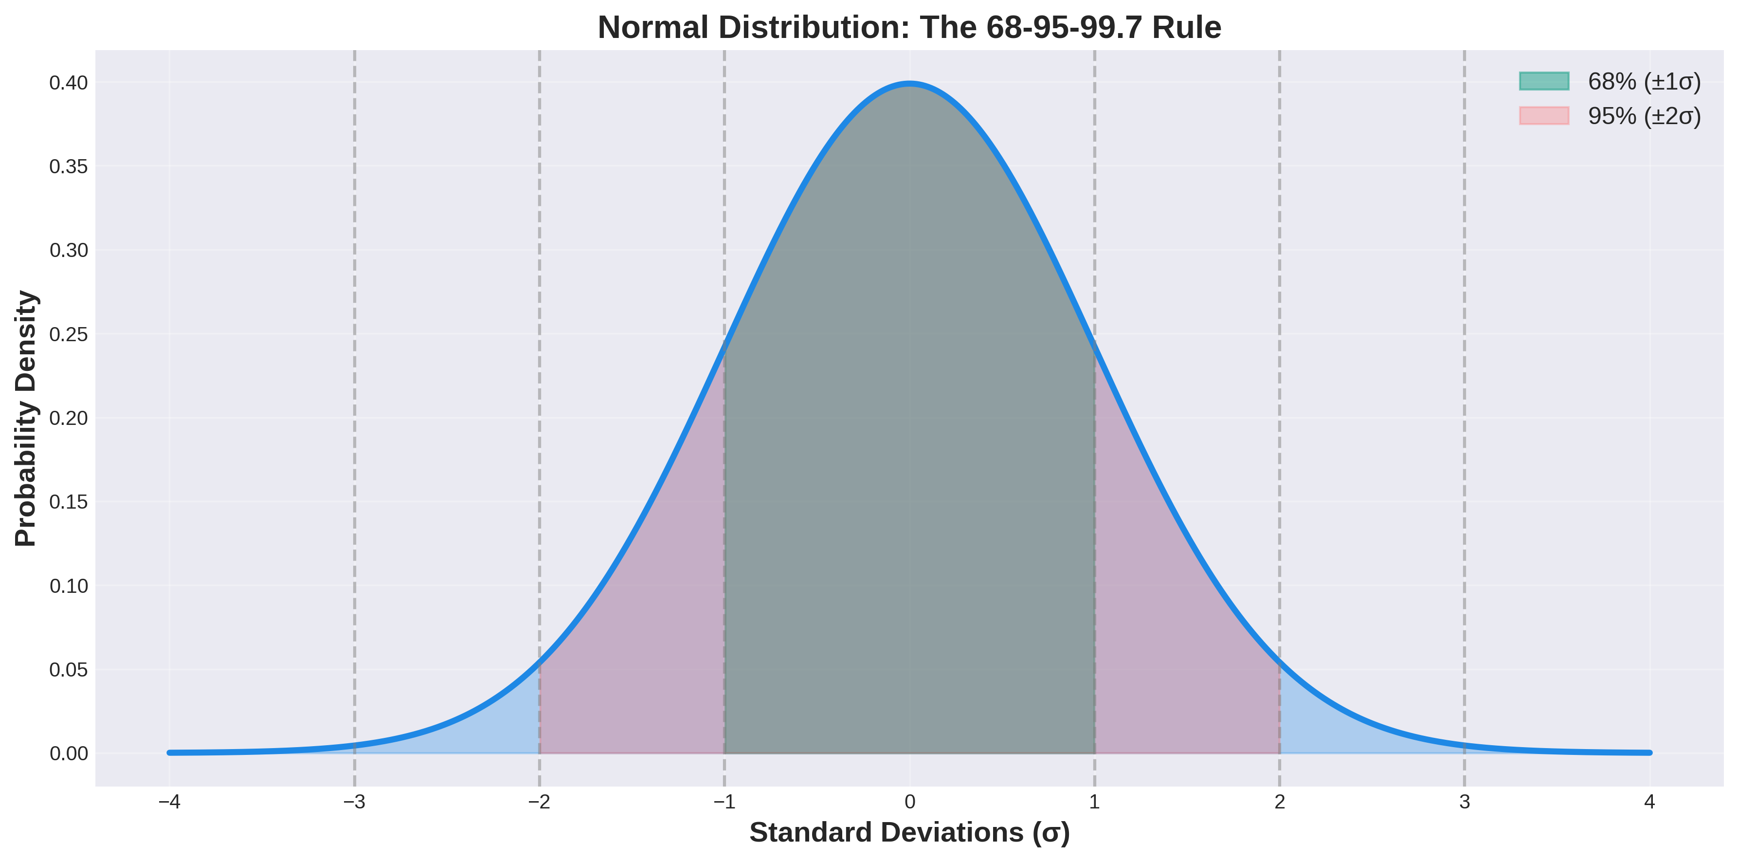
Normal Distribution (Bell Curve)
The most important distribution in statistics. 68% of data within 1 standard deviation, 95% within 2σ, 99.7% within 3σ

Slide 4
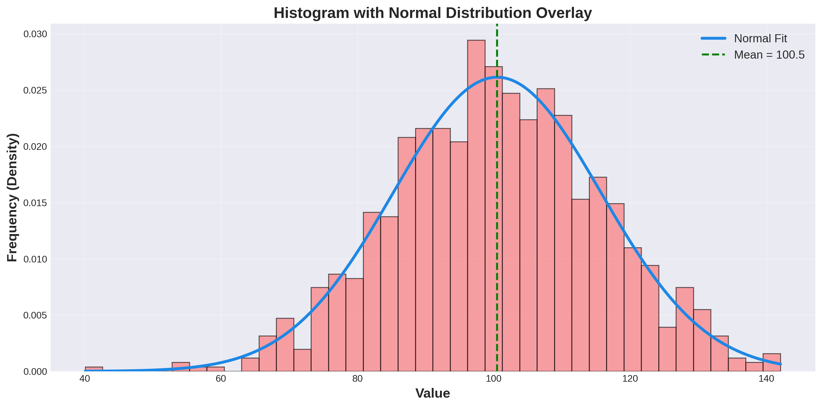
Histograms & Frequency Distributions
Visual representation of data distribution. Red bars show frequency, blue curve shows theoretical normal distribution fit

Slide 5
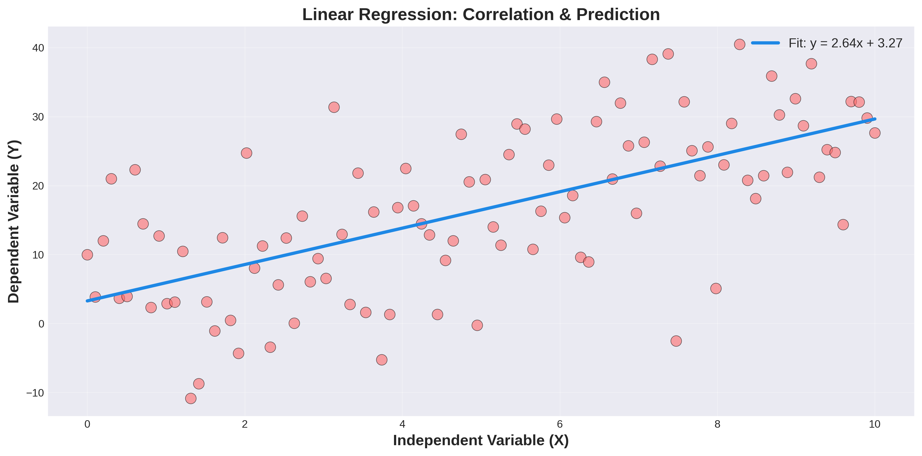
Correlation & Linear Regression
Scatter plot shows relationship between variables. Blue line represents best-fit linear regression for prediction

Slide 6
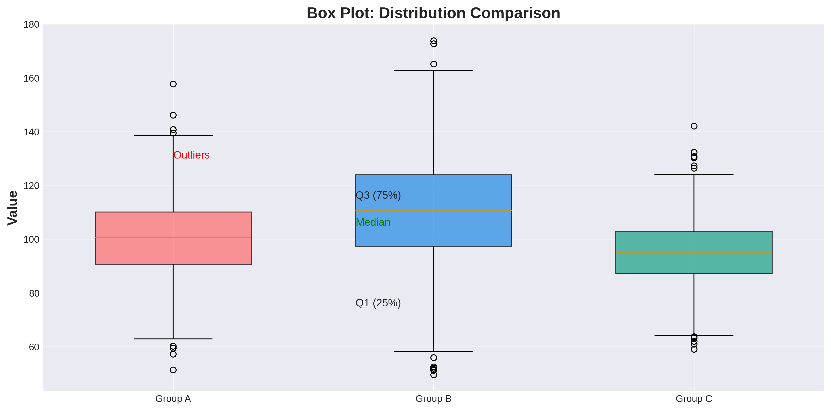
Box Plots & Quartiles
Box Plot Components:
Min
Lowest value
Q1 (25%)
Lower quartile
Q2 (50%)
Median
Q3 (75%)
Upper quartile
Max
Highest value
Outliers
> 1.5×IQR

Slide 7
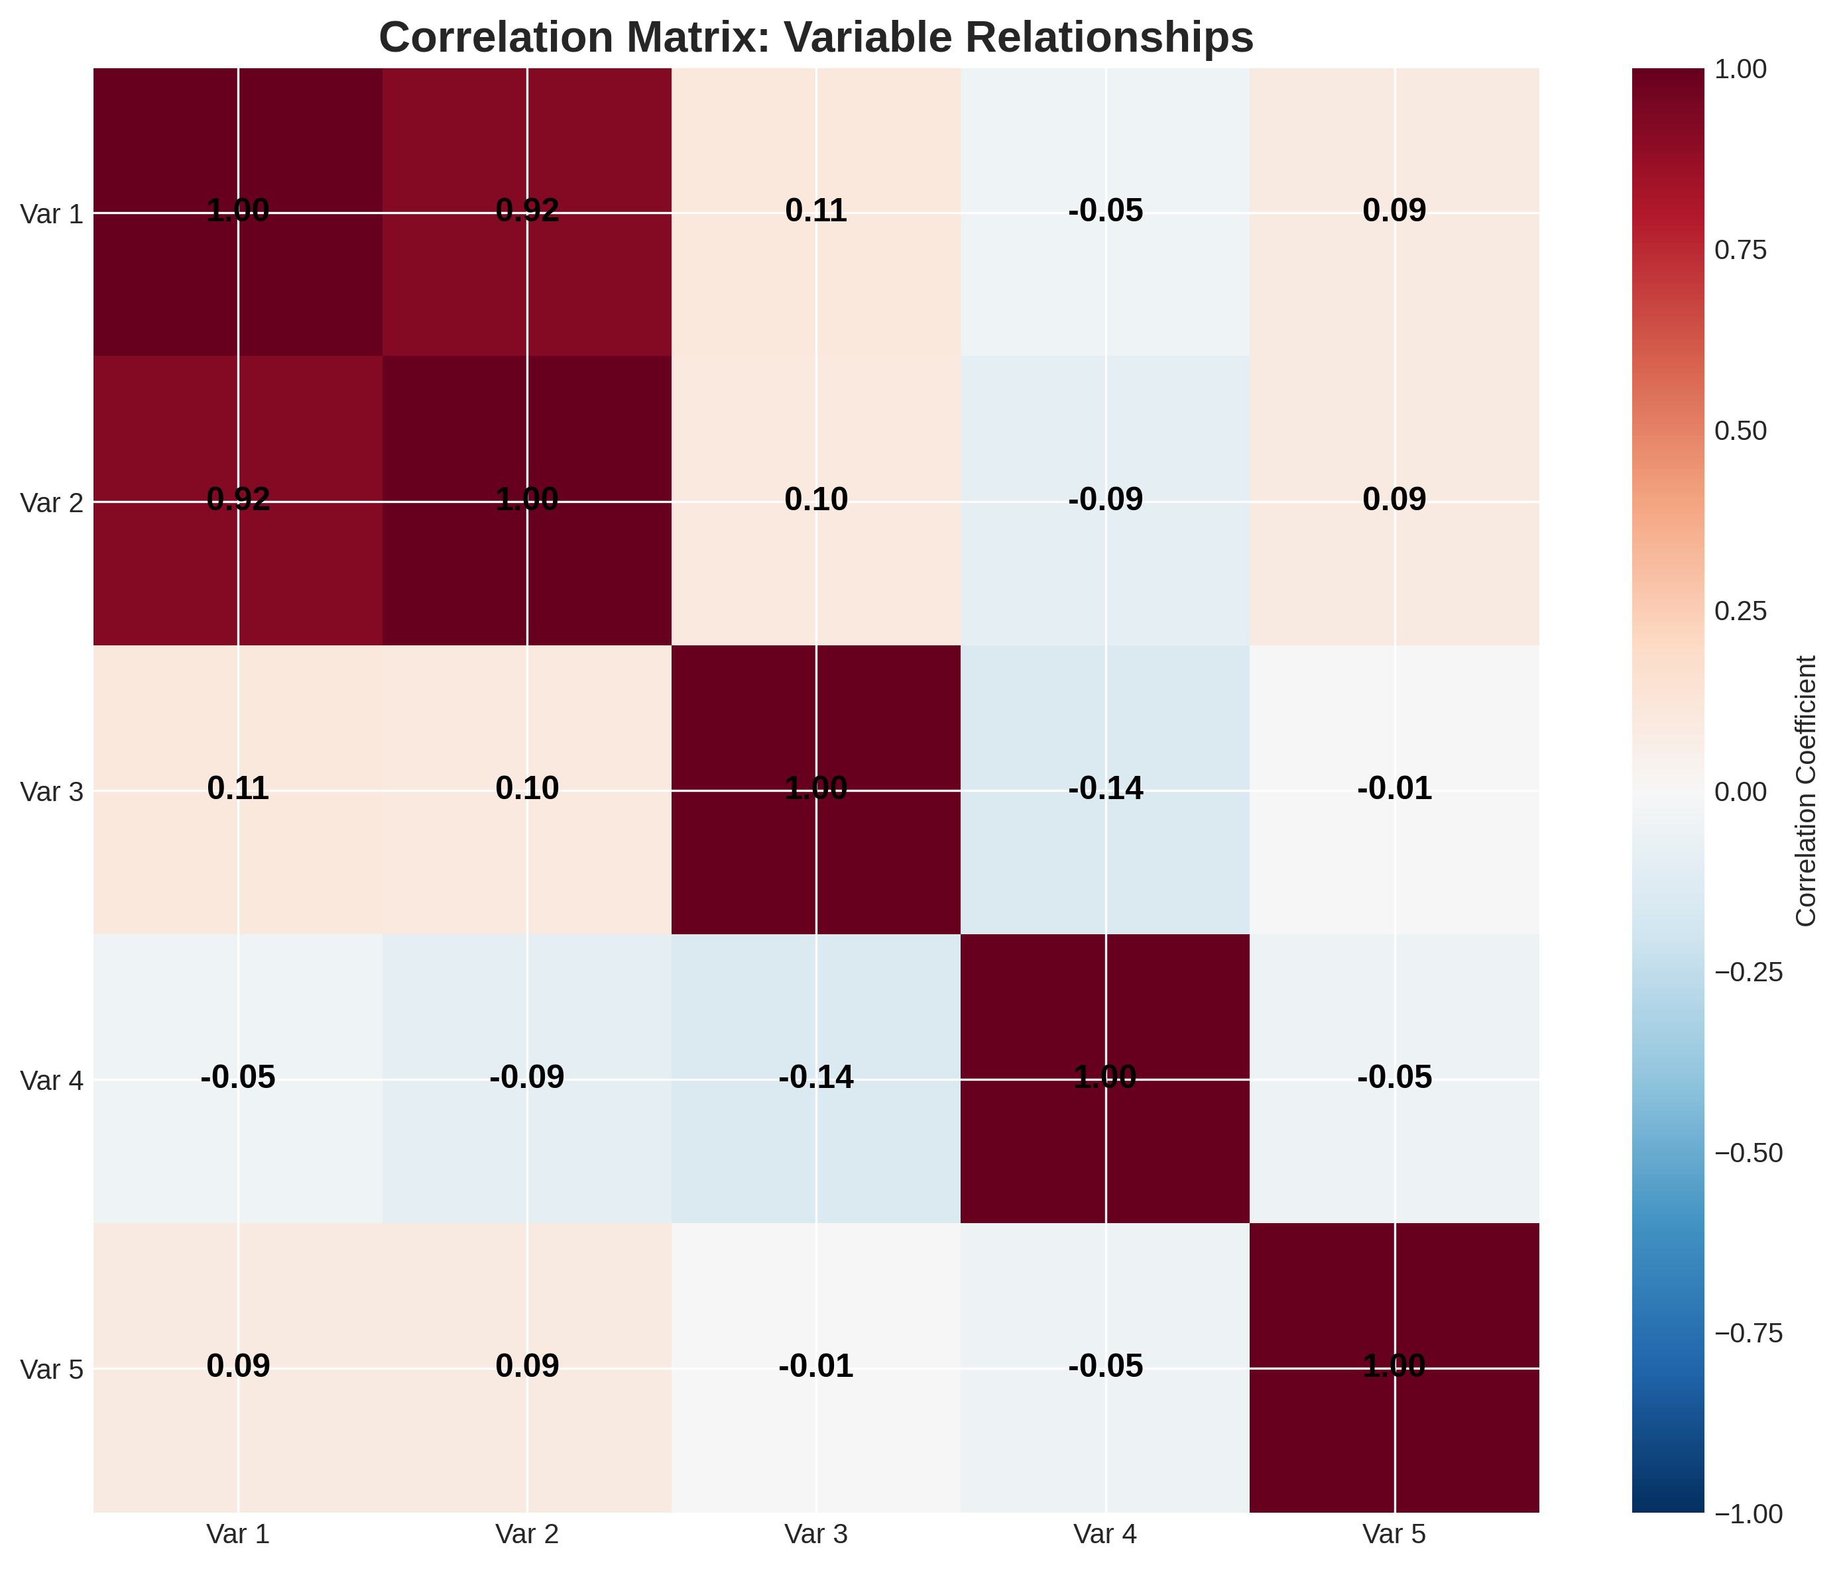
Correlation Matrix & Relationships
Heatmap shows correlation between variables. Red (negative), Blue (positive). Values range from -1 to +1

Slide 8
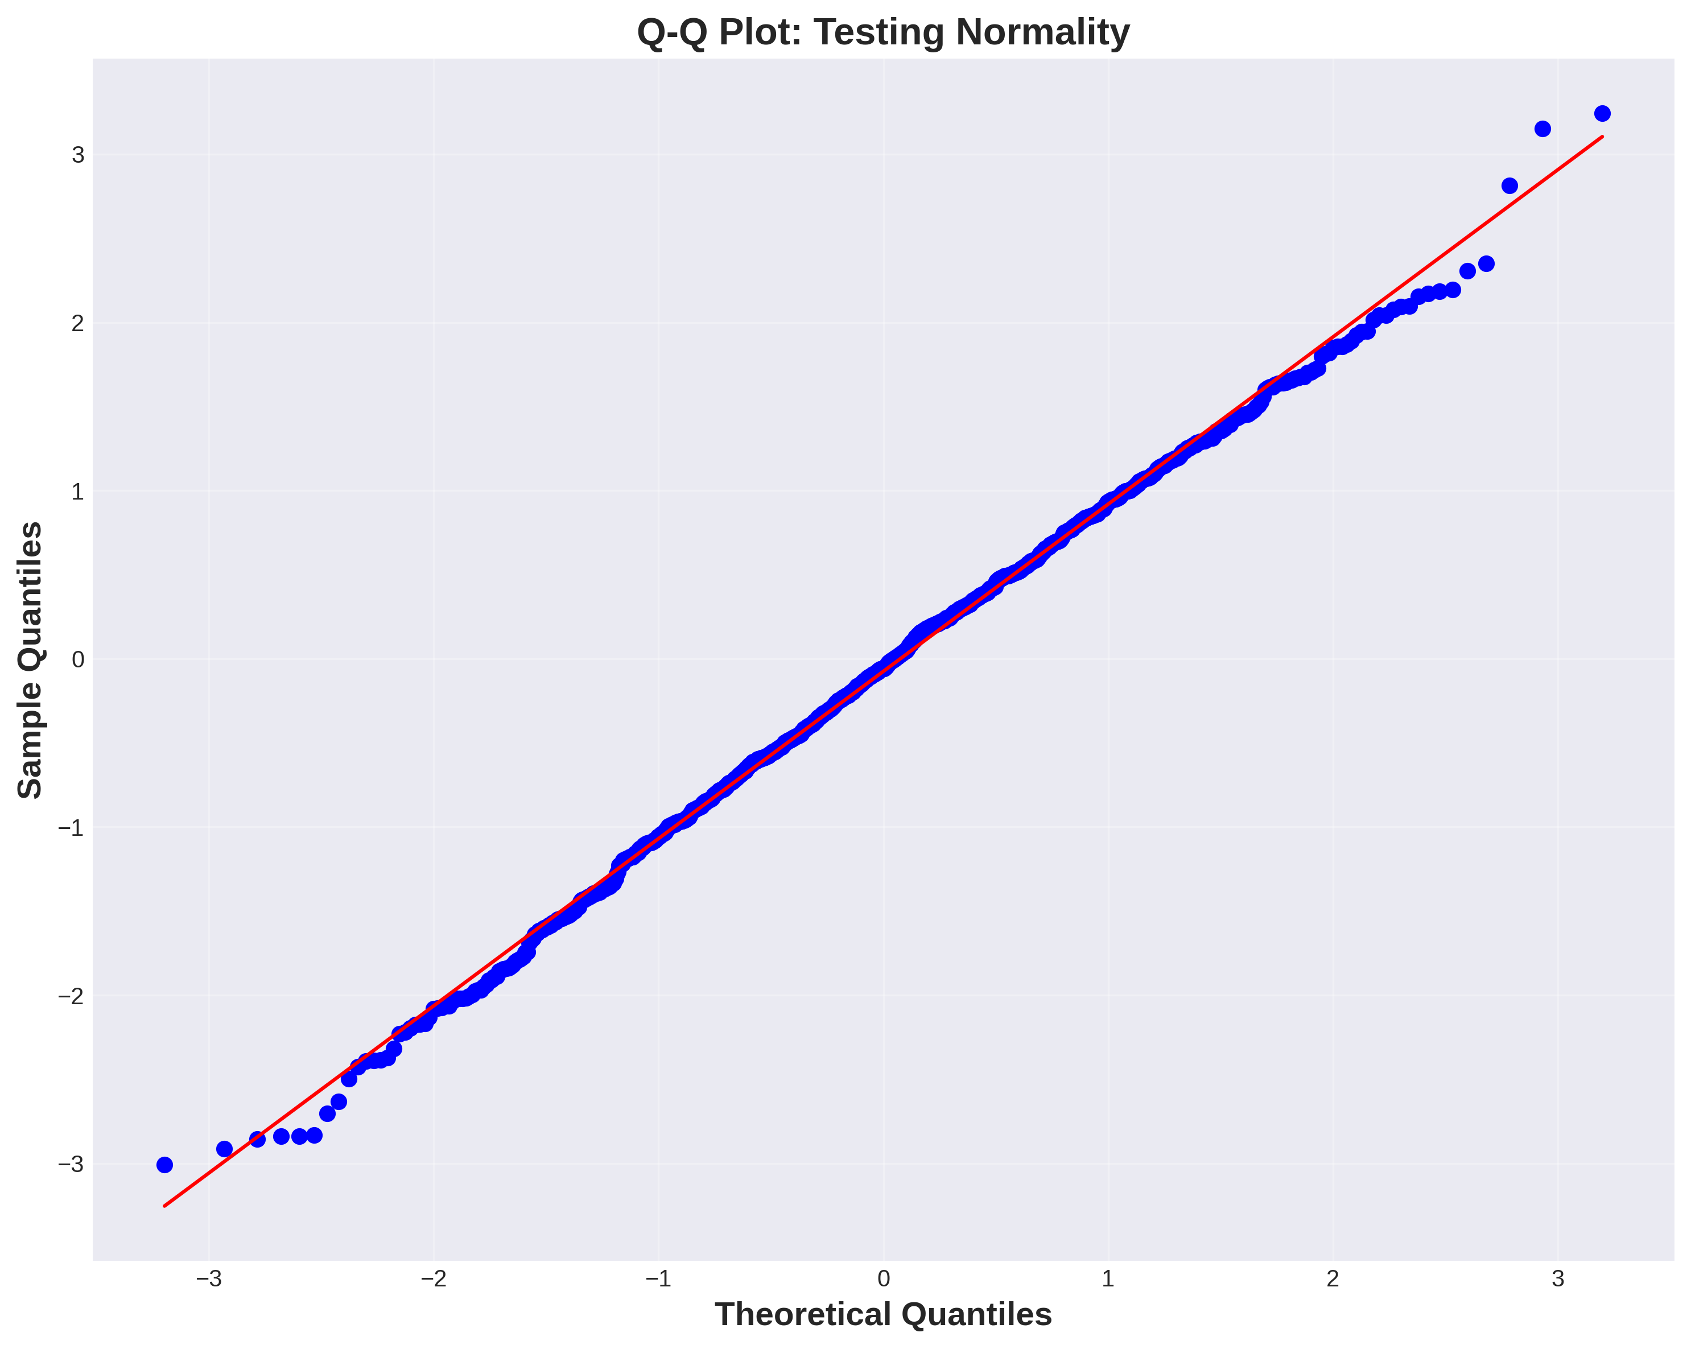
Q-Q Plot - Testing Normality
Q-Q plot compares data quantiles against theoretical normal distribution. Points on diagonal indicate normal distribution

Slide 9
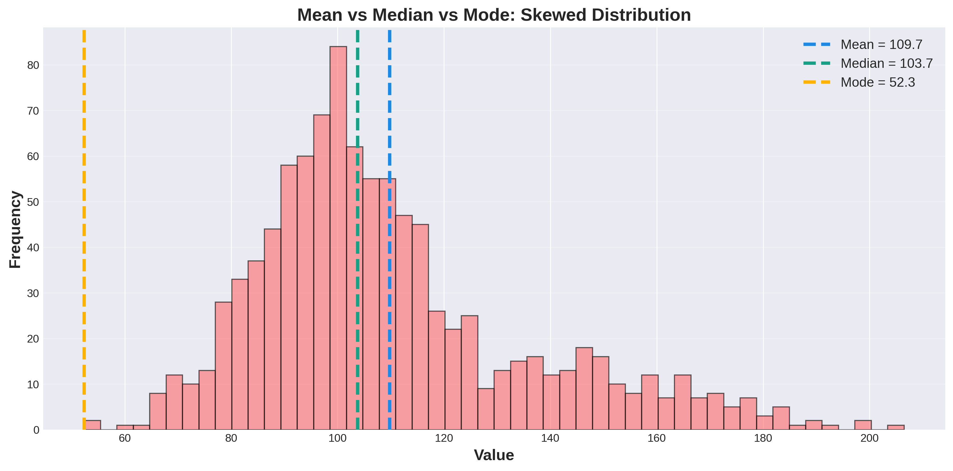
Mean vs Median vs Mode
In skewed distributions, median is more robust than mean. Use median for skewed data, mean for normal data

Slide 10
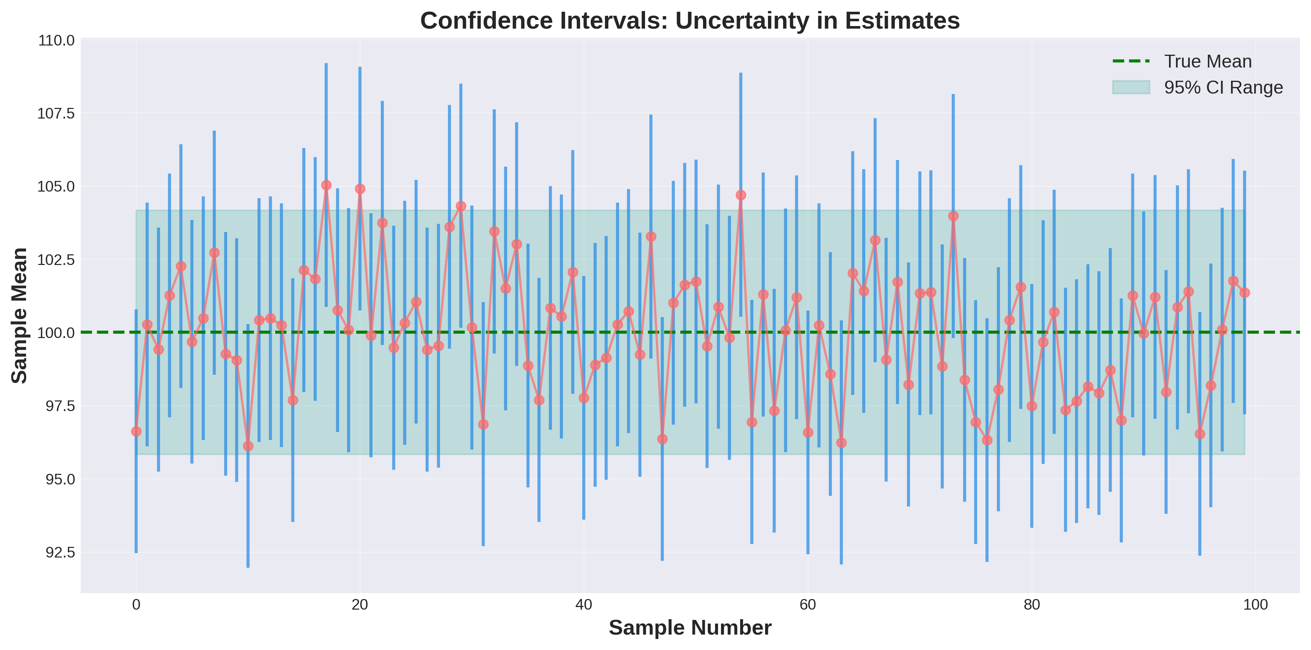
Confidence Intervals & Uncertainty
95% CI means we're 95% confident the true parameter lies in this range. Wider intervals = more uncertainty

Slide 11
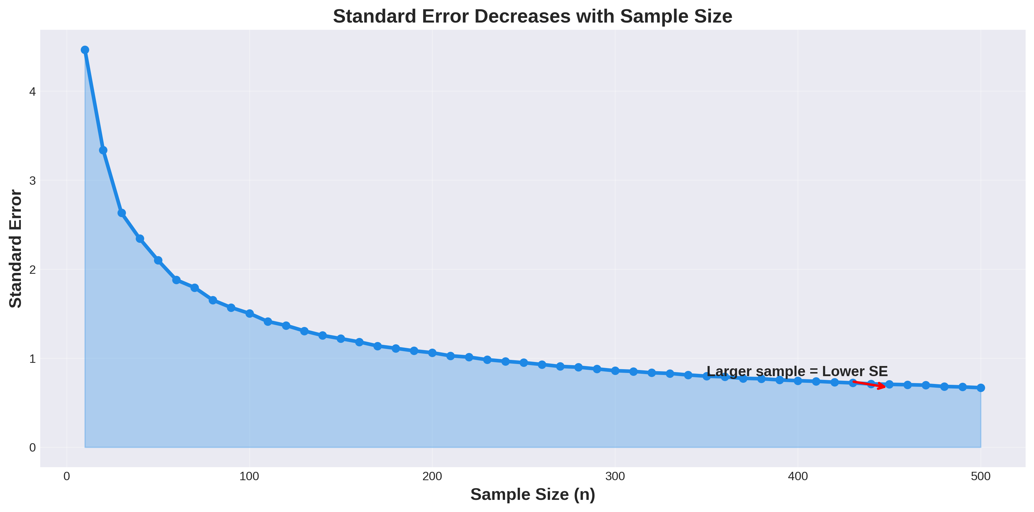
Standard Error & Sample Size
Standard error decreases as sample size increases. Larger samples give more reliable estimates

Slide 12
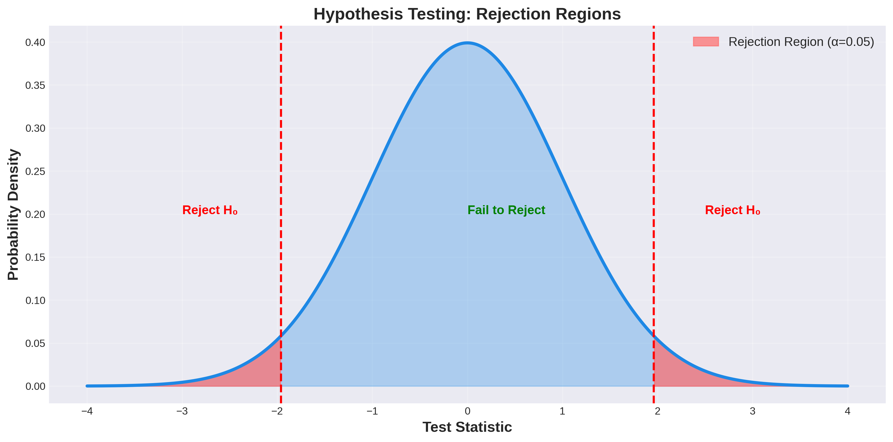
Hypothesis Testing & P-Values
Red regions are rejection zones. If test statistic falls in red, reject null hypothesis (typically α=0.05)

Slide 13
Statistics Drives Machine Learning
🎓 Model Training
📊 Evaluation
🔮 Inference
• Estimate parameters
• Minimize loss
• Optimize weights
• Performance metrics
• Cross-validation
• Confidence bounds
• Make predictions
• Quantify uncertainty
• Bayesian updates
💡 Statistics is the foundation of ML: Parameter estimation, hypothesis testing, and uncertainty quantification are central to every algorithm

Slide 14
Statistical Mistakes in ML
❌ Ignoring Data Distribution
Assuming normality when data is skewed
❌ P-Value Misuse
P < 0.05 does NOT mean 95% probability
❌ Overfitting to Sample
Sample statistics ≠ population parameters
❌ Correlation ≠ Causation
Correlation exists but cause may differ
❌ Ignoring Outliers
Outliers can heavily skew mean and variance

