Slide 1
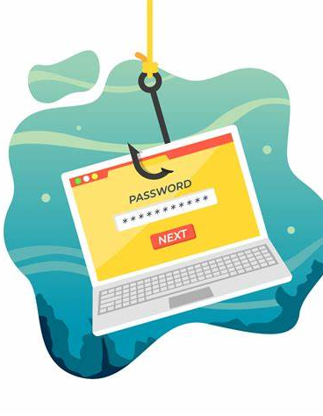
PHISHING ATTACKS
PRAVISHKA D

Slide 2
AGENDA
1
2
3
4
5
Introduction
Types
Recognition
How to Avoid?
Responding

Slide 3

INTRODUCTION
Cyberattack tricking victims into sharing sensitive info
Goals: Steal data, financial info, install malware
Everyone is a potential target, widespread risk
90% of data breaches start with phishing attacks

Slide 4
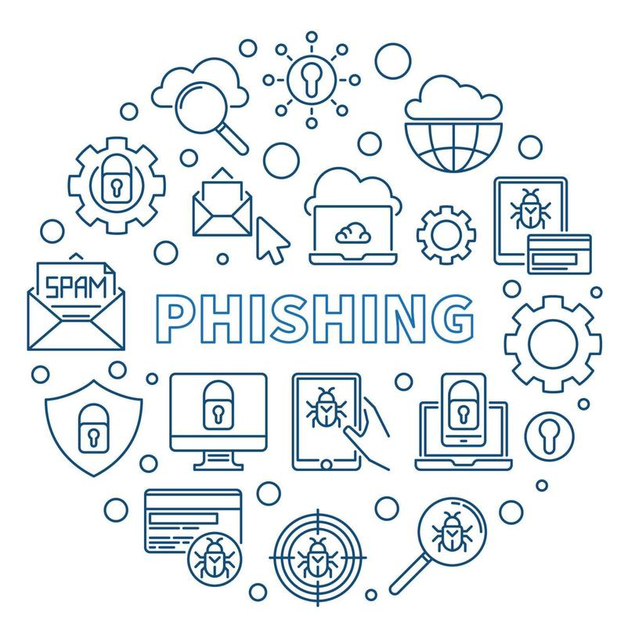
TYPES OF PHISHING

Slide 5
Email Phishing: The most common form, where attackers send deceptive emails.
Spear Phishing: A targeted version aimed at specific individuals or organizations.
Clone Phishing: Attackers use legitimate, previously sent emails, modifying the content to include malicious links or attachments.
Whaling: Targeting high-profile individuals like executives or CEOs.
Smishing and Vishing: Phishing via SMS (Smishing) or voice calls (Vishing).
Website Phishing: Fake websites mimicking legitimate ones to steal credentials.

Slide 6
HOW TO RECOGNIZE PHISHING EMAILS AND MESSAGES ?
Unfamiliar or suspicious sender email
Urgent language or threats
Generic greetings like "Dear Customer"
Grammatical or spelling errors
Suspicious attachments or links
Hover over links to verify URL

Slide 7
Phishing is the easiest way for a hacker to bypass your defenses—it's easier to trick someone into clicking a link than to hack through your security systems.
“
”
Kevin Mitnick, Former Hacker and Security Consultant

Slide 8




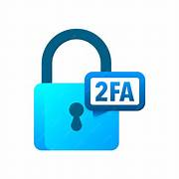
HOW TO AVOID PHISHING ATTACKS ?
Be cautious of unknown links and attachments
Verify unusual requests through direct contact
Ensure websites use HTTPS for sensitive info
Regularly update antivirus and browsers
Enable two-factor authentication for extra security

Slide 9
RESPONDING TO PHISHING ATTACKS
Do not engage or reply to phishing emails
Report phishing to IT or email provider
Change passwords and enable 2FA if compromised
Monitor financial accounts for suspicious activity
Delete phishing emails to avoid accidental clicks

Slide 10

CASE-STUDY
A large multinational company fell victim to a spear phishing attack when an email, appearing to be from the CEO, was sent to an executive requesting urgent wire transfers. The email used a sense of authority and urgency to pressure the recipient, leading them to transfer millions to a fraudulent account before realizing it was a scam. This attack could have been prevented by verifying the request through direct contact, implementing multi-level approval for financial transactions, conducting phishing awareness training, and using email filtering systems to flag suspicious requests.

Slide 11
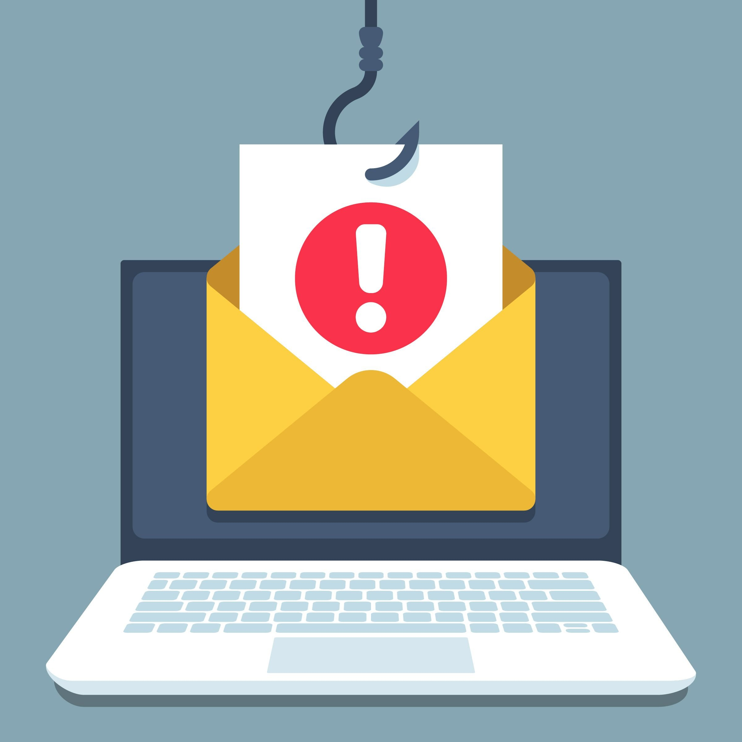
SUMMARY
This presentation covers the basics of phishing attacks, including how cybercriminals trick individuals into sharing sensitive information like login credentials or financial data. It highlights key red flags such as suspicious email addresses and urgent language, while providing actionable tips on avoiding phishing, like verifying requests and using two-factor authentication. The response steps include reporting incidents, changing passwords, and monitoring accounts. A real-life case study reinforces the need for proper verification and training to protect against phishing attacks, which is especially useful given your growing experience in cybersecurity.

Slide 12
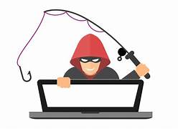
THANK YOU
Pravishka D
pravishkar2005@gmail.com
www.linkedin.com/in/pravishka-d-329975257

