Slide 1
A Cloud-Based Banking Chatbot Solution for Managing Growing Client Inquiries

Slide 2
AGENDA
Introduction to the Domain
Abstract
Challenges in Customer Service
Our Proposal: Banking Query Classification
Architecture
Implementation
Model Training and Deployment
Experimental Results
Conclusion and Future Works

Slide 3
INTRODUCTION TO DOMAIN
Deliberate the significance of customer service in banking.
Familiarize the concept of using machine learning to enhance customer interactions.
Provide an overview of the banking industry.
Highlight the challenges faced by banks in handling customer inquiries efficiently.
Emphasize the need for innovative solutions to improve customer service.

Slide 4
ABSTRACT
The Banking Query Classification initiative tackles the common challenges faced by both customers and banking staff when it comes to efficiently managing routine inquiries. By harnessing machine learning, particularly Natural Language Processing (NLP), Our project aim is to build a chatbot capable of understanding and addressing frequently asked questions (FAQs) about banking services. Acting as a virtual assistant, the chatbot aims to provide prompt and accurate solutions, reducing the need for human involvement and enhancing overall customer satisfaction. The project involves collecting data, preprocessing it, training models using Support Vector Classification (SVC), and deploying the solution via Flask for real-time interaction. Conducted on Google Colab as a cloud-based platform, this initiative highlights the importance of operational efficiency and customer satisfaction in modern banking systems.

Slide 5
CHALLENGES
Quality Data: Obtaining high-quality and relevant data for training the chatbot can significantly impact its accuracy and effectiveness.
Understanding Varied Queries: The chatbot must be capable of interpreting diverse language styles and queries from users, requiring robust natural language processing capabilities.
Regulatory Compliance: Ensuring the chatbot complies with banking regulations and data privacy laws is essential to maintain regulatory standards and protect sensitive customer information.
Integration Complexity: Integrating the chatbot seamlessly with existing banking systems and platforms may present technical challenges, requiring compatibility testing and system adjustments.

Slide 6
OUR PROPOSAL
To address these challenges, we propose developing a Banking Query Classification Chatbot. This innovative solution will leverage advanced machine learning techniques, particularly Natural Language Processing (NLP), to automate query handling. By accurately interpreting and responding to diverse user queries in real-time, the chatbot aims to enhance overall customer satisfaction and streamline banking operations.

Slide 7
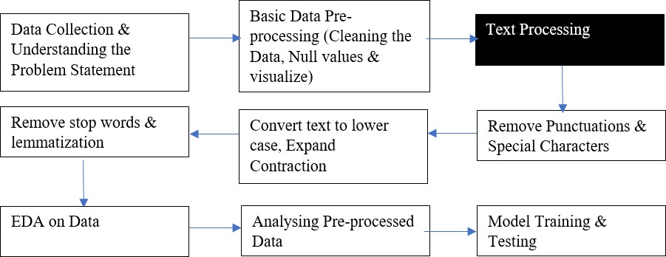
Architecture

Slide 8
IMPLEMENTATION
Data Collection & Preprocessing: Gathered a dataset of banking FAQs and conducted text cleaning, including handling null values and removing unwanted characters.
Feature Engineering: Extracted relevant features from the text data and performed label encoding to prepare it for model
Training Model Selection: Chose Support Vector Classifier (SVC) with a linear kernel for its effectiveness in text classification tasks.
Training & Validation: Trained the model on the preprocessed dataset, splitting it into training and validation sets to ensure generalization.
Hyperparameter Tuning: Fine-tuned model parameters to optimize performance, using techniques like grid search and cross-validation.
Evaluation Metrics: Evaluated model performance using accuracy, precision, recall, and F1-score to assess its effectiveness in classifying queries.

Slide 9
MODEL TRAINING AND DEPLOYMENT
Model Training:
Applied Support Vector Classifier (SVC) with a linear kernel due to its proficiency in managing high-dimensional data and binary classification tasks.
Partitioned the dataset into training and testing subsets to train the model using labeled data.
Saving Model:
We have saved the trained model to a file called model1.pkl using the pickle.dump() function.
Deployment Using Flask:
Implemented the deployment of the trained model as a web application through Flask, a nimble web framework for Python.
Established a RESTful API to manage incoming text queries, promptly predict categories, and deliver outcomes to users in real time.

Slide 10
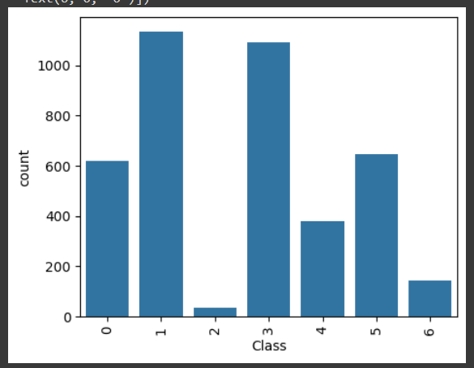
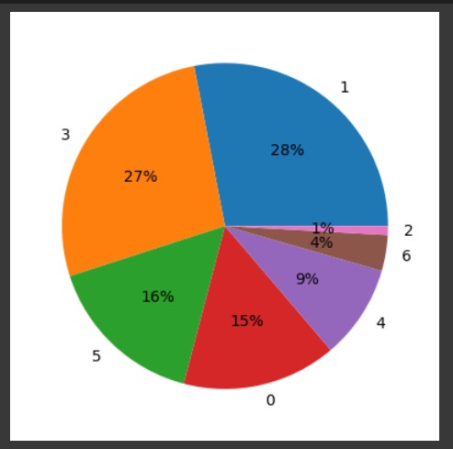
EXPERIMENTAL RESULTS
Visualization of Model Performance Metrics
Accuracy Score: 95.01%
Precision Score: 95.14%
The figure shows the graph between class and counts where class represents the accounts, cards, fund transfer, insurance , investments, loans and security. And counts represents the number.

Slide 11
Conclusion
In conclusion, our project has shown how machine learning-driven chatbots can make a big difference in how banks help their customers. By using fancy technology like Natural language Processing and smart algorithms, these virtual assistants change how people talk to banks. They make customers happier by answering questions quickly and accurately, and they help banks work better too. As we move ahead, using AI-based solutions like chatbots will keep making banking better and more interesting, shaping the future of banking in the digital age.
FUTURE WORK
Consolidation the chatbot's functionality via feedback arrangements and continuing learning.
Enhancing the chatbot's competences to incorporate more sophisticated banking services.
Calculating the chatbot's usefulness in actual banking sceneries.

Slide 12
REFERENCES
M. Hasal, J. Martin, J. Nowaková, K. Ahmed Saghair, H. Abdulla, V. Snášel, and L. Ogiela. "Chatbots:
Security, privacy, data protection, and social aspects." Concurrency and Computation: Practice and Experience 33, no. 19 (2021): e6426
Chanda, Rajat, and Sandeep Prabhu. "Secured Framework for Banking Chatbots using AI, ML and NLP." In 2023 7th International Conference on Intelligent Computing and Control Systems (ICICCS), pp. 60-65. IEEE, 2023.
Suhel, S. Fathima, V. K. Shukla, S.Vyas, and V.P. Mishra. "Conversation to automation in banking through chatbot using artificial machine intelligence language." In 2020 8th international conference on reliability, infocom technologies and optimization (trends and future directions)(ICRITO), pp. 611-618. IEEE, 2020.
S. Khan and M. R. Rabbani, “Artificial Intelligence and NLP-Based Chatbot for Islamic Banking and Finance,” International Journal of Information Retrieval Research, vol. 11, no. 3, pp. 65–77, Jul. 2021, doi: 10.4018/IJIRR.2021070105.
Dash, B., Swayamsiddha, S., & Ali, A. I. "Evolving of Smart Banking with NLP and Deep Learning." In Enabling Technologies for Effective Planning and Management in Sustainable Smart Cities, pp. 151-172. Cham: Springer International Publishing, 2023.
D. Doherty and K. Curran, “Chatbots for online banking services,” Web Intelligence, vol. 17, no. 4, pp. 327–342, 2019, doi: 10.3233/WEB190422

Slide 13
THANK YOU! ☺
Pravigna Pala Ashritha Gudeti Likhitha Naguluri
Phanindra Babu Upputuri

