Slide 1
Chatbot Technology Analysis
Digital & Innovation Team

Slide 2
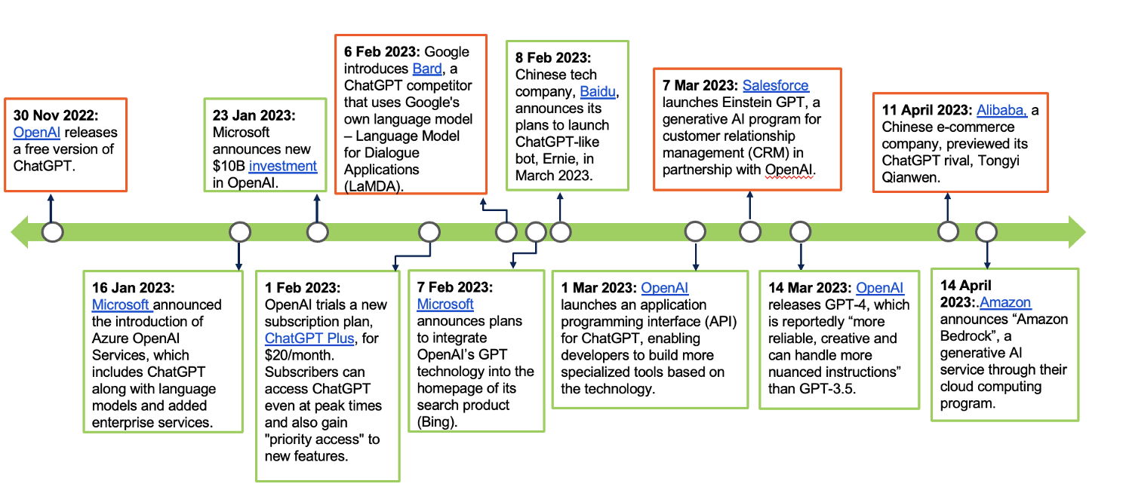
Explosion in Generative AI Developments
*Gartner Research Results
Conversational Chatbot Launch

Slide 3
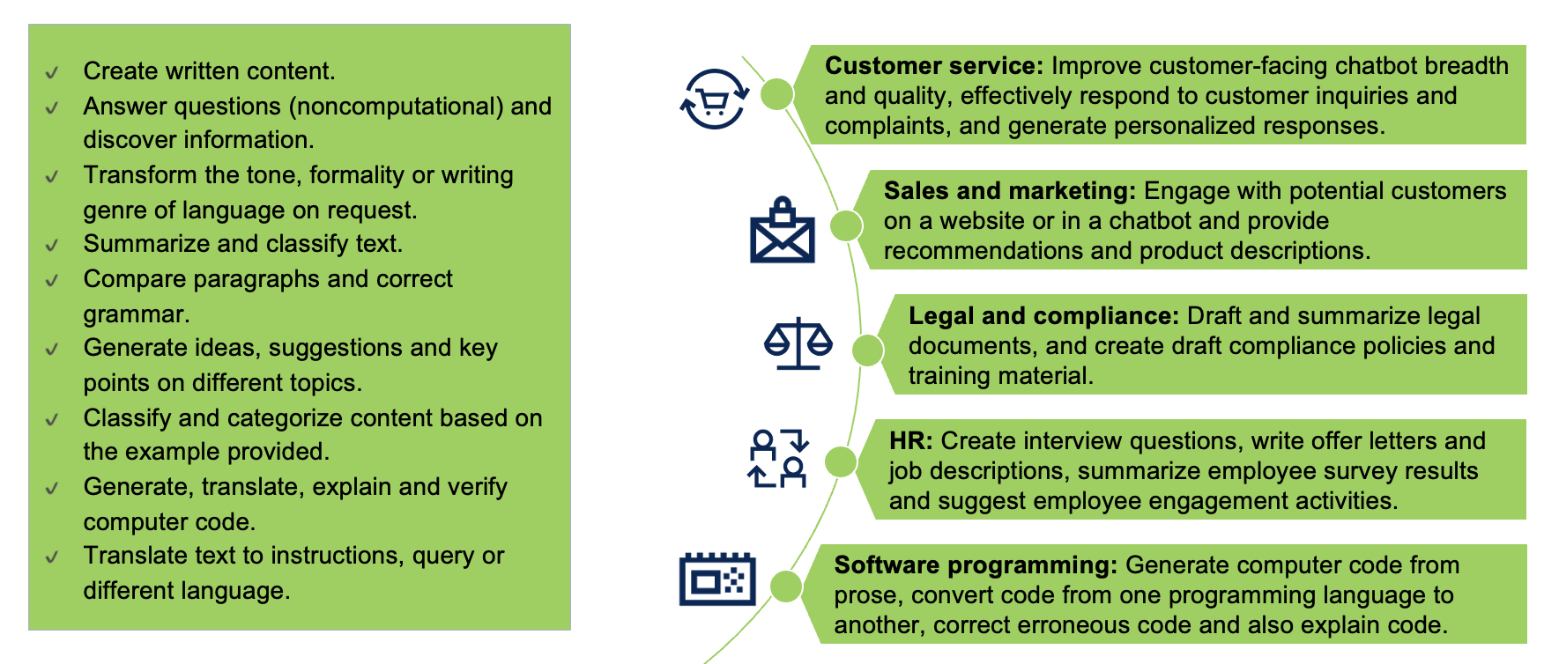
Popular Use Cases
Useful for our purpose
*Gartner Research Results

Slide 4
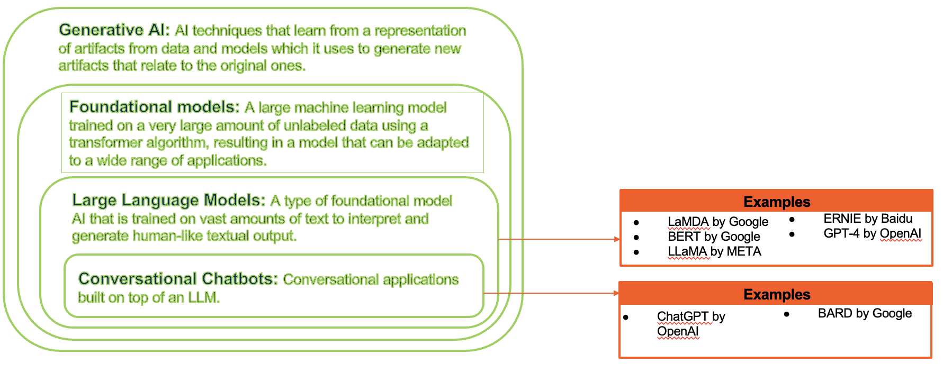
How LLMs Fit in the AI Landscape LLM: Large Language Models
*Gartner Research Results

Slide 5
Comparison of Conversational Bots
Tool name | Ownership | Strengths | Weaknesses | User cases
Bard | Google | Good text editing Free Access to Google | Can’t help much with code No sources Limited to emulating specific author styles | Text editing and write professional documents.
ChatGPT | OpenAI | Writing skills STEM knowledge | May generate incorrect or nonsensical answers. No memory of past interactions | Content generation Chatbots and virtual assistants Language translation

Slide 6
Our Opinions
The emergence of AI-powered chatbots has transformed the way businesses interact with their customers and manage routine tasks. Their impressive efficiency, availability, and scalability have become valuable tools that enhance customer experiences and reduce costs. Nevertheless, it is important to recognize their limitations. AI chatbots may struggle with complex conversations and unintentionally produce biased or incorrect responses, which can damage user trust and satisfaction. Additionally, their lack of human empathy can be a disadvantage in emotionally charged situations. To fully leverage AI chatbots, businesses must take on these challenges through continuous training, monitoring, and ethical guidelines. In summary, AI chatbots hold immense potential, but they require careful management to minimize their drawbacks and ensure they provide genuine value to both users and businesses.

Slide 7
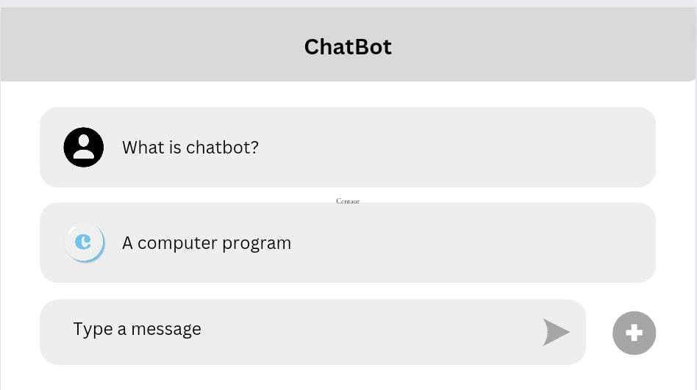
Style Guide & Low-fidelity Interface Sample

