Slide 1


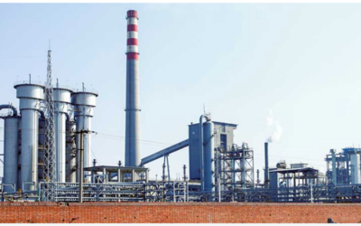
Industrial Combustion Energy use

Slide 2
PROJECT
Industrial Combustion Energy use
GROUP
1
PRESENT BY
Chaitali sure
Pravin Patil
Shreyash Patil
Shruthi jadav
Jyotsna singh
Ayesha Nadaf

Slide 3
CONTENTS
MMBtu_TOTAL for Ethane & Ethanol
% Share of MMBtu_TOTAL for each MECS Region
Unit Name trend (1950-2023) Vs GWht_TOTAL
Statistics about Solid Waste Landfill w.r.t. Facility and County
% Distribution of each Grouping for MMBtu_TOTAL and GWht_TOTAL

Slide 4
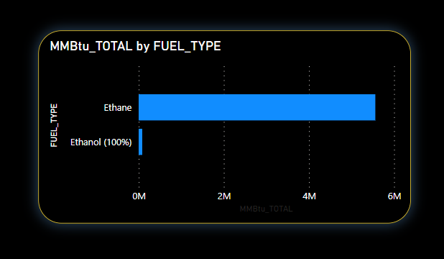
MMBtu_TOTAL for Ethane & Ethanol
KPI-1
We are currently depicting the calculated combustion energy values, such as industry type, location (let, long, zip code, county, and state), combustion unit type, and combustion unit name.
In the excel sheet we are describing how we have used the CSV data for energy.
We have used Bar graph for the total value of the fuel type ( ethane and ethanol ) .

Slide 5
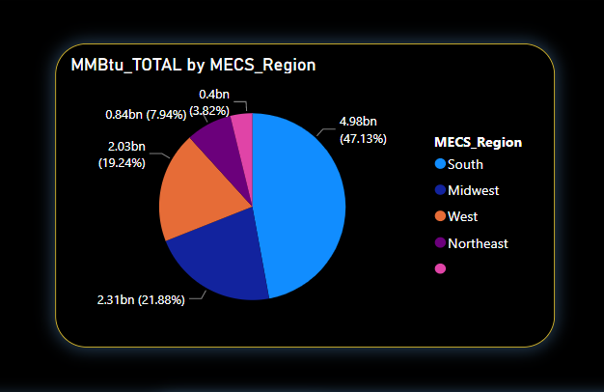
% Share of MMBtu_TOTAL for each MECS Region
KPI-2
In this KPI we have used the Region column to extract the selected Region from the given CSV data set.
This KPI shows the MMBtu values over the given Region which is South, Midwest, West, Northeast.
This KPI is shown in terms of Pie chart, with the help of pie chart you are able to compare all region with each other.

Slide 6
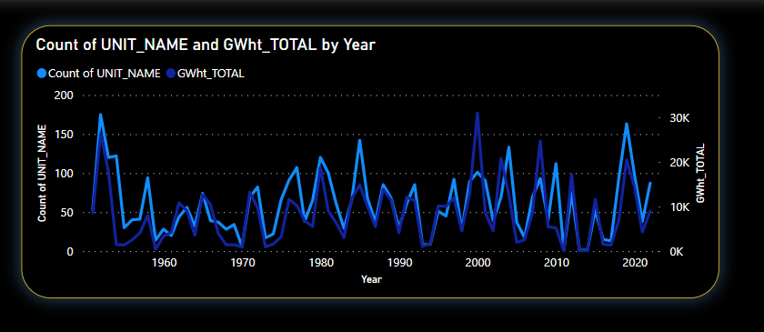
Unit Name trend (1950-2023) Vs GWht_TOTAL
KPI-3
In this KPI we have used the Unit_Name column to extract the selected years from the given CSV data set.
This KPI shows the gwht values over the given years which is 1950 to 2023.
This KPI is shown in terms of line chart, through which we can get the insight of combustion of energy in terms of gigawatt over the year from 1950 to 2023.

Slide 7
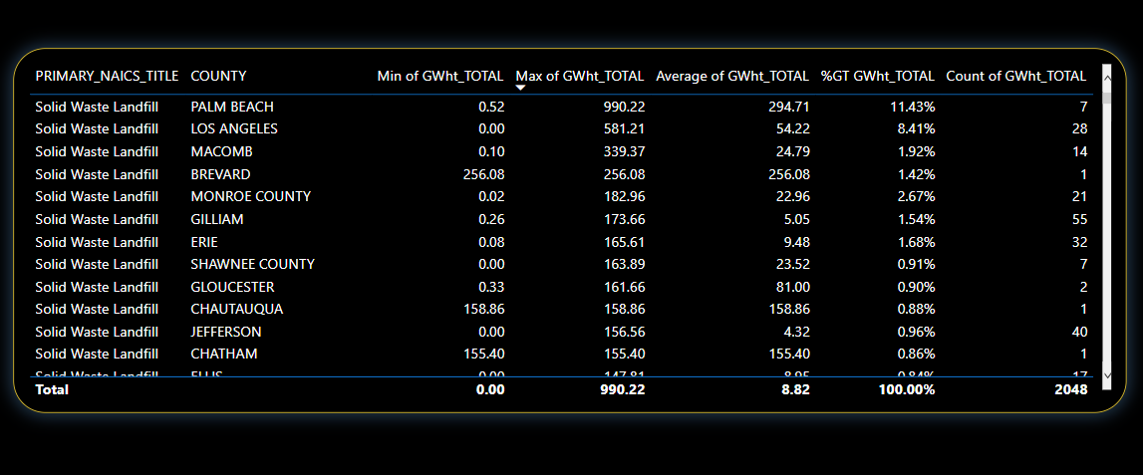
Statistics about Solid Waste Landfill w.r.t. Facility and County
KPI-4
By comparing max & min country wise heat calculated in gwht is increased by 98.80%
By grouping the facility wise country, we get the gwht high for palm beach which is 11.43% followed by Los Angeles which is 8.41%.
By comparing industry wise heat produced in GWht, The petroleum refineries produces 20.14% followed by fossil fuel 9.19% and solid waste landfills 0.58%

Slide 8
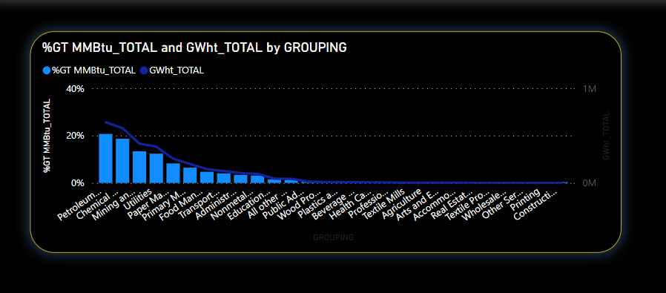
% Distribution of each Grouping for MMBtu_TOTAL and GWht_TOTAL
KPI-5
In this KPI we have used the Grouping column to extract the selected group from the given CSV data set.
This KPI shows the MMBtu and GWHt total values over the given group.
MMBtu-total is shown in bar char and GWHt-total is shown in line chart, with the help of you are able to compare which is max and min

Slide 9
THANK YOU

